Slide 1
Monkey Manager
Nick Aubuchon
Michael Bernardy
Brittany Dibble
Gregory Farinelli
Jesus Hernandez
Shane Lopez
Angelo Mendoza
Benjamin Siegel

Slide 2
Project Management
Agile
Weekly retrospectives
Daily standup meetings
Used slack for better communication
We had 6 Sprints
Sprint 1 -3 were working with Kivy and Python
On the 4th sprint we switched from python and Kivy to QT and C++
Sprints 4 and 5 we were getting the front end and the back end connected.
Sprint 6 was refactoring and documentation.
Greg was the project manager

Slide 3
Requirements Analysis
Minimum Viable Product:
UI
Creating a Project
Creating Tasks
Deleting Projects
Editing/Deleting Tasks
What we would have worked on if we had more time:
Calendar
Drag and Drop of widgets
Synchronization to a database

Slide 4
Design
Singleton - project utils - creates a single instance of a project, and main window is a single instance of the main ui
Observer - project list model - watches for changes in both the ui and the singleton and reflects the changes in either
Iterator - we use an iterator in project utils to find a project by name.

Slide 5
UML

Slide 6
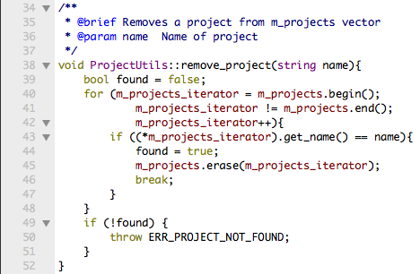
Implementation - ProjectUtils Class
The ProjectUtils class allows only one instance of all projects. This is the major workhorse of our program. Here is one of our functions in the class:

Slide 7
Test Plan
We did manual testing for all of our program. As a group we tested all of the functionality continuously as we developed and refactored. We made sure that in our code placed into our testing branch compiled and worked before merging feature branches into our main codebase.

