Slide 1
Alpha-beta Pruning
For the Minimax Algorithm

Slide 2
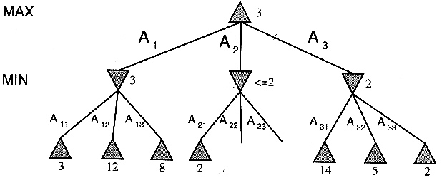
Cutting-Off Search
We want to prune the minimax tree:
Stop exploring subtrees with values that won’t influence the final minimax root decision

Slide 3
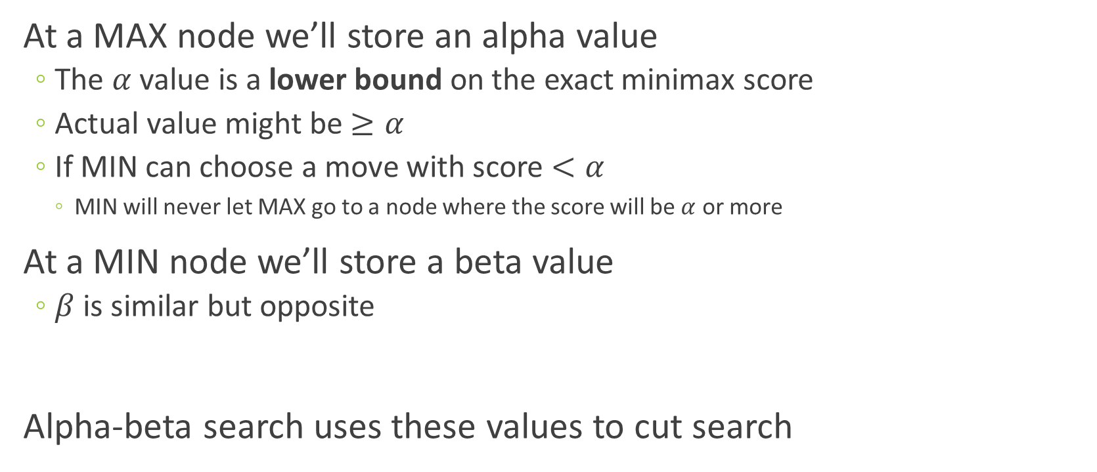
Alpha and Beta Values
At a MAX node we’ll store an alpha value
The $α$ value is a lower bound on the exact minimax score
Actual value might be $≥α$
If MIN can choose a move with score $<α$
MIN will never let MAX go to a node where the score will be $α$ or more
At a MIN node we’ll store a beta value
$β$ is similar but opposite
Alpha-beta search uses these values to cut search

Slide 4
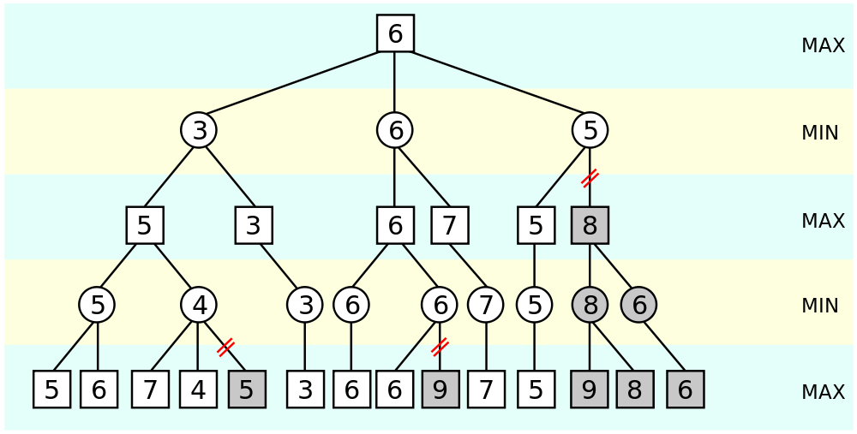
Example
Convince yourself why the grey subtrees don’t need to be evaluated

Slide 5
Example
Next slides are a step-by-step example of pruning
The example algorithm runs left-to-right
Right-to-left can produce different results
You’re free to choose any direction (even dynamically)
Follow it along with the description and pseudo-code:
http://en.wikipedia.org/wiki/Alpha%E2%80%93beta_pruning

Slide 6
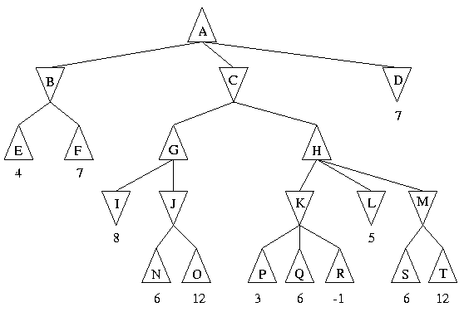
#2b Left->Right
α= -∞, β= +∞

Slide 7
#2b Left->Right
α= -∞, β= +∞
α= -∞, β= +∞

Slide 8
#2b Left->Right
α= -∞, β= +∞
α= -∞, β= +∞
α= -∞, β= +∞

Slide 9
#2b Left->Right
α= -∞, β= +∞
α= -∞, β= 4
α= -∞, β= +∞

Slide 10
#2b Left->Right
α= -∞, β= +∞
α= -∞, β= 4
α= -∞, β= +∞
α= -∞, β= 4

Slide 11
#2b Left->Right
α= 4, β= +∞
α= -∞, β= 4
α= -∞, β= +∞
α= -∞, β= 4

Slide 12
#2b Left->Right
α= 4, β= +∞
α= -∞, β= 4
α= 4, β= +∞
α= -∞, β= +∞
α= -∞, β= 4

Slide 13
#2b Left->Right
α= 4, β= +∞
α= -∞, β= 4
α= 4, β= +∞
α= -∞, β= +∞
α= -∞, β= 4
α= 4, β= +∞

Slide 14
#2b Left->Right
α= 4, β= +∞
α= -∞, β= 4
α= 4, β= +∞
α= -∞, β= +∞
α= -∞, β= 4
α= 4, β= +∞
α= 4, β= +∞

Slide 15
#2b Left->Right
α= 4, β= +∞
α= -∞, β= 4
α= 4, β= +∞
α= -∞, β= +∞
α= -∞, β= 4
α= 8, β= +∞
α= 4, β= +∞

Slide 16
#2b Left->Right
α= 4, β= +∞
α= -∞, β= 4
α= 4, β= +∞
α= -∞, β= +∞
α= -∞, β= 4
α= 8, β= +∞
α= 4, β= +∞
α= 8, β= +∞

Slide 17
#2b Left->Right
α= 4, β= +∞
α= -∞, β= 4
α= 4, β= +∞
α= -∞, β= +∞
α= -∞, β= 4
α= 8, β= +∞
α= 4, β= +∞
α= 8, β= +∞
α= 8, β= +∞

Slide 18
#2b Left->Right
α= 4, β= +∞
α= -∞, β= 4
α= 4, β= +∞
α= -∞, β= +∞
α= -∞, β= 4
α= 8, β= +∞
α= 4, β= +∞
α= 8, β= 6
α= 8, β= +∞

Slide 19
#2b Left->Right
α= 4, β= +∞
α= -∞, β= 4
α= 4, β= +∞
α= -∞, β= +∞
α= -∞, β= 4
α= 8, β= +∞
α= 4, β= +∞
α= 8, β= 6
(Alpha pruning)
α= 8, β= +∞

Slide 20
#2b Left->Right
α= 4, β= +∞
α= -∞, β= 4
α= 4, β= 8
α= -∞, β= +∞
α= -∞, β= 4
α= 8, β= +∞
α= 4, β= +∞
α= 8, β= 6
(Alpha pruning)
α= 8, β= +∞

Slide 21
#2b Left->Right
α= 4, β= +∞
α= -∞, β= 4
α= 4, β= 8
α= -∞, β= +∞
α= -∞, β= 4
α= 8, β= +∞
α= 4, β= 8
α= 4, β= +∞
α= 8, β= 6
(Alpha pruning)
α= 8, β= +∞

Slide 22
#2b Left->Right
α= 4, β= +∞
α= -∞, β= 4
α= 4, β= 8
α= -∞, β= +∞
α= -∞, β= 4
α= 8, β= +∞
α= 4, β= 8
α= 4, β= +∞
α= 8, β= 6
α= 4, β= 8
(Alpha pruning)
α= 8, β= +∞

Slide 23
#2b Left->Right
α= 4, β= +∞
α= -∞, β= 4
α= 4, β= 8
α= -∞, β= +∞
α= -∞, β= 4
α= 8, β= +∞
α= 4, β= 8
α= 4, β= +∞
α= 8, β= 6
α= 4, β= 8
(Alpha pruning)
α= 8, β= +∞
α= 4, β= 8

Slide 24
#2b Left->Right
α= 4, β= +∞
α= -∞, β= 4
α= 4, β= 8
α= -∞, β= +∞
α= -∞, β= 4
α= 8, β= +∞
α= 4, β= 8
α= 4, β= +∞
α= 8, β= 6
α= 4, β= 3
(Alpha pruning)
α= 8, β= +∞
α= 4, β= 8

Slide 25
#2b Left->Right
α= 4, β= +∞
α= -∞, β= 4
α= 4, β= 8
α= -∞, β= +∞
α= -∞, β= 4
α= 8, β= +∞
α= 4, β= 8
(Alpha pruning)
α= 4, β= +∞
α= 8, β= 6
α= 4, β= 3
(Alpha pruning)
α= 8, β= +∞
α= 4, β= 8

Slide 26
#2b Left->Right
α= 4, β= +∞
α= -∞, β= 4
α= 4, β= 8
α= -∞, β= +∞
α= -∞, β= 4
α= 8, β= +∞
α= 4, β= 8
(Alpha pruning)
α= 4, β= +∞
α= 8, β= 6
α= 4, β= 3
α= 4, β= 8
(Alpha pruning)
α= 8, β= +∞
α= 4, β= 8

Slide 27
#2b Left->Right
α= 4, β= +∞
α= -∞, β= 4
α= 4, β= 8
α= -∞, β= +∞
α= -∞, β= 4
α= 8, β= +∞
α= 5, β= 8
(Alpha pruning)
α= 4, β= +∞
α= 8, β= 6
α= 4, β= 3
α= 4, β= 8
(Alpha pruning)
α= 8, β= +∞
α= 4, β= 8

Slide 28
#2b Left->Right
α= 4, β= +∞
α= -∞, β= 4
α= 4, β= 8
α= -∞, β= +∞
α= -∞, β= 4
α= 8, β= +∞
α= 5, β= 8
(Alpha pruning)
α= 4, β= +∞
α= 8, β= 6
α= 4, β= 3
α= 4, β= 8
α= 5, β= 8
(Alpha pruning)
α= 8, β= +∞
α= 4, β= 8

Slide 29
#2b Left->Right
α= 4, β= +∞
α= -∞, β= 4
α= 4, β= 8
α= -∞, β= +∞
α= -∞, β= 4
α= 8, β= +∞
α= 5, β= 8
(Alpha pruning)
α= 4, β= +∞
α= 8, β= 6
α= 4, β= 3
α= 4, β= 8
α= 5, β= 8
(Alpha pruning)
α= 8, β= +∞
α= 4, β= 8
α=5, β=8

Slide 30
#2b Left->Right
α= 4, β= +∞
α= -∞, β= 4
α= 4, β= 8
α= -∞, β= +∞
α= -∞, β= 4
α= 8, β= +∞
α= 5, β= 8
(Alpha pruning)
α= 4, β= +∞
α= 8, β= 6
α= 4, β= 3
α= 4, β= 8
α= 5, β= 6
(Alpha pruning)
α= 8, β= +∞
α= 4, β= 8
α=5, β=8

Slide 31
#2b Left->Right
α= 4, β= +∞
α= -∞, β= 4
α= 4, β= 8
α= -∞, β= +∞
α= -∞, β= 4
α= 8, β= +∞
α= 5, β= 8
(Alpha pruning)
α= 4, β= +∞
α= 8, β= 6
α= 4, β= 3
α= 4, β= 8
α= 5, β= 6
(Alpha pruning)
α= 8, β= +∞
α= 4, β= 8
α=5, β=8
α=5, β=6

Slide 32
#2b Left->Right
α= 4, β= +∞
α= -∞, β= 4
α= 4, β= 8
α= -∞, β= +∞
α= -∞, β= 4
α= 8, β= +∞
α= 5, β= 8
(Alpha pruning)
α= 4, β= +∞
α= 8, β= 6
α= 4, β= 3
α= 4, β= 8
α= 5, β= 6
(Alpha pruning)
α= 8, β= +∞
α= 4, β= 8
α=5, β=8
α=5, β=6

Slide 33
#2b Left->Right
α= 4, β= +∞
α= -∞, β= 4
α= 4, β= 8
α= -∞, β= +∞
α= -∞, β= 4
α= 8, β= +∞
α= 6, β= 8
(Alpha pruning)
α= 4, β= +∞
α= 8, β= 6
α= 4, β= 3
α= 4, β= 8
α= 5, β= 6
(Alpha pruning)
α= 8, β= +∞
α= 4, β= 8
α=5, β=8
α=5, β=6

Slide 34
#2b Left->Right
α= 4, β= +∞
α= -∞, β= 4
α= 4, β= 6
α= -∞, β= +∞
α= -∞, β= 4
α= 8, β= +∞
α= 6, β= 8
(Alpha pruning)
α= 4, β= +∞
α= 8, β= 6
α= 4, β= 3
α= 4, β= 8
α= 5, β= 6
(Alpha pruning)
α= 8, β= +∞
α= 4, β= 8
α=5, β=8
α=5, β=6

Slide 35
#2b Left->Right
α= 6, β= +∞
α= -∞, β= 4
α= 4, β= 6
α= -∞, β= +∞
α= -∞, β= 4
α= 8, β= +∞
α= 6, β= 8
(Alpha pruning)
α= 4, β= +∞
α= 8, β= 6
α= 4, β= 3
α= 4, β= 8
α= 5, β= 6
(Alpha pruning)
α= 8, β= +∞
α= 4, β= 8
α=5, β=8
α=5, β=6

Slide 36
#2b Left->Right
α= 6, β= +∞
α= -∞, β= 4
α= 6, β= +∞
α= 4, β= 6
α= -∞, β= +∞
α= -∞, β= 4
α= 8, β= +∞
α= 6, β= 8
(Alpha pruning)
α= 4, β= +∞
α= 8, β= 6
α= 4, β= 3
α= 4, β= 8
α= 5, β= 6
(Alpha pruning)
α= 8, β= +∞
α= 4, β= 8
α=5, β=8
α=5, β=6

Slide 37
#2b Left->Right
α= 7, β= +∞
α= -∞, β= 4
α= 6, β= +∞
α= 4, β= 6
α= -∞, β= +∞
α= -∞, β= 4
α= 8, β= +∞
α= 6, β= 8
(Alpha pruning)
α= 4, β= +∞
α= 8, β= 6
α= 4, β= 3
α= 4, β= 8
α= 5, β= 6
(Alpha pruning)
α= 8, β= +∞
α= 4, β= 8
α=5, β=8
α=5, β=6

Slide 38
Beta Pruning
α= 4, β= +∞
α= -∞, β= 4
α= 4, β= 8
α= -∞, β= +∞
α= -∞, β= 4
α= 8, β= +∞
α= 4, β= 8
Value changed to exhibit beta pruning
(Alpha pruning)
α= 4, β= +∞
α= 8, β= 6
α= 4, β= 3
α= 4, β= 8
(Alpha pruning)
α= 8, β= +∞
9
α= 4, β= 8

Slide 39
Beta Pruning
α= 4, β= +∞
α= -∞, β= 4
α= 4, β= 8
α= -∞, β= +∞
α= -∞, β= 4
α= 8, β= +∞
α= 9, β= 8
(Alpha pruning)
α= 4, β= +∞
α= 8, β= 6
α= 4, β= 3
α= 4, β= 8
(Alpha pruning)
α= 8, β= +∞
9
α= 4, β= 8

Slide 40
Beta Pruning
α= 4, β= +∞
α= -∞, β= 4
α= 4, β= 8
α= -∞, β= +∞
α= -∞, β= 4
α= 8, β= +∞
α= 9, β= 8
(Beta pruning)
(Alpha pruning)
α= 4, β= +∞
α= 8, β= 6
α= 4, β= 3
α= 4, β= 8
(Alpha pruning)
α= 8, β= +∞
9
α= 4, β= 8

