Slide 1
Simple DirectMedia Layer
1.2

Slide 2

What is SDL?
SDL is a library for:
Games
Multimedia-type applications
Lightweight
Subsystems:
Input
Graphics (using OpenGL)

Slide 3
Resources
SDL Homepage
http://www.libsdl.org/
You can download SDL 1.2 from the homepage
SDL 1.2 Documentation
http://www.libsdl.org/release/SDL-1.2.15/docs/index.html
Already installed in UNIX

Slide 4
Basics
SDL header files
#include <SDL.h>
#include <SDL_video.h>
We have to initialize before doing anything with SDL
int SDL_Init(Uint32 flags);
Uint32 – 32-bit unsigned integer
Parameter “flags” tells SDL which parts to initialize
SDL_INIT_VIDEO
SDL_INIT_AUDIO
etc.

Slide 5
Basics
We only use video:
SDL_Init(SDL_INIT_VIDEO);
The function might fail, we should test it:
if (SDL_Init(SDL_INIT_VIDEO) < 0) {
printf(“ERROR: unable to init SDL: %s\n”, SDL_GetError());
return 1;
}
Before exiting, we should always quit SDL:
SDL_Quit();
atexit(SDL_Quit) – useful shortcut

Slide 6
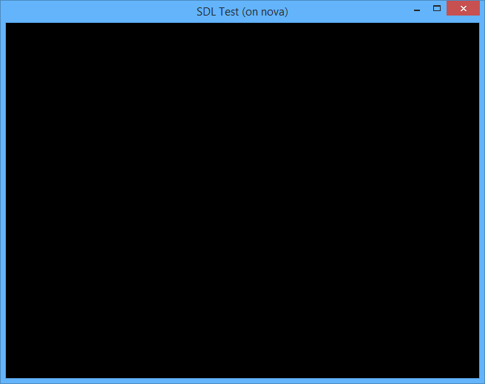
Window Initialization
Nearly every SDL method we’ll use requires a surface to operate on
SDL_WM_SetCaption(“SDL Test”, “SDL Test”);
Sets the window title and icon name for the display window
SDL_Surface* win = SDL_SetVideoMode(WIN_W,WIN_H,0,SDL_HWSURFACE|SDL_DOUBLEBUF);
What does it mean?
First and second parameters – window’s width and height
Third parameter – bits per pixel, we can use 0 for default
Extra flags go last – look them up!

Slide 7
Drawing Rectangles
We can draw simple rectangles (with color)
int SDL_FillRect(SDL_Surface *dst, SDL_Rect *dstRect, Uint32 color);
Arguments:
Window surface we created earlier
The rectangle we want to draw (NULL will fill the entire screen)
Color of the rectangle

Slide 8
Drawing Rectangles
We need SDL_Rect to draw to the screen
That’s a general rectangle struct - we can use it for anything else
We create a rectangle:
SDL_Rect rect;
…and fill it with values:
rect.x = 10; rect.y = 10;
rect.w = 50; rect.h = 50;
…or directly:
SDL_Rect rect = { 10, 10, 50, 50 };

Slide 9
Drawing Rectangles
To determine the color:
Uint32 SDL_MapRGB(SDL_PixelFormat *fmt, Uint8 r, Uint8 g, Uint8 b);
Arguments:
Pixel format – we just pass win->format from our surface
Last three arguments are obvious – RGB in range 0-255
We can also use SDL_MapRGBA for alpha blending

Slide 10
Drawing Rectangles
Finally, to draw our rectangle:
SDL_FillRect(w, &rect, SDL_MapRGB(w->format, 0, 255, 0));
…and don’t forget to check return value!
Rectangles are boring,
Let’s draw images!

Slide 11
Drawing Images
First, we need an image
Without libraries, SDL can only load BMP images
Thus, we’ll create BMP files, or convert existing images to BMP
Use UNIX command eog to view images (e.g., “eog test.bmp”)
To load an image:
SDL_Surface* SDL_LoadBMP(const char *file);
Returns a surface representing the loaded image, or NULL on error
We must free the memory when finished:
SDL_FreeSurface(SDL_Surface *surface);

Slide 12
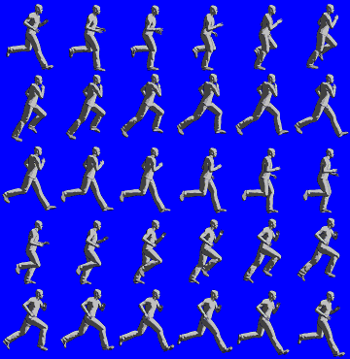
Drawing Images
Spritesheet
A collection of pictures in a single image
Used in animation to simulate movement
When drawing to the screen, we select:
Position to draw (only x,y)
Portion of the image to draw
Background color to make transparent

Slide 13

Drawing Images
To set transparent background color:
int SDL_SetColorKey(SDL_Surface* s, Uint32 flag, Uint32 key);
As usual, check return value
Arguments:
The image surface
SDL_SRCCOLORKEY (constant)
A color using SDL_MapRGB
Pick something not used in the actual image
Magenta is a common one (RGB: 255, 0, 255)

Slide 14
Drawing Images
int SDL_BlitSurface( SDL_Surface *src, SDL_Rect *srcrect, SDL_Surface *dst, SDL_Rect *dstrect);
Arguments:
src – the image to draw
srcrect – the area inside the image we want to draw
dst – our window surface
dstrect – where we want to draw (w,h are ignored)

Slide 15
Drawing Images
In summary:
SDL_Surface *img = SDL_LoadBMP(“test.bmp”);
SDL_Rect imgrect = {0,0,240,296};
if (SDL_BlitSurface(img, &imgrect, w, 0) != 0) {
printf(“ERROR: failed to blit image: %s\n”, SDL_GetError());
SDL_FreeSurface(img);
return 1;
}

Slide 16
Issues
We draw and nothing changes:
Happens because we use double-buffering
int SDL_Flip(SDL_Surface *surface);
We call this function every time we finish drawing a screen
Drawing leaves a “trail”:
Clear the screen before starting to draw
SDL_FillRect(w, 0, 0);
Images change too fast:
Wait a bit before redrawing
SDL_Delay(Uint32 ms);

Slide 17
Events
We know how to draw, now we want to handle input.
Implemented with events:
SDL_PollEvent(SDL_Event *event);
Fills the parameter with the next event waiting, or NULL if there’s no event waiting
Returns 1 if there are any events, 0 otherwise
We need to poll this to handle all events:
while (SDL_PollEvent(&e) != 0) { /* handle event e */ }

Slide 18
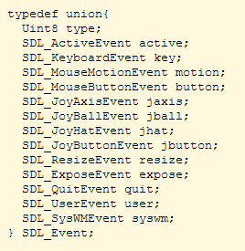
Events
SDL_Event
A union of various structures
Each contains information about a specific event type
To determine which event – check event.type
SDL_Event e;
while (SDL_PollEvent(&e) != 0) {
if (e.type == SDL_QUIT)
exit(0);
}

Slide 19
Makefile
To build a program using SDL, we need to link SDL libraries and headers
SDL Provides us with a utility
sdl-config --cflags - outputs needed compilation flags
sdl-config --libs - outputs needed linkage flags
We can add calls to it in our makefile:
gcc -std=c99 -pedantic-errors -c -Wall -g -lm sdl_test.c `sdl-config --cflags`
gcc -o sdl_test sdl_test.o -lm -std=c99 -pedantic-errors –g `sdl-config --libs`

