Slide 1


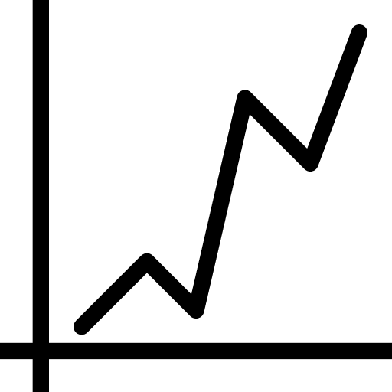
Login
Username
Password
Sign up
Username
Password
Email
Weight
Create\Join Group
Height
Group Name
Password
Join Group
Create Group
User 1
User1 Chart
Group Name
Band
Data Info
Monitor & Analyze
Fluid loss
user1
user2
user3
Client
Admin

