Slide 1



January 22, 2022
Hackalopes Final Presentation
Richard Larson Karthik Menon Ben Stormer Daniel Pang
Energy and Earth Resources
Energy and Earth Resources

Slide 2
Executive Summary
We needed to predict whether 40 Electronic Submersible Pumps (ESP) will fail or not within 30 days. To create our predictions, we developed a data analytics and machine learning workflow in Python. We found that the GOR, ESP vibration data, and other factors related to fluid flow through the pump are most critical in assessing the status of an ESP. We recommend that feature engineering of these factors and ... be used as a measure to evaluate the lifespan of ESPs in the future.

Slide 3
Workflow Overview
Overview with Steps / Flow Chart
Combined well data and daily data, removed outlier data
Aggregated solution well data, analyze to find unhelpful or redundant features
Engineer important features based on domain expertise
Craft an initial, minimum viable product
Create a more advanced machine learning model
Tune hyperparameters for advanced model

Slide 4
Workflow Overview
Theory Crafting
Mechanical Causes
Statistical Behaviors
Production Causes
Initial Data Inspection
Coverage and Correction
Data Pre-Processing
Creation of database and framework
Evaluate Prediction
Qualitative check
Machine Learning Models
Build testing method pipeline
Run models and predict features
Data Engineering
Feature Creation and Selection

Slide 5
Workflow (Multiple Slides)
Showcase Interesting and Innovative Aspects of Your Workflow.
State and Defend Modeling Decisions
Discuss Critical Results and Learnings for Workflow Steps
Captions for all Figures
Concise Text on Slides to Explain the Main Points

Slide 6
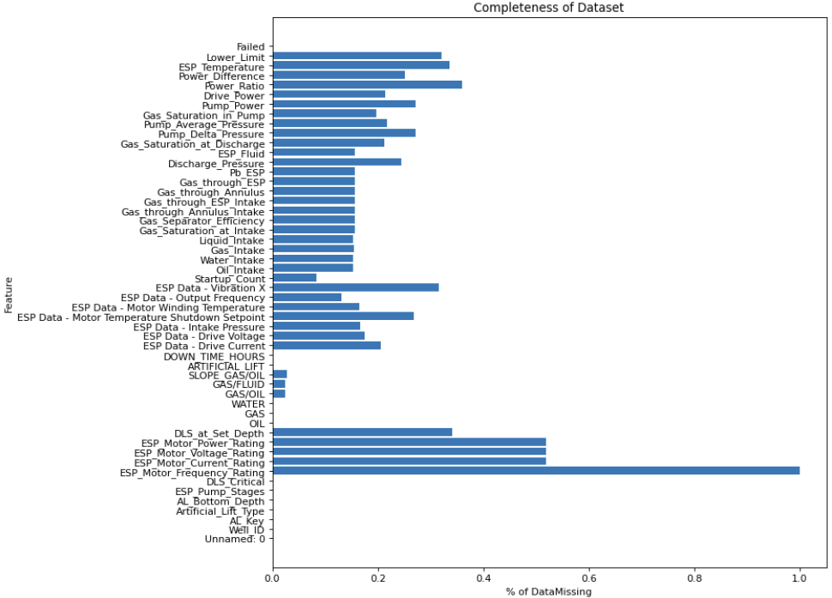
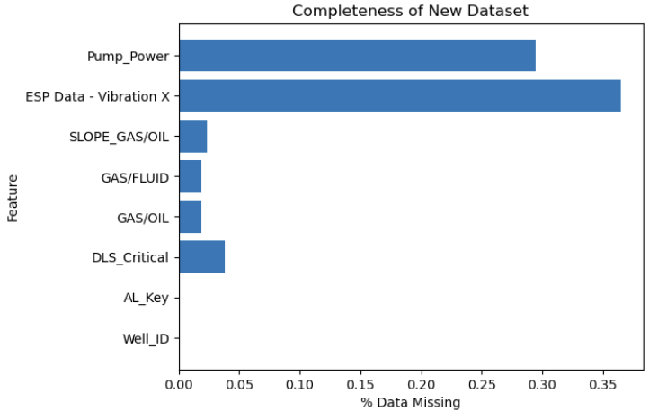
Workflow (Multiple Slides)

Slide 7
Workflow (Multiple Slides)

Slide 8
Workflow (Multiple Slides)

Slide 9
Workflow (Multiple Slides)

Slide 10
Results and Discussions
Present your predictions for ESPs to fail and NOT fail over the next 30 days.
Recall the ESPs are listed in data/solution.csv
Use table, graphs to communicate the model predictions, modeling tuning, feature engineering and importance, etc.

Slide 11
Feedback
What did your team learn?
What did your team like?
What could we do to improve next year?

