Slide 1



Hackalopes Final Presentation
January 22, 2022
Richard Larson Karthik Menon Ben Stormer Daniel Pang
Energy and Earth Resources
Energy and Earth Resources

Slide 2
Executive Summary
Predict whether 40 Electronic Submersible Pumps (ESP) will fail or not within 30 days.
Develop a data analytics and machine learning workflow in Python.
We found that the GOR, ESP vibration data, and other factors related to fluid flow through the pump are most critical in assessing the status of an ESP.
We recommend that feature engineering of these factors be used as a measure to evaluate the lifespan of ESPs in the future.

Slide 3
Workflow Overview
“Theory Crafting”
Mechanical Causes
Statistical Behaviors
Production Causes
Initial Data Inspection
Coverage and Correlation
Data Pre-Processing
Creation of database and framework
Selective Removal
Evaluate Prediction
Qualitative check
Modeling
Build testing method pipeline
Run models and predict features
Data Engineering
Feature Creation and Selection
Re-Iterate
Improve model building process

Slide 4
“Theory Crafting”
Consider situation as a physics problem
Pump failure is related to fluid movement through pump
Reservoir engineering principles
Statistical behavior
What features would be affected in this assumption?
GOR
Power Draw
Etc.

Slide 5
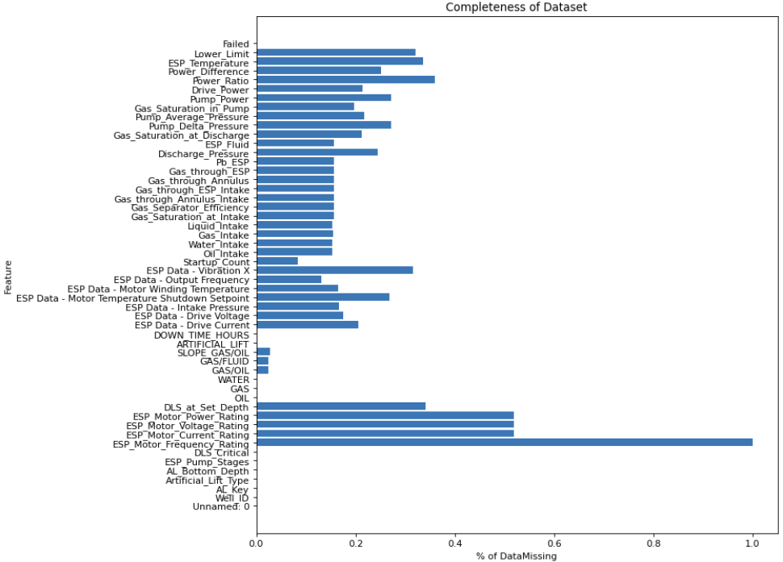
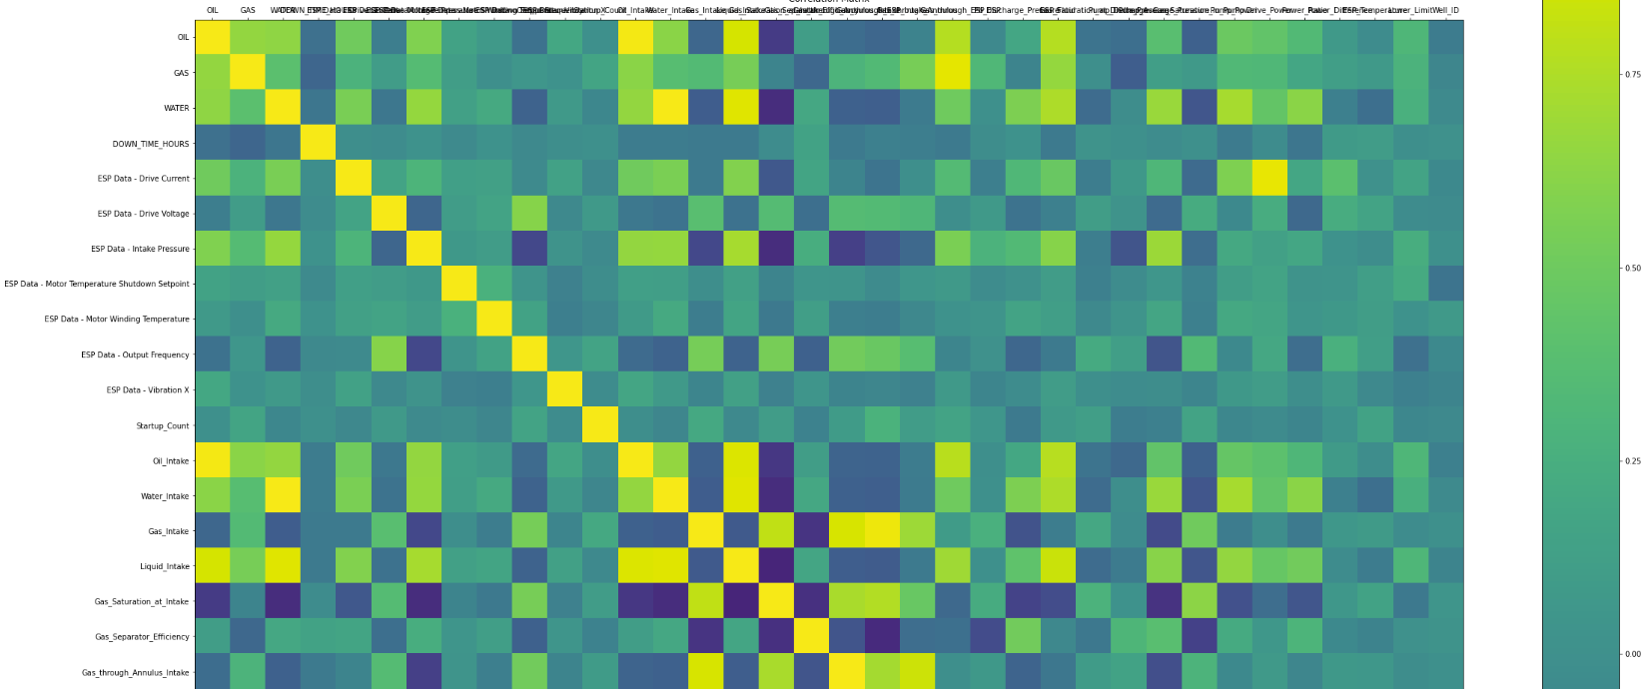
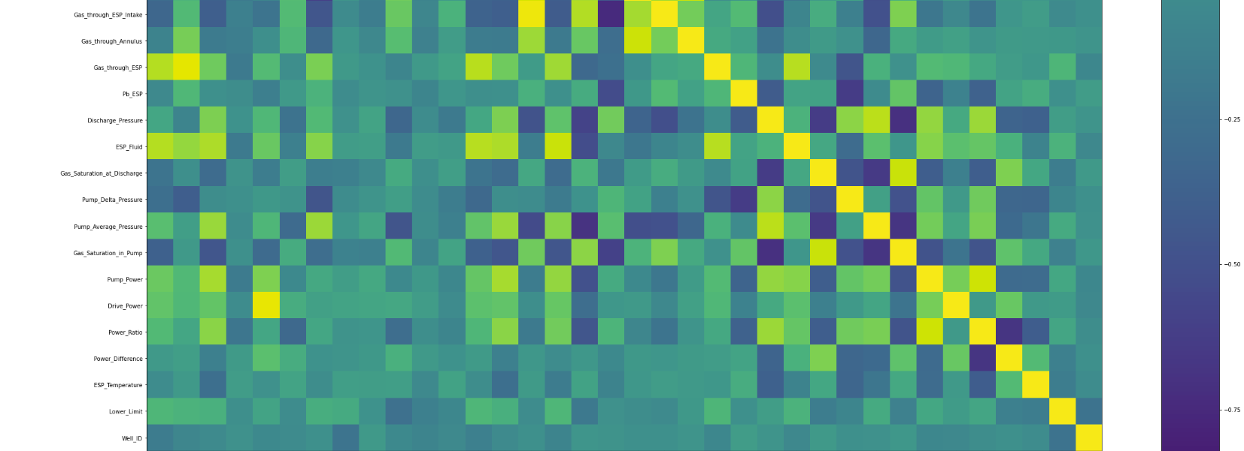
Initial Data Inspection
Coverage
Solution set coverage
Correlation

Slide 6
Data Pre-Processing
Create data frames and aggregate data
Remove unwanted features
Data Engineering
Feature Creation
GOR
Derivatives
GOR
Oil Production
Standard Deviations
GOR
Oil Production

Slide 7
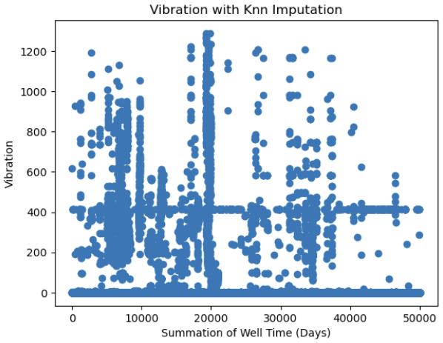
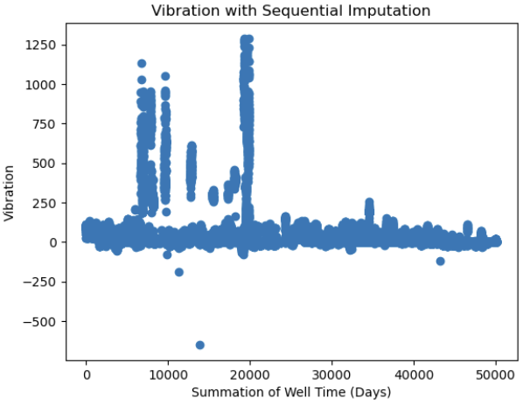
Different Imputation Methods

Slide 8
Modeling
Start with Minimum Viable
Iterate
Evaluate Prediction
Qualitative/Eye Check
Does the accuracy make sense?
Do the estimated number of failures make sense?
Does there appear to be bias?

Slide 9
Results
Accuracy: ~73%
We expect 9 out of the 40 wells to fail in the next 30 days

Slide 10
Thank You

Slide 11
Feedback
What did your team learn?
What did your team like?
What could we do to improve next year?

