Slide 1

Did stringency measures influence happiness across the world over the course of the pandemic? Benjamin Strusch, Nils Müller, Svea Graupner
Photo by the blowup

Slide 2
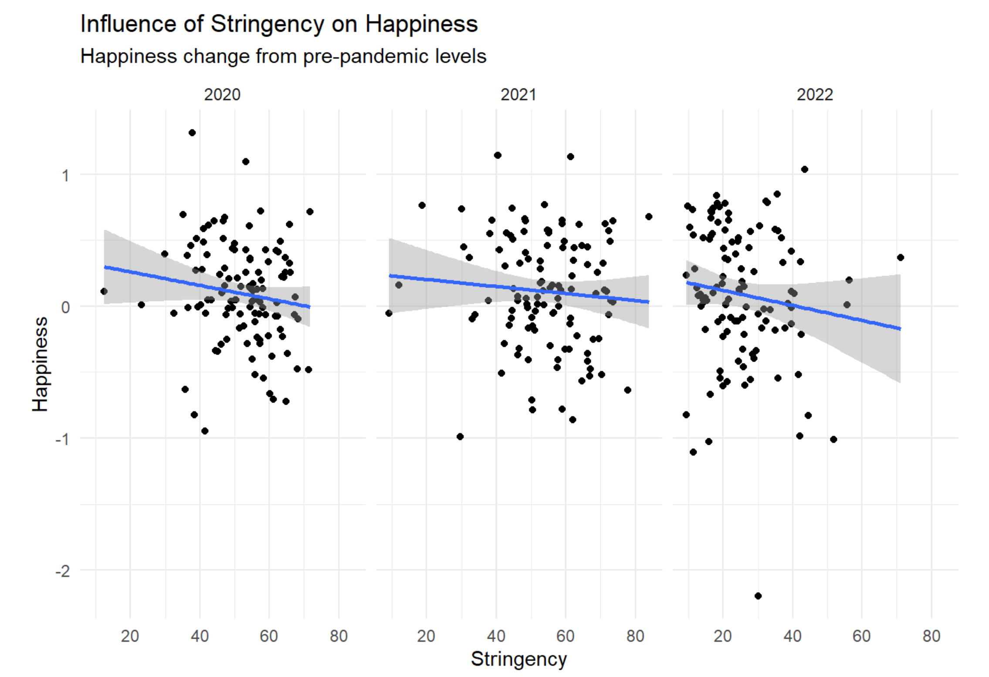
Notes:
obtained Happiness and Stringency data for 115 countries.
To really know whether differences are due to stringency and not inherent happiness differences
Computed pre-pandemic average and compared this to happiness for each country per year
Thus Centring → above and below 0
Prediction
In line, the graph descriptively shows us this trend, however, at large, the effect was not strong to warrant statistical significance

Slide 3

SORRY, WE ARE CLOSED – global happiness in the face of pandemic restrictions Benjamin Strusch, Nils Müller, Svea Graupner
Photo by the blowup

