Slide 1
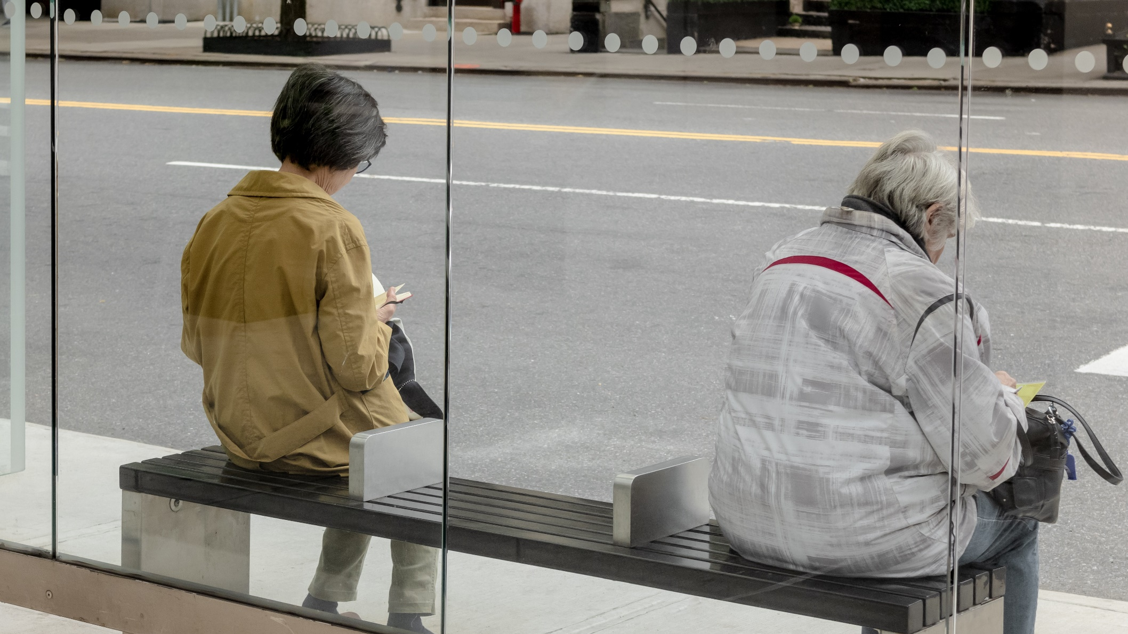
Did stringency measures influence happiness across the world over the course of the pandemic? Benjamin Strusch, Nils Müller, Svea Graupner
Photo by the blowup

Slide 2
