Slide 1

Did stringency in covid measures influence happiness and GDP in the years 2020/2021?

Slide 2
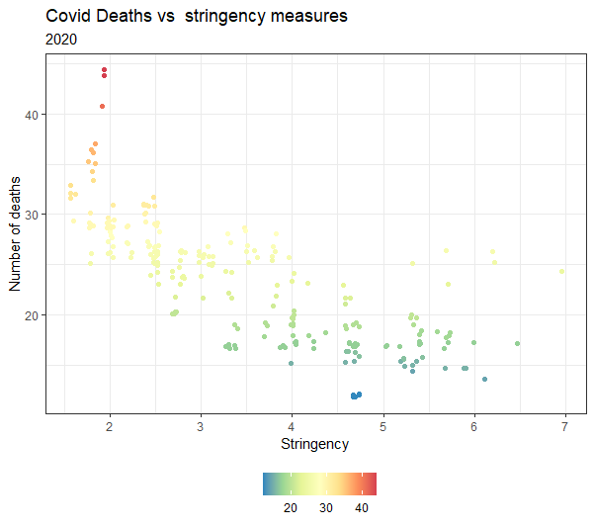
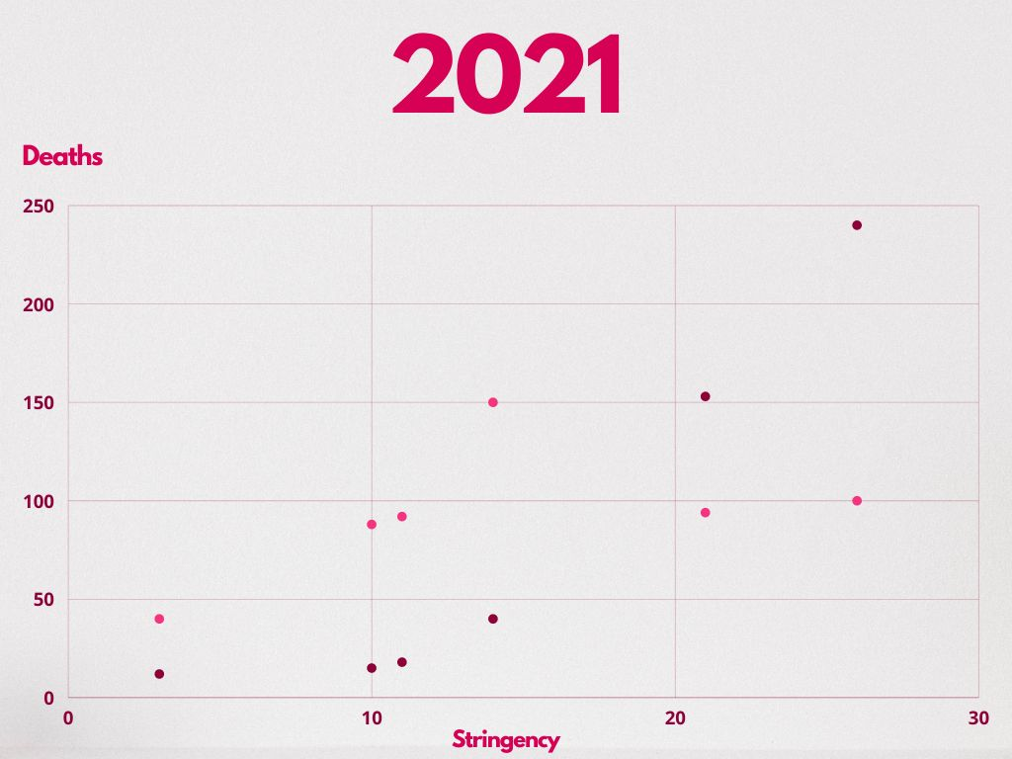
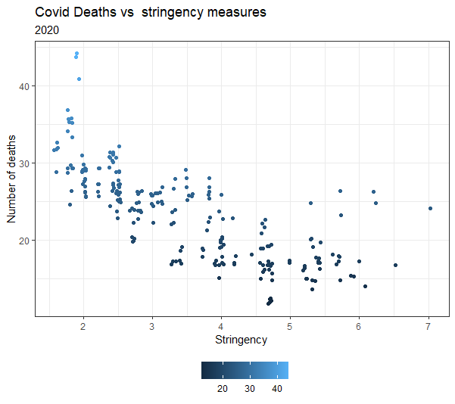
Happiness
GDP

