Slide 1

Did stringency in covid measures influence happiness and GDP in the years 2020/2021?

Slide 2
Methods & Analysis
Data: from Kaggle, Johns Hopkins University
Variables:
X (IV) → Stringency
Y(DV) → Covid-19 Deaths (total or percentage)
Moderators → Happiness & GDP
Analysis: Via Scatterplot, stat. analysis via regression, comparison between years (2020, 2021)
Visualisation: yet to be decided, current decision: scatterplot (see next slide as an example)

Slide 3
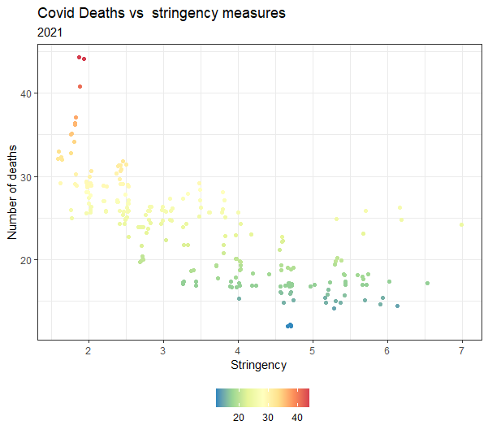

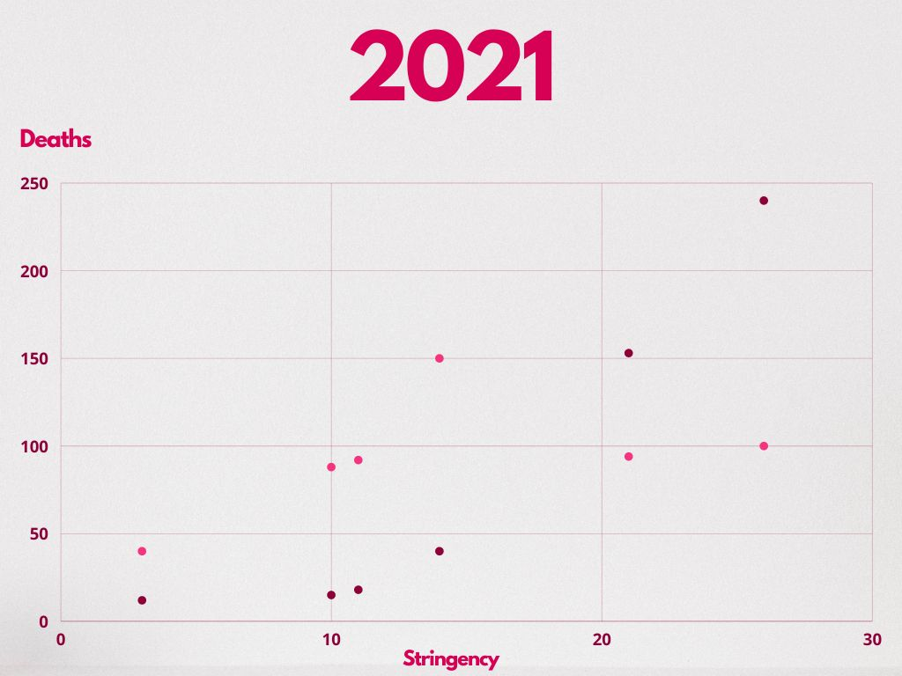
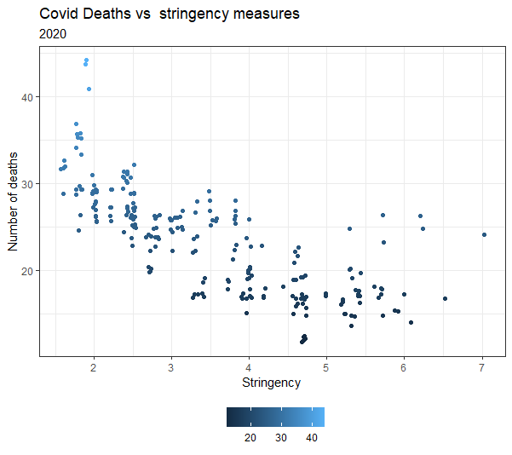

Happiness
GDP

Slide 4
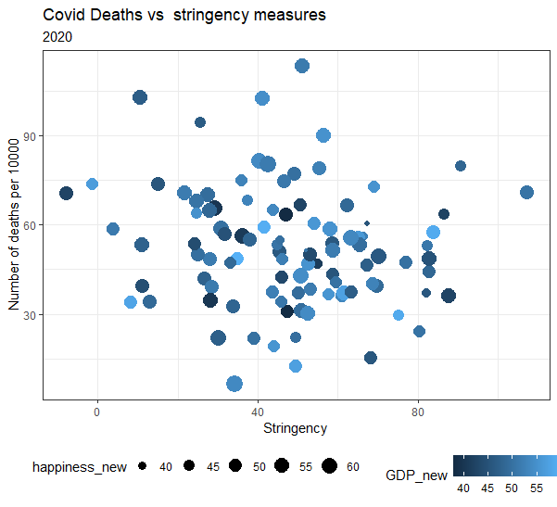
Potential Combination of GDP and Happiness

