Slide 1
CS 201 (2015) Exam-I Solution

Slide 2
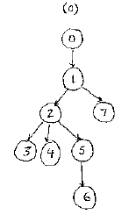
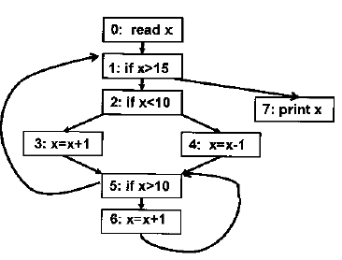
1. Control Flow Analysis + SSA form (5+5+5)
(b) (c)
5 → 1 {1, 2,3, 4, 5, 6}
6 → 5 {5, 6}

Slide 3
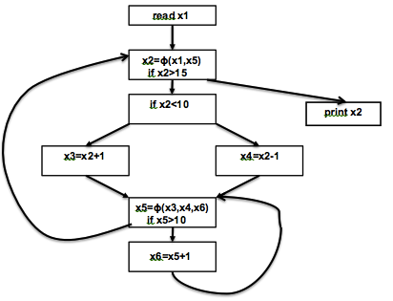
1. Control Flow Analysis + SSA form (5+10)
(e)
(d)
DF(0) = {}
DF(1) = {1}
DF(2) = {1)
DF(3) = {5}
DF(4) = {5}
DF(5) = {1,5}
DF(6) = {5}
DF(7) = {}

Slide 4
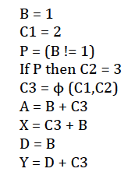
2. GVN + CCP (10+10)
(a)
(Initial)
{B,D} {C1} {P} {C2} {C3} {A,Y,X}
(Final)
{B,D} {C1} {P} {C2} {C3} {A,Y} {X}
(b)
{B,D} {C1,C3} {A,X,Y}
More congruences found

Slide 5
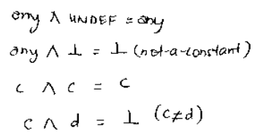
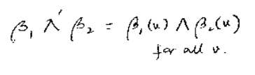
3. Copy Constant Propagation (5)
(a)

Slide 6
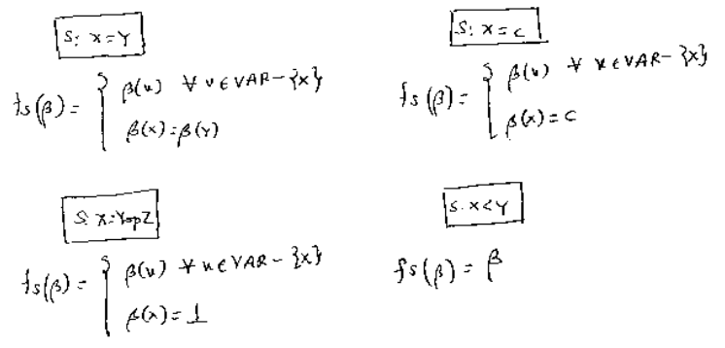
3. Copy Constant Propagation (10)
(b)

Slide 7

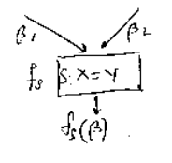
3. Copy Constant Propagation (5)
(c) It is distributive.

Slide 8
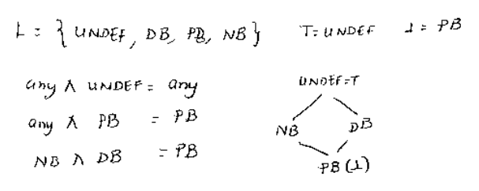
4. Busy-ness (4+6+4)
(a),(b),(c)

Slide 9
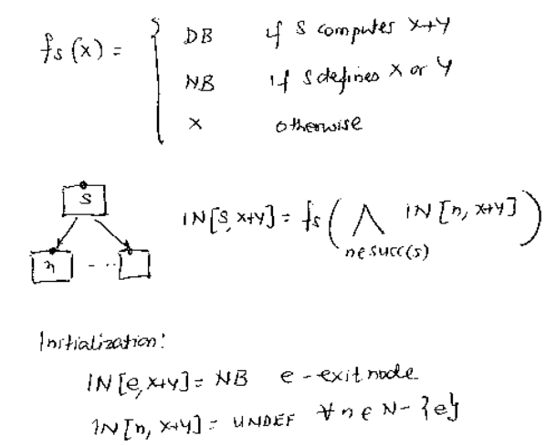
4. Busy-ness (6+6+4)
(d)
(e)
(f)

Slide 10
Distribution of Scores
4 → D
13 → C
Average – 57
Median – 55
Highest – 84
18 → C/B
9 → B/A
8 → A
4 → A

