Slide 1
A Hybrid Regression Technique for House Prices Prediction
framed by:
Aziz Khamjane
directed by:
Ben Touhami Mohamed Rida

Slide 2
Summary
01
02
03
04
05
06
Introduction
Diagram Overview
Formal Descriptions
of Algorithms
Demonstration
Limitations of Project Approachs
Conclusion

Slide 3
01
Introduction

Slide 4

Our project focuses on predicting optimal apartment prices in morocco, leveraging advanced machine learning algorithms trained on data sourced from "Mubawab" platform. Whether you're a seller aiming for a fair deal or a buyer navigating a dynamic market, our mission is to make the real estate process transparent and stress-free. The project unfolds through meticulous data collection, experimentation with powerful algorithms like Gradient Boosting and RandomForest, and the introduction of a groundbreaking "Hybrid Regression Technique.

Slide 5

What is Hybride Regression Technique?
In general, a hybrid regression technique refers to an approach that combines different regression methods or models to achieve improved predictive performance. The idea is to leverage the strengths of multiple algorithms or models, often addressing specific weaknesses or challenges associated with individual methods. By combining these models in a thoughtful and strategic manner, a hybrid regression technique aims to enhance the overall accuracy and robustness of predictions.

Slide 6
02
Diagram Overview

Slide 7
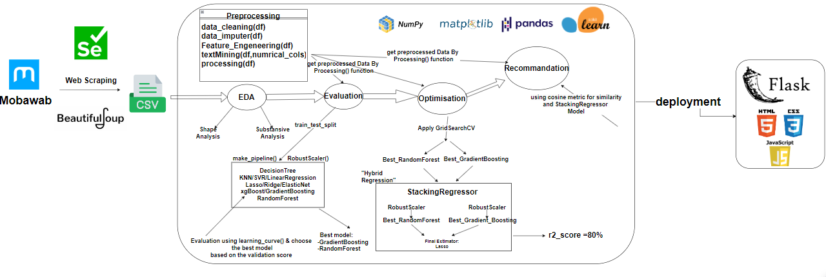

Slide 8
03
Formal Descriptions of Algorithms

Slide 9
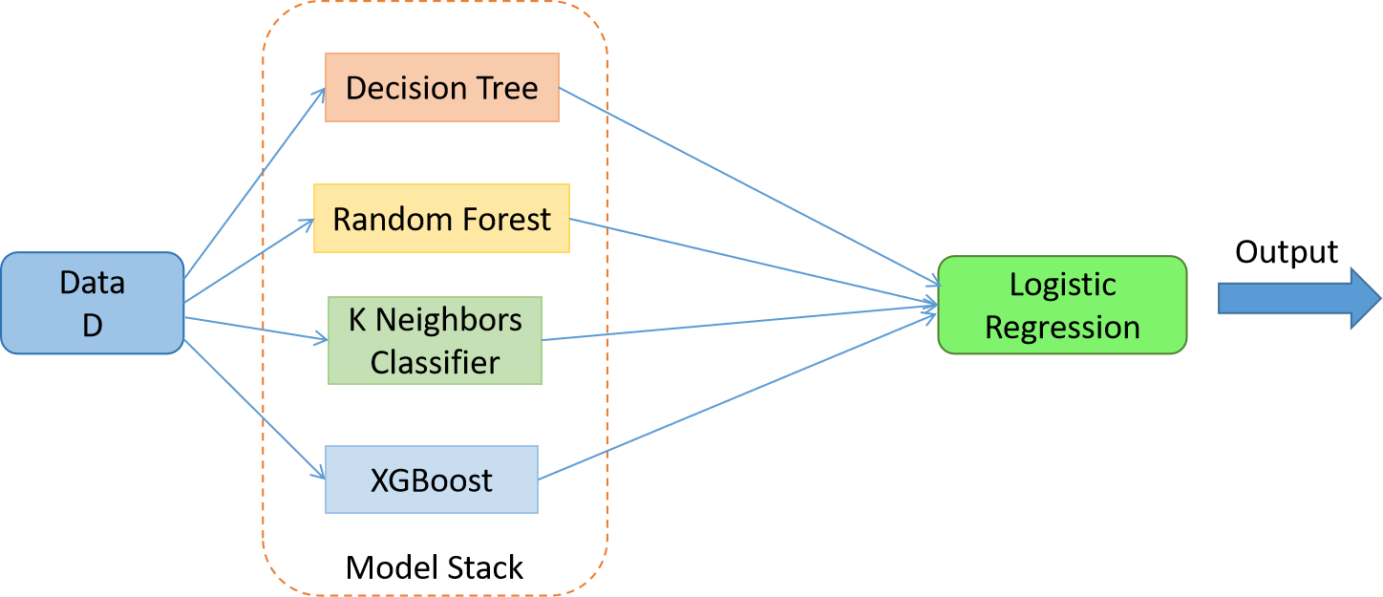
3.3. Stacking Regressor:
Stacking Regressor is indeed an ensemble learning technique that combines the predictions of multiple base regressors using a meta-regressor. It works by training a set of diverse base regressors on the input data, and then a higher-level meta-regressor is employed to make a final prediction based on the outputs of these base regressors. This approach allows for leveraging the strengths of different algorithms and can often result in improved predictive performance compared to individual models.

Slide 10
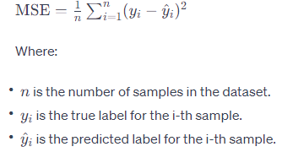
The three algorithms mentioned above are typically based on minimizing the Mean Squared Error (MSE) cost function. The MSE is calculated as follows:

Slide 11
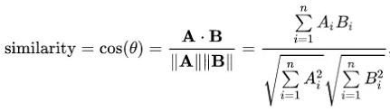
3.5 cosine metric:
Cosine similarity is used to determine the similarity between documents or vectors. Mathematically, it measures the cosine of the angle between two vectors projected in a multi-dimensional space, here is the formula of cosine similarity:

Slide 12
04
Demonstration

Slide 13
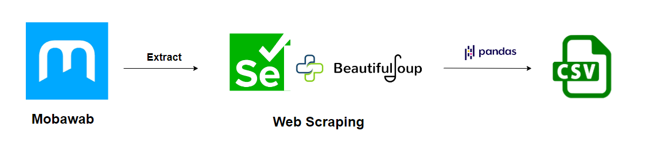
4.1 Data Collection

Slide 14
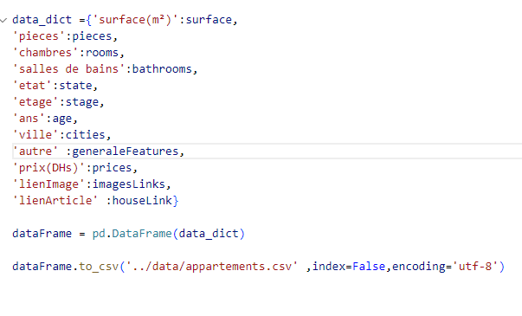
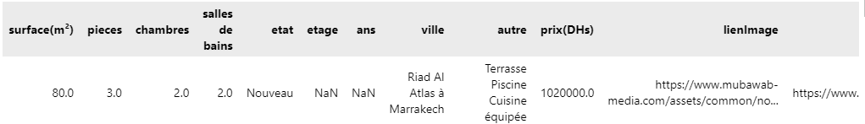
Extracted features:

Slide 15
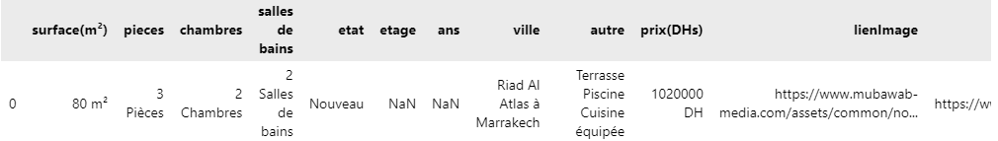
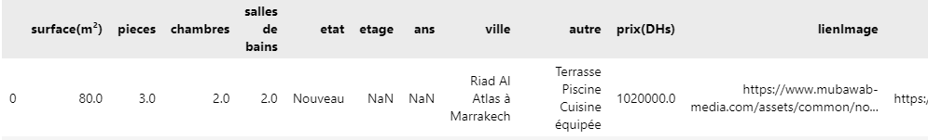
4.2 EDA-Exploratory Data Analysis-
Elemination of « m² DHs chambres ….. »

Slide 16
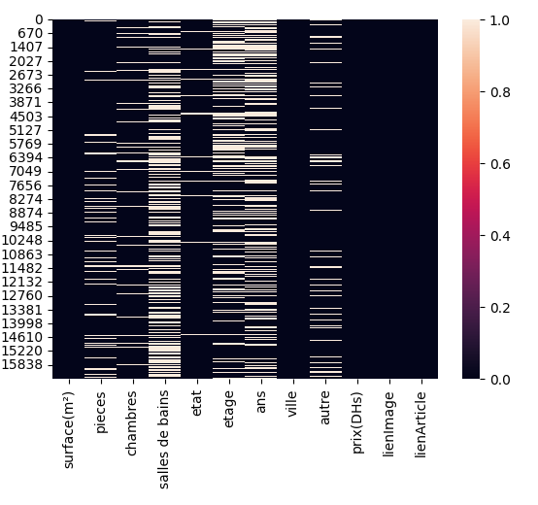
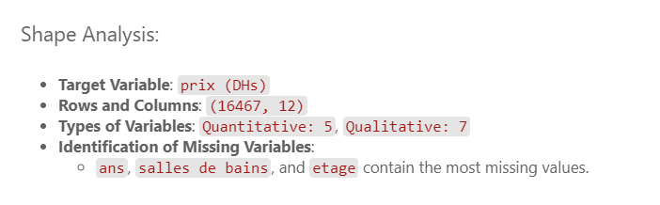
4.2.1 Shape Analysis

Slide 17
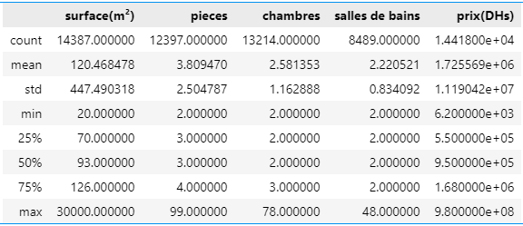
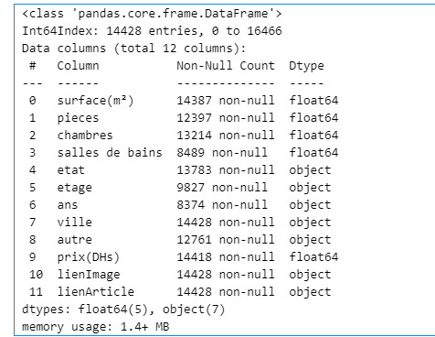
4.2.2 Substansive Analysis
Describe the data

Slide 18
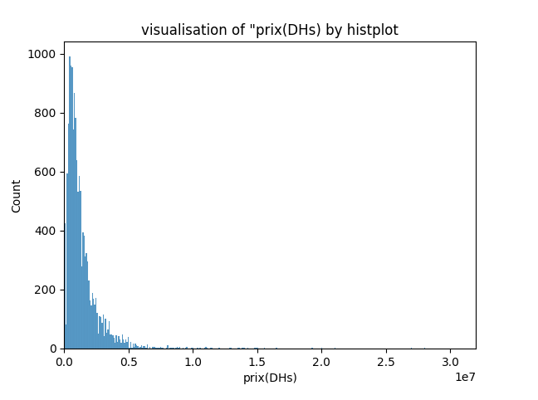
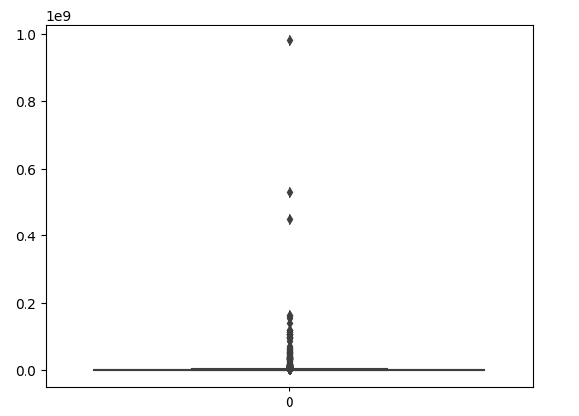
Visualisation of the target
Outliers

Slide 19
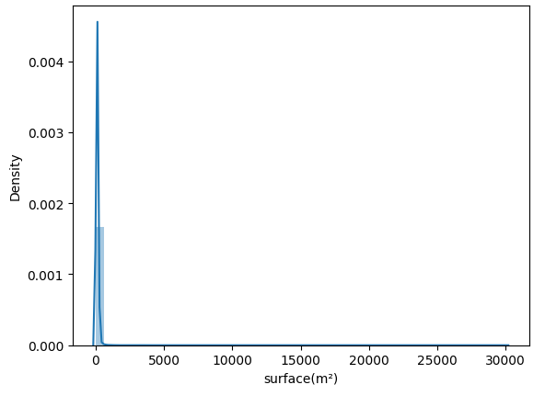
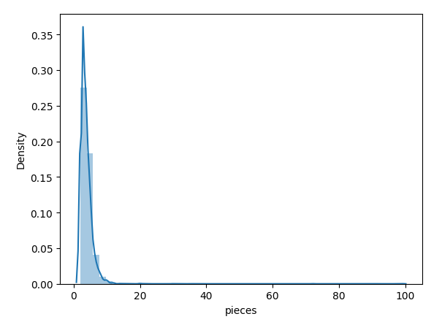
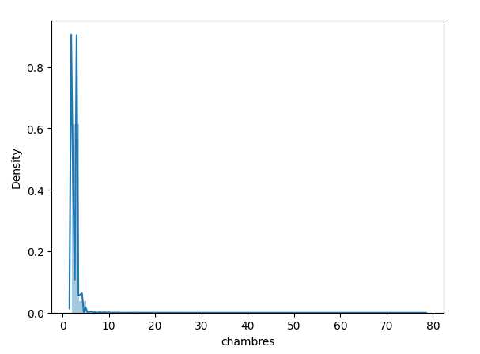
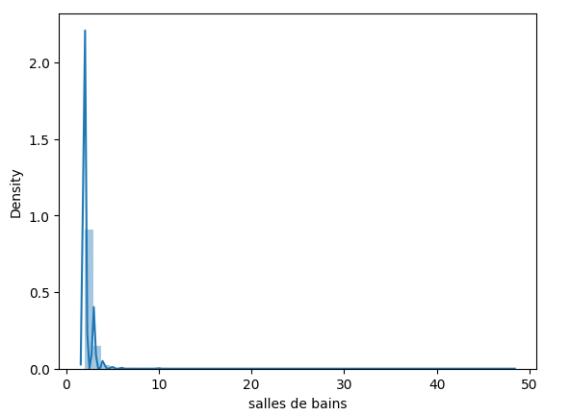
Visualisation of numerical varaibles
Most quantitative variables are skewed (asymmetric), with exceptions like “bathrooms" and “rooms," which are also skewed but multimodal.

Slide 20
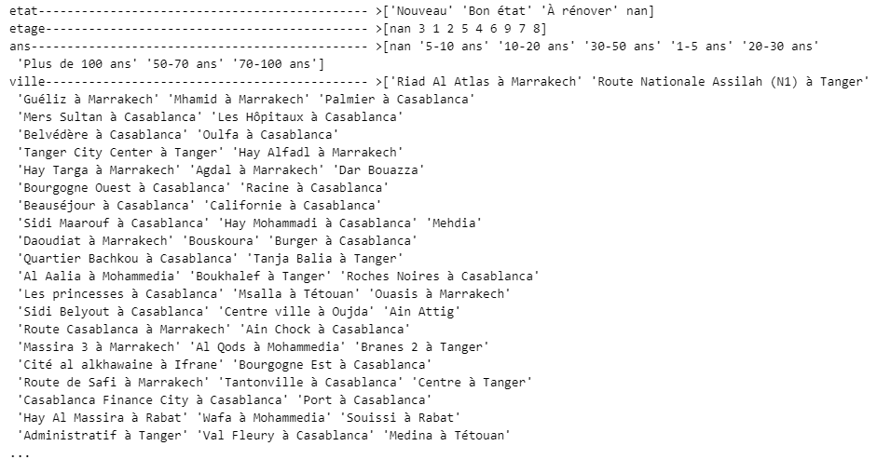
Visualisation of categorical varaibles
Varaibles « Ville » and « autre » contain a lot of different varaibles

Slide 21
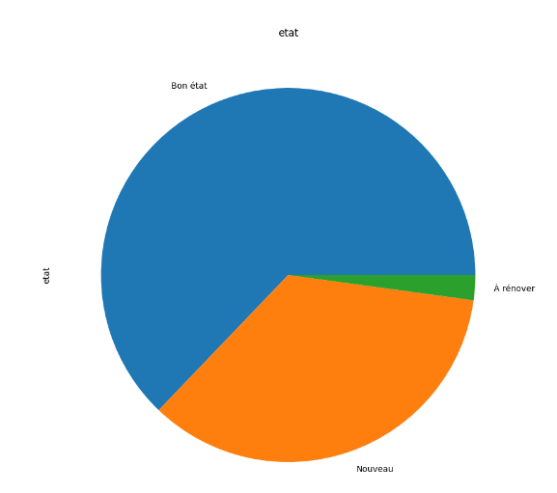
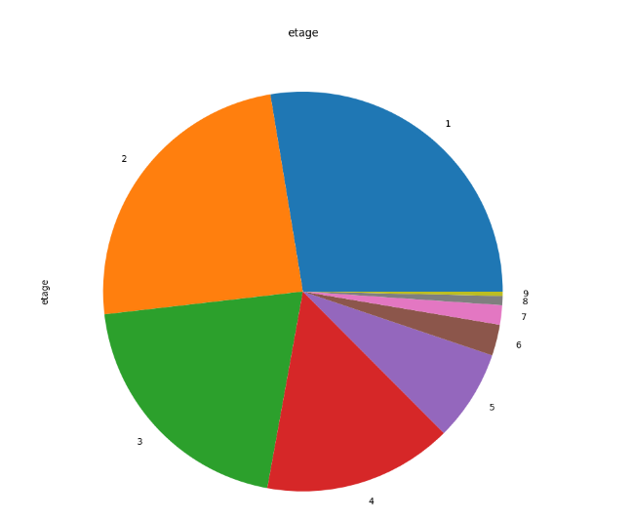
Etat
Etage

Slide 22
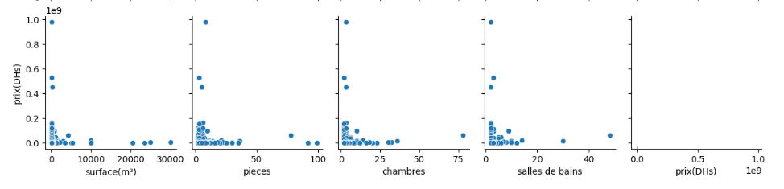
relation between target and numerical variable
We see a lot of outliers and also it ‘s seems that there not a big corellation between caraible and target variable

Slide 23
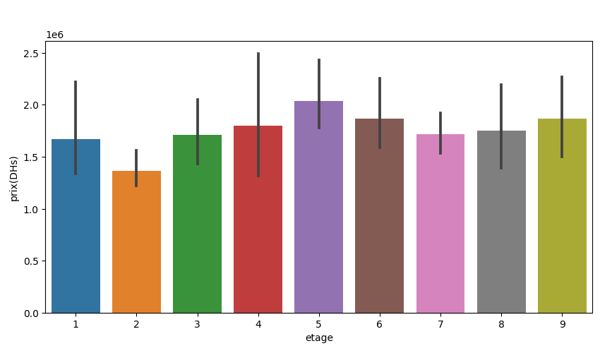
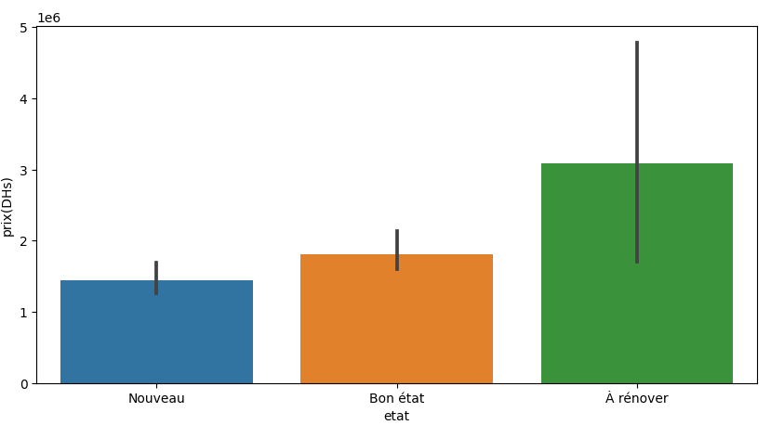
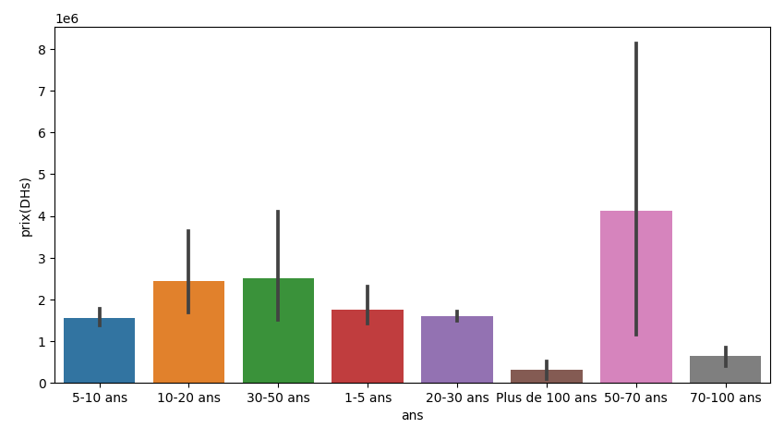
relation between target and categorical variable
Observation: Apartments to renovate and those with an age between 50-70 may be priced higher. This observation might seem unusual, but it could be due to the majority of these apartments being located in areas with elevated apartment prices, or it could be influenced by the presence of outliers.

Slide 24
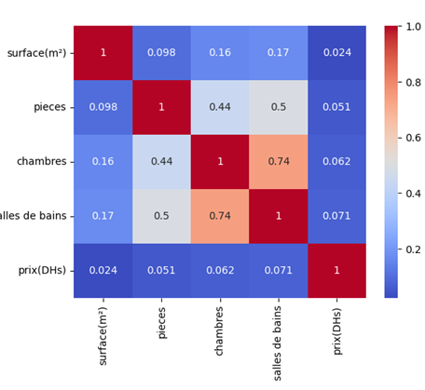
Correlatoin matrix
Observation: there a very low correlation between numerical variables except for relation between bathrooms and rooms

Slide 25
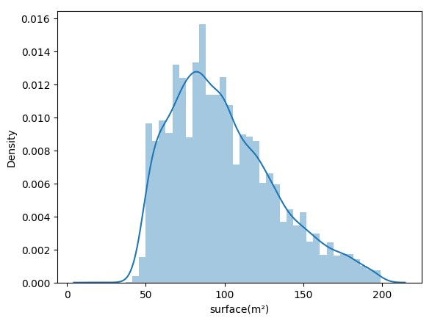
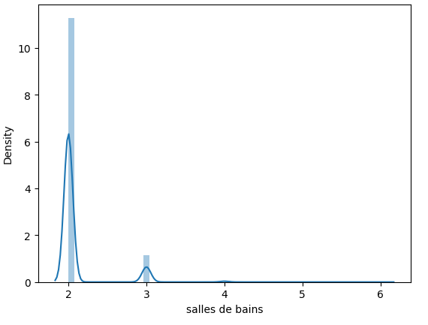
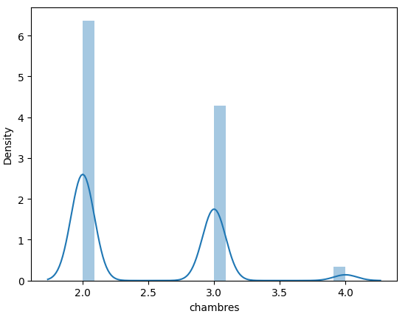
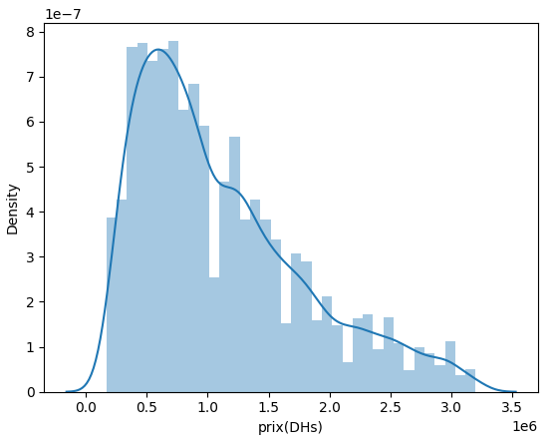
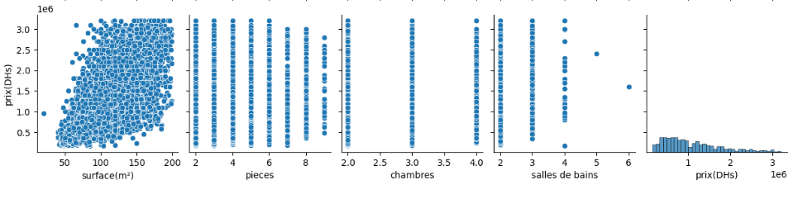
visualisation numerical after handling outliers

Slide 26
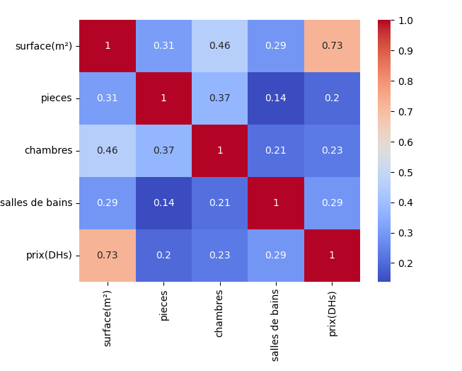
Correlation matrix
Before handling outliers
After handling outliers
Observation: After eliminating some outliers from the price and surface, the distribution of the data has changed, especially in terms of correlation. So the Outliers had a significant influence on the correlation

Slide 27
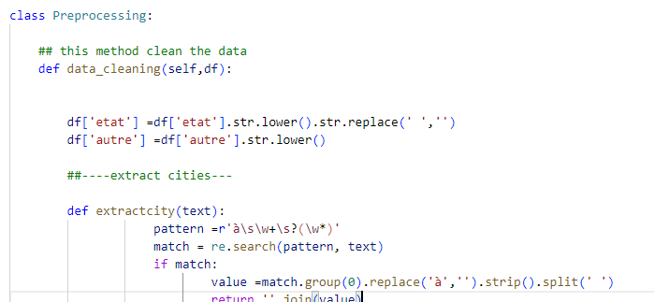
4.3 Preprocessing
4.3 Preprocessing
Class Preprocessing:
Method data_cleaning ()
I have implemented a class named Preprocessing that contain a method named data_cleaning, The data_cleaning function preprocesses a real estate dataset by standardizing columns, extracting relevant information, and filtering outliers. It cleans numerical and text data, handles missing values, and ensures data consistency. The result is a refined DataFrame ready for analysis or modeling.

Slide 28
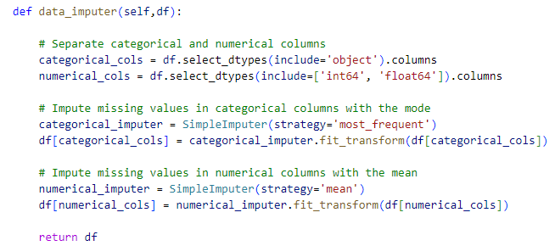
Method data_imputer()
This method handles the missing values .So the categorical variables are filled using the 'most_frequent' strategy, while numerical values are filled using the 'mean' strategy with SimpleImputer.

Slide 29
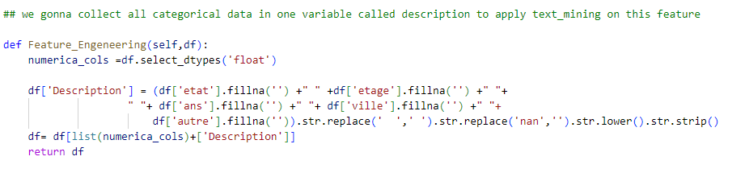
Methode Feature_engeneering()
. The class also features a function for feature engineering, creating a new "Description" feature that consolidates categorical then eliminate all other categorical featuer where feature “Description” still the unique categorical feature in datafame
In this stage, the DataFrame contains only numerical columns and the 'Description' column as a categorical column.

Slide 30
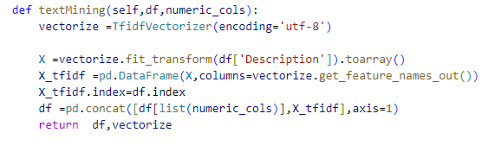
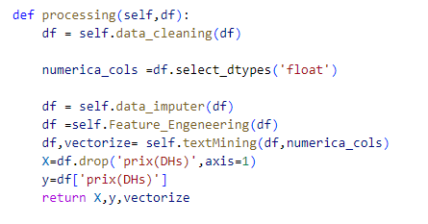
Methode textMining ()
This class applies TF-IDF on the 'Description' feature and then concatenates all numerical variables with the vectorized columns.
Methode processing ()
This method combines all the mentioned steps: it applies the data_cleaning() function, followed by data_imputer(), feature_engineering(), and subsequently text_mining(). Finally, it divides the target and independent variables, returning them, and also returns the vectorizer.

Slide 31
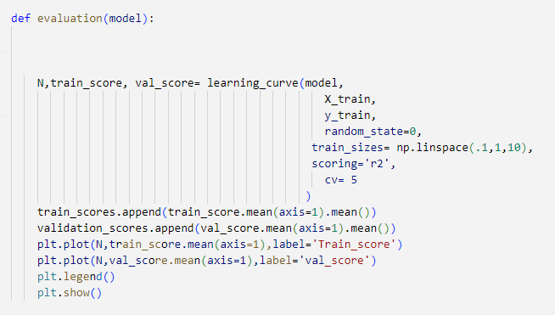
4.4 Evaluation
Each algorithm underwent evaluation using learning curves, tracking both training and validation scores and plot these two scores

Slide 32
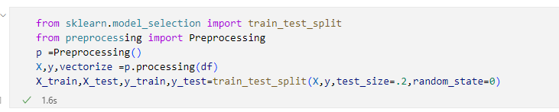
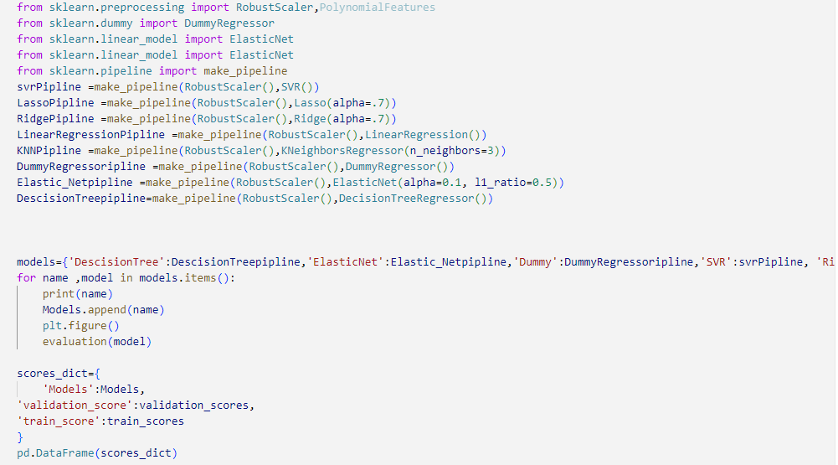
Apply preprocessing using the Preprocessing class, then split the data using train_test_split
I use the make_pipeline function to seamlessly integrate RobustScaler into my data preprocessing pipeline before training the models. In each pipeline corresponding to the desired model, Robust Scaler is applied for normalization, enhancing the model's robustness to outliers in the dataset

Slide 33
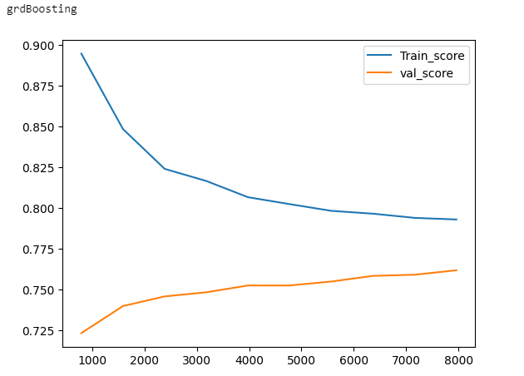
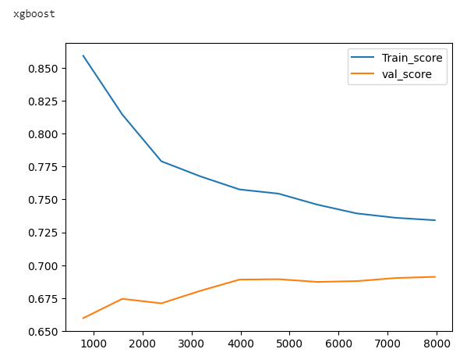
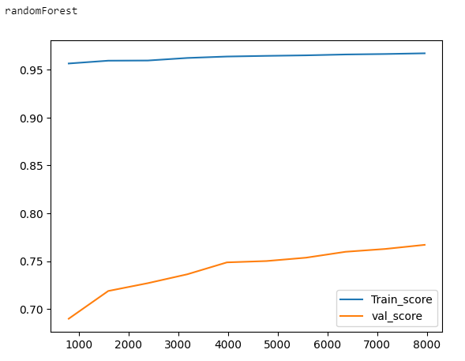

Slide 34
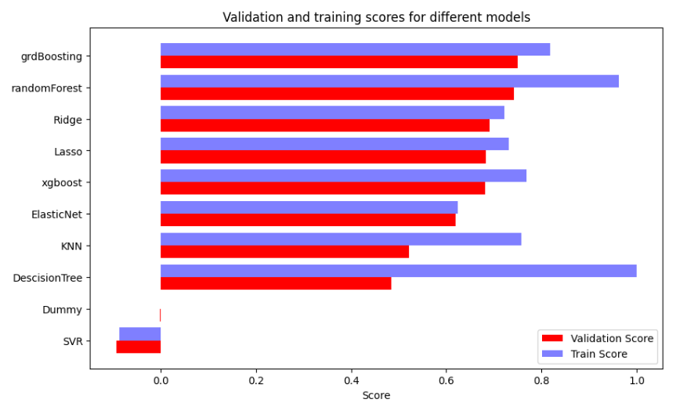
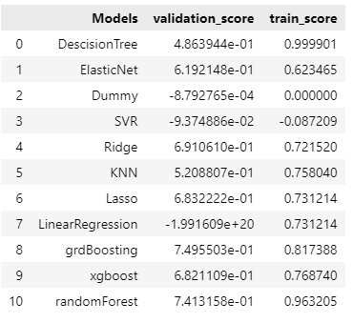
the Random Forest and Gradient Boosting algorithms exhibit the highest validation scores. Consequently, I have selected them as the base algorithms for further optimization, recognizing their superior performance. The optimization process aims to enhance the already strong predictive capabilities of Random Forest and Gradient Boosting in predicting housing prices.

Slide 35
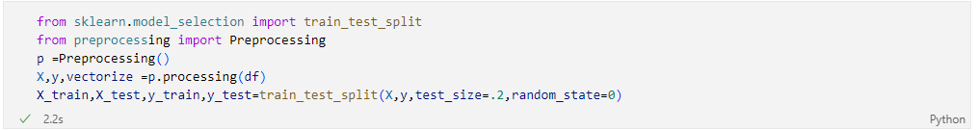
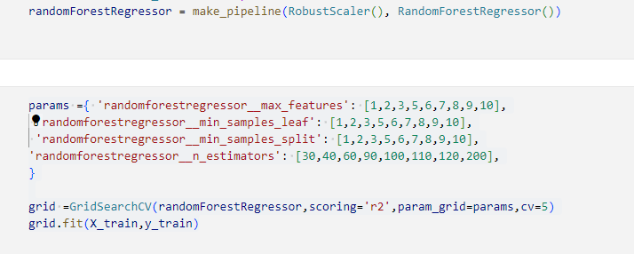
4.3 Optimisation
Apply prepocessing
Optimisation of RandomForest

Slide 36
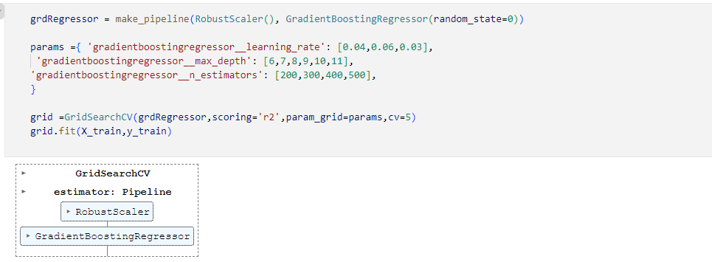
Optimisation of GradientBoosting

Slide 37
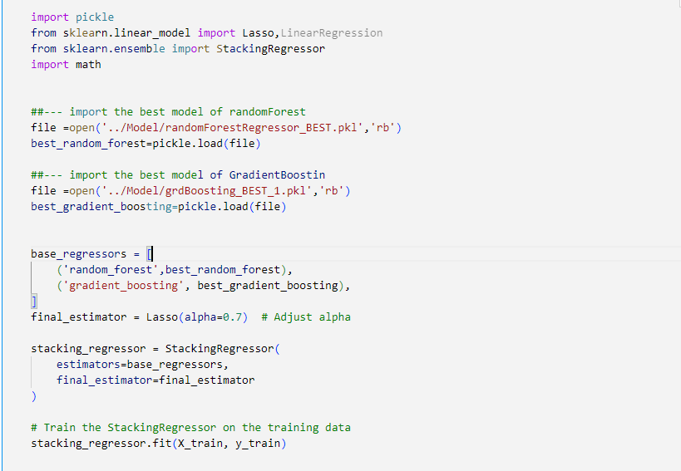

Apply StackingRegressor

Slide 38

comparison
To observe the outcomes of the Hybrid Regression technique, we can examine the results of a thorough comparison. This evaluation contrasts the performance metrics of the Hybrid Regression model, which combines Gradient Boosting and RandomForest within a StackingRegressor with Lasso, against models using only Gradient Boosting. The comparison encompasses key metrics such as MAE, R², and RMSE, providing a clear snapshot of the technique's effectiveness. The results consistently showcase the Hybrid Regression technique's superiority, as evidenced by lower MAE scores, higher R² values, and reduced RMSE levels when compared to traditional methods

Slide 39



Slide 40
4.3 Recommandation

Slide 41
05
Limitations of the Project Approach

Slide 42

Prediction Accuracy: Performance results, such as a Mean Absolute Error (MAE) of 222,406.14 and a Root Mean Square Error (RMSE) of 322,222.81 can show sometime a notable discrepancy between the model's predictions and the observed real estate prices, indicating a limitation in accuracy.
city prediction limitation : The city prediction limitation arises when the recommendation mechanism occasionally suggests apartments in locations different from those specified. This can be problematic in diverse real estate markets where precise location is crucial.
Quality of Data: The presence of numerous missing
data and significant outliers has a detrimental impact
on the model's performance.

Slide 43
07
Conclusion

Slide 44
The apartment price prediction project has achieved notable success, boasting an impressive R² score of around 80%. The innovative approach of combining Gradient Boosting and RandomForest through StackingRegressor with Lasso has significantly improved accuracy. This methodology not only benefits sellers and buyers but also enhances transparency and fairness in real estate transactions. While acknowledging the potential for further refinement with more accurate data and thorough preprocessing, the current model offers satisfactory results. Despite its imperfections, the model provides valuable insights, streamlining and easing the complexities of home selling and buying for all stakeholders involved.

Slide 45

Thank you for your attention

Slide 46
https://pub.towardsai.net/ridge-and-lasso-regression-51705b608fb9 https://chat.openai.com/ https://www.researchgate.net/figure/The-flowchart-of-random-forest-RF-for-regression-adapted-from-Rodriguez-Galiano-et_fig3_303835073 https://www.researchgate.net/figure/Flow-diagram-of-gradient-boosting-machine-learning-method-The-ensemble-classifiers_fig1_351542039
References

