Slide 1

Blah blah
Blah blah
Blah blah
Blah blah
Sign In
Sign Up

Slide 2
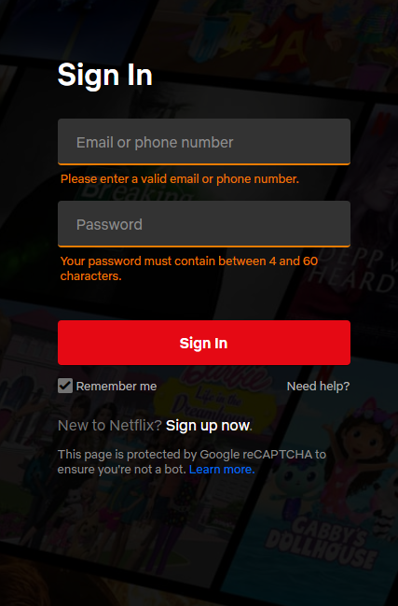
*BG Image

Slide 3
UserName
Password
Full Name
Google Authentication
*BG Image

Slide 4

User Settings
Dashboard
Balance: 45345$
150$
Add Expense
1500$
Add Income
*BG Image

