Slide 1

Blah blah
Blah blah
Blah blah
Blah blah
asdgsdag
Sign In
Sign Up

Slide 2

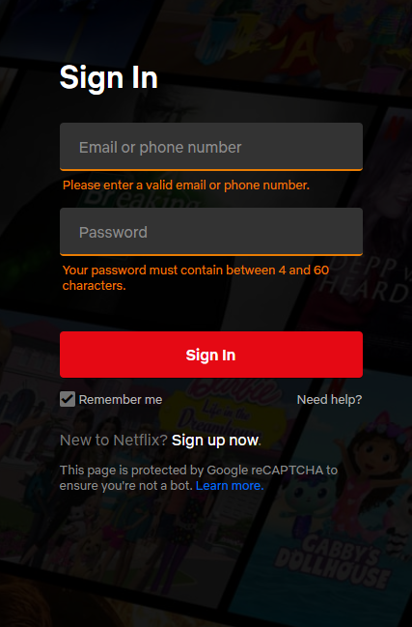
*BG Image

Slide 3
Sign Up
UserName
Password
Full Name
Google Authentication
*BG Image

Slide 4

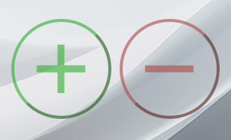
Dashboard (with grid illustration)
User Settings
TBD
Balance: 45345$
Add Income
Add Expense
2x2 grid within 2x3 grid

Slide 5
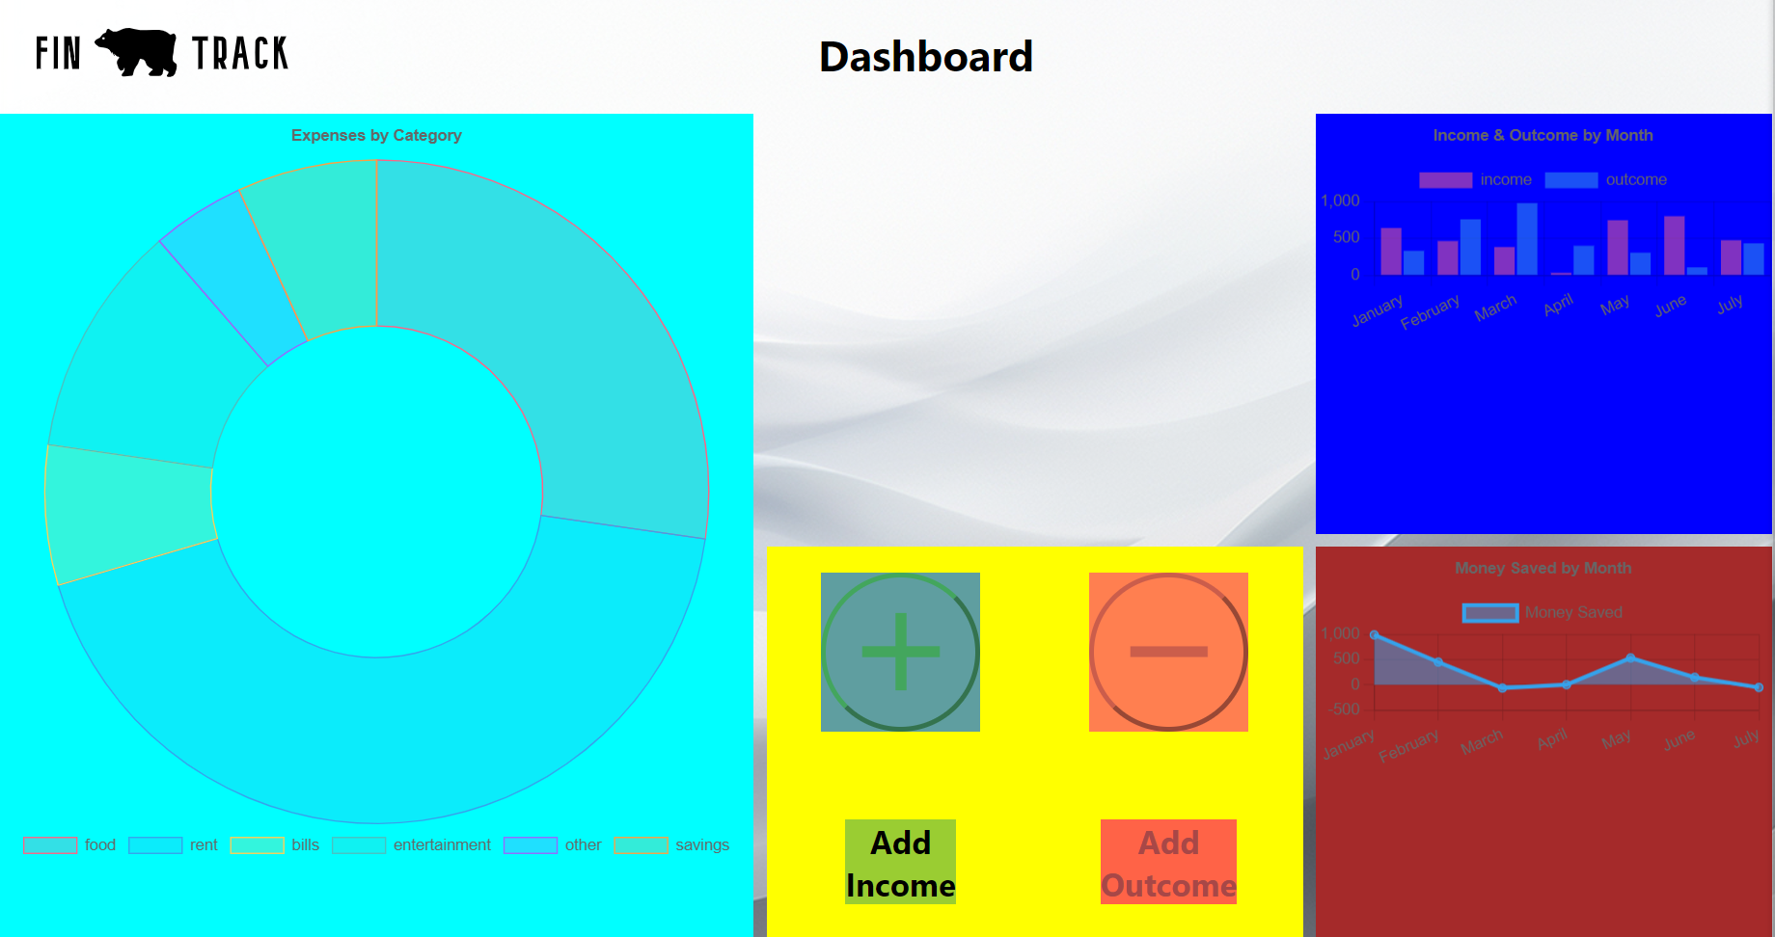
- Grid Illustration From the UI

Slide 6
