Slide 1
Qihoo 360 Browser
News

Slide 2
Agenda
Browser news
Root inclusion process

Slide 3
Browser news
New policy, version 1.1
Clarify the strategy and inclussion process
New CA form to include not only the root CA profiles but also subCAs and end user certificates
Working on a new version. Comments/suggestions are welcome
Removal of Wosign & StartCom roots from the 360 root store
Removed on March 2018 as of version 9.1 in both browsers
Show “not secure” warning when enter in HTTP mode
In 360EE (Extreme Explorer) already done as of version 9.5, in 360SE (Safe Explorer) expected by end of June, as of version 10.0
You can check at https://browser.360.cn

Slide 4
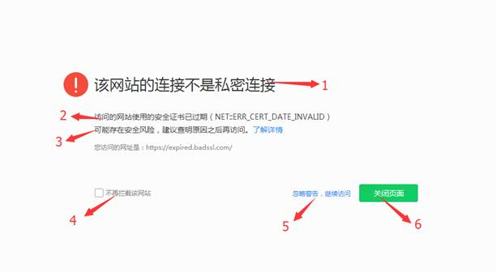
Browser news
To enhance the user experience when blocking pages by:
Showing the error description and the error code (1 & 2)
Adding a detailed hyperlink letting the user know more about the error (3)
Adding an option to mark it as “safe” for not intercepting anymore (4)
Adding an option for the user to ignore the issue (5)

Slide 5
Root inclusion process
Received some requests from CAs
Root store update is scheduled every quarter
For 2018 will start in the first week of October as mentioned

Slide 6
Thank You!

