Slide 1
Cisco Update for June 2018 CA/BF
J.P. Hamilton, Alex Wight
Cisco Cryptographic Services
Updated May 2018

Slide 2
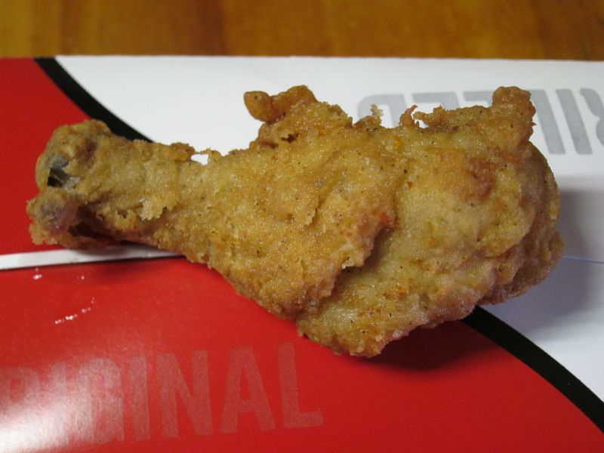
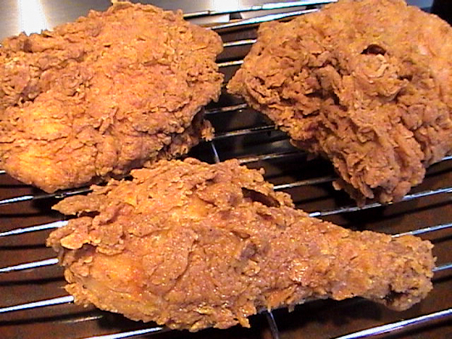
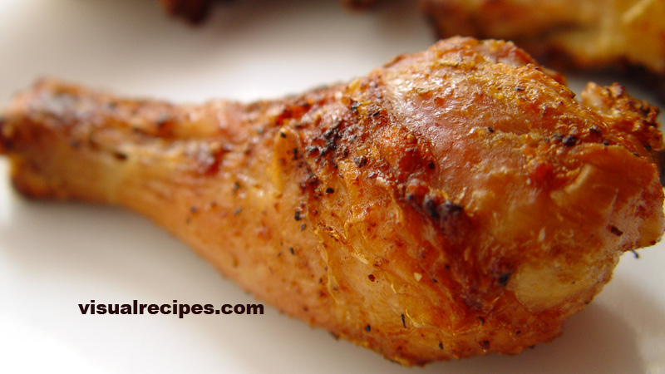
Cisco Trusted Root Stores
Recently mandated for all Cisco Products – Product Security Baseline
Part of Cisco Smart Licensing Program
Expect changes/additions to the program as we continue to mature the service
Recently joined CCADB
Expect specialty Root Stores (i.e. IoT specific)
ios.p7b
“Original Recipe”
ios_union.p7b
“Extra Crispy”
ios_core.p7b
“Grilled Lite”

