Slide 1
CSE 390a
Lecture 7
Regular expressions,
egrep, and sed
slides created by Marty Stepp, modified by Jessica Miller and Ruth Anderson
http://www.cs.washington.edu/390a/

Slide 2
Lecture summary
regular expression syntax
commands that use regular expressions
  egrep (extended grep) - search
  sed (stream editor) - replace
links
  http://www.panix.com/~elflord/unix/grep.html
  http://www.robelle.com/smugbook/regexpr.html
  http://www.grymoire.com/Unix/Sed.html or
  http://www.gnu.org/software/sed/manual/sed.html

Slide 3
What is a regular expression?
"[a-zA-Z_\-]+@(([a-zA-Z_\-])+\.)+[a-zA-Z]{2,4}"
regular expression ("regex"): a description of a pattern of text
  can test whether a string matches the expression's pattern
  can use a regex to search/replace characters in a string
  regular expressions are extremely powerful but tough to read
    (the above regular expression matches basic email addresses)
regular expressions occur in many places:
  shell commands (grep)
  many text editors (TextPad) allow regexes in search/replace
  Java Scanner, String split (CSE 143 grammar solver)

Slide 4
egrep and regexes
egrep "[0-9]{3}-[0-9]{3}-[0-9]{4}" faculty.html
grep uses “basic” regular expressions instead of “extended”
  extended has some minor differences and additional metacharacters
  we’ll just use extended syntax. See online if you’re interested in the details.
-i option before regex signifies a case-insensitive match
  egrep -i "mart" matches "Marty S", "smartie", "WALMART", ...
command | description
egrep | extended grep; uses regexes in its search patterns; equivalent to grep -E

Slide 5
Basic regexes
"abc"
the simplest regexes simply match a particular substring
this is really a pattern, not a string!
the above regular expression matches any line containing "abc"
  YES : "abc", "abcdef", "defabc", ".=.abc.=.", ...
  NO : "fedcba", "ab c", "AbC", "Bash", ...

Slide 6
Wildcards and anchors
. (a dot) matches any character except \n
  ".oo.y" matches "Doocy", "goofy", "LooPy", ...
  use \. to literally match a dot . character
^ matches the beginning of a line; $ the end
  "^fi$" matches lines that consist entirely of fi
\< demands that pattern is the beginning of a word;
\> demands that pattern is the end of a word
  "\<for\>" matches lines that contain the word "for"
Exercise : Find lines in ideas.txt that refer to the C language.
Exercise : Find act/scene numbers in hamlet.txt .
Notes:
Answer:
egrep "\<C\>" ideas.txt
egrep "^ACT|^Scene" hamlet.txt

Slide 7
Special characters
| means OR
  "abc|def|g" matches lines with "abc", "def", or "g"
  precedence of ^(Subject|Date) vs. ^Subject|Date:
  There's no AND symbol.
() are for grouping
  "(Homer|Marge) Simpson" matches lines containing
  "Homer Simpson" or "Marge Simpson"
\ starts an escape sequence
  many characters must be escaped to match them: / \ $ . [ ] ( ) ^ * + ?
  "\.\\n" matches lines containing ".\n"

Slide 8
Quantifiers: * + ?
* means 0 or more occurrences
  "abc*" matches "ab", "abc", "abcc", "abccc", ...
  "a(bc)*" matches "a", "abc", "abcbc", "abcbcbc", ...
  "a.*a" matches "aa", "aba", "a8qa", "a!?_a", ...
+ means 1 or more occurrences
  "a(bc)+" matches "abc", "abcbc", "abcbcbc", ...
  "Goo+gle" matches "Google", "Gooogle", "Goooogle", ...
? means 0 or 1 occurrences
  "Martina?" matches lines with "Martin" or "Martina"
  "Dan(iel)?" matches lines with "Dan" or "Daniel"
Exercise : Find all ^^ or ^_^ type smileys in chat.txt .
Notes:
Answer:
egrep "\^_*\^" chat.txt

Slide 9
More quantifiers
{min,max} means between min and max occurrences
  "a(bc){2,4}" matches "abcbc", "abcbcbc", or "abcbcbcbc"
min or max may be omitted to specify any number
  "{2,}" means 2 or more
  "{,6}" means up to 6
  "{3}" means exactly 3

Slide 10
Character sets
[ ] group characters into a character set;
will match any single character from the set
  "[bcd]art" matches strings containing "bart", "cart", and "dart"
  equivalent to "(b|c|d)art" but shorter
inside [ ], most modifier keys act as normal characters
  "what[.!*?]*" matches "what", "what.", "what!", "what?**!", ...
Exercise : Match letter grades in 143.txt such as A, B+, or D- .
Notes:
Answer:
egrep "[ABCDF][+\-]?" 143.txt

Slide 11
Character ranges
inside a character set, specify a range of characters with -
  "[a-z]" matches any lowercase letter
  "[a-zA-Z0-9]" matches any lower- or uppercase letter or digit
an initial ^ inside a character set negates it
  "[^abcd]" matches any character other than a, b, c, or d
inside a character set, - must be escaped to be matched
  "[+\-]?[0-9]+" matches optional + or -, followed by ≥ one digit
Exercise : Match phone #s in faculty.html, e.g. (206) 685-2181 .
Notes:
Answer:
egrep "[0-9]{3}-[0-9]{3}-[0-9]{4}" faculty.html

Slide 12
sed
Usage:
  sed -r "s/REGEX/TEXT/g" filename
    substitutes (replaces) occurrence(s) of regex with the given text
    if filename is omitted, reads from standard input (console)
    sed has other uses, but most can be emulated with substitutions
Example (replaces all occurrences of 143 with 390):
  sed -r "s/143/390/g" lecturenotes.txt
command | description
sed | stream editor; performs regex-based replacements and alterations on input

Slide 13
more about sed
sed is line-oriented; processes input a line at a time
  -r option makes regexes work better
    recognizes ( ) , [ ] , * , + the right way, etc.
  s for substitute
  g flag after last / asks for a global match (replace all)
special characters must be escaped to match them literally
  sed -r "s/http:\/\//https:\/\//g" urls.txt
sed can use delimiters besides / to make more readable (e.g. #) :
  sed -r "s#http://#https://#g" urls.txt

Slide 14
sed exercises
In movies.txt:
  Replace “The” with “The Super Awesome”
  Now do it only when The occurs at the beginning of the line.
  (Need the next slide for this)
  Move the year from the end of the line to the beginning of the line.
  Do this and also sort the movies by year
  Now do the two items above and then put the year back at the end of the line.

Slide 15
Back-references
every span of text captured by () is given an internal number
  you can use \number to use the captured text in the replacement
  \0 is the overall pattern
  \1 is the first parenthetical capture
  ...
Back-references can also be used in egrep pattern matching
  Match “A” surrounded by the same character: “(.)A\1”
Example: swap last names with first names
  sed -r "s/([A-Za-z]+), ([A-Za-z]+)/\2 \1/g" names.txt
Exercise : Reformat phone numbers with 685-2181 format to (206) 685.2181 format.
Notes:
Answer:
sed -r "s/([0-9]{3})-([0-9]{3})-([0-9]{4})/(\1) \2.\3/g" facnames.txt

Slide 16
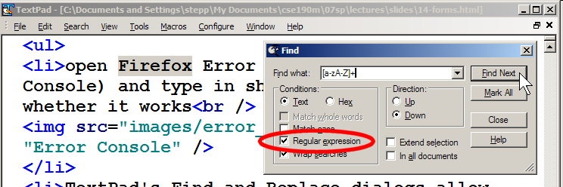
Other tools
find supports regexes through its -regex argument
  find . -regex ".*CSE 14[23].*"
Many editors understand regexes in their Find/Replace feature

Slide 17
Exercise
Write a shell script that reads a list of file names from files.txt and finds any occurrences of MM/DD dates and converts them into MM/DD/YYYY dates.
  Example:
  04/17
  would be changed to:
  04/17/2013

Slide 18
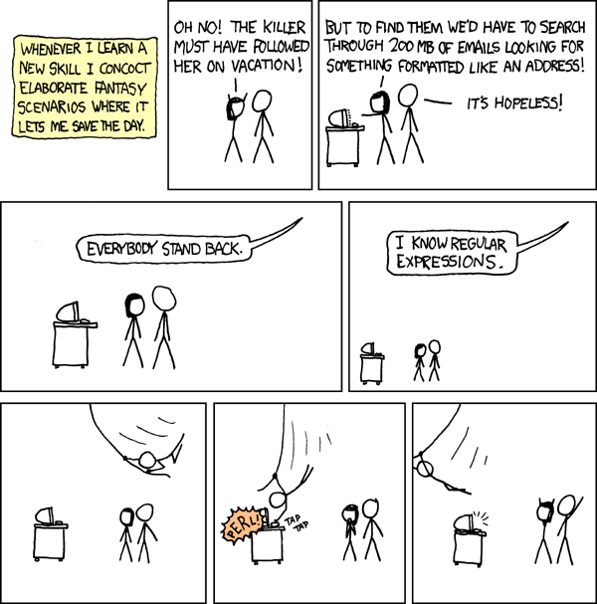
Yay Regular Expressions!
Courtesy XKCD

