Slide 1


SQL Connectivity
In Streamlit
By Benak Deepak

Slide 2
01
Prerequisites
02
SQL and Streamlit
AGENDA
03
Implementing the project
Code Understanding and conclusion
04

Slide 3
1)Python
2)VS Code
3)MySQL
4)Install packages:
i)pandas
ii)sql-connector
iii)sreamlit
01
Prerequisites

Slide 4
TERMINAL COMMANDS-
>>pip install mysql-connector-python
>>pip install streamlit
>>pip install pandas

Slide 5

02
SQL
Streamlit

Slide 6
SQL-CONNECTOR
Introduction
Key features
Advantages
->Python Library
->connect with Mysql
->Python applications to execute SQL queries
->Database connectivity
->SQL queries
->Data retrievals
->Error Handling
->Connecting Pooling
->Easy to use
->Performance
->Flexibility

Slide 7
SQL COMMANDS IN MySQL
Are as follows….

Slide 8
Step1->CREATE DATABASE FarmManagement;
Step2->USE FarmManagement;
Step3->CREATE TABLE Farmer (
farmer_id INT PRIMARY KEY,
name VARCHAR(100) NOT NULL,
address VARCHAR(255),
contact_info VARCHAR(255) );

Slide 9
----Creating the farm table----
CREATE TABLE Farm (
farm_id INT PRIMARY KEY,
location VARCHAR(255),
size DECIMAL(10, 2),
farmer_id INT, FOREIGN KEY (farmer_id) REFERENCES Farmer(farmer_id)
);

Slide 10
Recap on Streamlit:
Title
Sidebar
Header
Selectbox
Write
Form
And many more….

Slide 11
Connections…..
Database connection
Function to execute query and return results
To run an action in python

Slide 12
# Database connection
def get_connection():
return mysql.connector.connect(
host="localhost",
user="root",
password=“xyz",
database="FarmManagement"
)

Slide 13
# Function to execute query and return results
def run_query(query):
conn = get_connection()
cursor = conn.cursor()
cursor.execute(query)
data = cursor.fetchall()
columns = [col[0] for col in cursor.description]
conn.close()
return pd.DataFrame(data, columns=columns)

Slide 14
# To run an action in python
def run_action(query, values):
conn = get_connection()
cursor = conn.cursor()
cursor.execute(query, values)
conn.commit()
conn.close()

Slide 15


03
Implementing DBMS project

Slide 16
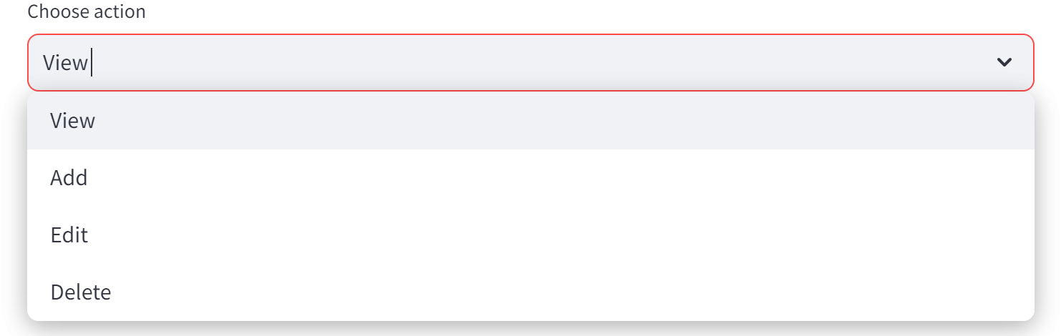
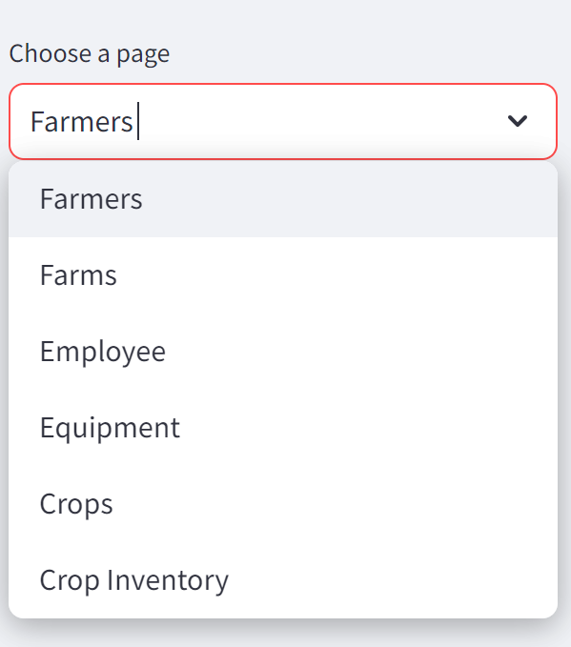
Project Explanation
Farm Management System

Slide 17
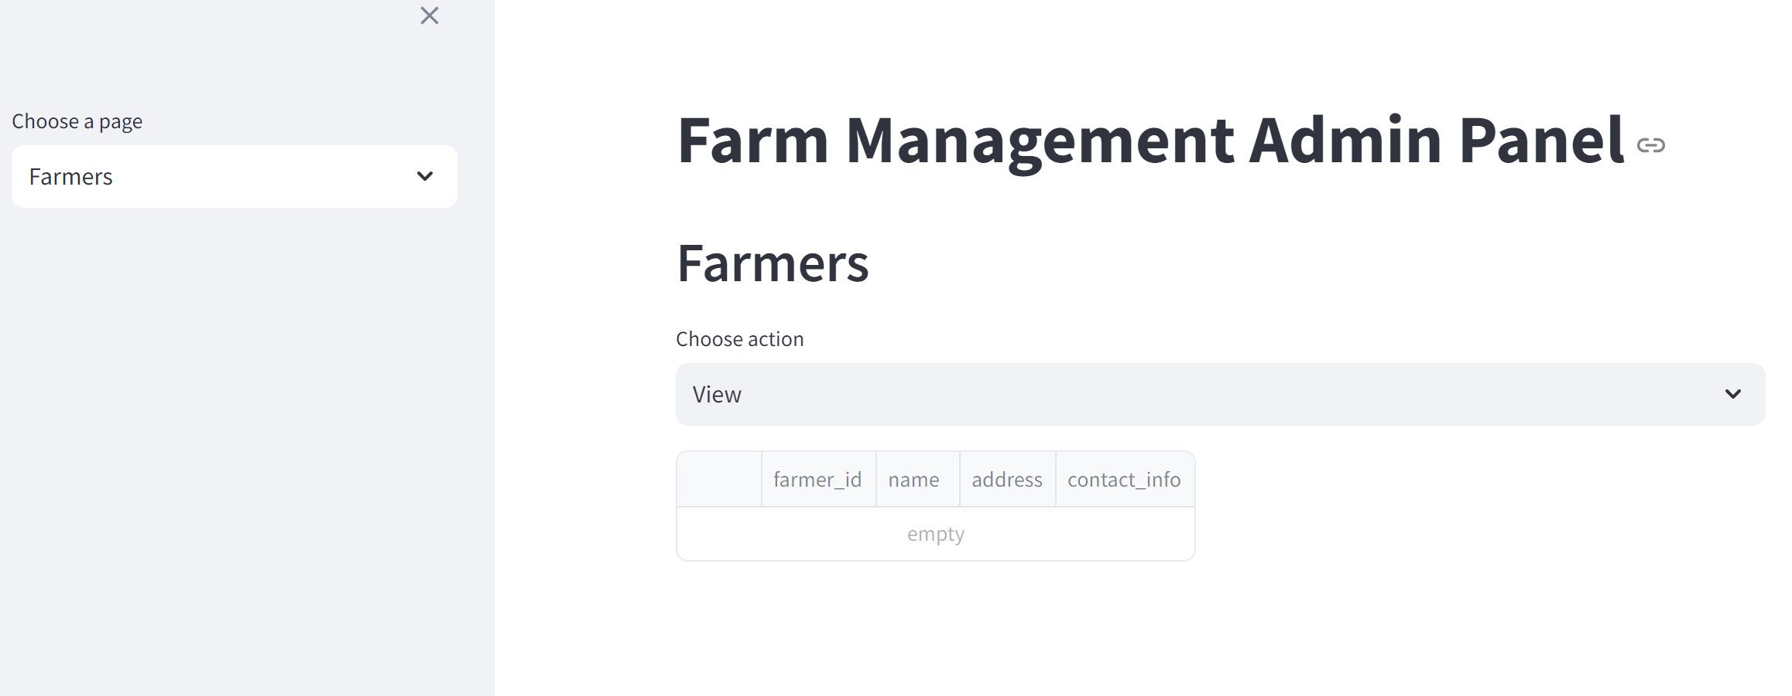

Slide 18
Shifting to VS Code

Slide 19

04
Conclusion

Slide 20


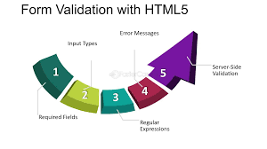
Future Extension
Advanced Data Visualization
Forms and User Input Handling
Multi media support

