Slide 2
Use for research should be acceptable | Possible roadblocks
Pre-1923 texts and images | License agreements / terms of service Questionable copyright claims in reproduction (as opposed to the underlying work
In-copyright texts for research purposes | Manual typing & scanning don’t scale. DRM removal illegal under DMCA
Databases of factual information | License agreements Scraping potentially illegal under CFAA

Slide 3
Very little fair use case law involving academic research
The negative: It’s unclear exactly what’s legal.
The positive: You’re unlikely to be the first example.

Slide 4
Mannapperuma et al. 2014.
“Is It in the Public Domain?”
Notes:
Mannapperuma et al. 2014. “Is it in the Public Domain?”
https://www.law.berkeley.edu/files/FINAL_PublicDomain_Handbook_FINAL(1).pdf

Slide 5
Some important precedents
Bridgeman Art Library v. Corel Corp., 36 F. Supp. 2d 191 (S.D.N.Y. 1999)
Meshwerks, Inc. v. Toyota Motor Sales U.S.A., Inc., 528 F.3d 1258 (10th Cir. 2008)
Key takeaway: Reproducing a work (e.g., by scanning or photographing) does not create a new copyright.

Slide 6
EEBO Terms & Conditions
“The electronic versions of any public domain works that may be included in EEBO are the copyright of ProQuest LLC. For all works in the collection, the printing or saving of texts is permitted only for private or educational use. Further reproduction is prohibited”
Notes:
https://eebo.chadwyck.com/about/terms.htm

Slide 7
Fair use: four factors
(1) the purpose and character of the use, including whether such use is of a commercial nature or is for nonprofit educational purposes;
(2) the nature of the copyrighted work;
(3) the amount and substantiality of the portion used in relation to the copyrighted work as a whole; and
(4) the effect of the use upon the potential market for or value of the copyrighted work.
U.S. Code Title 17, Section 107

Slide 8
Some important precedents
Perfect 10 v. Amazon.com (9th Cir. 2007)
Field v. Google (D. Nev. 2006)
A.V. ex rel. Vanderhye v. iParadigms (4th Cir. 2009)
Authors Guild v. HathiTrust (2d Cir. 2014)
Authors Guild v. Google (2d Cir. 2015)
Key takeaway: Copying a full work for the purpose of search is considered transformative, and is therefore OK.

Slide 9
DRM Circumvention
Forbidden under Digital Millennium Copyright Act (17 U.S. Code Section 1201, 1998)
Narrow exemptions, e.g.: - disability access - encryption research - phone jailbreaking - motion picture excerpts for education
Notes:
2015 rules:
https://copyright.gov/fedreg/2015/80fr65944.pdf

Slide 10
“The DMCA could effectively make copyright perpetual because even though the copyright term would expire, the legally protected encryption would continue....”
— James Boyle, The Public Domain: Enclosing the Commons of the Mind, 2008

Slide 11
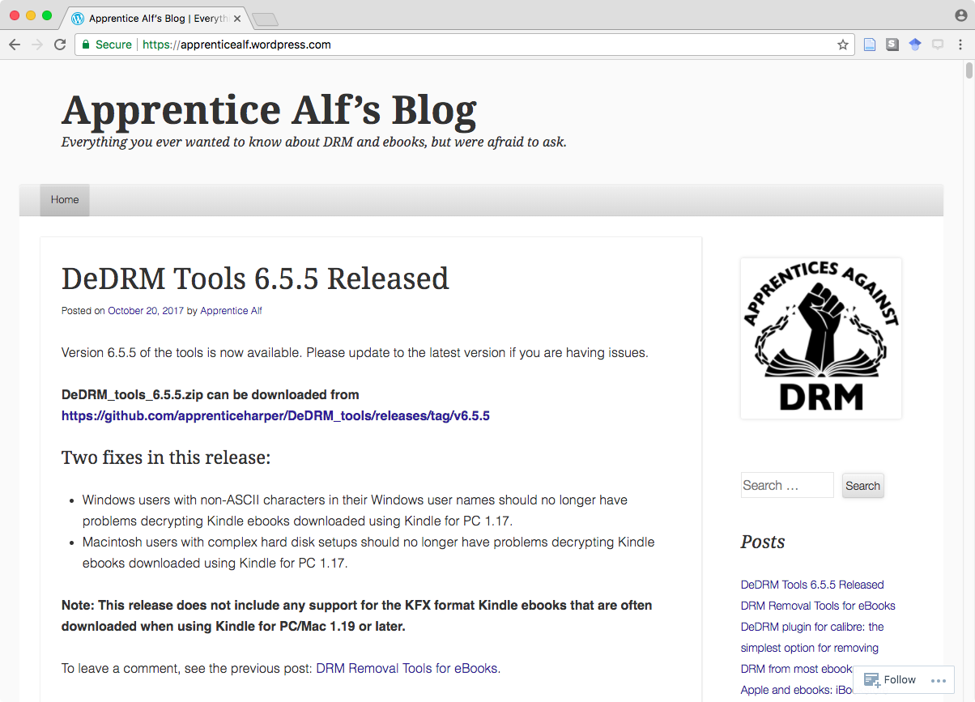

Slide 12
Computer Fraud and Abuse Act
Passed in 1986 (18 U.S. Code Section 130), after Reagan saw a screening of WarGames
Broad reach, outlawing
Spying on government computers
Committing fraud with a computer
Damaging computers with worms & viruses
Selling passwords to gov’t & commercial systems

Slide 13
Among CFAA criminal offenses:
Whoever— …
(2) intentionally accesses a computer without authorization or exceeds authorized access, and thereby obtains—
…
(C) information from any protected computer;

Slide 14
EEBO Terms & Conditions
“Downloading of all or parts of the Products in a systematic or regular manner so as to create a collection of materials comprising all or part of the Products is strictly prohibited whether or not such collection is in electronic or print form.”

