Slide 1
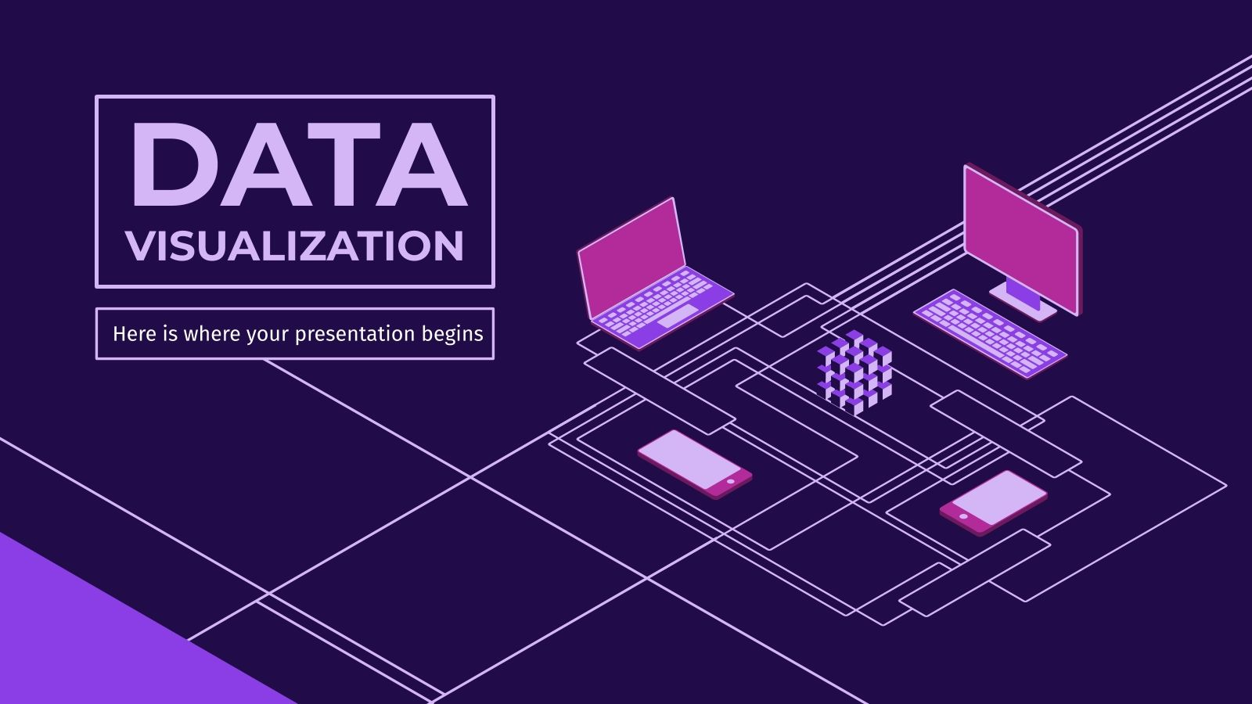
FOR DECISION MAKING

Slide 2
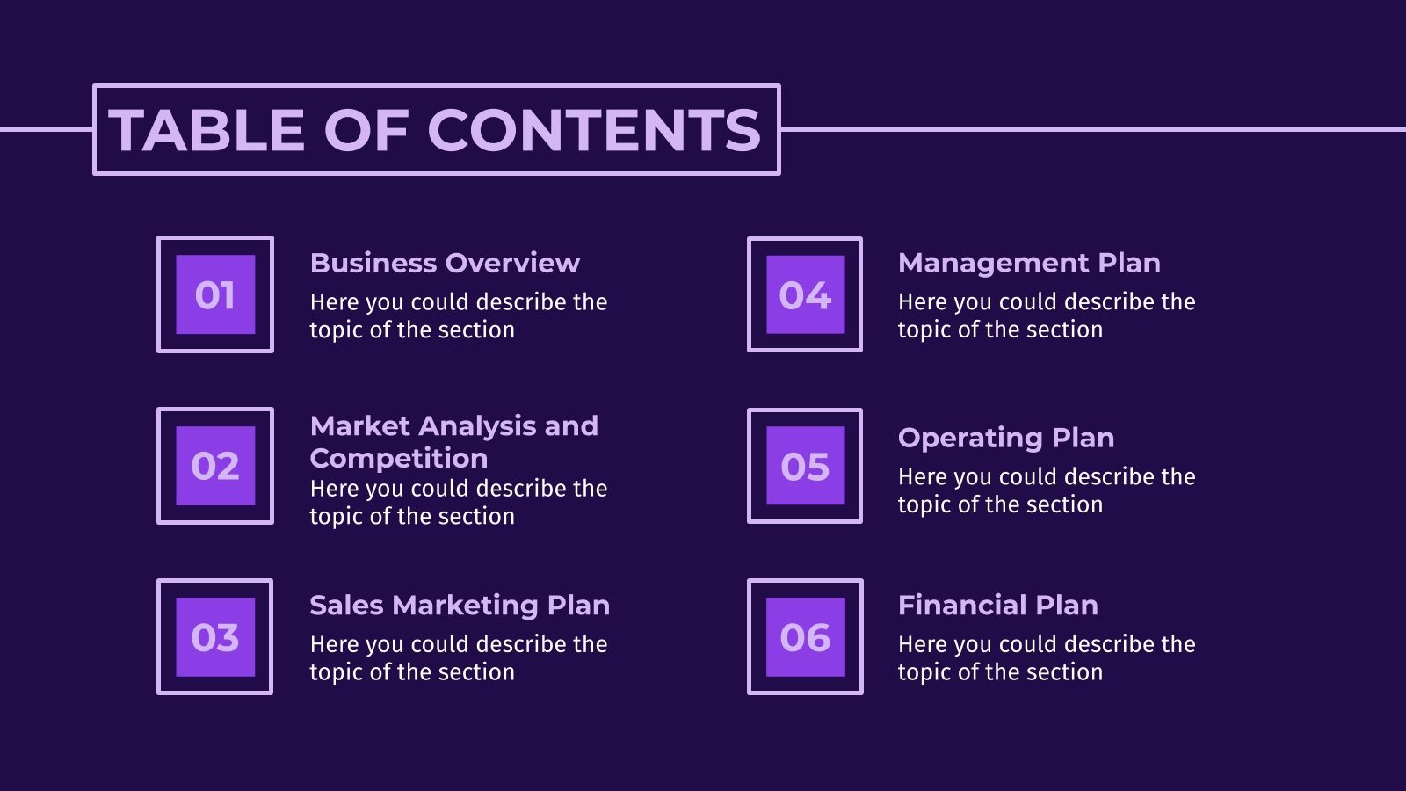
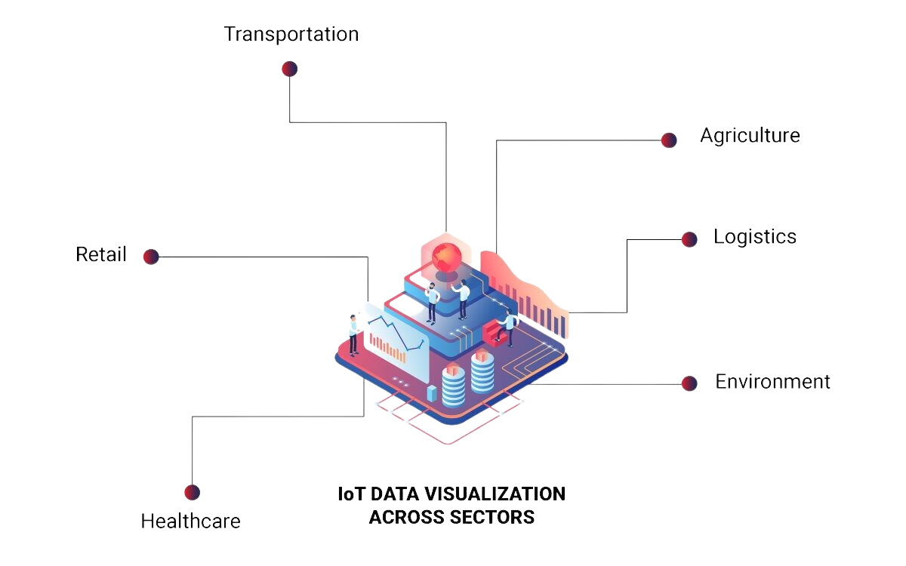
POWER OF CONNECTED DEVICES
Transportation
Agriculture
Logistics
Retail
Environment
IOT DATA VISUALIZATION ACROSS SECTORS
Healthcare

Slide 3




TRANSFORMING DATA INTO
ACTIONABLE INSIGHTS
COLLECT
Collect time series data coming from different sources, formats & rotate

Slide 4
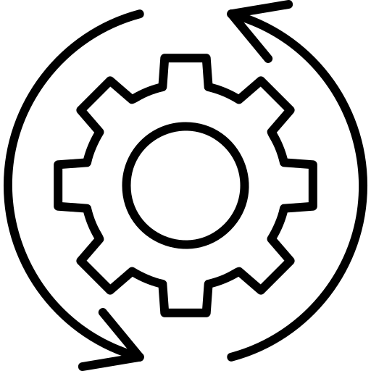
TRANSFORMING DATA INTO
ACTIONABLE INSIGHTS
Operator
Or System
Notify
COLLECT
PROCESS
Collect time series data coming from different sources, formats & rotate
Parse, Normalize
Enrich, Transform

Slide 5

TRANSFORMING DATA INTO
ACTIONABLE INSIGHTS
Operator
Or System
Notify
COLLECT
PROCESS
STORE
Collect time series data coming from different sources, formats & rotate
Store in multi-layered times series data store optimized for a variety of analysis
Parse, Normalize
Enrich, Transform

Slide 6

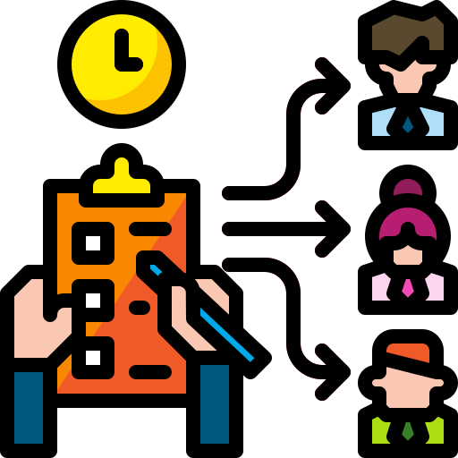
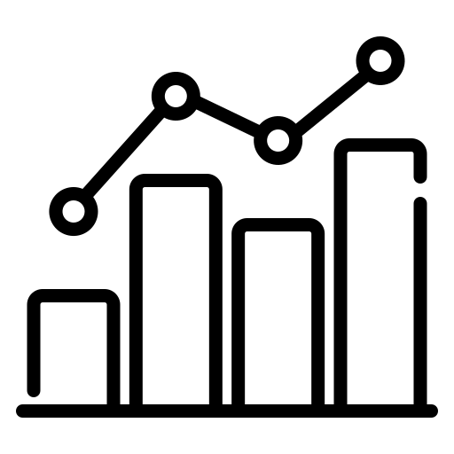
TRANSFORMING DATA INTO
ACTIONABLE INSIGHTS
Operator
Or System
Notify
Explore and monitor
Perform operational analysis
Models for learning & predictions
COLLECT
PROCESS
STORE
ANALYZE
Store in multi-layered times series data store optimized for a variety of analysis
Analyze and monitor operations by using assets and models for machine learning to make prediction
Collect time series data coming from different sources, formats & rotate
Parse, Normalize
Enrich, Transform

Slide 7
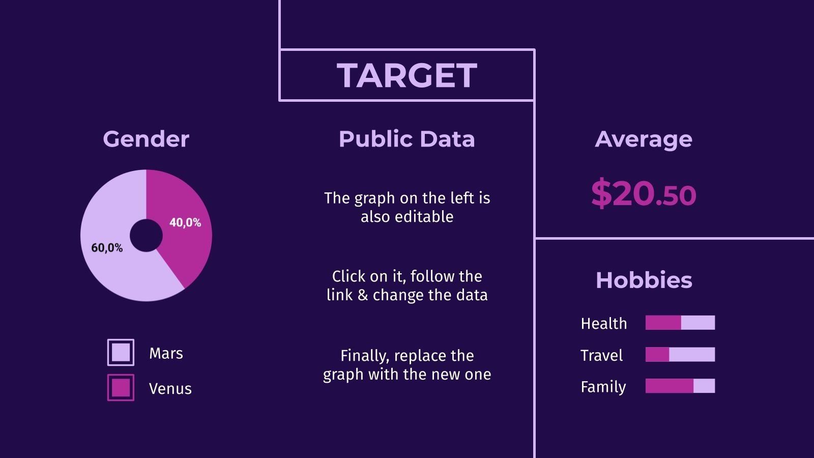



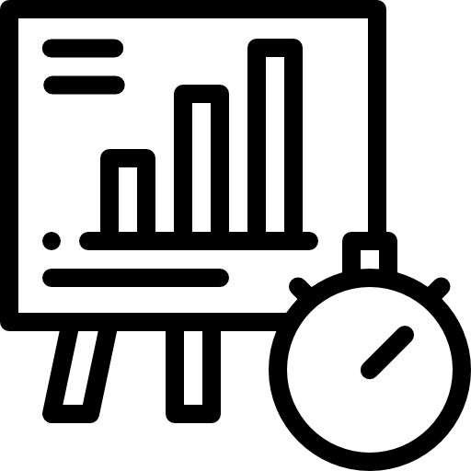
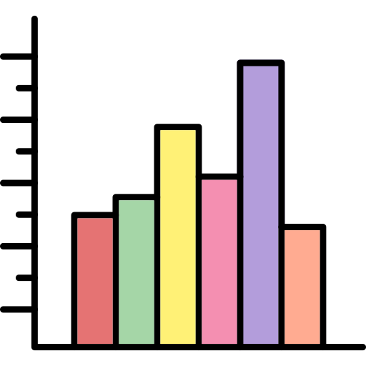



Data Visualization When and How to use?
Predictive Analytics
Real-time Dashboard
3D Visualizations
Time-series Chart
Histograms
Heatmaps
Bubble Chart
Geospatial Maps

Slide 8


Data Visualization When and How to use?
Predictive Analytics
Real-time Dashboard
Alert and Notification
3D Visualizations
Time-series Chart
Histograms
Heatmaps
Bubble Chart
Geospatial Maps

Slide 9

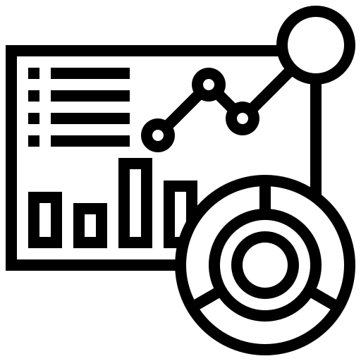
Data Visualization When and How to use?
Predictive Analytics
Real-time Dashboard
Alert and Notification
3D Visualizations
Time-series Chart
Histograms
Heatmaps
Composite Dashboard
Bubble Chart
Geospatial Maps

Slide 10
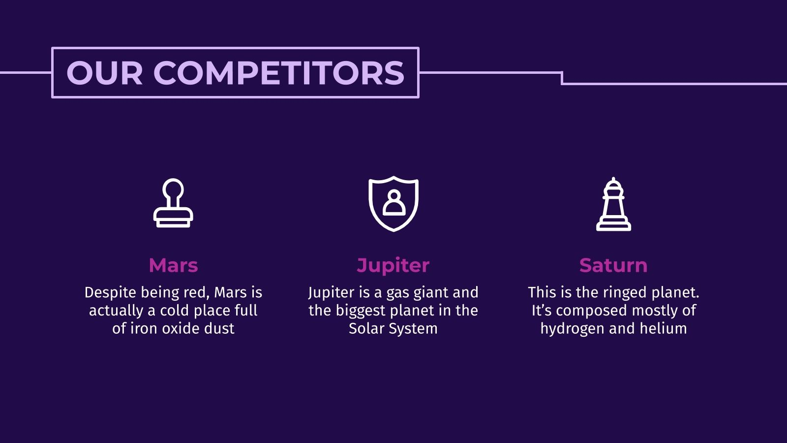
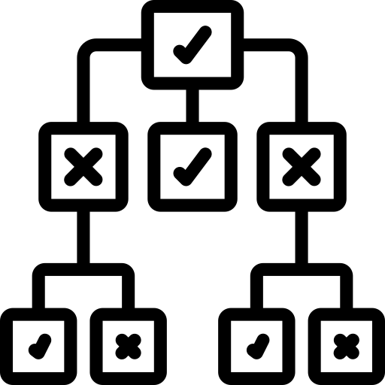
The Role of Real-time Visual Monitoring in Decision Support
Faster
Decision-making

Slide 11
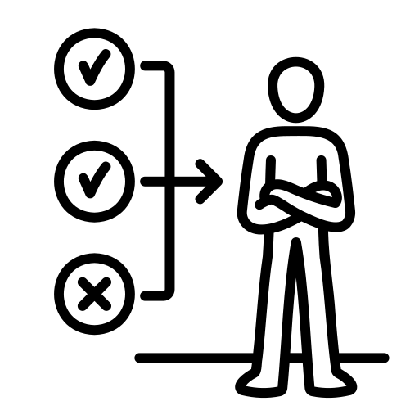
The Role of Real-time Visual Monitoring in Decision Support
Faster
Decision-making
Improved
Decision-making

Slide 12

The Role of Real-time Visual Monitoring in Decision Support
Faster
Decision-making
Improved
Decision-making
Customize
View

Slide 13

The Role of Real-time Visual Monitoring in Decision Support
Faster
Decision-making
Improved
Decision-making
Customize
View
Feedback
Loop

Slide 14

The Role of Real-time Visual Monitoring in Decision Support
Faster
Decision-making
Improved
Decision-making
Customize
View
Feedback
Loop
Data-Driven
Decision

Slide 15

The Role of Real-time Visual Monitoring in Decision Support
Faster
Decision-making
Improved
Decision-making
Customize
View
Feedback
Loop
Data-Driven
Decision
Enhanced
Customer Satisfaction

Slide 16
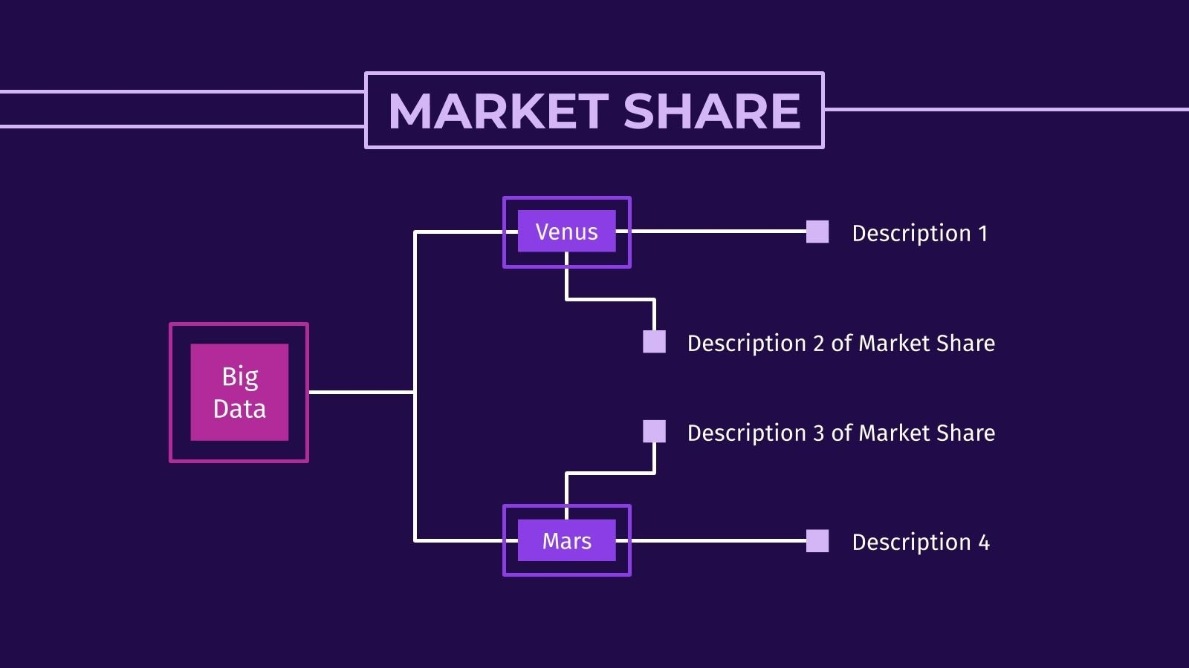

Harnessing Visual Analytics for informed Decision-making
Trends And Future Direction
Complexity
Comprehend the data's nuances
Gain a deeper understanding of underlying patterns
Trends

Slide 17

Harnessing Visual Analytics for informed Decision-making
Trends And Future Direction
Complexity
Comprehend the data's nuances
Gain a deeper understanding of underlying patterns
Trends
Machine learning, predictive modeling, and anomaly detection
Integrate advanced analytics techniques
Analytics Integration

Slide 18
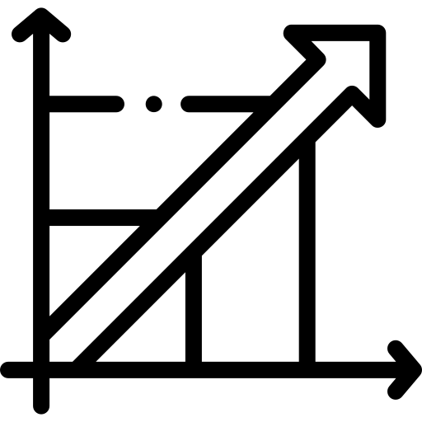
Harnessing Visual Analytics for informed Decision-making
Trends And Future Direction
Complexity
Scalability
Comprehend the data's nuances
IoT tools must handle massive datasets.
Gain a deeper understanding of underlying patterns
Ensure accurate interpretations as IoT device numbers grow.
Trends
Future
Machine learning, predictive modeling, and anomaly detection
Integrate advanced analytics techniques
Analytics Integration

Slide 19
Harnessing Visual Analytics for informed Decision-making
Trends And Future Direction
Complexity
Scalability
Comprehend the data's nuances
IoT tools must handle massive datasets.
Gain a deeper understanding of underlying patterns
Ensure accurate interpretations as IoT device numbers grow.
Trends
Future
Machine learning, predictive modeling, and anomaly detection
Advanced IoT platforms offer multilayer geo charts.
Integrate advanced analytics techniques
Cross filtering and geospatial contextualization enable quick IoT data analysis
Analytics Integration
Multilayer

Slide 20

THANK YOU
DO YOU HAVE ANY QUESTION?

