Slide 1
MAVEN TOYS SALES ANALYSIS
End-to-end data pipeline project
By Benas Baranovskis
2026

Slide 2
PROJECT OVERVIEW
Business model: Maven toys is a toys retail company in Mexico, which is operating stores in different cities and locations and it sells different toy products.
The data: 5 tables. The sales table has around 829k rows and stores past sale data from January 2022 to September 2023.
THE MAIN GOAL: To understand what business decisions they could derive from their (past) data, which might convert to more revenue and profit in the future.
Secondary goal: To create a structure for data automatization process, so that the results could be delivered more efficiently and more sustainably.

Slide 3
DATA PIPELINE AND RESULT DELIVERING PROCESS
Raw data
(CSV)
INGESTION AND TRANSFORMATION
(Python|Pandas|SQLAlchemy)
STORAGE
(local PostgreSQL)
DATA MODELING, TESTING AND TRANSFORMATION
(Dbt)
DELIVERABLES
(PBI Dashboard, Excel Report, Pptx/pdf report)
VISUALIZATION
(Power BI, Excel, Power point)

Slide 4
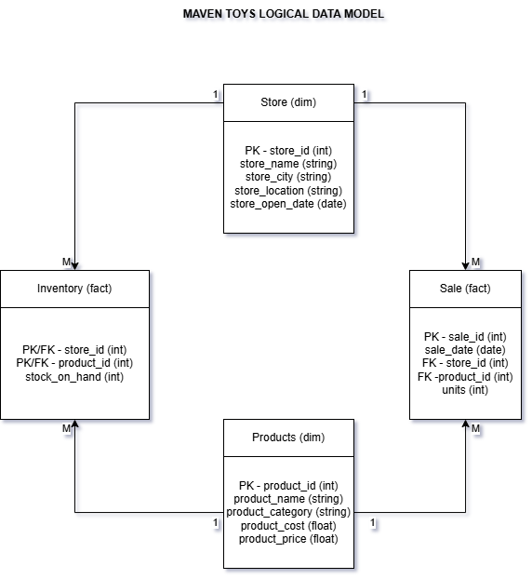
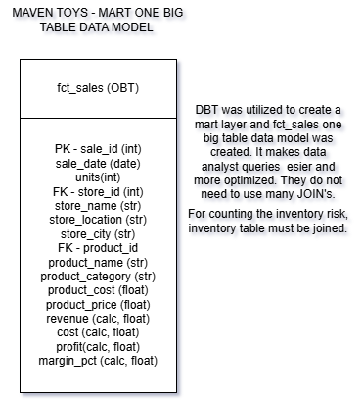
DATA MODEL – From star schema to one big table
A Star schema was ingested, which was big and inefficient. Layered with Dbt and created an OBT model with automatic metric counting. 4 more OBT models where created in marts layer.

Slide 5
OTHER TECHNICAL NUANCES
For replication of production environment Docker was implemented. 3 different containers where used.
Airflow was used for pipeline orchestration.
Dbt was used for model testing and dveloping a semantic layer.

Slide 6
KEY FINDINGS

Slide 7
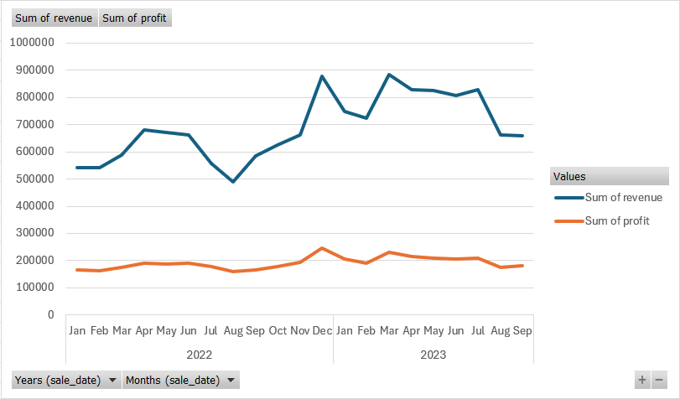
KF 1– REVENUE TRENDS
A spike of revenue and profit during December can be seen. This is due to Christmas holiday season. In April its Día del Niño (Children‘s day) in Mexico.
2023 consistently stronger than 2022 - growth trend confirmed.
Profit margin stable at ~25% despite revenue fluctuations.

Slide 8
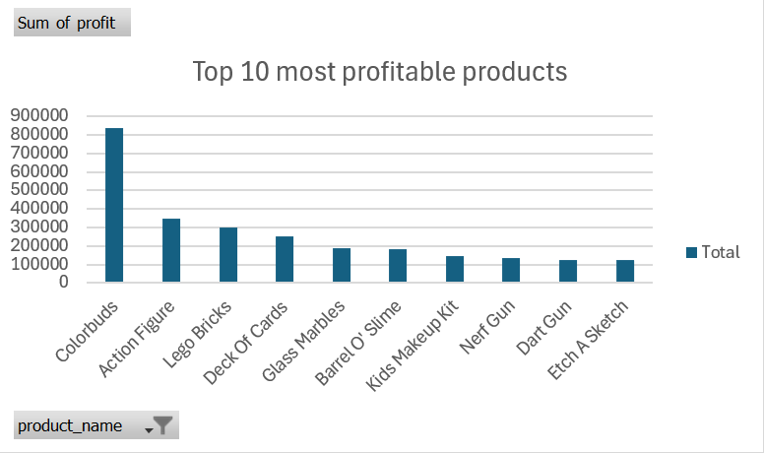
KF 2 – PRODUCT PERFORMANCE
Colorbuds (electronics) are making the most profit during the period. (Cost 6.99, Retail Price 14.99)
Other products might need more marketing or discounts. Revenue generation must be diversified to lower the supply chain risks.
Limitation: No marketing performance data.

Slide 9
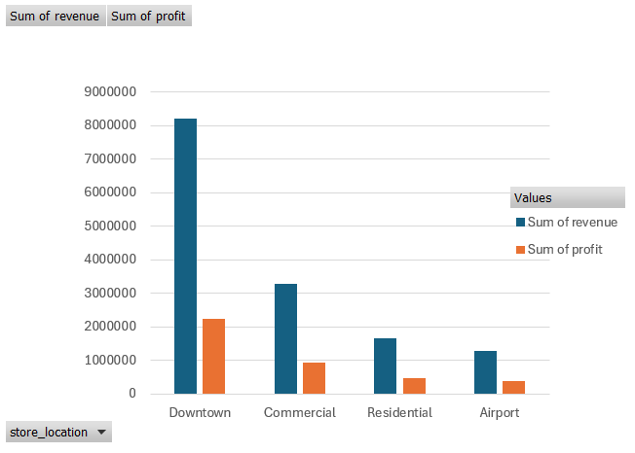
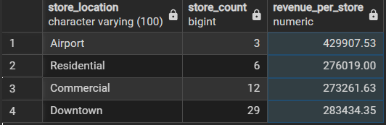
KF 3 – STORE LOCATION INSIGHTS
Downtown location generates the most revenue and profit.
In Downtown 29 stores in Airport 3 stores.
Airport location has a better performance on average per store.
Limitation: No store operating costs data.

Slide 10
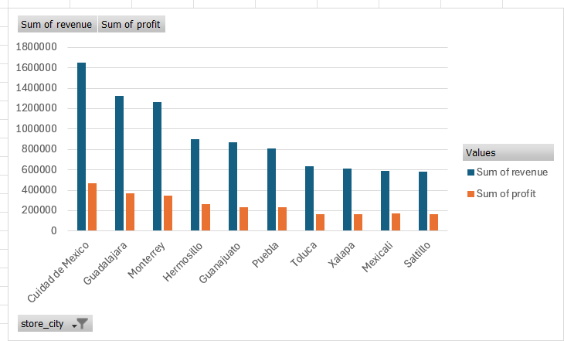
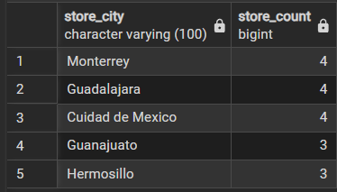
KF 4 – PERFORMANCE BY CITY
Ciudad de Mexico (4 stores) the capital city generates the most revenue and profit. More population means more profit.
More stores in the city means more revenue from the city. Altough population matters too.

Slide 11
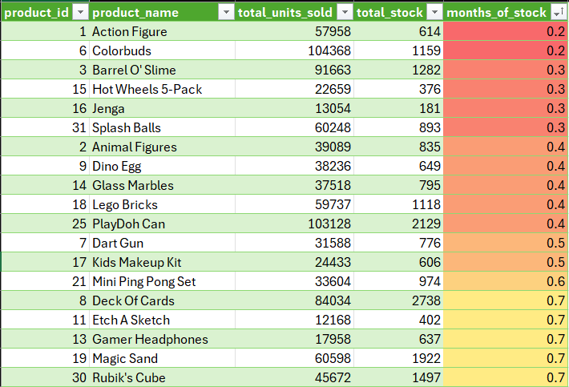
KF 5 – INVENTORY RISK
Products at inventory risk: Action figure and Colorbuds.
Both are sold the best.
Therefore it is better to stock up on them before holiday season.

Slide 12

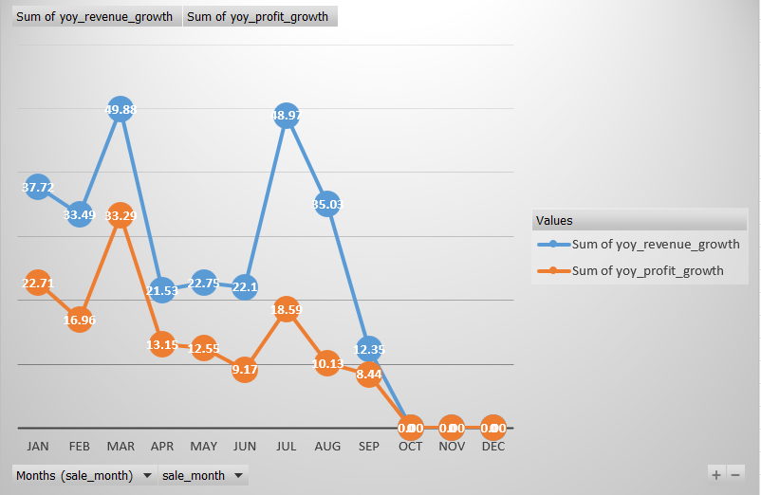
KF 6 – YOY MONTHLY GROWTH
March and July had the greatest YoY monthly growth.
New Questions: Why July and March had greatest monthly YoY? Which products where the drivers of this? In which locations those sales wehere made?

Slide 13
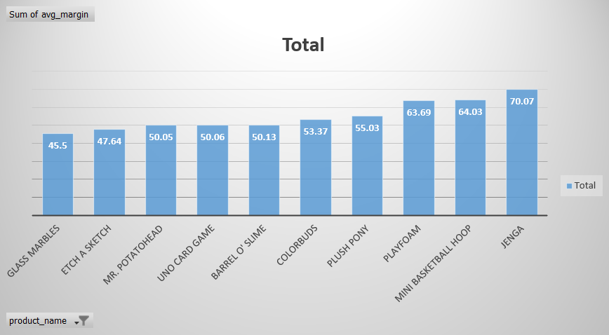
KF 7.1 – PRODUCT PROTFOLIO MATRIX
JENGA has a 70% profit margin.
COLORBUDS has 53% profit margin.

Slide 14
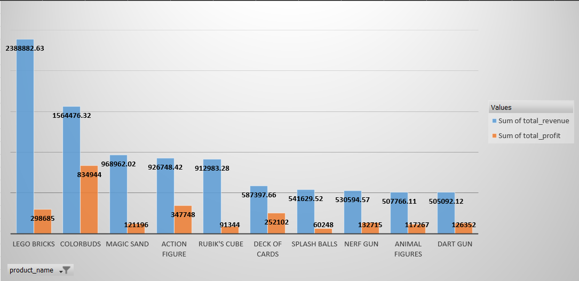
KF 7.2 – PRODUCT PROTFOLIO MATRIX
Lego Bricks, magic sand, rubik’s cube has a low profit margin, but generating a lot of profit.
Seeing this trend we developed a case study.

Slide 15
CASE STUDY – PRICING STRATEGY PROPOSAL
We developed a case study report which is attached to the documents in pdf format.
In this case report a pricing analysis and pricing change and expermentation is proposed.

Slide 16
RECOMMENDED BUSINESS DECISIONS
PRODUCT: Diversify the revenue and profit generation over different products to mitigate the supply chain risks.
PRICING: Experiment with pricing to develope better margins for different products to make greater profit.
SCALING: Get store operating cost data and analyze if it would be profitable to open more stores at Airport locations. Open more shops in Ciudad de Mexico.
INVENTORY: Greatest inventory risks are at December and April, check inventory before those months and stock up if needed. Stock up on Colorbuds and Action figures.

Slide 17
FURTHER ANALYSIS POSSIBILIETES
Analyze marketing performance of Lego bricks and other products.
Analyze operation cost data to understand how to make more profit.
Analyze the main competitors in different locations.
Think about E-commerce capabilities.
New Questions: Why July and March had greatest monthly YoY? Which products where the drivers of this? In which locations those sales wehere made?

Slide 18
CONCLUSION – WHAT HAVE I LEARNT?
I have learnt to ingest data with Python.
I have used Dbt to build staging, intermediate, mart layers and turned inefficient star schema into one big table with pre-calculated metrics.
Produced a Power BI dashboard, excel report, pptx/pdf report with business decision suggestions.
Owned all the process from ingestion to deliverables.
Airflow implementation for pipeline job orchestration.
Docker implemented.
Better understanding of data warehousing (Imon to Kimball to OBT).
How to conduct an end-to-end data pipeline.
WHAT COULD BE IMPROVED:
Airbyte to automate ingestion.
New fake sales data created and ingested.

Slide 19
What I would have done differently?
I would spend more time at first to understand the business case. I would develop a proposal of solutions at first.
I would find the business questions and business problems first and then develop the technical solutions for it. (Business question -> Do we need a dashboard for it?)
As now I understand the data team flow. I would better understand the requirements and ask better questions about them.

