Slide 1
Benbellah Owino Oruko
Aviation accidents report

Slide 2
Objectives
Which aircraft is the safest?
Identify the safest and most dangerous countries & locations to fly over.
The most common type of accidents so as to invest in advance in preventive measures

Slide 3
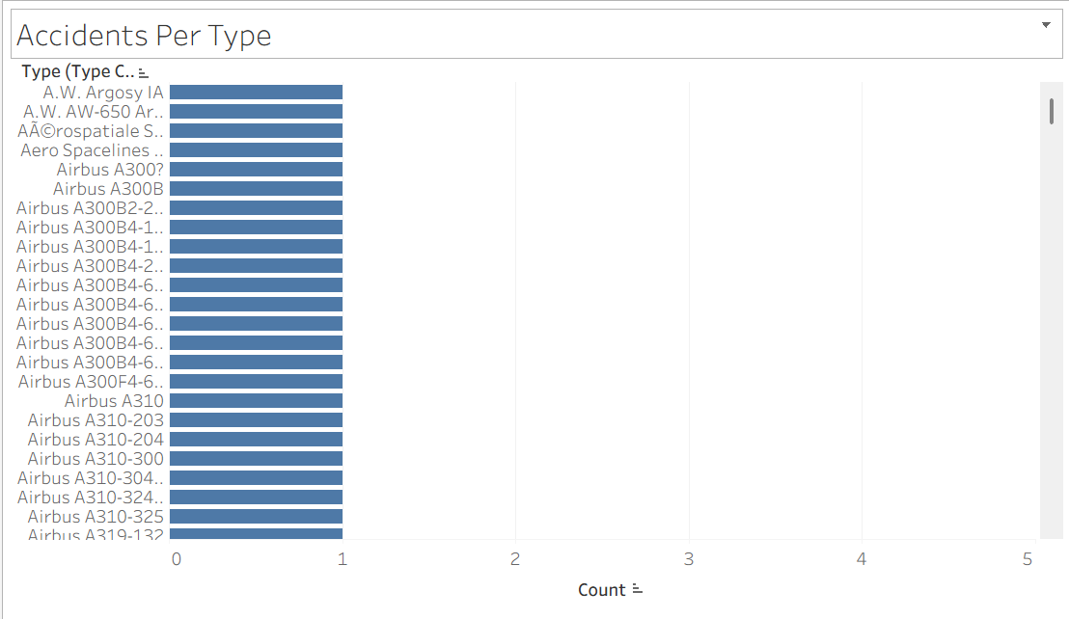
Aircraft types with lowest number of accidents

Slide 4
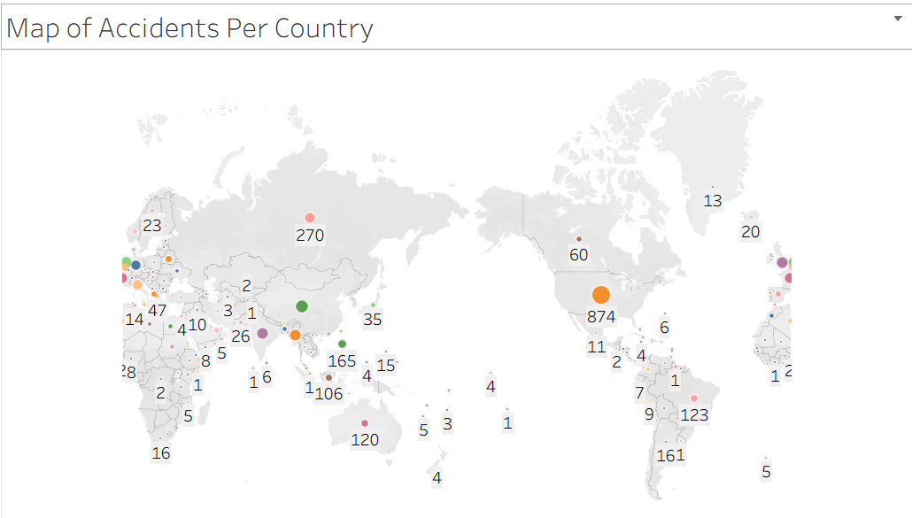
Map of accidents per country

Slide 5
Conclusions
1 - The airbus seems to have alot of aircrafts with involved in the least crashes. I'd advise the company to invest in Airbus aircrafts due to their safety and wide range of applications.
According to the map, America and Europe have the most accidents. However, most accidents in Europe occured during WWII. In america however, the accidents in the 21 century were still many. While we can conclude that accidents in this regions are great, we have to consider that these regions expirience alot of airtraffic so these numbers are expected.
2- According to the map, America and Europe have the most accidents. However, most accidents in Europe occured during WWII. In america however, the accidents in the 21 century were still many. While we can conclude that accidents in this regions are great, we have to consider that these regions expirience alot of airtraffic so these numbers are expected.
African countries are underrepresented in the data so matbe the company can invest in the continent.

Slide 6
Objectives cont.
3- The most common type of accident is the A1, which means the accident had a high fatality rate(the data shows most fatalities are in this category). This means the company has to invenst alot in airplane servicing and ensure they follow safety regulations and advise to the later.

