Slide 1
Mixtures Workshop Figures

Slide 2
Unsupervised Methods

Slide 3
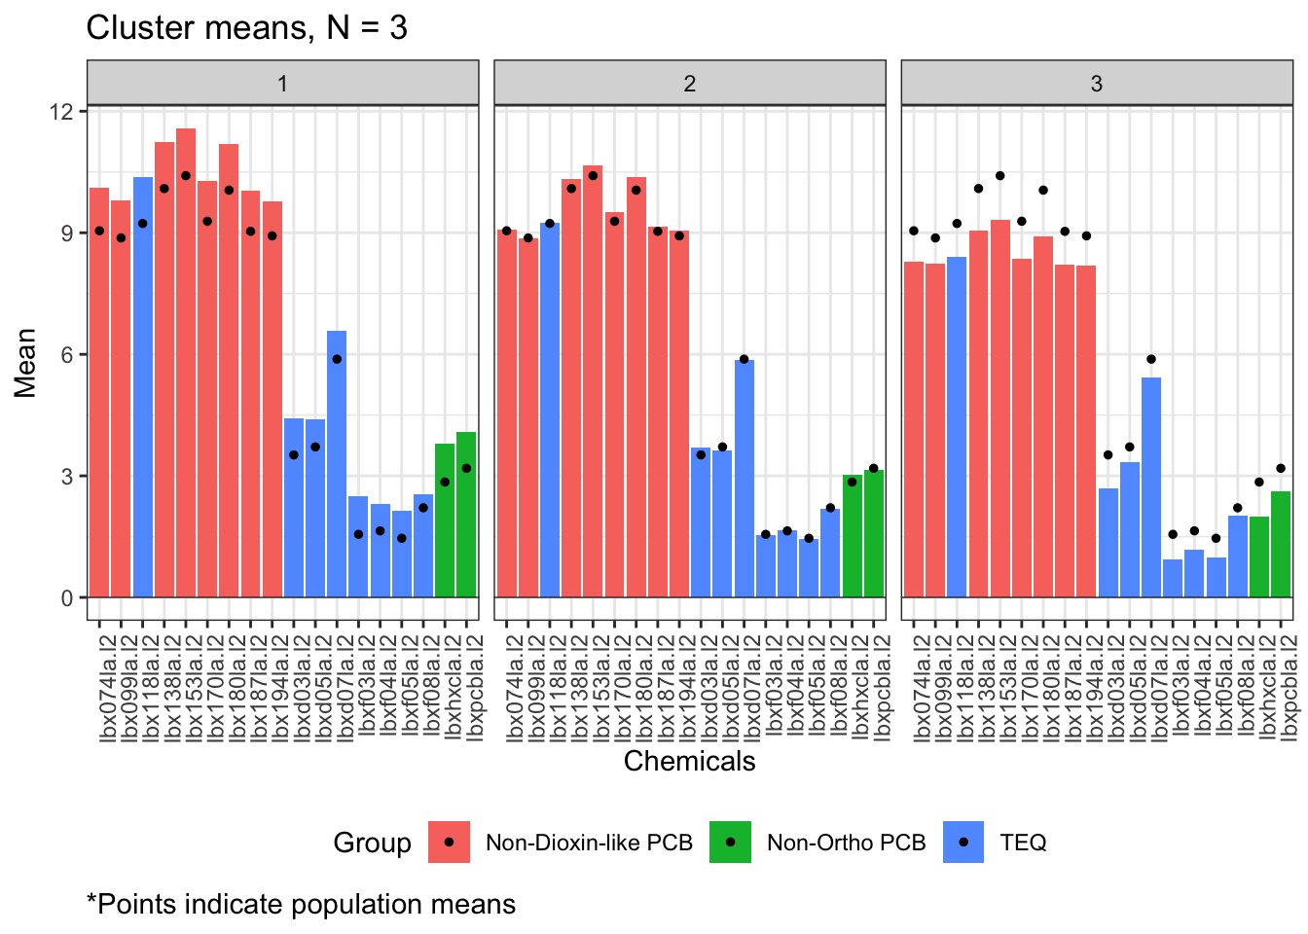
K-means clustering

Slide 4
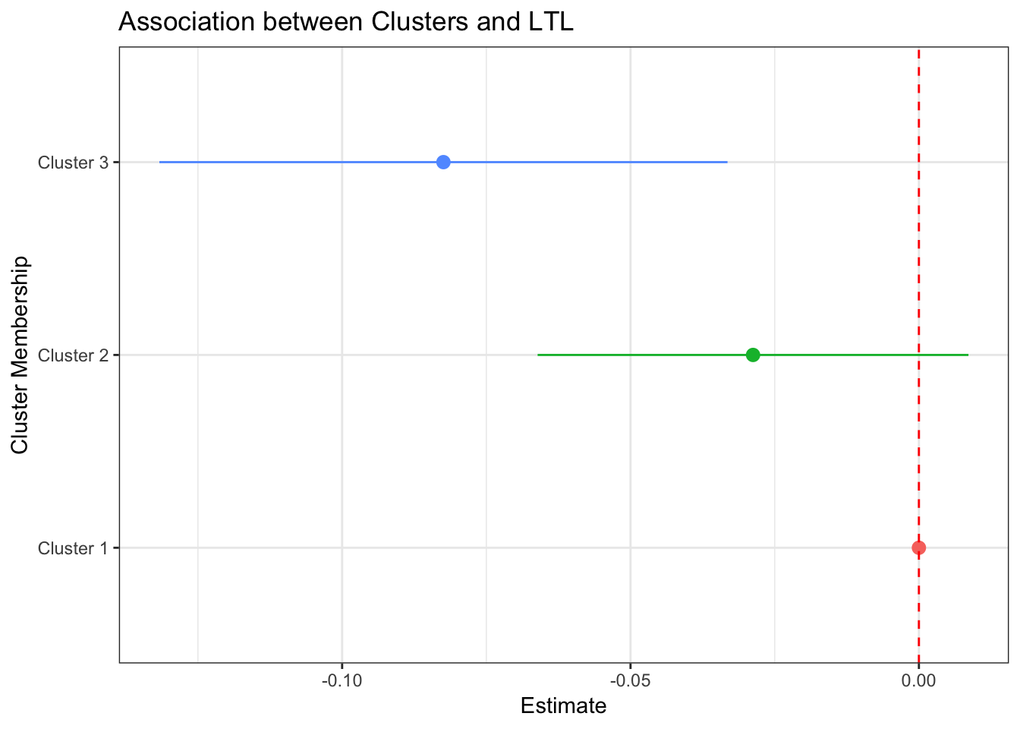
K-means clustering

Slide 5
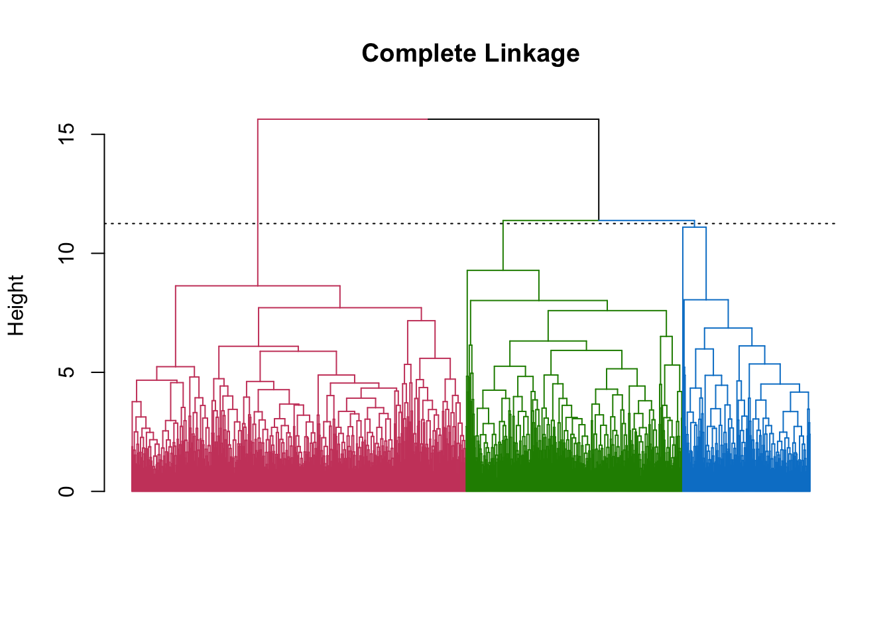
Hierarchical clustering

Slide 6
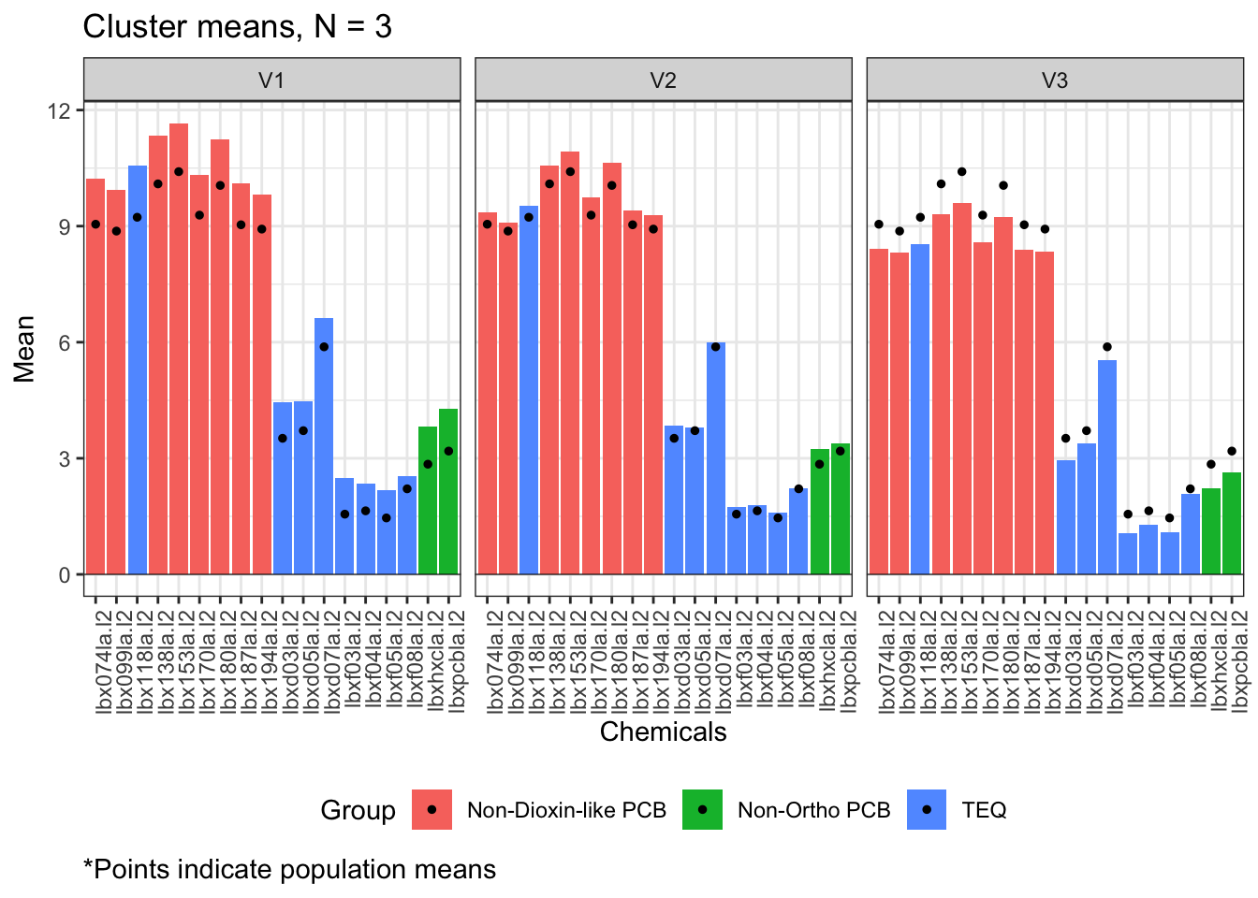
Hierarchical clustering

Slide 7
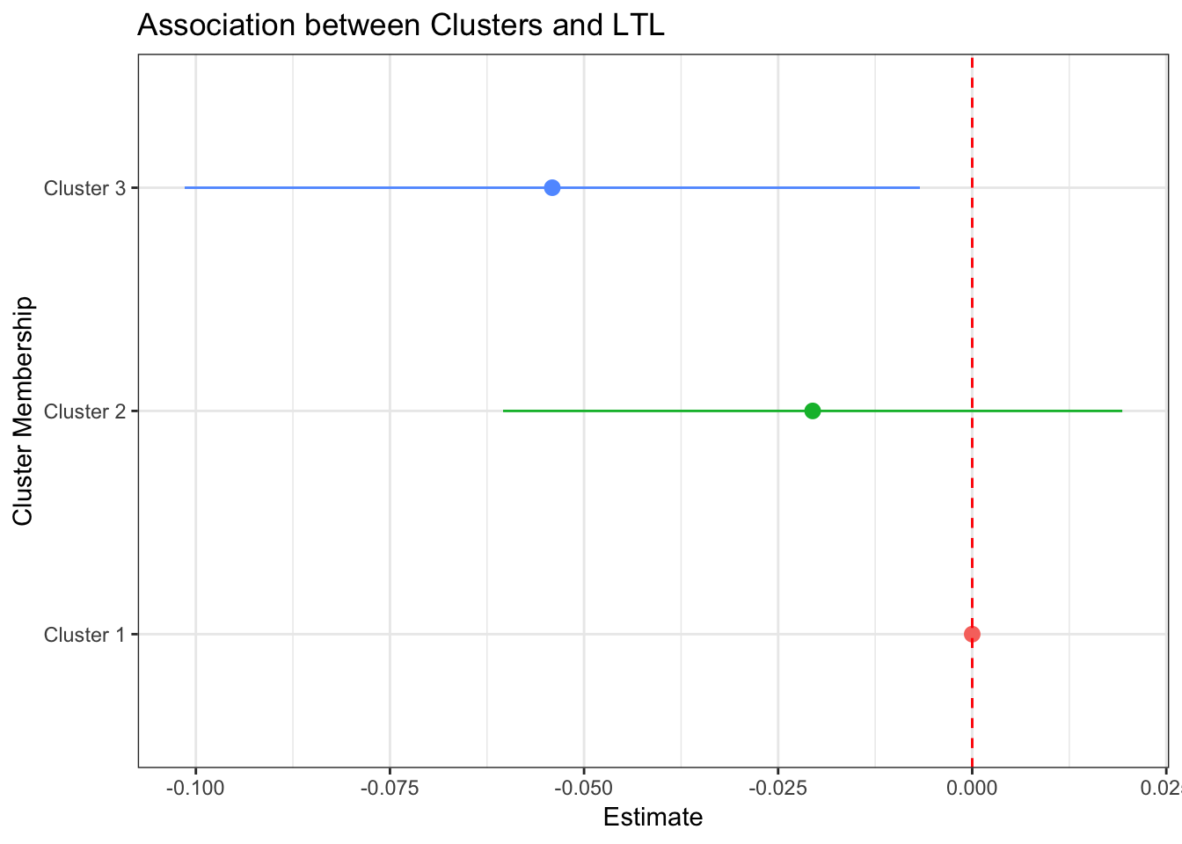
Hierarchical clustering

Slide 8
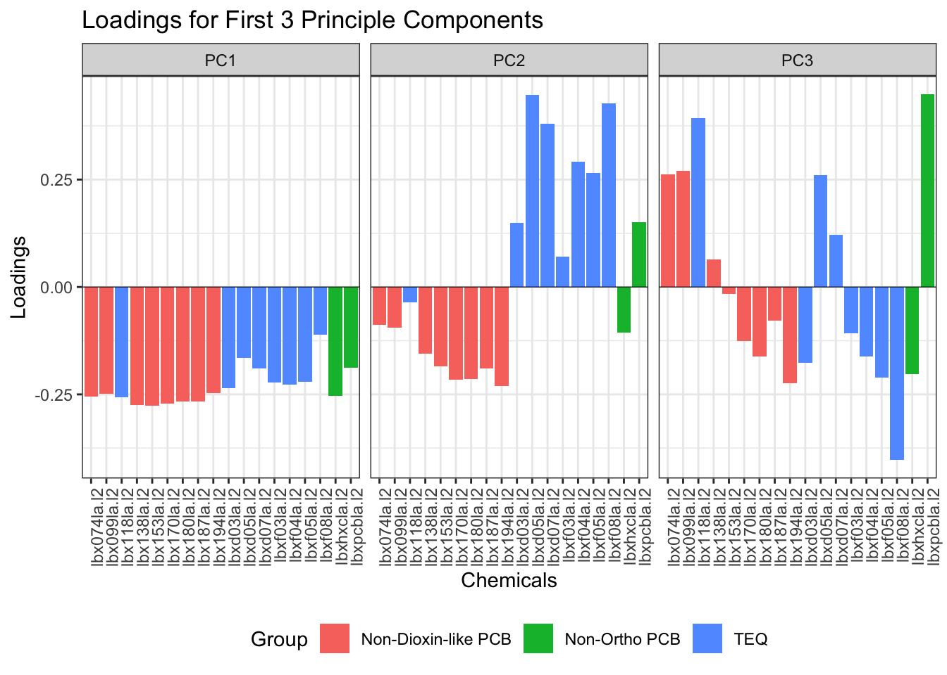
PCA

Slide 9
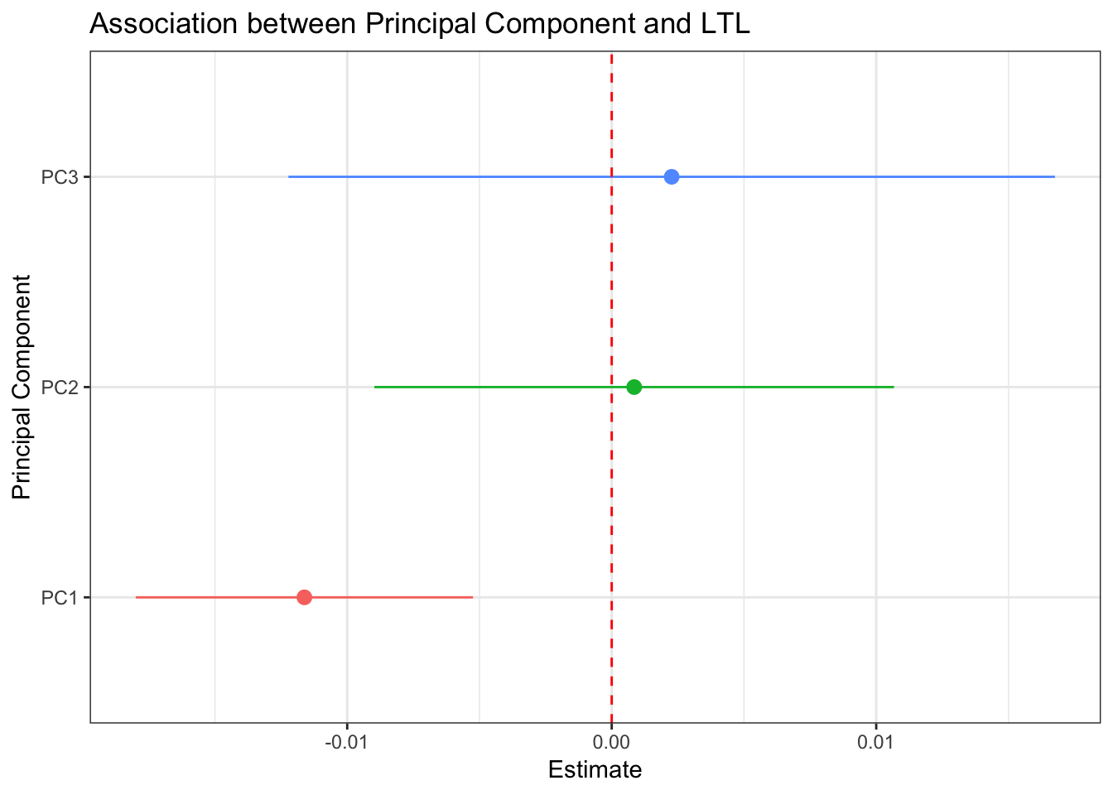
PCA

Slide 10
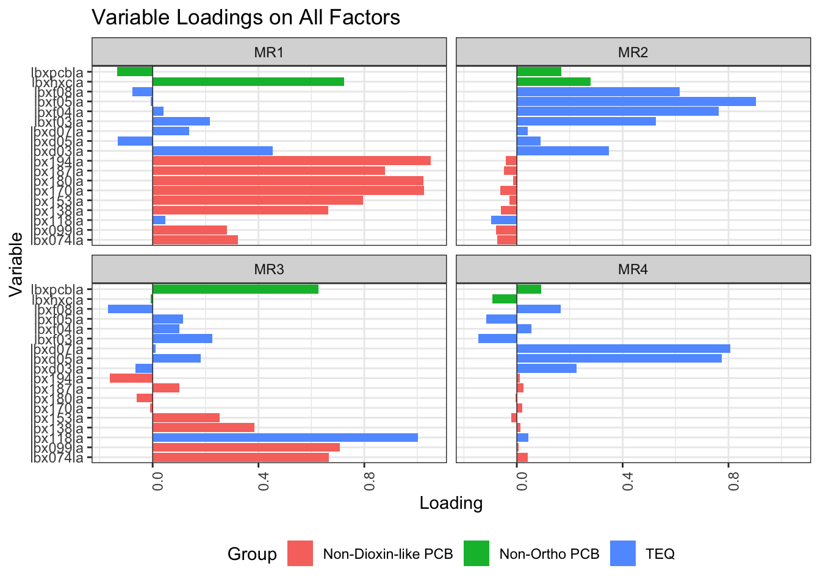
Factor analysis

Slide 11
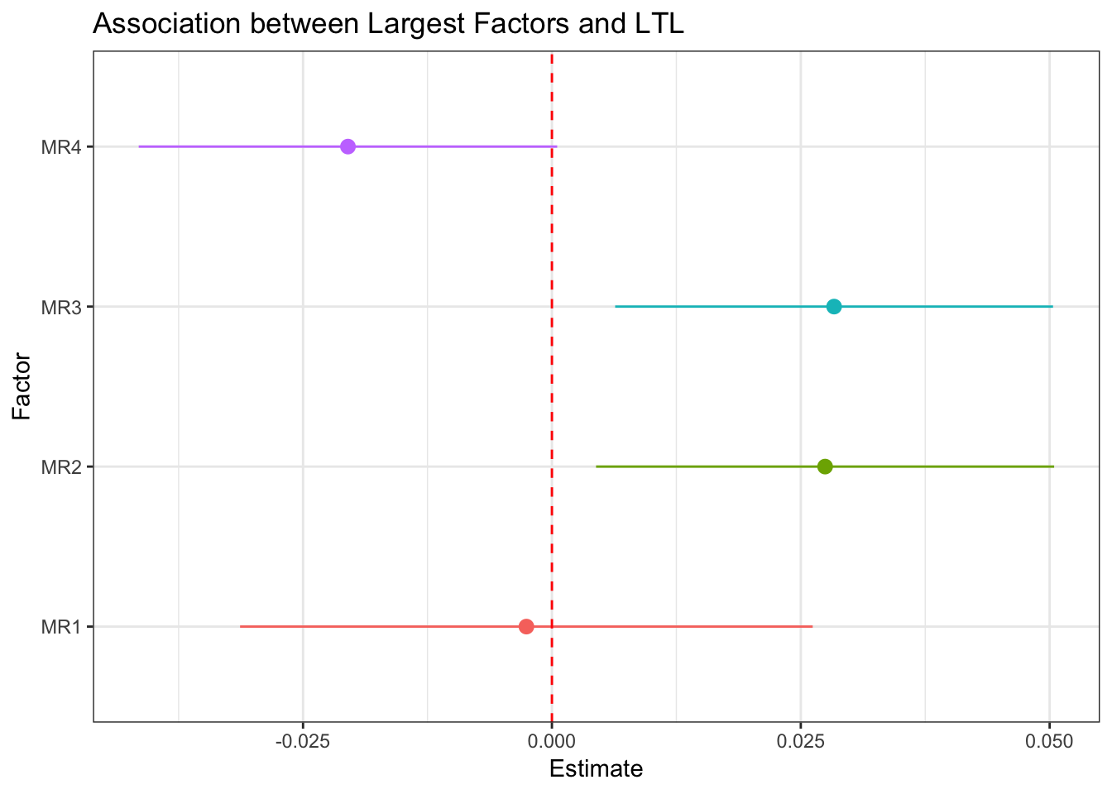
Factor analysis

Slide 12
Variable Selection Methods

Slide 13
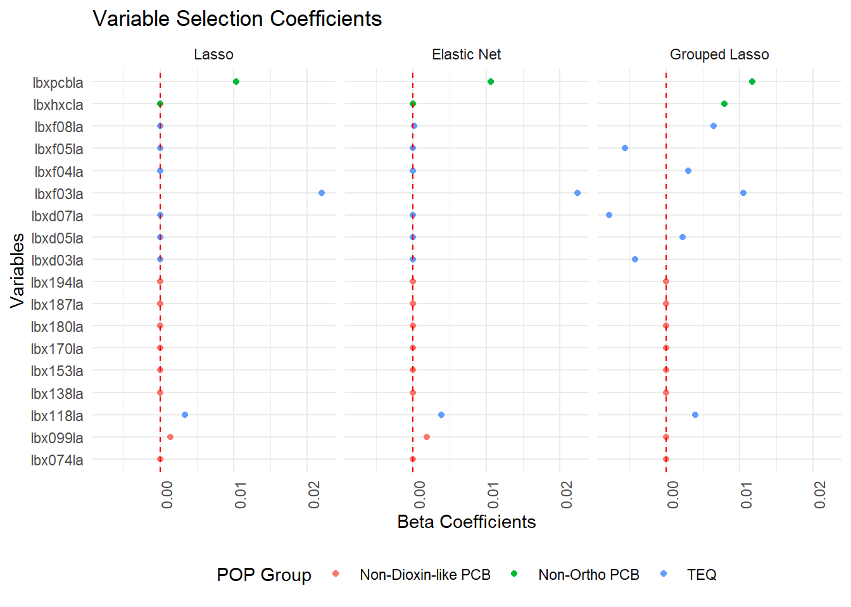

Slide 14
BKMR

Slide 15
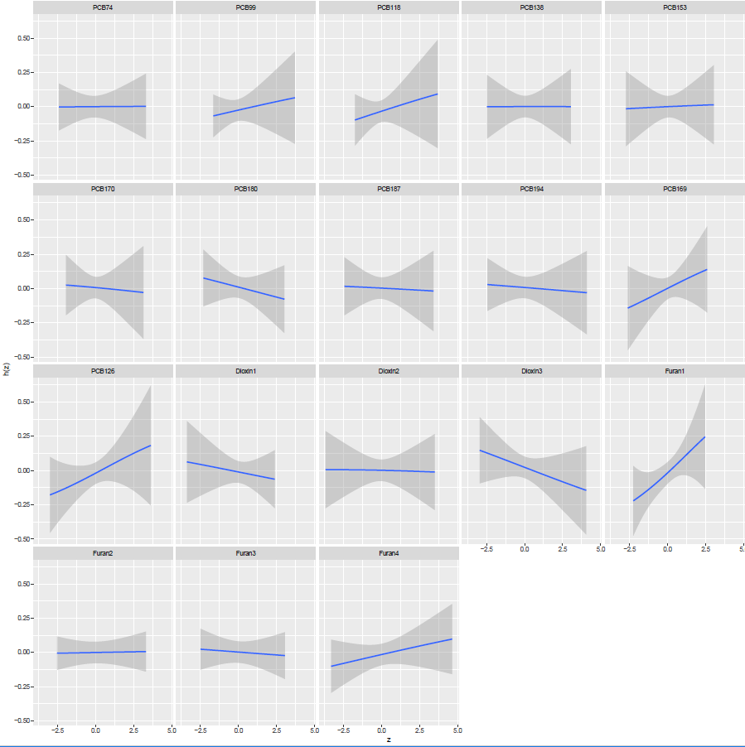
BKMR

Slide 16
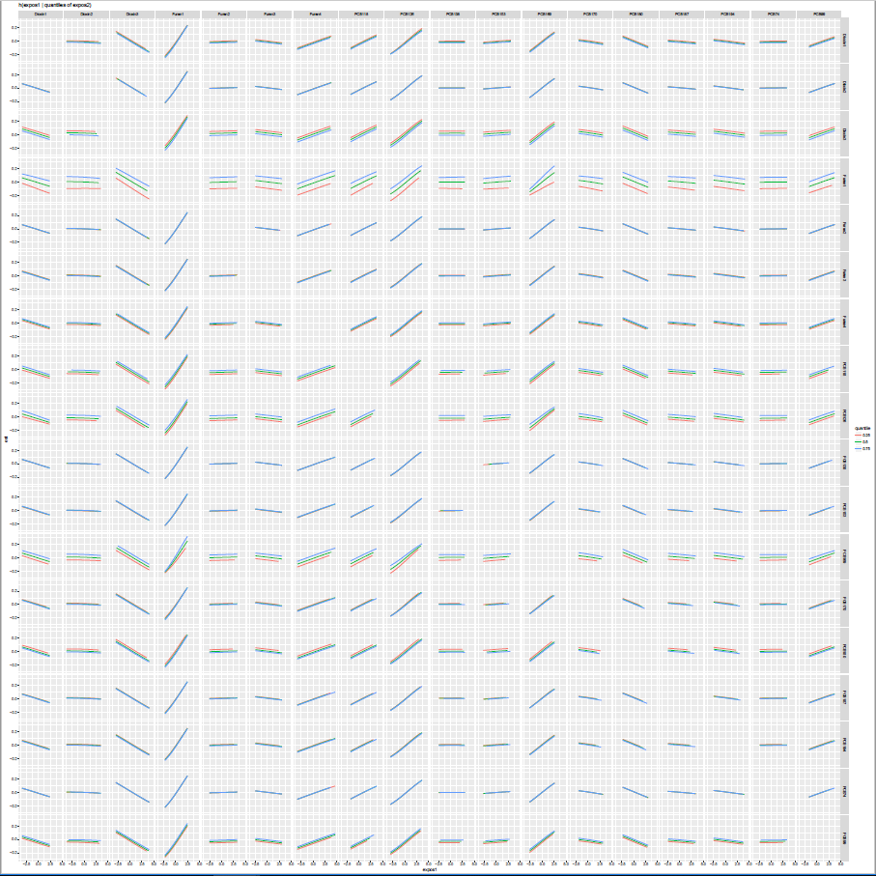
BKMR

Slide 17
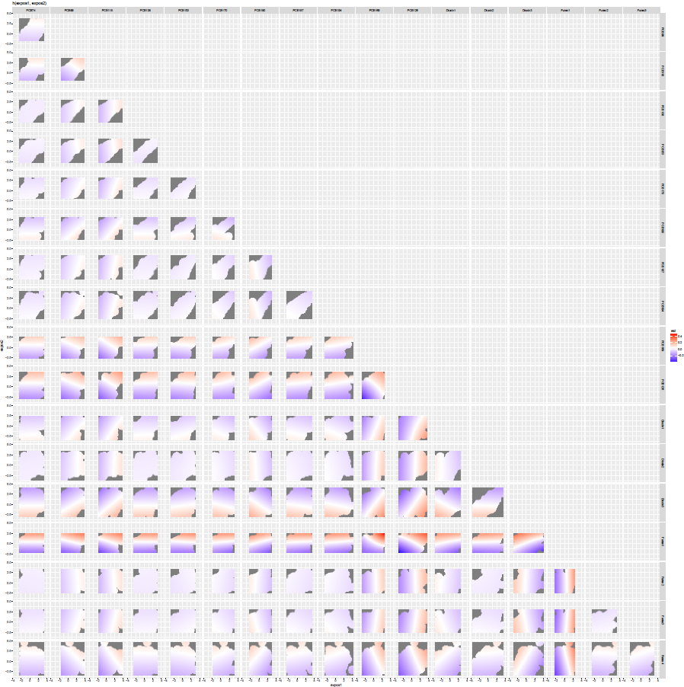
BKMR

Slide 18
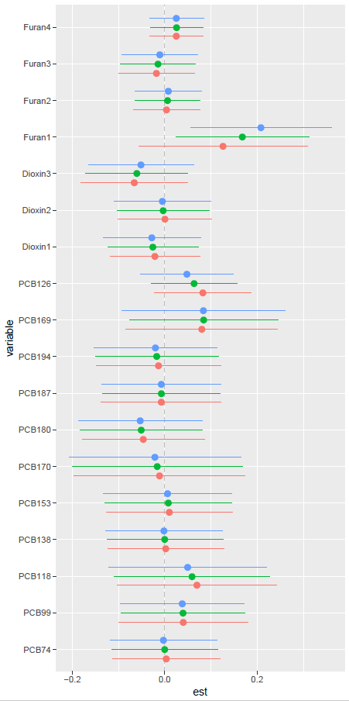
BKMR

Slide 19
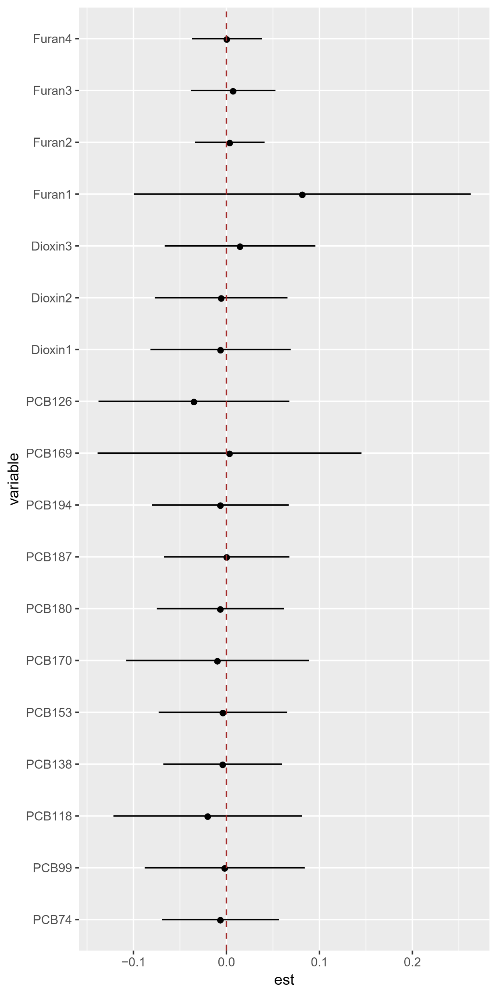
BKMR

Slide 20
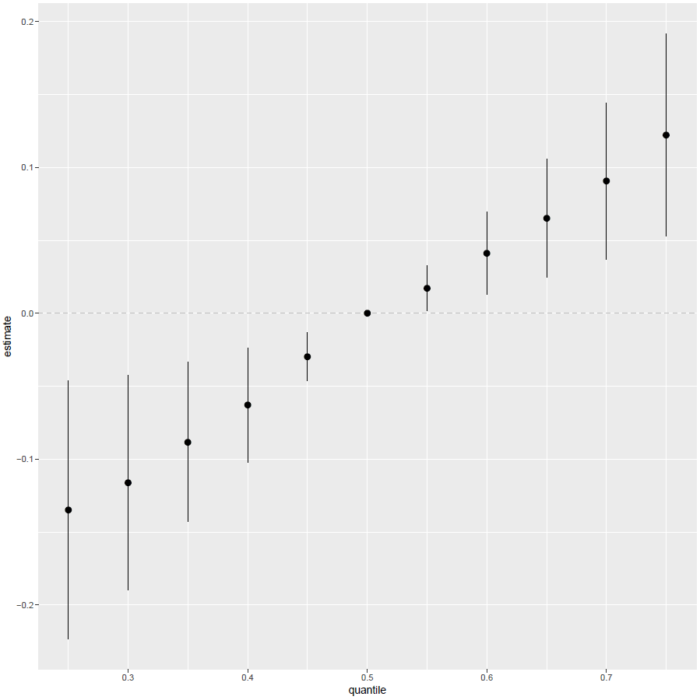
BKMR

Slide 21
WQS

Slide 22
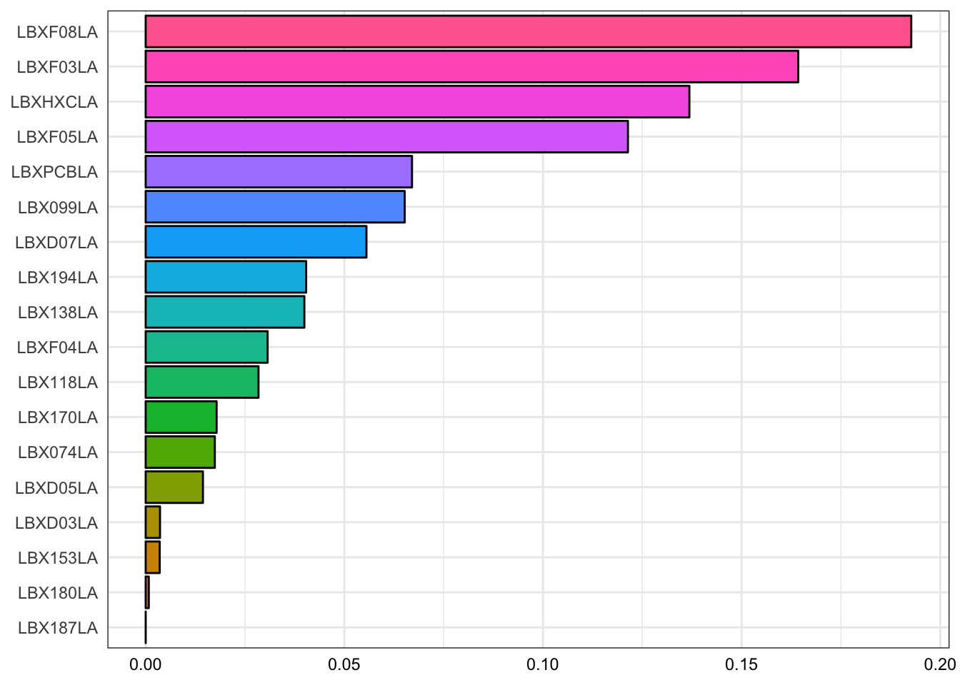
WQS

Slide 23
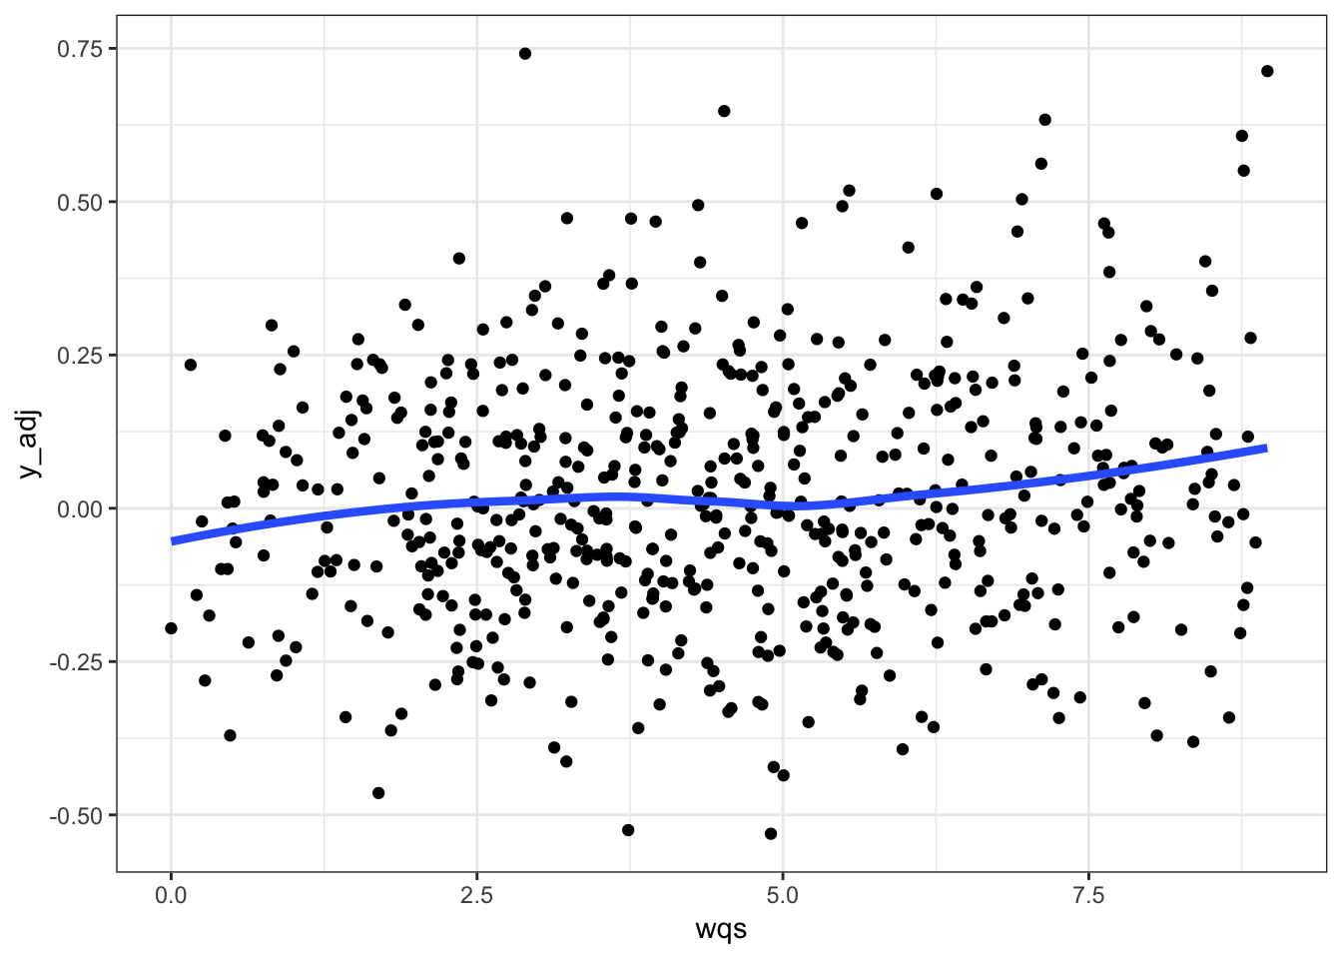
WQS

