Slide 2
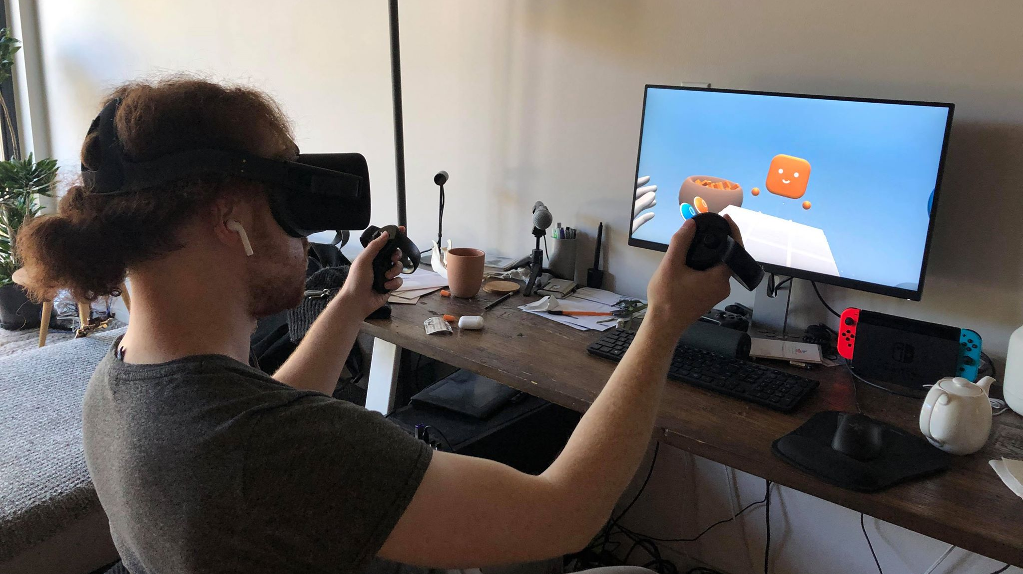
User Feedback Session #1
Comfort
Table initially too high
All table motion in all directions, not just up/down
Visual Design
Get rid of glowing orb below legs
Hard to read the score (rotate towards head)
Move containers even with table
Cubes disappear too slowly when dropped
Add Ambient Occlusion.
Confusing that the reset button resets the score. Put the button under the score indicator
Add initial “Pick me up” Text near your container at the start of the game.
Z-fighting issue on board geometry
Avatar
Faces (at least blinking)
More realistic motions / floating animation
Haptics
When touching objects
Gameplay
Allow throwing shapes onto the table
Communicate who’s turn it is
Make it fun/sad when you lose. “Incredibly disappointing when I win that nothing happens”
Block placing pieces while its not your turn (make shapes turn transparent when near the board)
Particles
Poof particle when object drops on the ground
Sparkles when hover game-piece over board
UX
Hands should push pieces around in container
Handle should move to hand when changing table height
Let the player throw objects at the AI

Slide 3
User Feedback Session #1
Comfort
Table initially too high
All table motion in all directions, not just up/down
Visual Design
Get rid of glowing orb below legs
Hard to read the score (rotate towards head)
Move containers even with table
Cubes disappear too slowly when dropped
Add Ambient Occlusion.
Confusing that the reset button resets the score. Put the button under the score indicator
Add initial “Pick me up” Text near your container at the start of the game.
Z-fighting issue on board geometry
Avatar
Faces (at least blinking)
More realistic motions / floating animation
Haptics
When touching objects
Gameplay
Allow throwing shapes onto the table
Communicate who’s turn it is
Communicate who won/lose/tie
Make it fun/sad when you lose. “Incredibly disappointing when I win that nothing happens”
Block placing pieces while its not your turn (make shapes turn transparent when near the board)
Particles
Poof particle when object drops on the ground
Sparkles when hover game-piece over board
UX
Hands should push pieces around in container
Handle should move to hand when changing table height
Let the player throw objects at the AI

