Slide 1
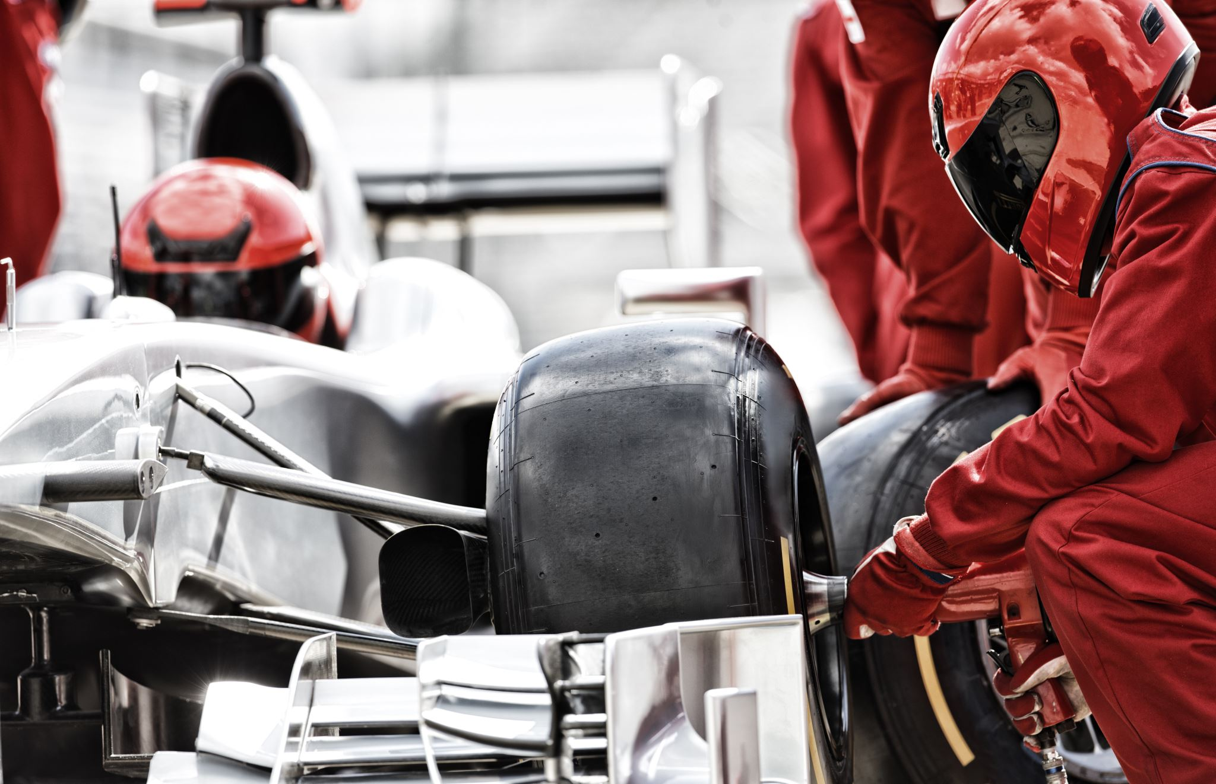
Gyula Go-Kart Track – Web Project
Modern booking system & website
React + Laravel

Slide 2
Project Overview
Website for the Gyula Go-Kart Track
Online booking and reservation system
Modern, fast, and user-friendly design
Scalable backend with database support

Slide 3
Technology Stack
Frontend: React
Backend: Laravel (REST API)
Database: MySQL / PostgreSQL
Authentication and role management

Slide 4
Main Features
Online booking with time slots
User registration and login
Admin panel for track management
Booking confirmation and history

Slide 5
Booking Flow
User selects date and time
Available slots are shown
Reservation saved to database
Email / on-screen confirmation

Slide 6
Database Concept
Users table (customers, admins)
Bookings table (date, time, status)
Tracks / sessions table
Relationships between users and bookings

Slide 7
Team & Work Distribution
Bence – Frontend (React UI, booking pages)
Márk – Backend (Laravel API, business logic)
Gyuri – Database design & deployment
Shared responsibility: testing & documentation

Slide 8
Project Timeline
Planning & design
Frontend and backend development
Database integration
Testing and final deployment

Slide 9
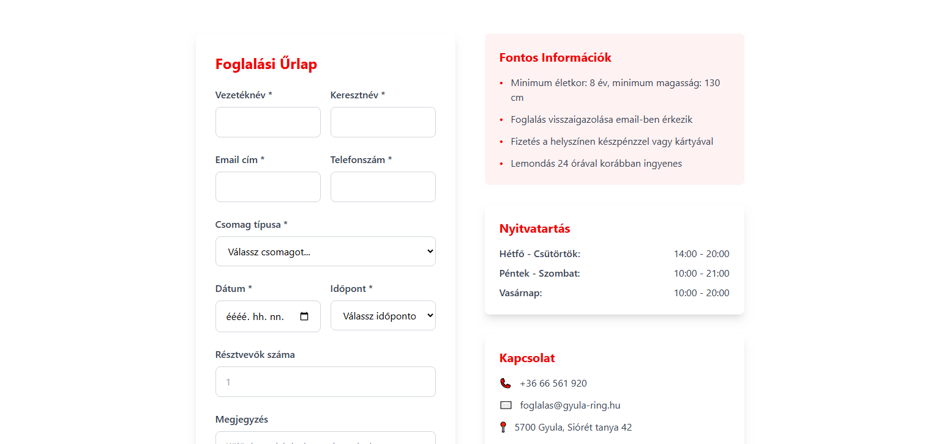
Reservation – Go-Kart Track

Slide 10
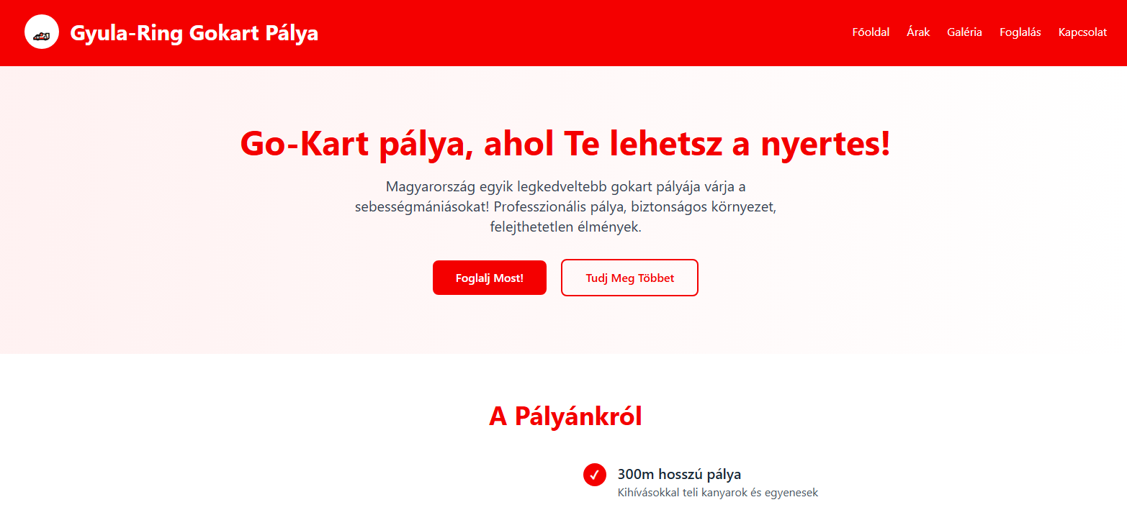
Homepage

Slide 11
Conclusion
Modern web solution for a real business
Easy online booking for customers
Clear team roles and scalable system
Ready for future extensions

