Slide 1
pygame
5. Fejezet dokumentációja: Spriteok

Slide 2
Tartalom
Spriteok
Objektum orientáltság
Weboldal
Github

Slide 3



Felhasznált technológiák

Slide 4
Scroll-animációk
Reszponzív
Felhasznált technológiák

Slide 5
A
A

Slide 6
A
A

Slide 7

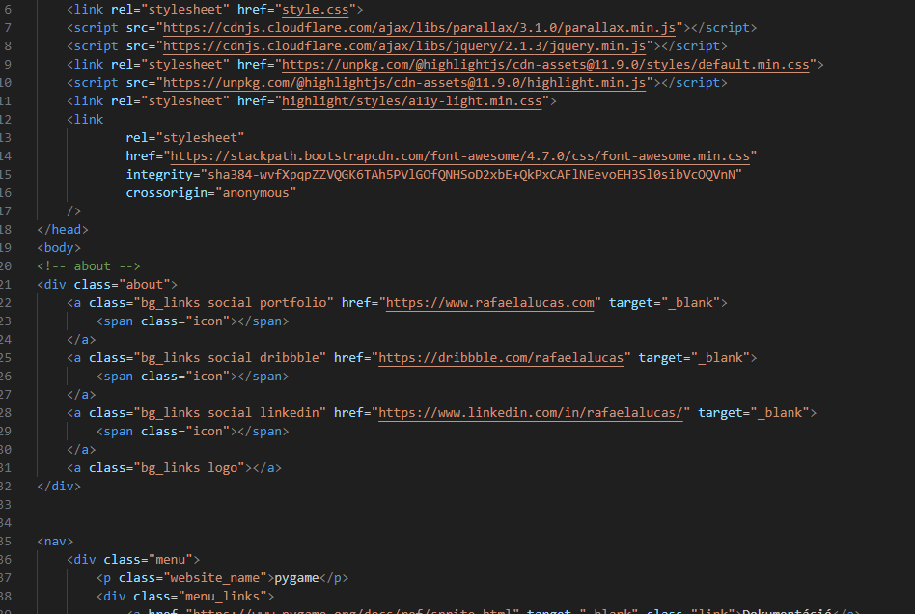
Mi is az a sprite?
In Pygame, a sprite is an object that represents a game element. It can be an image, animation, or any other visual element in a game. Pygame provides a Sprite class that you can use to create and manage sprites efficiently.

Slide 8
Mi is az a sprite?
In Pygame, a sprite is an object that represents a game element. It can be an image, animation, or any other visual element in a game. Pygame provides a Sprite class that you can use to create and manage sprites efficiently.

Slide 9
Mi is az a sprite?
In Pygame, a sprite is an object that represents a game element. It can be an image, animation, or any other visual element in a game. Pygame provides a Sprite class that you can use to create and manage sprites efficiently.

Slide 11
Köszönjük a figyelmet!
Készítette: Kállai Gábor, Szalai Bence, Bánhidai Mátyás

Slide 12

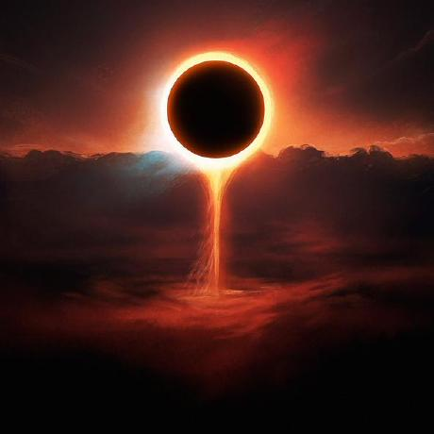


33%
33%
33%

