Slide 1



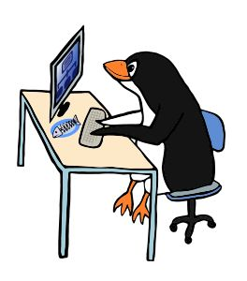
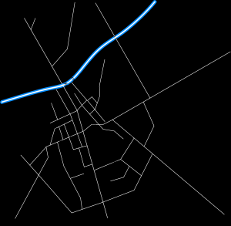
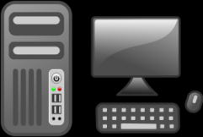

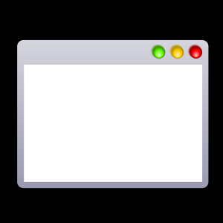


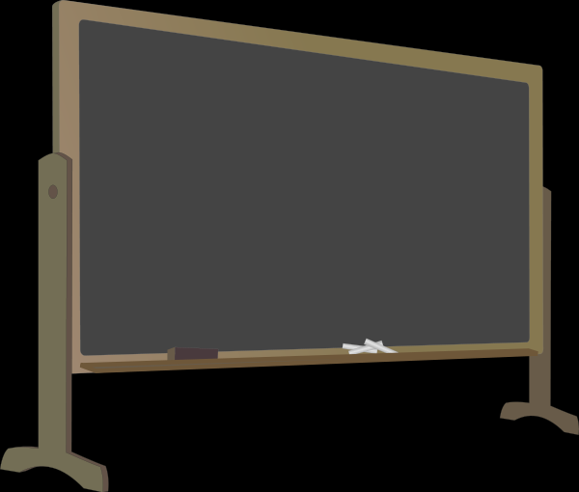
Brokers
operation
metrics
Portal
messages
MIST
GraphEditor
MIST
coordination
Console
Clients
Broker Info
Routing
Config
Apache ZooKeeper™

