Slide 1
AutoMapper

Slide 2
What is AutoMapper.?
AutoMapper library is a convention-based object-to-object mapper.
This is useful in several contexts: mapping from data objects to business objects.
Relies on naming patterns and sensible defaults.

Slide 3
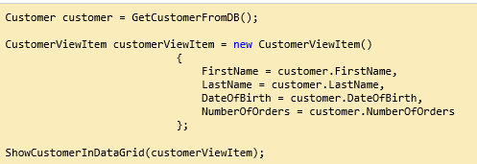
Conventional Mapping

Slide 4
Problems With Convention Mapping.
Hand Mapping
Name of the entities should match.
Rendering Null Values
Imperative Code
Complexity of Coupling.
Expensive to Maintain.

Slide 5
Problems AutoMapper Solves
Complexity Between of Domain Model to View.
Manual Mapping.
Imperative(Traditional) to Declative.

Slide 6
How Does It Work?
Given a source type and destination type.
AutoMapper will assign values from source members, properties, and methods.
Corresponding members on the destination.
It does this automatically based on member names.

Slide 7
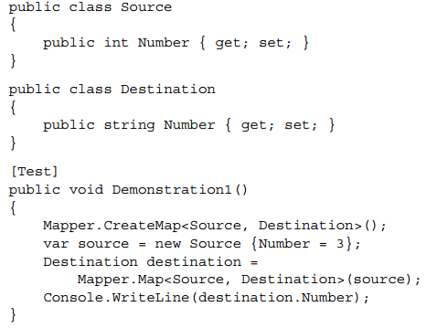
Introductory Example

Slide 8
Methods of Mapping

Slide 9
Lets Learn Again! How to Do It
Mapper.CreateMap<Customer, CustomerViewItem>();
Use to create Map between Source to Destination.
Customer customer = GetCustomerFromDB();
CustomerViewItem customerViewItem = Mapper.Map<Customer, CustomerViewItem>(customer);
ShowCustomerInDataGrid(customerViewItem);

Slide 10
What do we get?
Mapped Objects in any DataSet.
Null Reference is Solved.

