Slide 1
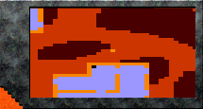
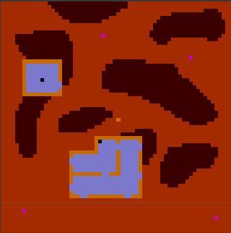
Texture
Texture
RawImage
RawImage
H
X
W
Y

Slide 2
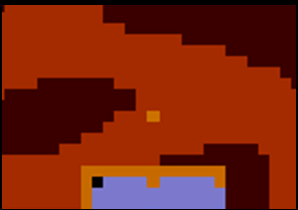
Minimap
Dictionary:
Key: Player
Value: X 10 Y 20
Minimap
Dictionary:
Key: Player
Value: X10, Y20
Key: Enemy1
Value: X20, Y5
Key: Enemy2
Value: X20, Y20

