Slide 1
Comp 2071- Data Structures - Lab 3: Train Simulation
Group 14:
Terrance Curley - ADT, Station Class
Gregory Lee - Train Class
Rixing Wu - Train Route&Simuation, Code Review
Elvin Xu - Passenger Class, Document

Slide 2
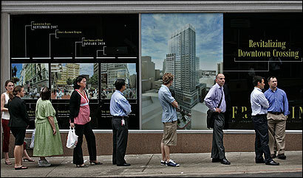
ADT - QUEUE
First in First out format.
Adding an item to the queue (enqueue method) adds it to the back.
Taking an item out of the queue removes it from the front (dequeue).
Circular Array-based implementation
Can “wrap around” the array as items are dequeued and enqueued.
Does this by keeping track of front/back indices.
Source: Boston.com

Slide 3
Application
Purpose: to simulate a basic train system
Passengers wait in queues at stations. They have a destination in mind.
Trains come to stations, drop off passengers, and pick up new ones.
5 Stations on the route and trains go back and forth.
As time goes by in the program, trains move along the route and passengers show up at stations.
We create a rough graphical display in the console that shows the user where trains are, and how many passengers are on each train.

Slide 4
Issues and Solutions
Getting the big idea of the application
Discussed as a group to formulate our simulation idea.
Created algorithms for the individual classes.
Getting our different pieces to work together fluidly
Discussed and made changes to methods within our classes to get the program working.
i.e. random generation of passengers.

Slide 5

Take-aways
The queue is a very important data structure because of how common it is in both computing and in real life.
The importance of algorithms.
Forming ideas before getting to work on the implementation itself.
Dividing up work for a large project.
essee.us

