Slide 1

Meal Provider Cloud Native Development
Meal Provider Cloud Native Development
Benedict Tiong

Slide 2


Frontend High-Level overview
Menu
Management
Order Record
Management
Admin
Credit
Management
Rating System
Management
Login Page
Home Page
Menu
Page
Order
Page
User
Order Record
Page
Credit Record
Page
Rating
Page

Slide 3
Frontend Website Preview
Menu
Management
Menu
Page
Order Record
Management
Order
Page
Credit
Management
Order Record
Page
Rating System
Management
Credit Record
Page
Navbar
Rating
Page
Navbar
Admin Home Page
User Home Page

Slide 4
Frontend API Detail
Menu
Management
GET
View Menu
PUT
Update Menu
DELETE
Delete Menu
POST
Add Menu
Order Record
Management
GET
View all orders
Admin
Credit
Management
GET
View all credits
POST
Send reminder
Rating System
Management
GET
View all ratings
Login Page
Home Page
Menu
Page
GET
View Menu
POST
Login
GET
Role
Order
Page
GET
View orders
PUT
Update order
DELETE
Delete order
POST
Place order
User
Order Record
Page
GET
View own order
Credit Record
Page
GET
View own credit
Rating
Page
POST
Rate meal

Slide 5
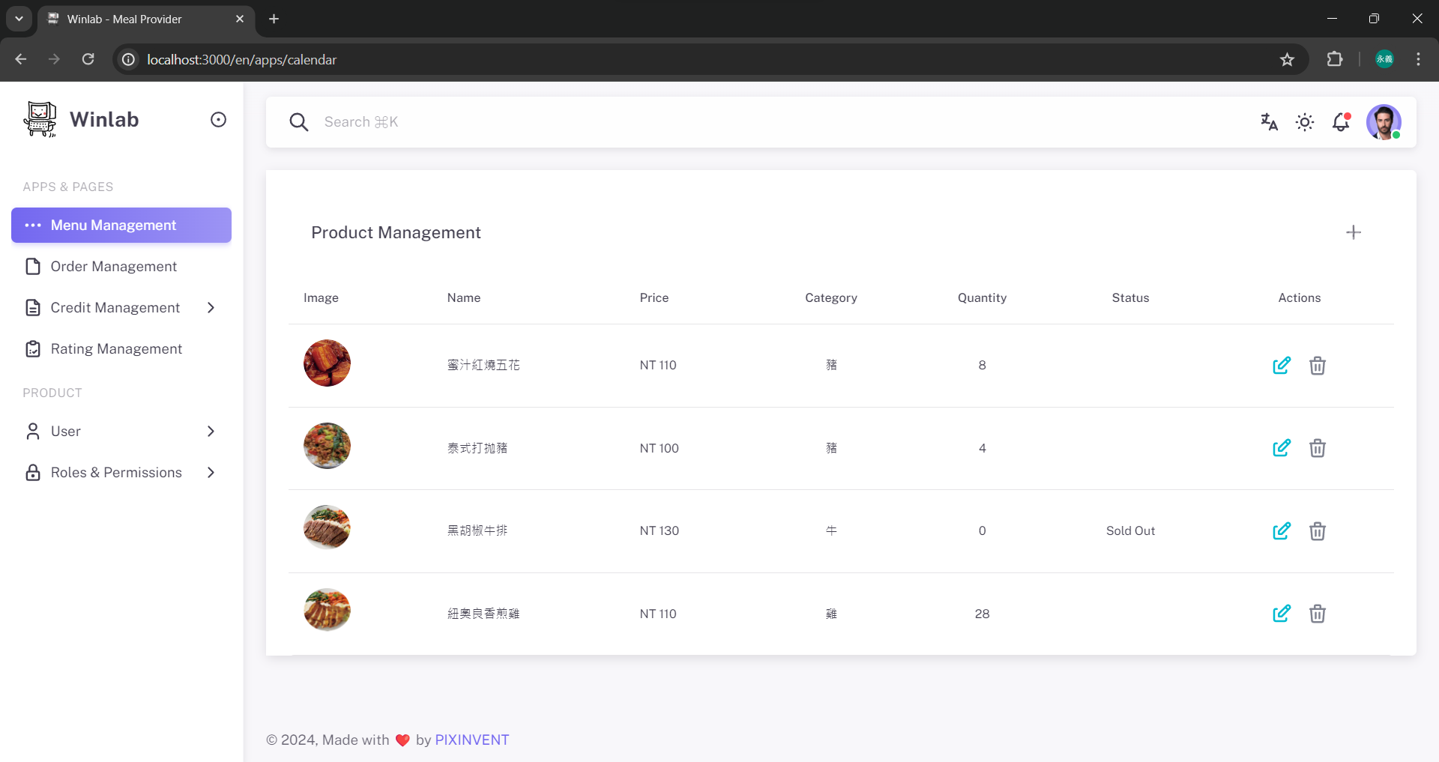
Menu Management Page

