Slide 1
Financial Discipline in Accounting
“One who is faithful in a very little Is also faithful in much”
Luke – 16:10

Slide 2
Introduction
Accounting is important to lead an organization and a family. We are accountable to our Creator.
If a family or an organization does not maintain the accounts properly it causes the problem listed below
Unable to find whether it is profit or loss. (Ref: Matthew - 25:18)
It leads to liabilities (Ref : II Kings – 4:1 – 7)
It leads to Negative decision (Ref : Matthew - 27:5)
When we maintain accounts properly the Lord will bless us.(Ref : Matthew - 14:19 & 20)
As a Christian family whatever we receive as income, first we should pray and thank God for it (Example: Our Salary)
When we maintain accounts for Rs.100/- then the Lord will trust us and increase you a thousand times (Ref : Matthew - 25:21)

Slide 3
Accounting Notes
Get the cash bills of your purchase & payments made should be acknowledged.
Write your transactions on daily basis otherwise it will be a story.
Prepare your monthly budget and spend accordingly.
File all your bills and important documents.
All your financial transactions should be known to your family (Husband Wife = Children)

Slide 4
Golden Rules
All the accounting procedure are based on the three golden rules of accounts.
Type of Accounts | Rules
Real Account | *Debit what comes in *Credit what goes out
Personal Account | *Debit the receiver *Credit the giver
Nominal Account | *Debit all expenses and losses *Credit all income and gain

Slide 5
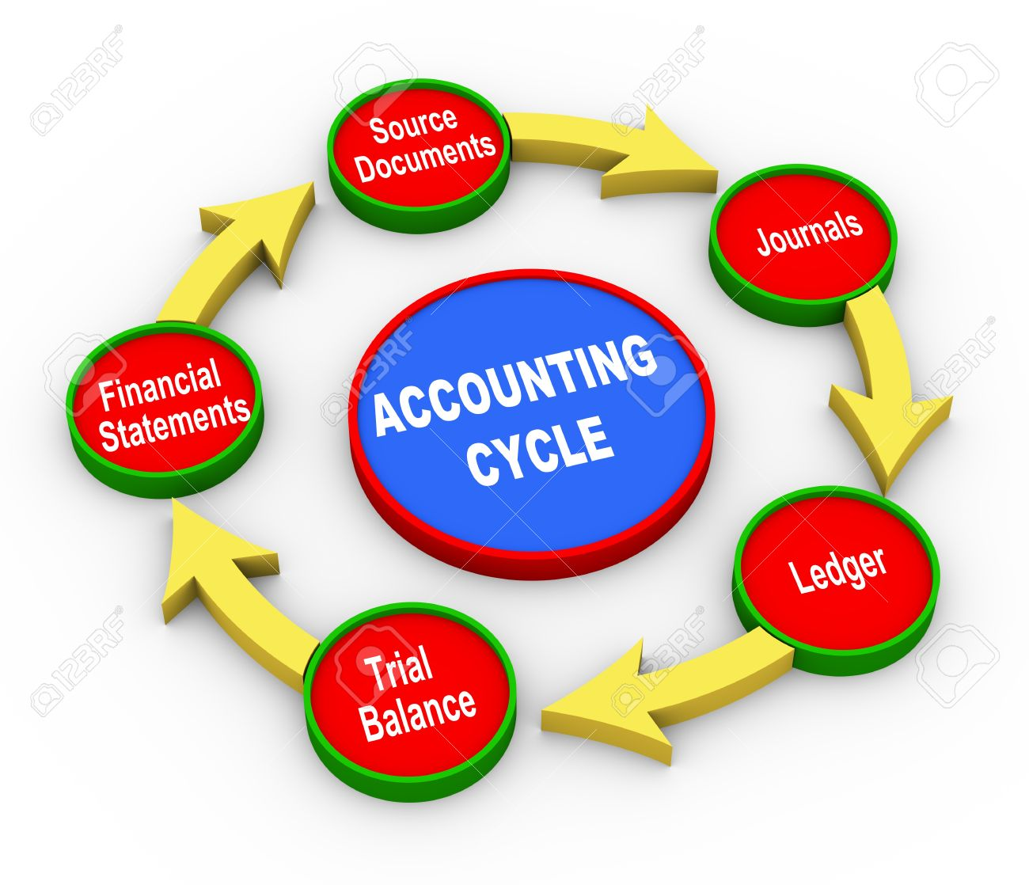
Accounting Cycle
The direct and indirect expenses should be accounted in our family

Slide 6
Book Keeping
“Book keeping is the systematic recording and organizing of financial transaction in a family”
Bank book
Cash book
Day book
Petti cash book
Inventory book (Stock register)

Slide 7
Merits of Bookkeeping
In our day to day life it is good to maintain petti cash book.
Bookkeeping helps us to find out your transactions easily.
It is a record of your finance transparency.
It shows your financial status of your family.
It avoids mistakes.

Slide 8
Accounting terms
What is Debit
What is Credit
What is Journal
What is Ledger
What is Profit and loss a/c
What is Asset
What is liabilities
What is Debtors
What is Creditors
What is Trial balance
What is Balance sheet

Slide 9
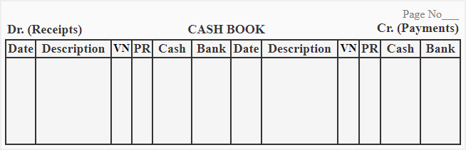
What is Debit
An accounting entry where there is either an increase in assets or a decrease in liabilities on a company's balance sheet.

Slide 10
What is Credit
An accounting entry that may either decrease assets or increase liabilities and equity on the company's balance sheet, depending on the transaction.

Slide 11
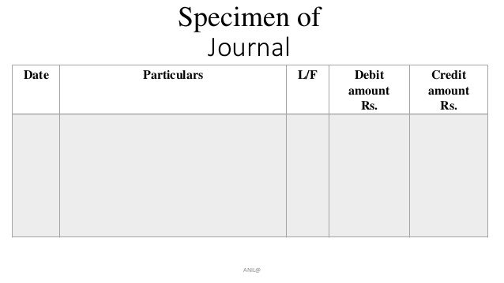
What is Journal
In accounting and bookkeeping, a journal is a record of financial transactions in order by date

Slide 12
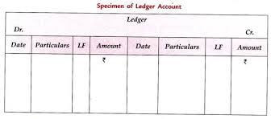
What is Ledger
A complete record of the financial transactions over the life of a company.

Slide 13
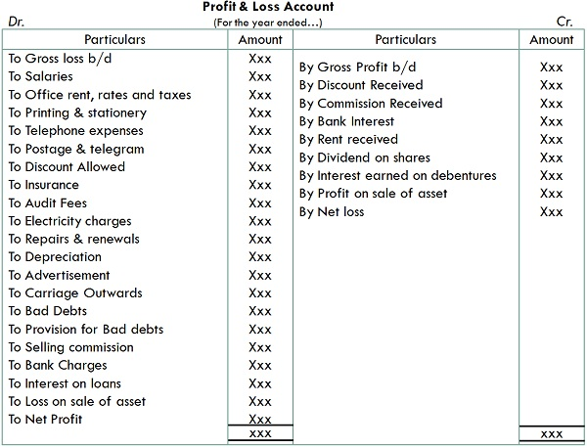
What is Profit and Loss a/c
A financial statement that is used to summarize a company’s performance and financial position by reviewing revenues, costs and expenses during a specific period of time, such as quarterly or annually.

Slide 14
What is Asset
Current assets : Current assets are those that will be converted to cash within one year. Typically, this could be cash, inventory or accounts receivable
Example :Cash, Goodwill, Investment etc..,
Fixed assets : Fixed assets are long-term and will likely provide benefits to a company for more than one year, such as a real estate, land or major machinery
Example : Building, Furniture & Computer etc..,

Slide 15
What is liabilities
A company's debts or financial obligations incurred during business operations.
Example : Accounts Payable, Salaries Payable, Wages Payable, etc…,

Slide 16
What is Debtors
A debtor is a person, company, or other entity that owes money. In other words, the debtor has a debt or legal obligation to pay the amount owed.

Slide 17
What is Creditors
A creditor could be a bank, supplier or person that has provided money, goods, or services to a company and expects to be paid at a later date

Slide 18
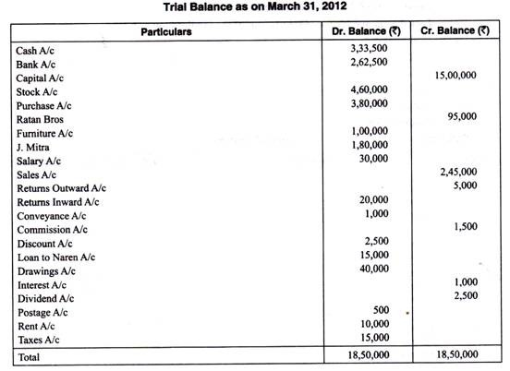
What is Trail Balance
A business document in which all ledgers are compiled into debit and credit columns in order to ensure a company’s bookkeeping system is mathematically correct.

Slide 19
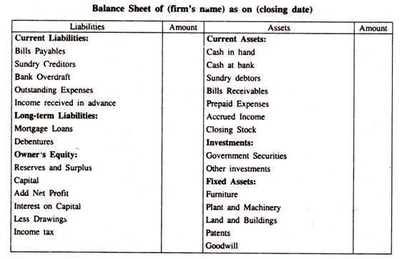
What is Balance Sheet
A financial report that summarizes a company's assets , liabilities and owner or shareholder equity ;at a given time.

Slide 20
Steps to maintain Petti cash book
For recording the transactions in the petti cash book following steps should be taken.
Step 1: In the “Date” column, the day, month & the year on which transaction occurs should be recorded.
Step 2: In the “Particular” column, the nature of the transactions from where cash is received or paid, gets recorded.
Step 3: In the “Amount” column, the actual cash paid or received is recorded.
Step 4:All the expenses gets recorded in debit column, all the income in the credit column, & in the voucher column bill number gets recorded.
Step 5: The cash book should be balanced daily, weekly or monthly.

Slide 21
Taxes
We should know basic taxes.
Tax Deducted at Source (TDS)
Goods and Services Tax (GST)

Slide 22
Practical session
Preparation of petti cash book for the transactions took place in a family for the month of April 2019
Materials given for preparation of petti cash book.
Best three petti cash book will be awarded.

Slide 23
Resolve it
Prepare petti cash book from the transactions made in Mr.Joel family in the month of April 2019.
01.04.2019 – Petti cash received – Rs.8000
02.04.2019 – House rent paid – Rs.200
02.04.2019 – Purchase of vegetables – Rs.200
03.04.2019 – Electricity bill paid - Rs.400 (Bill no:2461)
04.04.2019 – Sale of old newspaper – Rs.200
05.04.2019 – Fuel filling – Rs.500 (Bill no:0011)
06.04.2019 – Donation received – Rs.100
07.04.2019 – Purchase of groceries – Rs.500, discount given Rs.50
08.04.2019 – Vehicle repair – Rs.100
10.04.2019 -- Paid for newspaper – Rs.100
11.04.2019 – Cash received from father – Rs.100
12.04.2019 – Paid to debtors – Rs.200
13.04.2019 – Received from debtors – Rs.200

Slide 24
Resolve it
14.04.2019 – Purchase of milk – Rs. 200
15.04.2019 – Purchase of snacks – Rs.200
16.04.2019 – School fees paid – Rs.2000 (Bill no:2081)
16.04.2019 – Telephone bill paid – Rs.100
17.04.2019 – Purchase of cloth– Rs.500
18.04.2019 – Discount received – Rs.100
19.04.2019 – Paid to tailor shop – Rs.100
20.04.2019 – Paid to water can – Rs.200
21.04.2019 – Pocket money for children – Rs.100
25.04.2019 – Paid to cylinder – Rs.800
26.04.2019 – Travel to AOJ meeting – Rs.500
27.04.2019 – Hospital expenses – Rs.200
28.04.2019 – Purchase of snacks – Rs.100
29.04.2019 – Received money from relative - Rs.100
30.04.2019 – Salary paid to servant – Rs.1000 (Voucher no:0051)
30.04.2019 – Cash in hand – Rs.650

Slide 25
Thank you

