Slide 1

“CORRECTION”
IS CORRECTION NEEDED?
WHAT IF CORRECTION NOT DONE OR DELAYED?
THE NEED OF CORRECTION IN FAMILY,WORK PLACE, CHURCH?
HOW IT CAN BE DONE?

Slide 2

you hate discipline Ps 50:17
For you hate discipline, and you cast my words behind you. Psa 50:17, 16
“What right have you to recite my statutes or take my covenant on your lips?

Slide 3
Maintaining accounts to be taught from childhood – Misuse, overuse or stealing others’ share – to be corrected from childhood.
Whatever you give to your children –Check whether they use it or waste it. Teach them accountability
Money – Re 1 onwards - accountable
Food – not to be wasted
Dresses, toys – do not give all that a child asks. Make a budget
Time : Teach the child punctuality
Facilities – House, vehicles, helpers, education, language, health, authority – not to be misused
Let your child know that one day, it has to give an account to the creator, of everything it was given to use on earth
Earth is to be safeguarded – Violation brings punishment
Gen 2:17
Bringing damage to the earth – rivers, forest, sky, punishable- brings
Tsunami, unnatural changes in climate & tides
Global warming- deforestation
Converting agricultural land into ..
Farming & farmers affected. Synthetic & chemicals products in markets – Health affected - Medical industry flourishing. Good amount of earnings go for medicine & treatment.
Urbanization – increase in pollution & crime
Removing lakes, pools and converting them into house plots – causes stagnation of water -> -> flood -> mosquitoes -> plagues etc.

Slide 4
Bible examples – God servants
Children well brought up - God could use directly
1. Samuel – brought up as an orphan – Could hear the voice of God as a child
Esther- An orphan. Knew her limit- How much to spend for decoration
God could use directly
If you train up your child in Bible discipline, it will become a vessel in the hand of God. No further training needed.
Children who lived in affluence & enjoyed privileges at home- had to be corrected & pruned by God
God had to peel off all the worldly ways without showing any mercy
Moses – Thrown out of the palace – trained in the desert
Joseph – beloved child of his father
God cut him off from his family – sent to unknown place- trained as a slave,
in jail, ...
when training completed, could be used as a vessel.
Jacob – Mother’s pet child – had to be sent out of home – Had to live in exile – cut off from family relationships before making him a blessing

Slide 5

“If you see a thief, you are pleased with him”, Ps 50:18
On 29.4.2019
The Lord showed me in a row
Many Chief Shepherds of Churches, how they failed to correct their believers, coworkers, even family members
Hence their Church has become a den of thieves. Gave Ps. 50, 17,16,18 for them.
One pastor without shame told me,
I appoint only non believers in my office, see me driver, cook, ….
All non believers. They know how to behave.
Believers do not have courtesy, politeness, do not know how to behave, etc….

Slide 6
THE FIRST CORRECTION, REVELATION 12-3,4,7,9
ISAIAH 14:1414I will ascend above the tops of the clouds; I will make myself like the Most High
EZEKIEL 28:16 16Through your widespread trade you were filled with violence, and you sinned. So I drove you in disgrace from the mount of God, and I expelled you, guardian cherub, from among the fiery stones.
GENESIS 3:21,22,23 21The LORD God made garments of skin for Adam and his wife and clothed them. 22And the LORD God said, "The man has now become like one of us, knowing good and evil. He must not be allowed to reach out his hand and take also from the tree of life and eat, and live forever." 23So the LORD God banished him from the Garden of Eden to work the ground from which he had been taken.

Slide 7
CORRECTION IS A CHARACTERISTICS OF GOD
Correction must become a habit

Slide 8
WHAT ARE THE THINGS WHICH PREVENT US FROM CORRECTION?
1) Confusion about forgiveness and loving others
2) To avoid friction with others
3) Personal loss/ loss of life
4) Loss to the ministry
5) Am I right in correcting others

Slide 9
Does correction contradict forgiveness and loving others
Matthew 18:21,22 21Then Peter came to Jesus and asked, "LORD, how many times shall I forgive my brother or sister who sins against me? Up to seven times?"
Matthew 18:15,17 15"If your brother or sister sins, go and point out their fault, just between the two of you. If they listen to you, you have won them over.
If they still refuse to listen, tell it to the church; and if they refuse to listen even to the church, treat them as you would a pagan or a tax collector.

Slide 10

Does correction contradict forgiveness and loving others
Forgiveness Follows After Correction
Stephen forgave them after correcting them.
Acts 7: 51 “You stiff-necked people, with uncircumcised heart and ears! You are just like your fathers: you resist the Holy Sprit!
Acts 7:59 While they were stoning him, Stephen prayed, “ Lord Jesus, receive my spirit.” 60 then he fell on his knees and cried out, “ Lord, do not hold this sin against them. “ When he said this, he fell asleep.

Slide 11
FRICTION AND FEAR OF CORRECTION
Luke 12:51Do you think I came to bring peace on earth? No, I tell you, but division.
Wicked and adulterous generation ( Matthew 12:1)
Proverbe 10:17
Proverbe 12:1
Proverbe 13:18
Proverbe 15:32
Proverbe 29:15
Proverbe 29:17
Psalms 39:11

Slide 12
LOSS /LOSS OF LIFE
Mark 6:17,18 17For Herod himself had given orders to have John arrested, and he had him bound and put in prison. He did this because of Herodias, his brother Philip's wife, whom he had married.
Mark 3:6 6Then the Pharisees went out and began to plot with the Herodians how they might kill Jesus.

Slide 13
LOSS /LOSS OF LIFE
35Women received back their dead, raised to life again. There were others who were tortured, refusing to be released so that they might gain an even better resurrection.
36Some faced jeers and flogging, and even chains and imprisonment.
37They were put to death by stoning;[a] they were sawed in two; they were killed by the sword. They went about in sheepskins and goatskins, destitute, persecuted and mistreated—

Slide 14
LOSS TO MINISTRY
JOHN 31:21 After he had said this, Jesus was troubled in spirit and testified, "Very truly I tell you, one of you is going to betray me.”
27. As soon as Judas took the bread, Satan entered into him. So Jesus told him, "What you are about to do, do quickly.”

Slide 15
AM I RIGHT IN CORRECTING OTHERS
Psalms 32:8I will instruct you and teach you in the way you should go; I will counsel you with my loving eye on you.
1 CORINTHIANS 5:12What business is it of mine to judge those outside the church? Are you not to judge those inside?
2 Timothy 3:16 6All Scripture is God-breathed and is useful for teaching, rebuking, correcting and training in righteousness,
17 7so that the servant of God may be thoroughly equipped for every good work.

Slide 16

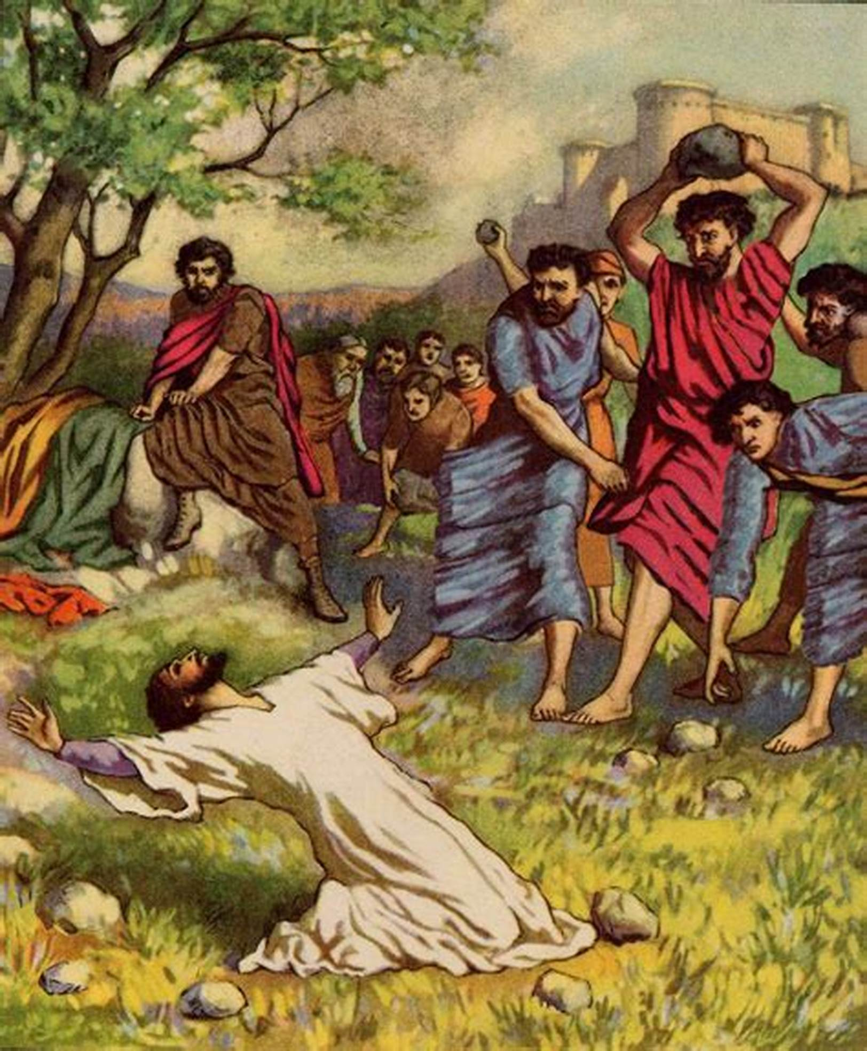
CORRECTION IN OLD TESTAMENT
400 yrs in Egypt
Exodus 21:12,14,15,17,23

Slide 17

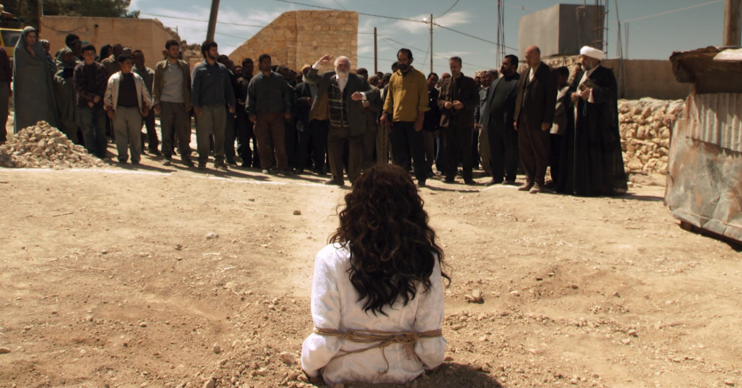
SABBATH RULES
Exodus 31:14 14"'Observe the Sabbath, because it is holy to you. Anyone who desecrates it is to be put to death; those who do any work on that day must be cut off from their people.
Leviticus 24:11 Blasphemer stoned
Numbers 15:35 35Then the LORD said to Moses, "The man must die. The whole assembly must stone him outside the camp.”
Exodus 21= mark 7:11(corba)
Exodus 31:14=Mark 3:6

Slide 18
KORAN, DOTHAN, ABIRAM
Numbers 16:3 3They came as a group to oppose Moses and Aaron and said to them, "You have gone too far! The whole community is holy, every one of them, and the LORD is with them. Why then do you set yourselves above the LORD's assembly?
Numbers 16:41 41The next day the whole Israelite community grumbled against Moses and Aaron. "You have killed the LORD's people," they said.

Slide 19

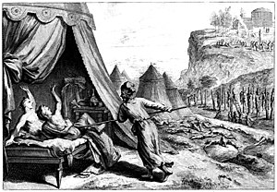
MOAB SEDUCES ISRAEL
Numbers 25:7,8,13 7When Phinehas son of Eleazar, the son of Aaron, the priest, saw this, he left the assembly, took a spear in his hand 8and followed the Israelite into the tent. He drove the spear into both of them, right through the Israelite man and into the woman's stomach. Then the plague against the Israelites was stopped;13
He and his descendants will have a covenant of a lasting priesthood, because he was zealous for the honor of his God and made atonement for the Israelites."
Phinehas son of eleazar
Psalms 106:28-31
Exodus 32:25

Slide 20
IMPORTANCE OF CORRECTIONS
Psalms 106:28-31
28They yoked themselves to the Baal of Peor and ate sacrifices offered to lifeless gods; 29they aroused the LORD's anger by their wicked deeds, and a plague broke out among them. 30But Phinehas stood up and intervened, and the plague was checked. 31This was credited to him as righteousness for endless generations to come.
Exodus 32:25 2
5Moses saw that the people were running wild and that Aaron had let them get out of control and so become a laughingstock to their enemies.

Slide 21
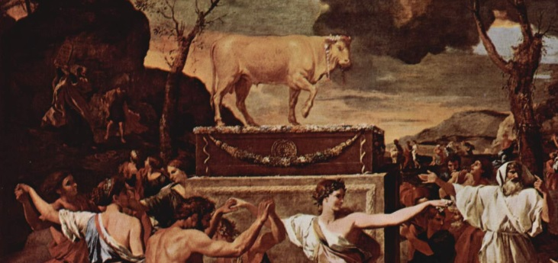
WITH OUT CORRECTION
Exodus 32:25 2
5Moses saw that the people were running wild and that Aaron had let them get out of control and so become a laughingstock to their enemies.

Slide 22
NEW TESTAMENT -TEST THE SPIRITS
1 John 4:11Dear friends, do not believe every spirit, but test the spirits to see whether they are from God, because many false prophets have gone out into the world.
Revelation- overcome
1 corinthians 5:5
2 Peter 2
Jude

Slide 23
THANK YOU

