Slide 1
Financial Discipline
Session 1
Introduction

Slide 2
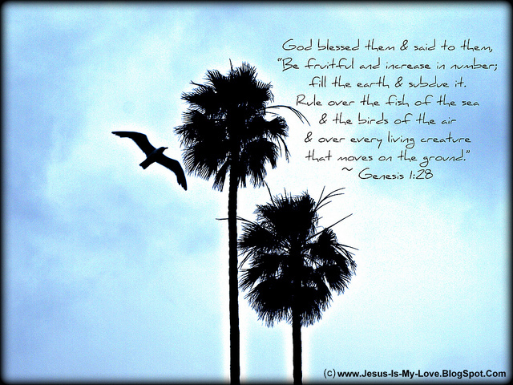
God gave earth with all its riches to man to subdue and rule!
“God blessed these humans by saying to them, "Be fruitful, multiply, fill the earth, and subdue it! Be masters over the fish in the ocean, the birds that fly, and every living thing that crawls on the earth!" Gen 1:28

Slide 3
பூமியை கீழ்ப்படுத்தி, ஆண்டுகொள்ளுங்கள்
ஆதியாகமம்1:28 பின்பு தேவன் அவர்களை நோக்கி: நீங்கள் பலுகிப் பெருகி, பூமியை நிரப்பி, அதைக் கீழ்ப்படுத்தி, சமுத்திரத்தின் மச்சங்களையும் ஆகாயத்துப் பறவைகளையும், பூமியின்மேல் நடமாடுகிற சகல ஜீவஜந்துக்களையும் ஆண்டுகொள்ளுங்கள் என்று சொல்லி, தேவன் அவர்களை ஆசீர்வதித்தார்.

Slide 4
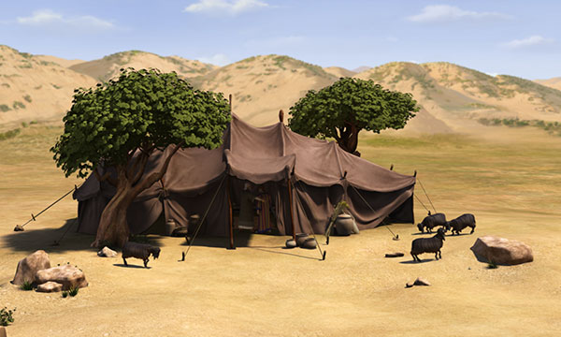
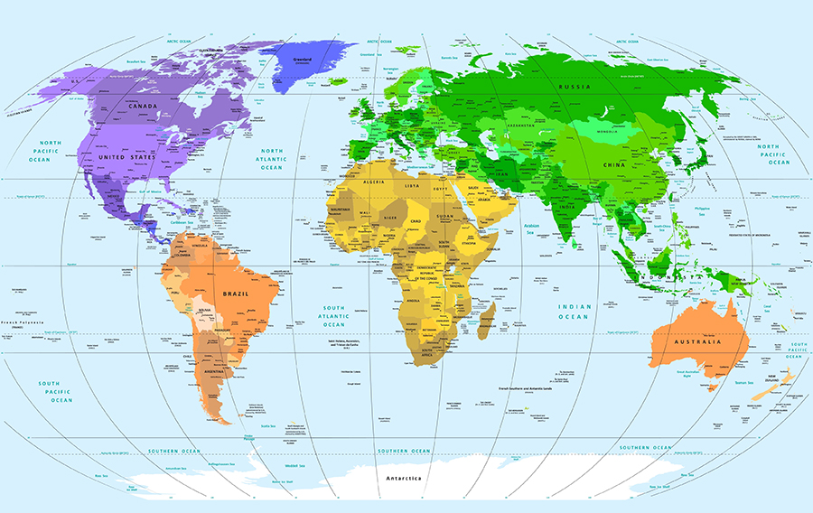
Earth divided into continents
“When the Most High gave nations as their inheritance, when he separated the human race, he set boundaries for the people according to the number of the children of God.” Deu 32:8
Men progressed in acquiring skills , invented tools and equipped themselves for survival and sustenance on this earth.
They explored the land
Made new inventions & became rich
Divided the land and wealth of the earth among themselves & their descendants.
Organized themselves as villages, towns, districts, States, countries, continents etc.,
Appointed leaders over them to protect their borders, and to see to the welfare of the people.

Slide 5
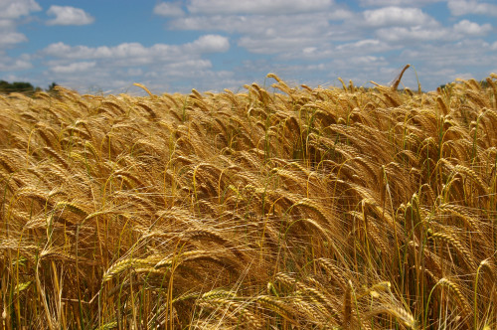
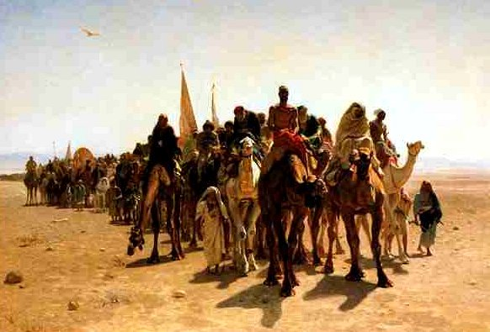
Men explored the richness of the earth!
As years went by, as civilization progresses, human beings realized out how rich the earth, (the land, the nature, the sky and the ocean is which God has created!
They started cultivating the land and began rearing animals. The barter system which they practised gave way to monetary system. Those who prospered and possessed more lands or animals, were called rich.
Gen 13:2 Abram was very rich in livestock, in silver, and in gold.
2 Ch 18:1 Now Jehoshaphat had riches and honor in abundance

Slide 6
Various meanings of wealth?
The word “wealth” has different connotations. For different people it means different things. For certain people, it means
Money
Knowledge
Health their hard Labour
Their Children and descendants.
Assets they have (land, property, buildings, institutions they have)
Character, principles people hold
Relationship with God.
For that they are willing to sacrifice

Slide 7
The greatest Wealth of God – Jesus
The greatest wealth of Father = His Son
In Jesus Father handed over all His wealth to the world
Jesus inside of Him and walking with Him is the greatest wealth a human being can possess in this world.
This is the wealth Adam was given free. Even though he lost it, God restored this wealth through His Son Jesus Christ.

Slide 8
9. என் தேவன் தம்முடைய ஐசுவரியத்தின்படி உங்கள் குறைவையெல்லாம் கிறிஸ்து இயேசுவுக்குள் மகிமையிலே நிறைவாக்குவார். பிலிப்பியர் 4:19

Slide 9
Need of the school of Financial discipline?
Anybody who chooses Jesus Christ is the wealthiest man is this world.
“And my God will fully supply your every need according to his glorious riches in the Messiah Jesus”. Ph 4:19
But today, many even the so called Christians, prefer the gifts (finance, assets, promotion etc) which Jesus Christ give, than Jesus Himself.
Thus they err and fall into many temptations. Hence the need of this school, Financial Discipline.

Slide 10
Disciplinary rules for acquiring & spending wealth
Disciplinary rules regulates human life in society.
We, as Indians, bound by Indian Constitution.
While travelling on road, bound by traffic rules and signals.
Students studying are bound by - rules and regulations of the institutions they study.
For every organization, institution, company, firm, it has its own disciplinary rules and regulations. When they are violated, the subject is punished and even dismissed from the company depending upon the gravity of the rule.
Is there any discipline for acquiring wealth and finance for human beings while living on earth?
Yes. There are.

Slide 11
One among the In 10 commandments
Exo 20:17 “You shall not covet your neighbor’s house. You shall not covet your neighbor’s wife, nor his male servant, nor his female servant, nor his ox, nor his donkey, nor anything that is your neighbor’s.”
Exo 3:22 But every woman shall ask of her neighbor, and of her who visits her house, jewels of silver, jewels of gold, and clothing; and you shall put them on your sons, and on your daughters. You shall plunder the Egyptians.”

Slide 12
Laws for Finance – Secular & spiritual
TN Chief Minister (late) convicted & arrested for amassing wealth.
Many Govt officials …..
Bible is the Constitution the Lord God has given for every human being living on earth. It explicitly spells the code of conduct & behaviour of an individual in all areas, also in the pursuit of wealth.
Bible - solution to all the problems in this world.
Make a spread sheet of all the disciplinary laws regarding Finance = You will get the solution for all the problems existing in this world.

Slide 13
Every Nation – its own laws for Finance
Every nation has principles and laws
Ways and means of making money,
spending money,
investing it,
making profit ,
attracting foreigners to invest not curtailing the freedom of sons of the soil etc.
But who will be able to predict or foretell the reasons of financial crisis in a country?
Bible does that. God governs the financial system of the world.

Slide 14
God’s punishment drought & scarcity of water
"I also have scheduled food shortages for you in all of your cities, and lack of bread in all of your settlements, but you haven't returned to me," declares the LORD. but you have not returned to me," declares the LORD. Amos 4:6
"I overthrew your cities, as God overthrew Sodom and Gomorrah. You've become like a burning ember, snatched from the fire, but you have not returned to me," declares the LORD. prepare to be summoned to your God, Israel!" Am 4:6-12

Slide 15
ஆமோஸ் 4:7
7. அறுப்புக்காலம் வர இன்னும் மூன்றுமாதம் இருக்கும்போதே மழையை நான் தடுத்தேன், ஒரு பட்டணத்தின்மேல் மழைபெய்யவும் ஒரு பட்டணத்தின்மேல் மழை பெய்யாமலிருக்கவும் பண்ணினேன்; ஒரு வயலின்மேல் மழைபெய்தது, மழைபெய்யாத மற்ற வயல் காய்ந்து போயிற்று. 8. இரண்டு மூன்று பட்டணங்களின் மனுஷர் தண்ணீர் குடிக்க பட்டணத்துக்குப் போய் அலைந்தும் தாகந்தீர்த்துக்கொள்ளவில்லை; ஆகிலும் நீங்கள் என்னிடத்தில் திரும்பாமற்போனீர்கள் என்று கர்த்தர் சொல்லுகிறார்.

Slide 16
Yahweh controlled the financial system of Israel ……
Here Yahweh claims that He who gives all the good things for human beings, sent the following evils to Israel.
sent famine,
stopped rain
caused scarcity of drinking water,
affliction of blight and fungus
sent locust swarms to devour the crops
sent plagues
killed the choicest young men
killed horses &
Sent d summon to meet Him finally.
In the above list there is loss of wealth, health, and even life.

Slide 17
God is in control of the finance of..
IMF.. (International monetary fund)
World Bank …
The nations….
Your country…
Your State….
Your City….
Your village….
Your company…
Your family….

Slide 18
Problems of the World – result of violating God’s financial rules
When we violate the rules of Yahweh, it brings heavy loss of wealth and lives.
All the problems of the world today,
hunger, famine, poverty, sickness, war, tsunami, floods, wild animals, fire, earth quakes,
can be traced back to violation of a particular law or laws put forward by God in Bible.
Whether it is of any individual, of a particular nation or of the whole the world, no doubt it is due to the violation of a law in the Bible.
Violation of the financial discipline of Bible brings disasters of nature.
Yahweh, Father of Jesus Christ and ours - put forward explicit conditions for human beings in Bible for earning wealth, storing it up, methods of spending it, and the correlation in making money and spending it.

Slide 19
Financial discipline covers all areas
Covers all areas like
One’s personal life, family, institutions
Govts, companies, natural resources etc.
God appointed Joseph as a finance Minister to Pharaoh. Since he followed God’s instructions, Egypt became the supplier of food for the whole world.
Children of God need to consult God in everything, selecting a career, planning your finance etc.

Slide 20
Some general rules of financial discipline of the Lord
God gives wealth
a man to whom God gives wealth, riches, and honor, so that he lacks none of his heart's desires—but God does not give him the capability to enjoy them. Instead, a stranger consumes them. This is pointless and a grievous affliction. Ecc 6:2
Wealth hoarded harmful
I have observed a painful tragedy on earth: Wealth hoarded by its owner harms him, Ecc 5:13

Slide 21
God’s rich treasury
Deu 28:12 "The LORD will open his rich treasury, the heavens, to release rain upon your land in season and bless everything you undertake so that you'll lend to many nations but won't borrow.
God makes people poor or rich
1 Sa 2:7 The LORD makes people poor and he makes people rich, he brings them low, and he also exalts them.

Slide 22
Wealth is a fortress for rich to hide
Pro 10:15 The rich hide within the fortress that is their wealth, but the poor are dismayed due to their poverty.
Wealth & Poverty
Pro 13:7 One person pretends to be wealthy, but has nothing; another pretends to be poor, yet is rich.
The poor lives a blameless life
Pro 28:6 It's better to be poor and live a blameless life than to be rich but crooked in one's lifestyle.

Slide 23
Rich man wise in his own eyes:
Pro 28:11 The rich man may be wise in his own opinion; but a discerning, poor man sees through him.
Those who are in a hurry to get riches will be punished
Pro 28:20 The faithful man will prosper with blessings, but whoever is in a hurry to get rich will not escape punishment.
Excess wealth of the rich will not allow him to rest.
Ecc 5:12 Sweet is the sleep of a working man, whether he eats a little or a lot, but the excess wealth of the rich will not allow him to rest.
Rich food
Isa 30:23 He will also provide rain for your seed that you sow in the ground, and the food that comes from the ground will be rich and abundant. At that time, your cattle will graze in broad meadows.

Slide 24
Don’t spend money on what is not bread
Isa 55:2 Why spend your money on what is not bread, and your labor on what does not satisfy? Listen carefully to me, and eat what is good, and let your soul delight itself in rich food.
Do not become rich with treachery.
Jer 5:27 'Like a cage full of birds, so their houses are filled with treachery. This is how they have become prominent and rich.

Slide 25
Jesus although poor got a tomb with the rich
Isa 53:9 Then they made his grave with the wicked, and with rich people in his death, although he had committed no violence, nor was there any deceit in his mouth.“
The rich should not boast in their riches
Jer 9:23 This is what the LORD says: "The wise man is not to boast in his wisdom; the strong man is not to boast in his strength; and the rich man is not to boast in his riches.

Slide 26
Rich people are filled with violence, lies and deceit
Mic 6:12 Her rich people are filled with violence, and her inhabitants tell lies—their tongues speak deceitfully!
Shepherds became rich by selling the sheep
Zec 11:5 Their buyers slaughter them without being punished, continuing to sell them as they say, 'Bless the LORD!' and 'I'm rich!' Meanwhile, their shepherds show them no compassion
God sends the rich away empty:
Luk 1:53 He filled hungry people with good things and sent rich people away with nothing.

Slide 27
Miseries will overtake the rich
Jas 5:1 Now listen, you rich people! Cry and moan over the miseries that are overtaking you.
Riches will topple people into temptation
1Ti 6:9 But people who want to get rich keep toppling into temptation and are trapped by many stupid and harmful desires that plunge them into destruction and ruin.
Worldly riches make people miserable, pitiable, poor, blind & naked
Rev 3:17 You say, "I am rich. I have become wealthy. I don't need anything." Yet you don't realize that you are miserable, pitiful, poor, blind, and naked.

