Slide 1

Financial Discipline
Session 3
“You shall not steal”

Slide 2
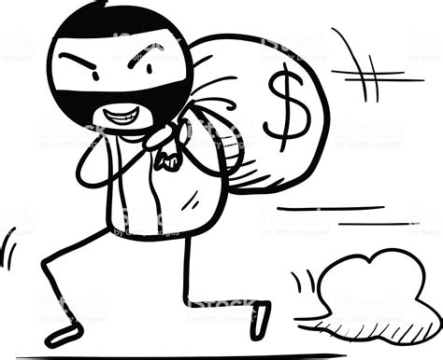
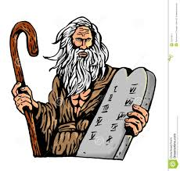
What is Stealing ?
The meaning of stealing is given in the dictionary like this -"Take (another person's property) without permission or legal right and without intending to return it”
This is one of the ten commandments given to Moses by the Lord.
Exo. 20:15 “You shall not steal”
Lev. 19:11 “‘You shall not steal”
Deu. 5:19 “You shall not steal”

Slide 3

Stealing & Punishment in Bible
What is meant by stealing in Bible?
15 ways of stealing & punishments

Slide 4

1. Kidnapping
Exo 21:16 "Whoever kidnaps a person, whether he has sold him or whether the victim is still in his possession, is surely to be put to death.
Deu 24:7 "If a man is found kidnapping his relative, a fellow Israeli, and mistreats or sells him, that kidnapper must die. By doing this, you will remove this evil from among you.

Slide 5

2. Security lost
Lev 6:2-7 "A person sins against the LORD by acting treacherously toward his neighbour regarding something entrusted to his care, security for a loan,
robbery, or if he has oppressed his neighbour, found something that had been lost and then lied about it, or if he makes a false oath about any of these things, thus committing a sin with respect to these things.

Slide 6
"If that person has sinned and has been found guilty, then he is to return the stolen thing that he took or obtained by oppression, or the security that had been entrusted to him, or the lost thing that he had found, or the thing about which he had given a false oath. He is to restore it in full, add a fifth to it, then give to whom it belongs the very day he's found guilty.
……… Then the priest is to make atonement for him in the LORD's presence, and it will be forgiven him regarding whatever he did.

Slide 7
3. False dealing with neighbour
Lev 19:11 "You are not to steal or lie or deal falsely with your neighbour.

Slide 8
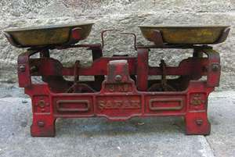
4. False measuring, weight & quantity
Deu 25:13-16 "Don't have different weights in your bag—one heavy and one light. Don't have different measuring devices in your house—one large and one small. You must have honest weights and measuring devices, so you may live long in the land that the LORD your God is about to give you, for anyone who does these things—anyone who deals dishonestly—is detestable to the LORD your God."
Lev 19:35 -37 "You are not to act unjustly in deciding a case or when measuring weight and quantity. You are to maintain just balances and reliable standards for weights, dry volumes, and liquid volumes. I am the LORD your God, who brought you out of the land of Egypt.

Slide 9
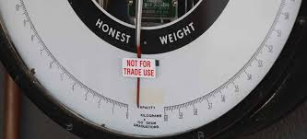
Pro 11:1 The LORD hates false scales, but he delights in accurate weights.
Mic 6:10 Are the treasures of wickedness still in the house of the wicked, and the short measure that is hateful?
Mic 6:11 Shall I count those with the wicked scales pure, and those with the bag of deceitful weights?
Eze 45:10, 11-14 You're to use an honest scale, an honest dry measure, and an honest liquid measure!
"The ephah and the bath are to be of equal volume; that is ………he olive oil quota is to be based on the bath, measured at ten baths to each homer, which is equal to one kor.

Slide 10
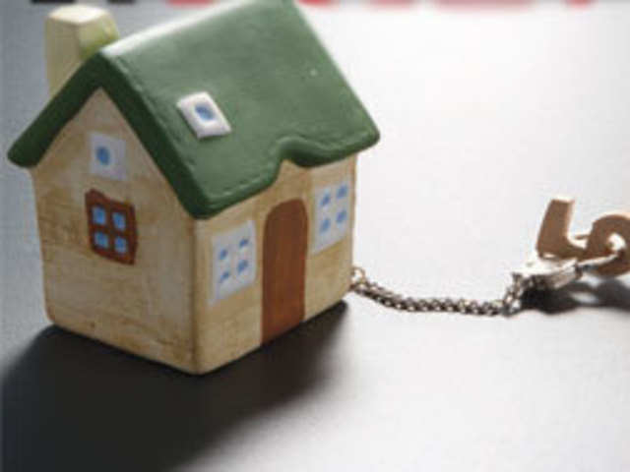
5. Seizing houses which one has not built
Job 20:19-22 because he has crushed and abandoned the poor; he has seized a house that he didn't build.
"Since his appetite won't quit; he won't let anything escape his lust. Because nothing was left for him to devour, therefore his prosperity won't last. Even though he is satiated and self-sufficient, he suffers—everyone in any sort of trouble will attack him.

Slide 11
6. Filling houses with spoil
Pro 1:13-15
We'll find all kinds of valuable wealth, and we'll fill our houses with spoil.
Throw your lot in with us, and all of us will have one purse."
My son, do not go along with them, and keep your feet away from their paths!

Slide 12

7. Treasures taken from others by violence
Amo 3:10 Because they do not know how to act right," declares the LORD, "they are filling their strongholds with treasures that they took from others by violence into their fortified citadels."

Slide 13
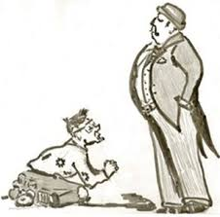
8. Intending to make the poor of the land fail
Amo 8:4-6
"Hear this, you who are swallowing up the needy, who intend to make the poor of the land fail, saying, When will the new moon be gone so that we may sell grain?
And the sabbath, that we may set forth wheat, making the ephah small and the shekel great, and perverting the balances by deceit; that we may buy the poor for silver and the needy for a pair of sandals; and sell the chaff of the wheat?
Farmers problem & suicides in India

Slide 14
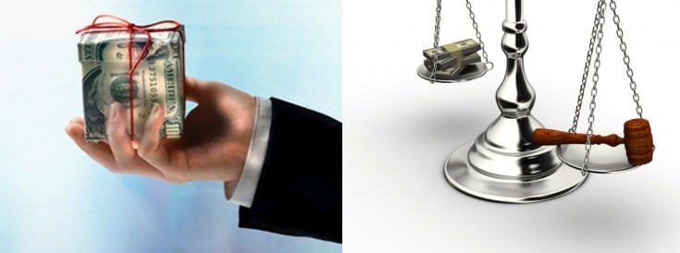
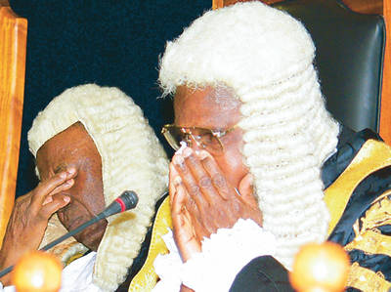
9. Ruler & Judge asking for bribes
Mic 7:3
Both hands are on evil, to do it well. The ruler asks for a bribe, and the judge also; and the great man speaks the evil desire of his soul. So they weave it together.

Slide 15
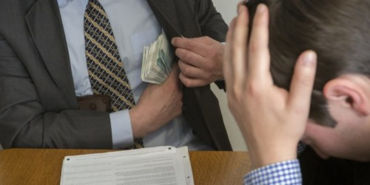
10. No forcible extortion - Content with wages
Luk 3:13-14
And he said to them, Continue to do no more than that commanded to you.
And the soldiers also asked of him, saying, And what shall we do? And he said to them, Do not forcibly extort anyone, nor accuse any falsely. And be content with your wages.

Slide 16


11. Do not exploit or take advantage of brother –sexual immorality
1 Th 4:6
Furthermore, you must never take advantage of or exploit a brother in this regard, because the Lord avenges all these things, just as we already told you and warned you.
Coveting the wife/husband of a brother and deceiving him/her

Slide 17
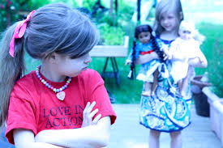
12. No coveting of others’ wife, servant, herds or anything …
Exo 20:17
"You are not to covet your neighbour's house. You are not to covet your neighbour's wife, or his male or female servant, or his ox, or his donkey, or anything that belongs to your neighbour."

Slide 18
13. Wages of a labourer not to remain in possession
Lev 19:13 "You are not to oppress your neighbour or rob him. "The wages of a hired labourer are not to remain in your possession until morning.
Jas 5:4 Look! The wages that you kept back from the workers who harvested your fields are shouting out against you, and the cries of the reapers have reached the ears of the Lord of the Heavenly Armies.

Slide 19

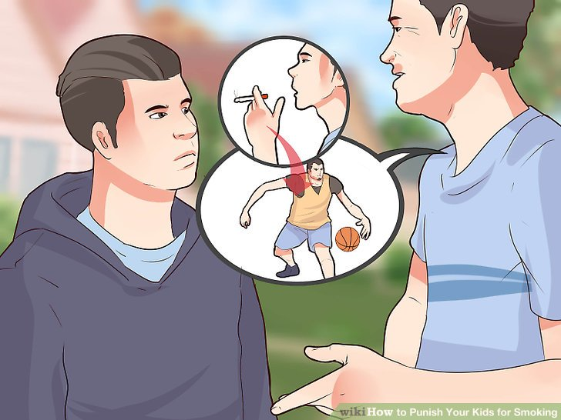
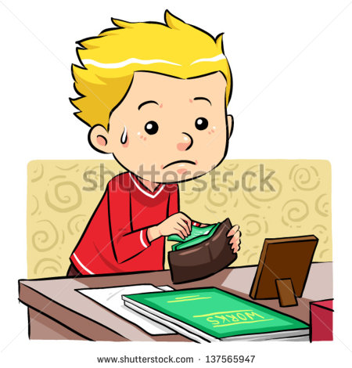
14. Stealing from Father or Mother is sin
Pro 28:24 Whoever steals from his father or mother but claims, "It's no sin," is a companion to someone who demolishes.

Slide 20
15. Unjust gains earned
Eze 22:13 "Watch out! I'm vehemently angry about the unjust gains that you've earned, and about the blood that has been shed among you.
Pro 28:16 A Commander-in-Chief who is a cruel oppressor lacks understanding, but whoever hates unjust gain will live longer.

Slide 21

Punishment for stealing
Zec 5:3 And he said to me, This is the curse that goes forth over the face of the whole earth; for from now on everyone who steals shall be cut off according to it; ………
Zec 5:4 I will bring it forth, says Jehovah of Hosts; and it shall enter into the house of the thief,……. And it shall remain in the midst of his house, and shall devour it, and its timber and its stones.

Slide 22
Theft comes from human heart – It defiles a person
Mat 15:19 For out of the heart come evil thoughts, murders, adulteries, fornications, thefts, ……..

Slide 23
New Testament command – Violation bring in all the curses of Deu 28:15
Mat 19:18 He said to Him, Which? Jesus said, You shall not , …. you shall not steal, …

Slide 24
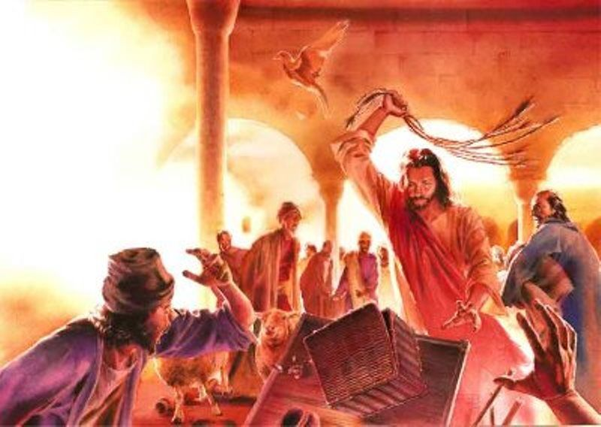
Worshipping place found to be den of thieves – Jesus started whipping & toppling down money changing tables
Mat 21:13 And He said to them, It is written, "My house shall be called the house of prayer"; but you have made it a den of thieves.

Slide 25
Thieves will not inherit the kingdom of God
1Co 6:9 Do you not know that the unrighteous shall not inherit the kingdom of God? Do not be deceived; neither fornicators, nor idolaters, nor adulterers, nor abusers, nor homosexuals,
1 Co 6:10 nor thieves, nor covetous, nor drunkards, nor revilers, nor extortioners, shall inherit the kingdom of God.

Slide 26
Eph 4:28
Eph 4:28 Let him who stole steal no more, but rather let him labor, working with his hands the thing which is good, so that he may have something to give to him who needs.

Slide 27
Stealing among God servants 1. Achaan - Cannot stand in war
Jos 7:12 The Israelis have been unable to stand before their enemies. ………………because they themselves have been turned over to destruction. I will not be with you anymore unless you destroy these things that have been turned over to destruction.
Jos 7:21 I noticed among the war spoils a beautiful mantle from Shinar, 200 shekels of silver, and a bar of gold weighing 50 shekels. Because I wanted them, I took them, and they're buried in the ground inside my tent. The silver is underneath."

Slide 28
2. Saul – stealing from things- turned over to destruction – Dethroned from Kingship
1Sa 15:9 Saul and the people spared Agag and the best of the sheep and cattle—the fattened animals and lambs—along with all that was good. They were not willing to completely destroy them, but they did completely destroy everything that was worthless and inferior.

Slide 29
3. Gehazi – Prophet Elisha’s aid Generations becomes lepers
2Ki 5:26 -27 But Elisha responded, "Didn't my heart break as the man was turning from his chariot to greet you? Is now the time to receive money? To receive clothes? And olive groves, vineyards, sheep, oxen, servants, or female attendants? Naaman's leprosy will plague you and your descendants forever!“. As he left Elisha's presence, he was infected with leprosy that looked like white snow.

Slide 30
4. Prophet Balaam – Made a profit out of the gift of prophecy – perished Jude 11, Rev.2:14, 2 Pet 2:15
Num 22:15-17 In response, Balak sent more officers—higher ranking ones, at that!—
who approached Balaam with this message:
“ ……….. I'm determined to reward you generously, and I'll do everything you tell me to do. So come right away and curse this people for me."
Jud 1:11 How terrible it will be for them! For they lived like Cain did, rushed headlong into Balaam's error to make a profit, and destroyed themselves, as happened in Korah's rebellion.

Slide 31
5. Joh 12:6 Judas -Jesus disciple turned to be a thief - Destroyed body, soul & spirit
Joh 12:6 He said this, not that he cared for the poor, but because he was a thief and held the moneybag and carried the things put in.

Slide 32
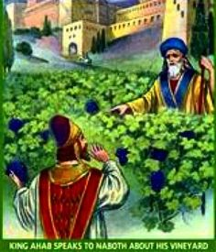
6. King Ahab coveted vineyard from farmer Naboth – led to murder & generational curse
1 Ki 21:19 Ask the king, 'Did you commit murder? And now you're going to steal as well?' Also tell him, 'This is what the LORD says: "Where the dogs were licking up Naboth's blood, dogs will also lick up your blood—that's right—yours!"

