Slide 1
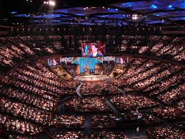
Church Buildings = Symbols of Gentiles’ temples
How did Christianity become a Religion?

Slide 2
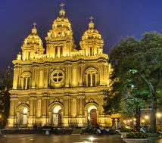
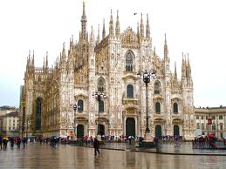
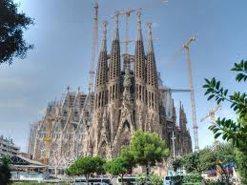
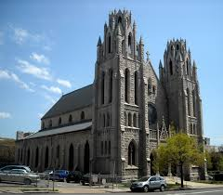
Edifice Complex
“church" building is so connected with the idea of church that we unconsciously equate the two.
how can a group of Christians rightfully claim to be a church without a building? Today’s thinking

Slide 3
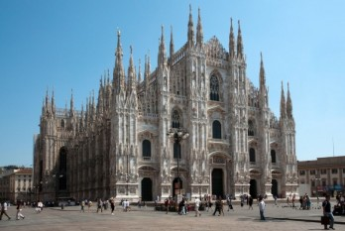

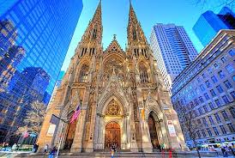
Today Church has almost become the building
Talk among believers
“That is the largest church I have ever seen”!
This thought has nothing to do with New Testament Christianity
reflects the thinking of other religions— Judaism and paganism.

Slide 4
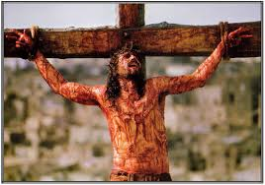
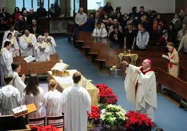
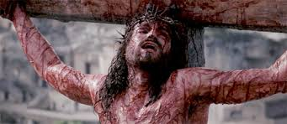
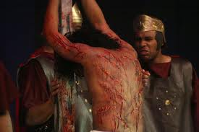
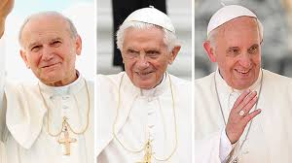
Temple, Priesthood, & Sacrifices
3 elements of Judaism
Jesus ended all three, fulfilling them in Himself
Jesus- the temple, the priest and perfect sacrifice (Acts 7:48)

Slide 5
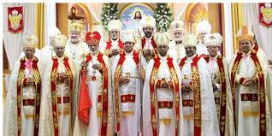
Christianity- the first non-temple-based religion ever to emerge
In Greco-Roman paganism,
3 elements present
Pagans had
temples, priests, and sacrifices
For early Christians, people were holy place- not architecture
They themselves—corporately—were the temple of God and the house of God.

Slide 6
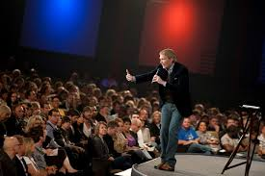
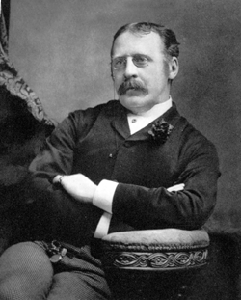
History of the Church
Nowhere in the New Testament do we find the terms ‘church” used to refer to a building.
The first recorded use of the word ekklesia to refer to a Christian meeting place -AD 190 by Clement of Alexandria(150-215)

Slide 7

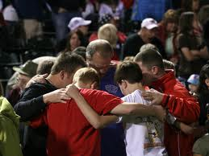
History of the Church
114 times ‘Church’ comes in N.T.
Everywhere “Church" = People
Even the word Clement used “Church” is a House
not building constructed for worship

Slide 8
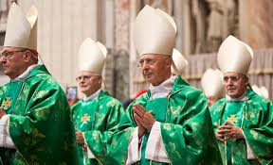
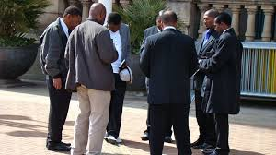
Churches, Priests, Sacrifice
Until the year 300, no
buildings built as churches.‘
Neither did they have a special
priestly caste that was set apart to
serve God.
Instead, every believer recognized that
he or she was a priest unto God.
The early Christians also did away with
sacrifices.
Only sacrifice offered –
spiritual sacrifices of praise and
thanksgiving (Heb. 13:15, 1 Peter2:5).

Slide 9
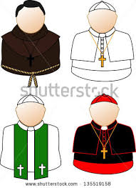
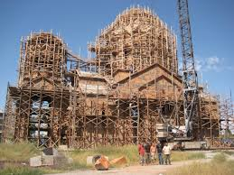
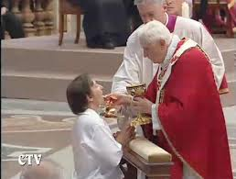
History of the Church
When Roman Catholicism evolved in the 4th -6th centuries.
it absorbed many of the religious practices of both paganism and Judaism.
Professional priesthood (Ministerial Priesthood)
Erected sacred buildings
Turned the Lord's Supper into a mysterious sacrifice.

Slide 10
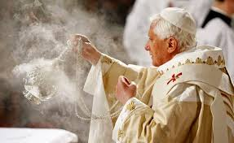
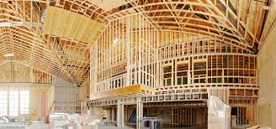
History of the Church
Following the path of the pagans, early Catholicism adopted the practice of burning incense and having vestal (sacred) virgins
The Protestants dropped the sacrificial use of the Lord's
Supper, the burning of incense, and the vestal virgins. But they
retained the priestly caste (the clergy)
as well as the sacred building.
Jesus’ announcement - if
the Temple was destroyed, He would build a new one in three days! ( John 2:19-21.)
His body -Temple .

Slide 11
History of the Church
Since Christ has risen, we Christians have become the temple of God. At His resurrection, Christ became a "life-giving spirit"(1 Cor. 15:45)

Slide 12
Hierarchical Structure of the Church
Pope
Cardinals
Sacred Congregations
Internuncios
Archbishops, Bishops
Priests
Laity

Slide 13
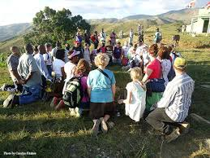
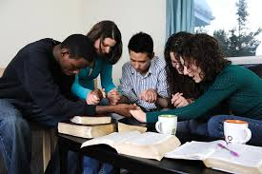

History of the Church
For the first three centuries, the Christians did not have any special buildings! As one scholar put it, "The Christianity that conquered the Roman Empire was essentially a home-centered movement.""
The Christian faith was born in homes, out in courtyards, and along roadsides.
As Christian congregations grew in size, they began to remodel their homes to accommodate their growing numbers."
Christians did not begin calling their buildings temples until the fifteenth century.‘

Slide 14
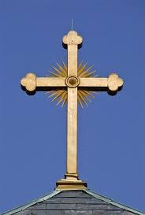
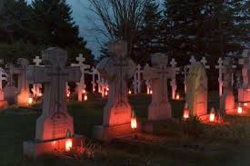
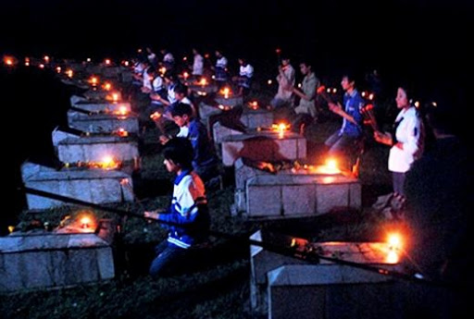
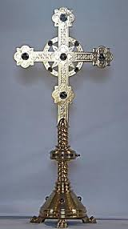
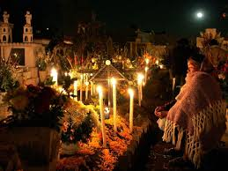
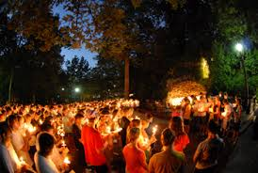
2nd, 3rd centuries
Christians began to adopt the pagan view of reverencing the dead.
Focus - honoring the memory of martyrs. So prayers for the saints(which later evolved into prayers to them) began .

Slide 15
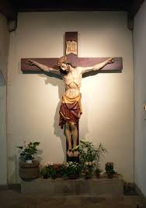
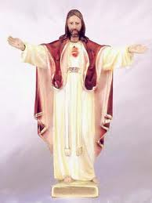
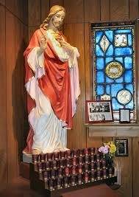
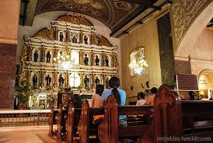
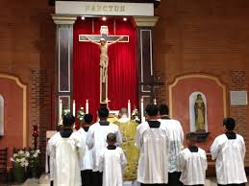
The custom of making the "sign of the cross" with one's hands dates back to 2nd century.
The crucifix, an artistic representation of the Savior attached to the cross, made its first appearance in the 5th century

Slide 16
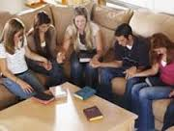
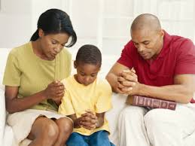
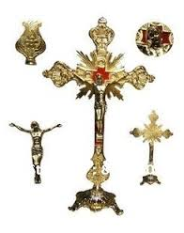
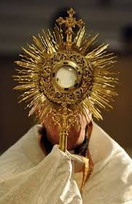
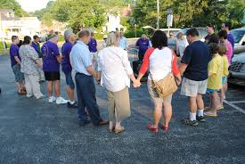
3rd century
Christians had two places for their meetings: their homes and the cemetery.”
began to decorate the catacombs (under-ground burial places) with Christian symbols. Christians began to venerate the bones of the saints, regarding them as holy and sacred
second- and third-century Christians began to assimilate the magical mind-set that characterized pagan thinking

Slide 17
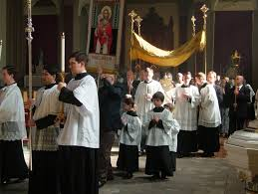
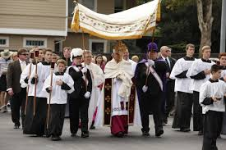
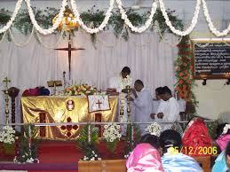
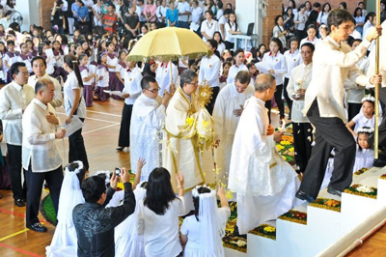
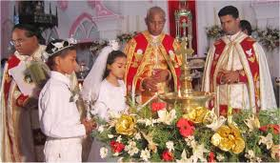
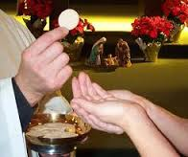
By the fourth century, the cup and the bread were seen as producing a sense of awe, dread, and mystery. As a result, the churches in the East placed a canopy over the altar table where the bread and cup sat.

Slide 18
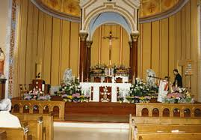
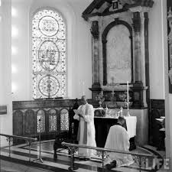
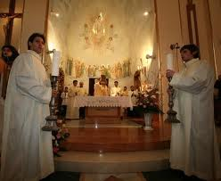

In the 16thcentury, rails placed upon the altar table.
Rails signified - altar table was a holy object only to be handled by holy persons
All factors made the Christian terrain ready for creating church buildings

Slide 19


Constantine ( 285-337) Father of Church Building
By 324, he became emperor of the entire Roman Empire.
He began ordering the construction of Church buildings
Intention
If the Christians had their own sacred buildings—as did the Jews and the pagans—their faith would be regarded as legitimate.

Slide 20
Sun worship of Constantine
Following his conversion to Christianity, Constantine never abandoned sun worship.
And he setup a statue of the sun god that bore his own image in the Forum of Constantinople

Slide 21

Constantine - Sun God worshipper
In AD 321, Constantine decreed that Sunday would be a day of rest—a legal holiday.
In honor of the god Mithras, the ‘Unconquered Sun.'(He described Sunday as "the day of the sun.")
Constantine "still functioned as the high priest of paganism."" In fact, he retained the pagan title Pontifex Maximus, which means chief of the pagan priests!
Constantine dedicated Constantinople as his new capital on May 11, 330, he adorned it with treasures taken from heathen temples.
Monuments to the twelve apostles.
Tomb reserved for Constantine in the centre —thus making himself the13th and chief apostle.

Slide 22




Sacred places & objects
pagan notion of sacredness of objects &
places - strengthened in Christianity
Palestine named “ Holy Land" - 6th century
After Constantine's death, he was declared to be "divine
Senate declared him to be pagan god at his death
In AD 326, his mother Helena made pilgrimage to Palestine

Slide 23
Step by step the Church deviated from the commandments of the Lord.
This led to the fall, bloodshed, all disputes power struggle we see in the Church today

Slide 24
Constantine’s Building program
Because the church building regarded as sacred, congregants had to undergo a purification ritual before entering.
4th entury, fountains erected in the courtyard so the Christians could wash before they entered the building.“
Constantine's church buildings - spacious and magnificent edifices that were said to be "worthy of an Emperor."
They were so splendid that his pagan contemporaries observed that these "huge buildings imitated" the structure of pagan temples." Constantine even decorated the new church buildings with pagan art."

Slide 25
Constantine’s Building program
The church edifices built - patterned exactly after the model of the basilica.”
Basilicas served the same function as high school auditoriums do today. They were wonderful for seating passive and docile crowds to watch a performance.
He favored it because of his fascination with sun worship. Basilicas were designed so that the sun fell upon the speaker as he faced the congregation." Like the temples of the Greeks and Romans, the Christian basilicas were built with a facade (front) facing east."

Slide 26
Christian basilicas
Christian basilicas possessed an elevated platform where the clergy ministered. The platform was usually elevated by several steps. There was also a rail or screen that separated the clergy from the laity."
The altar – became the most holy place - 2 reasons
1. Altar often contained the relics of the martyrs.“
2. In front of the altar stood the bishop's chair, called the cathedra."

Slide 27
Major influences on worship
Because the emperor was the number one "lay-person" in the church, a simple ceremony was not sufficient. In order to honor him, the pomp and ritual of the imperial court was incorporated into the Christian liturgy.'"
It was the custom of the Roman emperors to have lights carried before them whenever they appeared in public. The lights were accompanied by a basin of fire filled with aromatic spices.

Slide 28
Major influences on worship
Taking his cue from this custom, Constantine introduced candles & the burning of incense as part of the church service. And they were brought in when the clergy entered the room.‘
Under Constantine's reign, the clergy, who had first worn every-day clothes, began dressing in special garments. What were those special clothes? They were the garments of Roman officials.

Slide 29
Major influences on worship
The Roman custom of beginning a service with processional music was adopted as well. For this purpose, choirs were developed and brought into the Christian church. Worship became more professional, dramatic, and ceremonial.
All of these features were borrowed from the Greco-Roman culture and carried straight into the Christian church."'

Slide 30
4th Century Christianity
4th century Christianity - profoundly shaped by Greek paganism and Roman imperialism.'"
The upshot of it all was that there was a loss of intimacy and open participation. The professional clergy performed the acts of worship while the laity looked on as spectators.’
As one Catholic scholar wrote, with the coming of Constantine "various customs of ancient Roman culture flowed into the Christian liturgy . . . even the ceremonies involved in the ancient worship of the emperor as a deity found their way into the church's worship, only in their secularized form.

Slide 31
Recognition of Christianity
Constantine brought peace for all Christians.'" Under his reign, the Christian faith had become legitimate. In fact, it had risen to a status greater than Judaism and paganism.“
For these reasons, the Christians saw Constantine's rise to emperor as an act of God. Here was God's instrument who had come to their rescue.
Christianity and Roman culture were now melded together.'"

Slide 32
Christian Buildings
The Christian building demonstrates that the church, whether she wanted it or not, had entered into a close alliance with pagan culture.'
As Will Durant, author of The Story of Civilization (a sweeping, eleven-volume work on world history that earned him a Pulitzer Prize), put it,
"Pagan isles remained in the spreading Christian sea.’ - a tragic shift from the primitive simplicity that the church of Jesus Christ first knew.

Slide 33
Tax Exemption, Church endowments
The 1st century Christians were opposed to the world's systems and avoided any contact with paganism.
This all changed during the 4th century when the church emerged as a public institution in the world and began to "absorb and Christianize pagan religious ideas and practices.“
As one historian put it, "Church buildings took the place of temples; church endowments replaced temple lands and funds."'
Under Constantine, tax exempt status was granted for all church property.'"

Slide 34
Pagan Customs - absorbed
Christians imbibed the pagan idea that there exists a special place where God dwells in a special way. And that place is made "with hands.” opposite to Acts 7, 47,48
All pagan customs absorbed into the Christian faith (such as the liturgy, the sermon, clerical vestments, and hierarchical leadership structure)."

Slide 35
Victory of the Cross - Ekklesia
The old Mosaic economy of sacred priests, sacred buildings, sacred rituals, and sacred objects has been forever destroyed by the cross of Jesus Christ.
It has been replaced by a
non hierarchical,
non ritualistic, non liturgical
organism called
The ekklesia – House Church.

Slide 36
Basilica- Byzantine- Romanesque
After Constantine, Christian architecture Basilica - Byzantine phase
Byzantine churches -wide central domes and decorative icons and mosaics.
Byzantine architecture -> Romanesque architecture.'
Romanesque buildings - three-story elevation, massive pillars supporting round arches, and colorful interiors.'"
Romanesque -> Gothic style

Slide 37
12th Century –Gothic Architecture
Gothic architecture - the spell-binding Gothic cathedrals - cross-ribbed vaults, pointed arches, and flying buttresses.“
Colored glass - introduced to church buildings in 6th cen - the ultimate symbol of heaven joining the earth.'"
So with its use of light, color, and excessive height, the Gothic cathedral fostered a sense of mystery, transcendence, and awe.‘ Gregory of Tours (538-594).

Slide 38
Man’s quest to sense the divine with physical senses
Basilica, Romanesque, and Gothic Model church buildings - all human attempt to duplicate that which is heavenly and spiritual.‘
In a very real way, the church building throughout history reflects man's quest to sense the divine with his physical senses – Absolutely Impossible attempt

Slide 39
4th Cen. Christianity loses touch with heavenly realities
By the fourth century, the Christian community had lost touch with those heavenly realities and spiritual intangibles that cannot be perceived by the senses, but which can only be registered by the human spirit(1 Cor 2:9-16).
Message of Gothic architecture X Message of the Gospel
"God is transcendent and unreachable—so be awed at His majesty." But such a message defies the message of the gospel, which says that God is very accessible—so much so that He has taken up residence inside of His people.

Slide 40
Protestant Churches
In the 16th century, the Reformers inherited the aforementioned building tradition. In a short period of time, thousands of medieval cathedrals became their properties & the local rulers who controlled those structures joined the Reformation.‘
Most of the Reformers were former priests. Hence, they had been unwittingly conditioned by the thought patterns of medieval Catholicism.' So even though the Reformers did some remodelling to their newly acquired church buildings, they made little functional change in the architecture.'

Slide 41
Reformation – Martin Luther
The Reformers wanted to bring radical changes to the practice of the church - the masses were not ready
Martin Luther - quite clear that the church was not a building or an institution."
Yet it would have been impossible for him to overturn more than a millennium of confusion on the subject.'"

Slide 42
Babel- “Reach to the heavens”
Ever since the inhabitants of Babel erected a tower to "reach to the heavens," civilizations have followed suit by building structures with pointed tops.''
The Babylonians & Egyptians -> obelisks & pyramids that reflected their belief that they were progressing toward immortality.
Greek philosophy, culture came along, the direction of architecture changed from upward and vertical to down-ward and horizontal. All of this suggested the Greek belief in democracy, human equality, and earthbound gods.'"

Slide 43
Church Edifice - Huge investment of Money
The church edifice demands a vast infusion of money. In U. S. A. real estate owned by institutional churches today is worth over $230 billion.
Church building debt, service, and maintenance consumes about 18 percent of the $50 to $60 billion tithed to churches annually.
Point: Contemporary Christians are spending an astronomical amount of money on their buildings.

Slide 44
Sanctifying brick & stone
Most of us - completely unaware of what we lost as Christians when we began erecting places devoted exclusively for worship.
The Christian faith was born in believers' homes, yet every Sunday morning, scores of Christians sit in a building with pagan origins that is based upon pagan philosophy.
Scores of Christians pay good money each year to sanctify their brick and stone. By doing so, they have supported an artificial setting where they are lulled into passivity and prevented from being natural or intimate with other believers.‘

Slide 45
Victims of our Past
We have been
Fathered by Constantine who gave us the prestigious status of owning a building,
blinded by the Romans and Greeks who forced upon us their hierarchically structured basilicas
Taken by the Goths who imposed upon us their Platonic architecture.
Hijacked by the Egyptians and Babylonians who gave us our sacred steeples.
Swindled by the Athenians who imposed on us their Doric columns. From Byzantine to Romanesque model
3 stories one above the other

Slide 46
House of God?
Somehow we have been taught to feel holier when we are in "the house of God"
The building is an architectural denial of the priesthood of all believers. It is a contradiction of the very nature of the ekklesia—which is a countercultural community.

Slide 47
Revolution in Faith
It is high time we Christians wake up to the fact that we are being neither biblical nor spiritual by supporting church buildings.
Doing great damage to the New Testament message by calling man-made buildings "churches.“
If every Christian on the planet would never call a building a church again, this alone would create a revolution in our faith.

Slide 48
Challenge
Will you take up this challenge?
Of building people instead of building edifices?

