Slide 1
ISE 311
Sheet Metal Forming Lab
Shearing and Bending in conjunction with
Section 20.2 in the text book
“Fundamentals of Modern Manufacturing”
Third Edition
Mikell P. Groover
December 11, 2007

Slide 2
Outline
Introduction
Shearing
Bending
Objectives of the Lab
Bending experiment (Material and Equipment)
Bending experiment (Videos)
Summary

Slide 3
Introduction/ Shearing
The Shearing process involves cutting sheet metal into
individual pieces by subjecting it to shear stresses in the
thickness direction, typically using a punch and die,
similar to the action of a paper punch.
Unlike cup drawing where the clearance between the
punch and the die is about 10% larger than the sheet
thickness, the clearance in conventional shearing is from
4 to 8% of the sheet thickness.

Slide 4
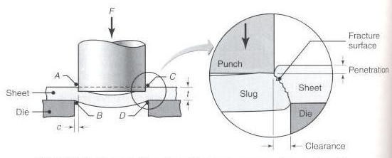
Introduction/ Shearing
Important variables of shearing are shown below
Manufacturing processes by S. Kalpakjian and S. Schmid

Slide 5
Introduction/ Shearing
The force required for shearing is:
F = S*t*L; where
S: shear strength of the sheet metal
t: sheet thickness
L: length of the cut edge
The shear strength S can be estimated by:
S = 0.7 * UTS; where
UTS: the Ultimate Tensile Strength
The above formula does not consider other factors such
as friction

Slide 6
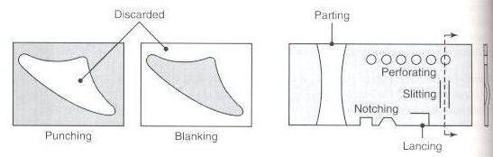
Introduction/ Shearing
Examples of shearing operations:
Manufacturing processes by S. Kalpakjian and S. Schmid
In punching, the slug is considered scrap, while in
blanking it is the product

Slide 7
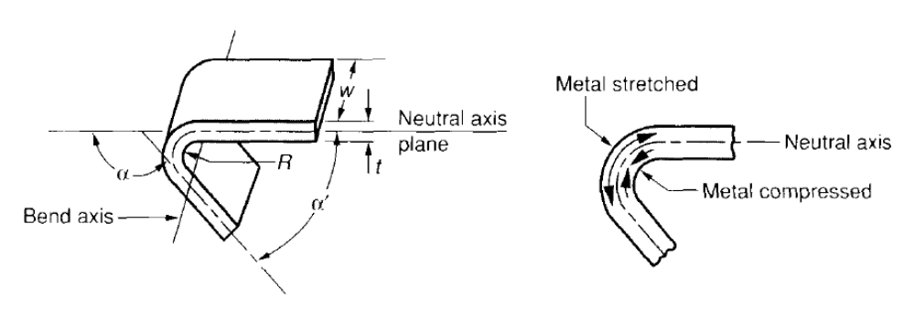
Introduction/ Bending
Bending is defined as the straining of metal around a straight axis. During this process, the metal on the inside of the neutral axis is compressed, while the metal on the outside of the neutral axis is stretched.
Fundamentals of Modern Manufacturing by M. Groover
α = bend angle
w = width of sheet
R = bend radius
t = sheet thickness
α′ = 180° - α, “included” angle

Slide 8
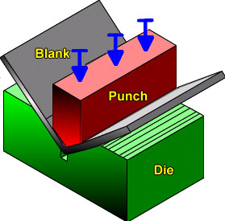
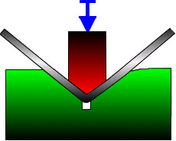
Introduction/ Types of Bending
Two common bending methods are:
  V-bending
  Edge or wipe bending.
In V-bending the sheet metal blank is bent between a V-shaped punch and die. The figure below shows a front view and isometric view of a V-bending setup with the arrows indicating the direction of the applied force:
Figure courtesy of Engineering Research Center for Net Shape Manufacturing

Slide 9
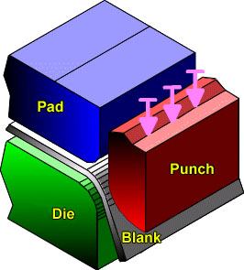
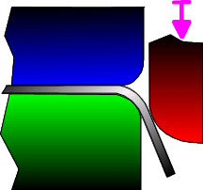
Introduction/ Types of Bending
Edge or wipe bending (conducted in lab) involves cantilever loading of the material. A pressure pad is used to apply a Force to hold the blank against the die, while the punch forces the workpiece to yield and bend over the edge of the die. The figure below clearly illustrates the edge (wipe)-bending setup with the arrows indicating the direction of the applied force (on the punch):
Figure courtesy of Engineering Research Center for Net Shape Manufacturing

Slide 10
Springback in bending
When the bending stress is removed at the end of the deformation process, elastic energy remains in the bent part causing it to partially recover to its original shape. In bending, this elastic recovery is called springback. It increases with decreasing the modulus of elasticity, E, and increasing the yield strength, Y, of a material.
Springback is defined as the increase in included angle of the bent part relative to the included angle of the forming tool after the tool is removed.
After springback:
The bend angle will decrease (the included angle will increase)
The bend radius will increase

Slide 11
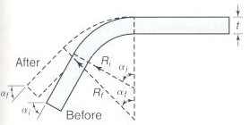
Springback in bending
Following is a schematic illustration of springback in bending:
Manufacturing processes by S. Kalpakjian and S. Schmid
α_{i}: bend angle before springback
α_{f}: bend angle after springback
R_{i}: bend radius before springback
R_{f}: bend radius after springback
Note: R_{i} and R_{f} are internal radii

Slide 12

Springback in bending
In order to estimate springback, the following formula
can be used:
Manufacturing processes by S. Kalpakjian and S. Schmid
where:
R_{i,} R_{f}: initial and final bend radii respectively
Y: Yield strength
E: Young’s modulus
t: Sheet thickness

Slide 13
Compensation for Springback
Many ways can be used to compensate for springback. Two common ways are:
Overbending
Bottoming (coining)
When overbending is used in V-bending (for example), the punch angle and radius are fabricated slightly smaller than the specified angle and raduis of the final part. This way the material can “springback” to the desired value.
Bottoming involves squeezing the part at the end of the stroke, thus plastically deforming it in the bend region.

Slide 14
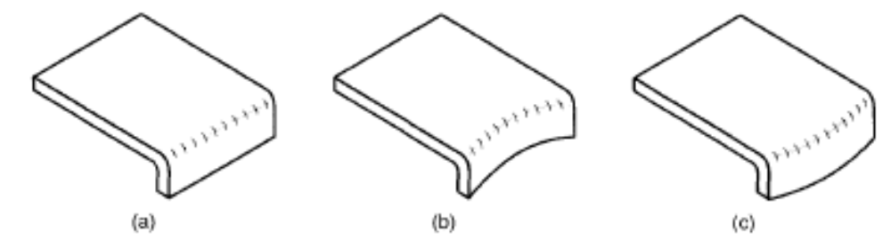
Variations of Flanging
Other bending operations include:
Flanging is a bending operation in which the edge of a sheet metal is bent at a 90° angle to form a rim or flange. It is often used to strengthen or stiffen sheet metal. The flange can be straight, or it can involve stretching or shrinking as shown in the figure below:
Straight flanging
Stretch flanging
Shrink flanging

Slide 15
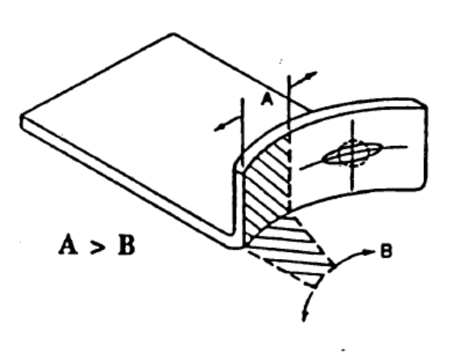
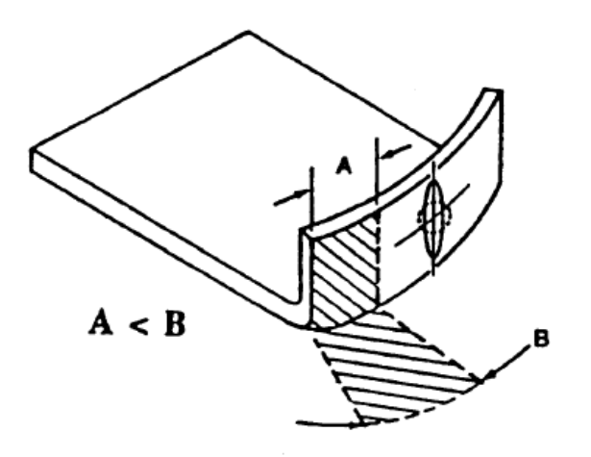
Variations of Flanging
In stretch flanging the curvature of the bending line is concave and the metal is circumferentially stretched, i.e., A > B. The flange undergoes thinning in stretch flanging.
In shrink flanging the curvature of the bending line is convex and the material is circumferentially compressed, i.e., A < B. The material undergoes thickening in shrink flanging.
Figures courtesy of Engineering Research Center for Net Shape Manufacturing

Slide 16
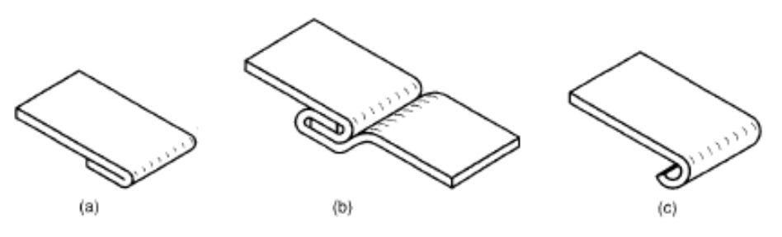
Variations of Bending
Other bending operations include:
Hemming involves bending the edge of the sheet over onto itself in more than one bending step. This process is used to eliminate sharp edges, increase stiffness, and improve appearance, such as the edges in car doors.
Seaming is a bending operation in which two sheet metal edges are joined together.
Curling (or beading) forms the edges of the part into a roll. Curling is also used for safety, strength, and aesthetics.
Hemming
Seaming
Curling

Slide 17
Bending Lab./ Objectives
This lab has the following objectives:
Become familiarized with the basic processes used in shearing and bending operations.
Analyze a bending operation and determine the springback observed in bending on aluminum strip.

Slide 18
Bending Lab.
Test Materials and Equipment
  Foot-operated shear
  “Finger brake” machine
Safety Equipment and Instructions
  Wear safety glasses.
  Conduct the test as directed by the instructor.

Slide 19
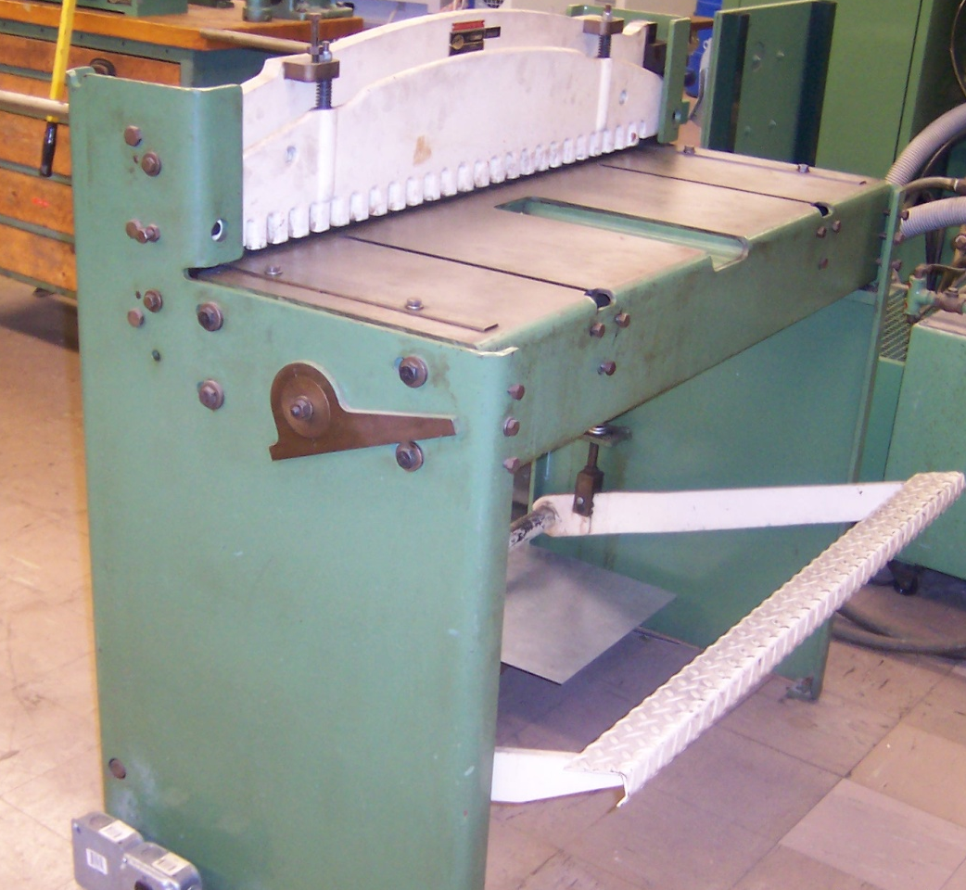
Bending Lab.
Procedure:
Obtain two different grades of Aluminum specimens to be sheared.
Cut two strips of each grade of Aluminum to approximately 0.5” width using the foot-operated shear.
Measure samples dimensions and record them in your datasheet

Slide 20
Bending Lab.
Procedure (continued):
Lock one specimen of each grade into the finger brake (use the 1/4” radius spacer) and use the lever located at the far right of the machine to clamp the specimens.
Once the 2 specimens are locked lift up the “wiping” table to bend the sheet against the die.
Next, lower the table, raise the lever, and remove the specimens.
Repeat the process again for the second spacer (1/8” radius)

Slide 21
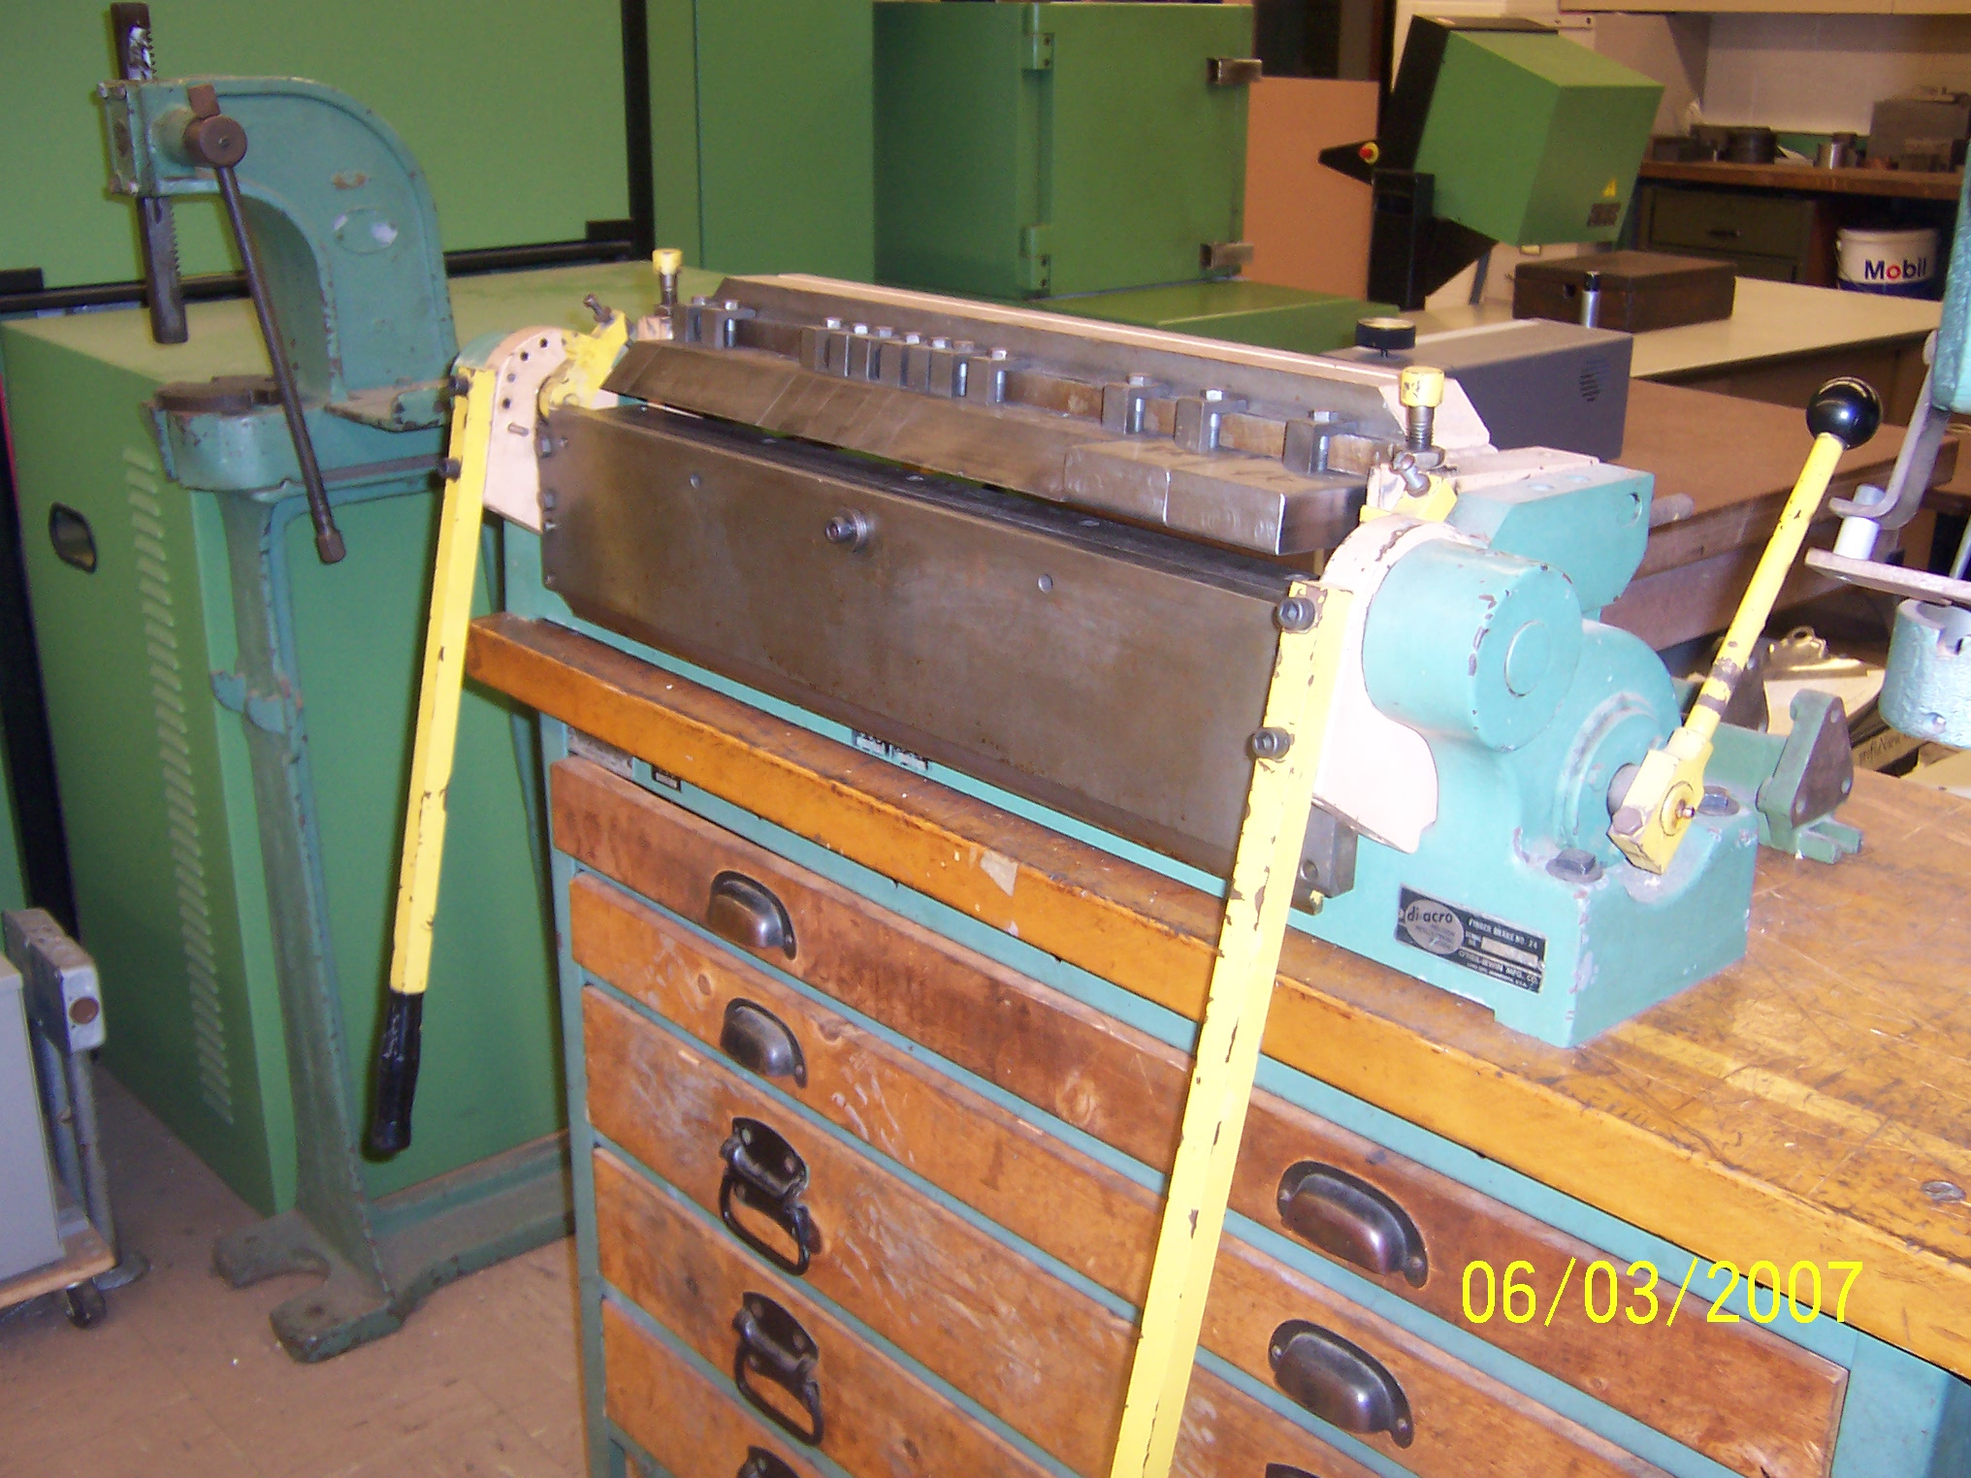
Bending Lab.
Dies used in bending
Locking lever
Wiping table

Slide 22
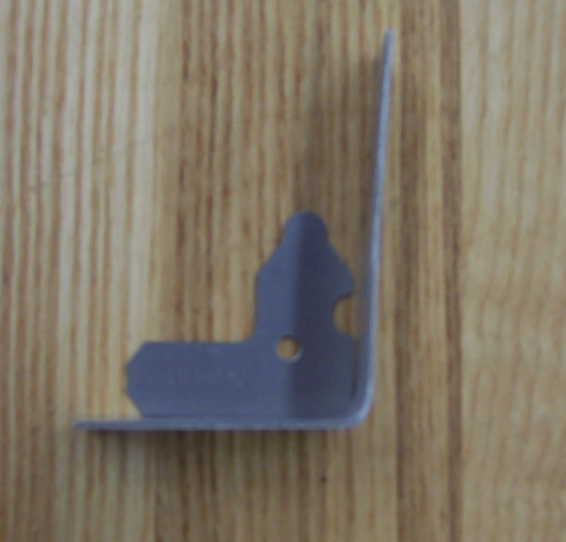
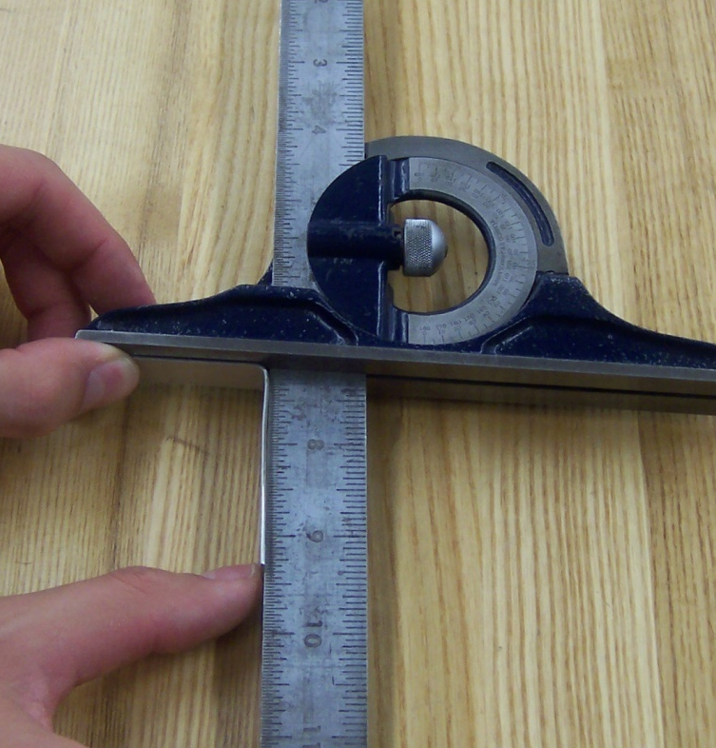
Bending Lab.
Procedure (continued):
After removing the specimens, use the radius gauges to measure the bend radius of each sample.
Measure the resulting bend angle of each specimen after springback.
Record the measured radii and angles in your datasheet

Slide 23
Finite Element Analysis (FEA) and Simulations
With FEA it is possible to emulate the compression and stretching of the material during bending.
Next slides illustrate the animation of a strip of sheet metal undergoing a bending process generated by FEA that simulates the actual deformation and springback of the sheet specimen.

Slide 24
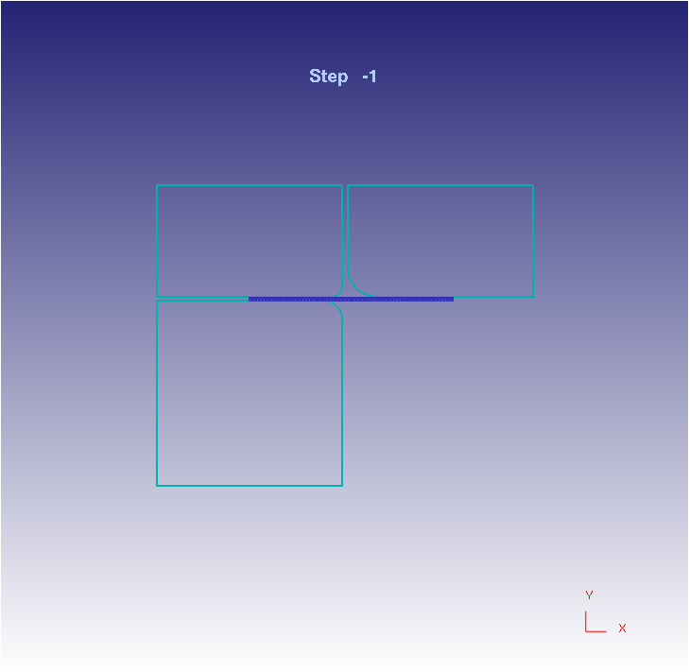
Bending Animation

Slide 25
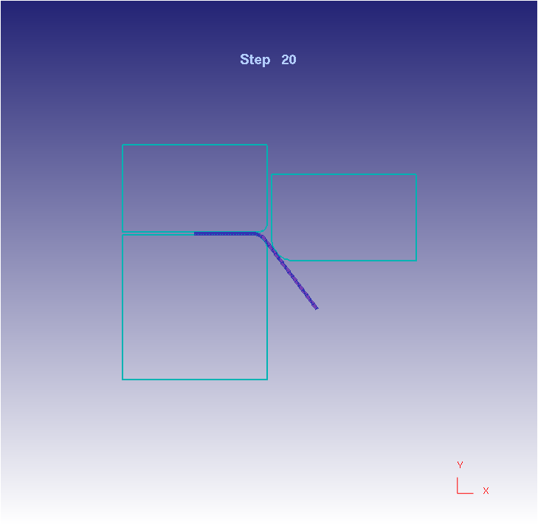
Bending Animation

Slide 26
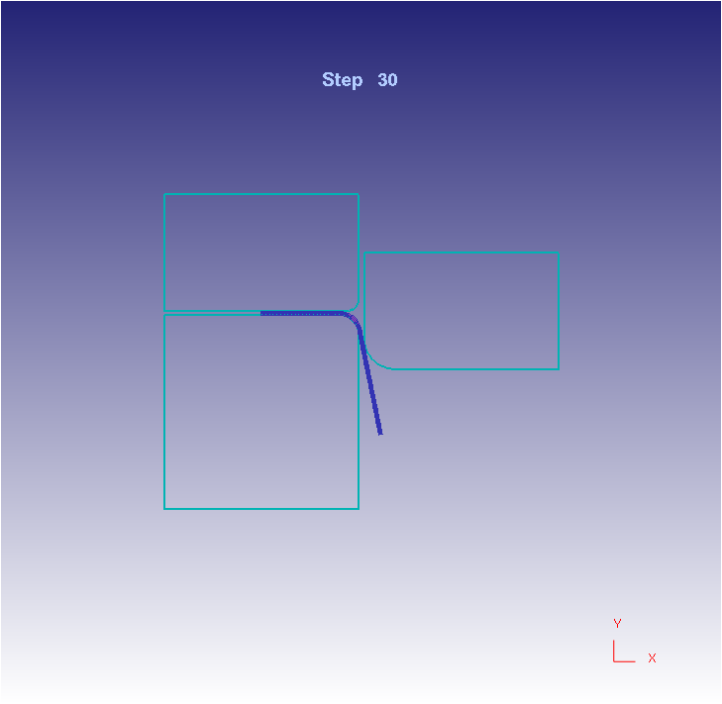
Bending Animation

Slide 27
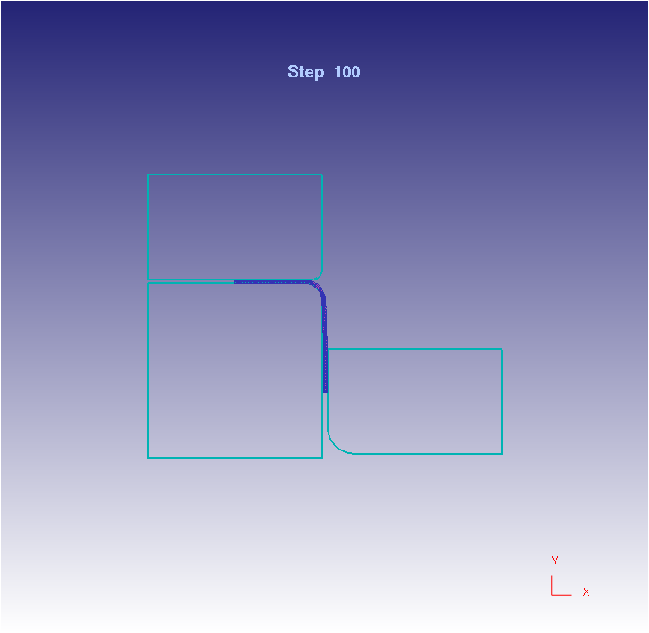
Bending Animation

Slide 28
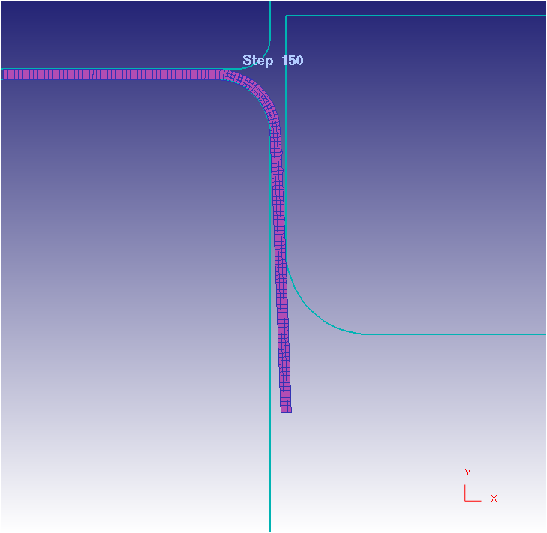
Springback Animation

Slide 29
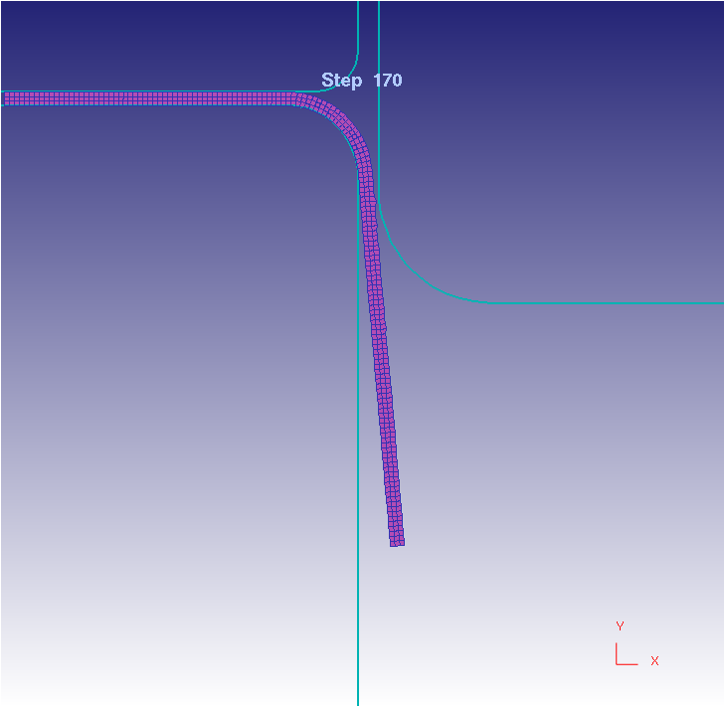
Springback Animation
Springback

Slide 30
Summary
This presentation introduced:
The basic principles of shearing, bending and the terminology used
Springback concept and prediction
The objectives of and the expected outcomes from the evaluation of experimental trials
The testing equipment and test procedure
FE simulation of the bending process

