Slide 1
PCF Intro
Benedikt Bergmann

Slide 2
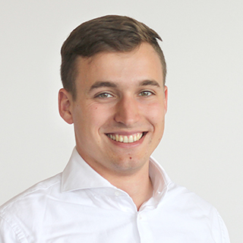
Benedikt Bergmann
Bachelor of Science Computer Science
Since October 2017 in Stockholm
Since November 2020 working for CRM Konsulterna
Microsoft Consultant
Dynamics CRM/CE/MDA
Power Platform
.Net development
Angular
First contact with Dynamics ~6.5 years ago

Slide 3
Agenda
What is PCF?
Use cases
Issues

Slide 4
What is PCF?
”Power Apps component framework”
”Agreement” → create components
Deployable
Reusable
Configurable
Different types
Field
Subgrid
Use on Forms, Views, Dasboard
Model-driven and Canvas (preview)
No Iframe

Slide 5
Use cases
Enhanced user experience
Visualize
(Integrate)
Transform
Optimize creation process
(Data validation)

Slide 6
Issues
No LookUp
Not stand alone
Custom PCFs → classic UI
Needs developer

Slide 7
Thank you
Twitter: https://twitter.com/BergmannBene
LinkedIn: https://www.linkedin.com/in/benedikt-bergmann
Mail: benedikt@benediktbergmann.eu
Blog: http://benediktbergmann.eu

