Slide 1
Characterisation horn antennas
Data: 26.11.2025

Slide 2
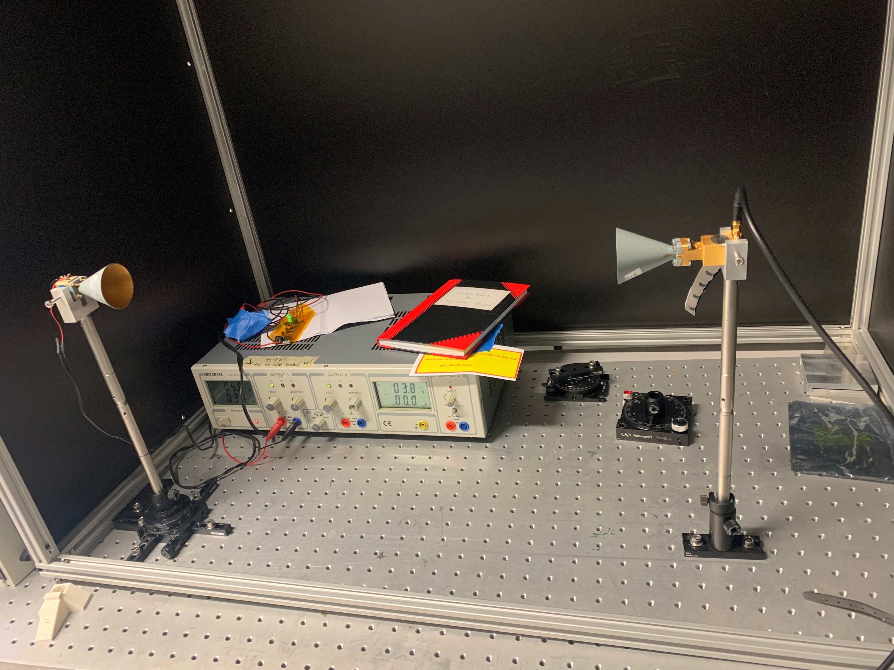
Rotate

Slide 3
Took a measurement from 0° to -50° in 0.5° steps

Slide 5
Next step:
  Automate
  Print a test lens

