Slide 1

Project Title - Seasonal Agriculture Performance Analysis
NAME: BENEETA JOHN
COLLEGE: PRESIDENCY UNIVERSITY, BENGALURU
AICTE STU ID : STU6a2b951ed47561781241118

Slide 2

PROBLEM STATEMENT
Agricultural performance is influenced by seasonal variations in environmental conditions, farming practices, resource availability, and market conditions.
Raw agricultural data does not clearly explain how agricultural performance changes across seasons or what patterns exist under different seasonal conditions.
This project analyzes the agricultural dataset to identify seasonal differences, meaningful patterns, trends, relationships, and variations in agricultural performance.

Slide 3
Project Description
Seasonal Agriculture Performance Analysis is a data analytics project that studies agricultural activities across different seasons, geographical areas, and farming conditions.
The dataset contains information about environmental conditions, farming practices, crop production, resource usage, and economic performance.
The project uses Python-based data analysis and visualization to clean the data, compare agricultural performance across seasons, analyze relationships between variables, identify patterns and unusual observations, and generate evidence-based insights and recommendations.

Slide 4

WHO ARE THE END USERS?
Farmers To understand seasonal crop performance and make better farming decisions.
Agricultural Departments To support evidence-based agricultural planning and identify seasonal trends.
Agricultural Analysts & Researchers To analyze patterns, relationships, resource usage, and agricultural outcomes.
Agricultural Planners & Decision Makers To compare seasonal performance and support resource and crop planning.

Slide 5

Technology Used
Programming Language
Python
Data Analysis & Visualization
Pandas • NumPy • Matplotlib • Seaborn • SciPy
Development & Project Management
Google Colab • Jupyter Notebook • GitHub

Slide 6
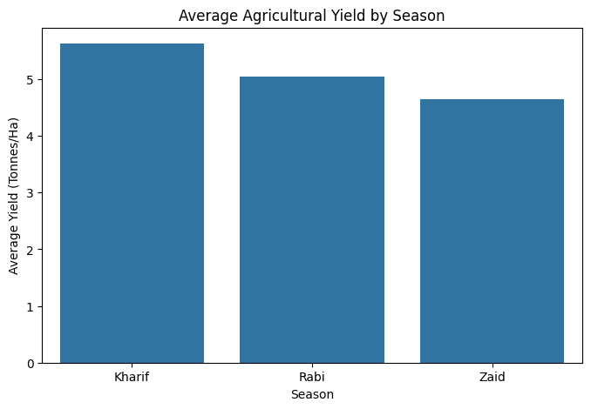
RESULTS – SEASONAL YIELD ANALYSIS
Kharif recorded the highest observed average yield (5.63 tonnes/ha), followed by Rabi (5.04 tonnes/ha) and Zaid (4.64 tonnes/ha).

Slide 7
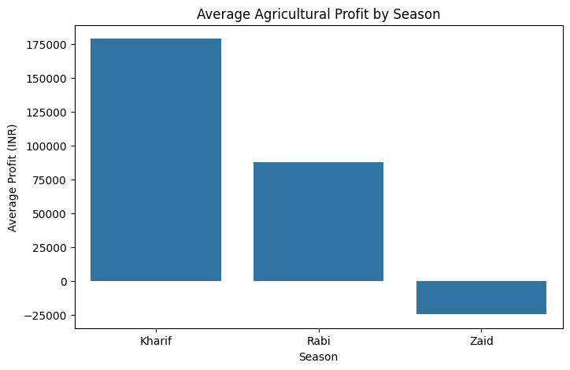
RESULTS – SEASONAL PROFITABILITY ANALYSIS
Kharif recorded the highest average profit (₹1.79 lakh), followed by Rabi (₹0.88 lakh), while Zaid recorded an average loss of ₹0.25 lakh.

Slide 8
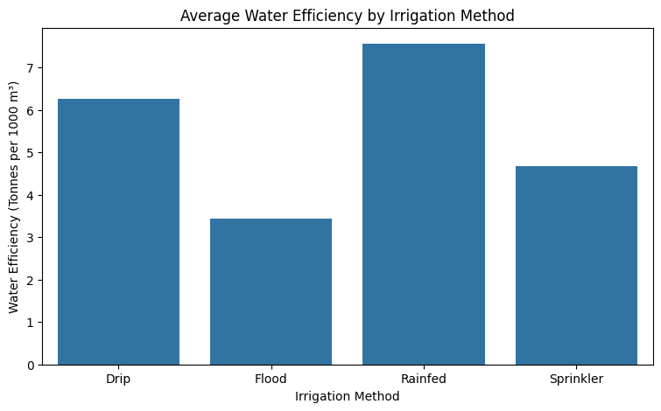
RESULTS – IRRIGATION & WATER EFFICIENCY
Rainfed farming recorded the highest average water efficiency (7.56 t/1000 m³), while Flood irrigation recorded the lowest (3.44 t/1000 m³).

Slide 9
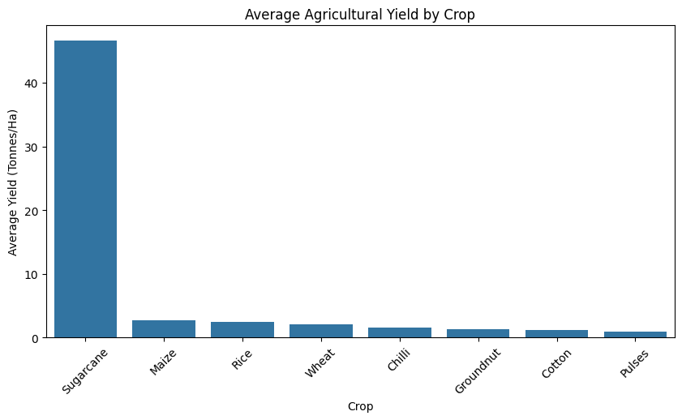
RESULTS – CROP PERFORMANCE ANALYSIS
Sugarcane recorded exceptionally high average yield (46.64 tonnes/ha), while Pulses recorded the lowest average yield (0.92 tonnes/ha).

Slide 10
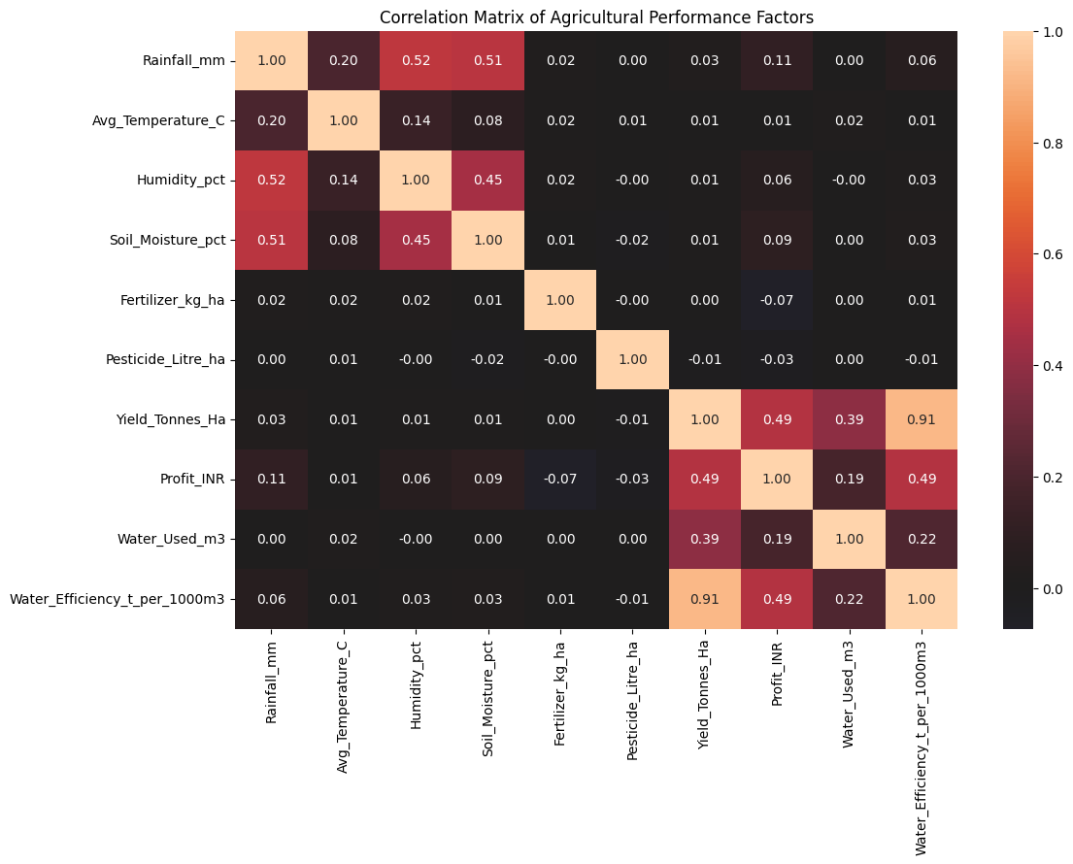
RESULTS – CORRELATION ANALYSIS
Water efficiency showed a very strong positive correlation with yield (r = 0.91), while yield showed a moderate positive correlation with profit (r = 0.49).

Slide 11
Future scope
Real-time agricultural data integration for continuous monitoring.
Weather forecasting integration to improve seasonal planning.
Predictive machine learning models for crop yield and profit forecasting.
Interactive dashboards for easier decision-making by farmers and agricultural planners.

Slide 12
GitHub Link
https://github.com/Beneeta2601/seasonal-agriculture-performance-analysis.git

Slide 13

VOIS Course completion certificate - Course name- Data Visualization

Slide 14
Thank you
.

