Slide 1
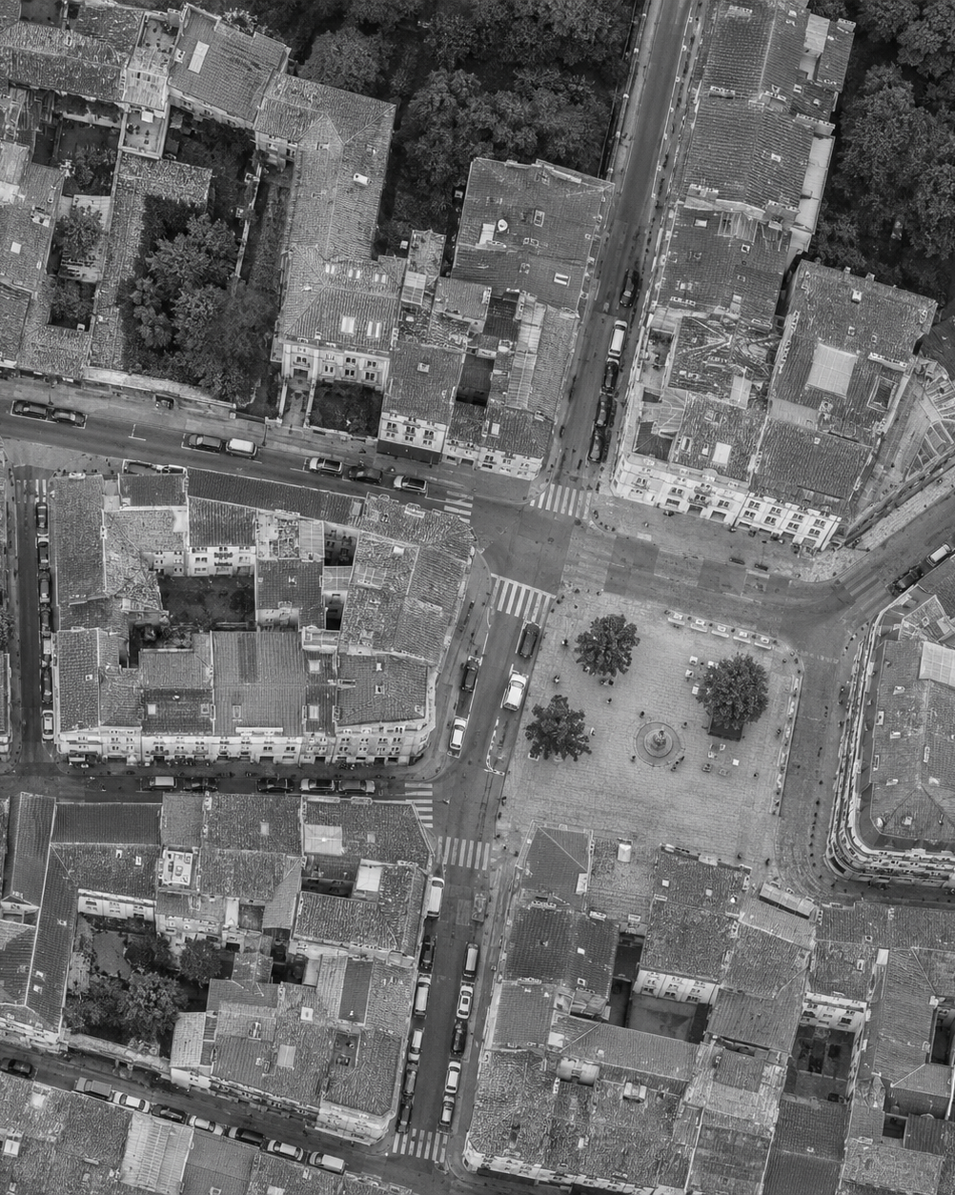
DIJKSTRA / TWO PRIORITY QUEUES
Does the
better bound
win on the clock?
Ben & James / Theory × measurement
01
Notes:
SLIDE 1 | JAMES | VIDEO 0:00–0:15
YOUR RECORDING: 0:00–0:15
READ ALOUD
We’re comparing binary and Fibonacci heaps inside Dijkstra’s shortest-path algorithm. I’m James, responsible for the binary implementation, and Ben is responsible for Fibonacci. Our question is whether the better theoretical bound translates into faster execution.
DO NOT READ ALOUD — SLIDE CUE
JAMES: NEXT SLIDE → 2 — A shorter route.
EVIDENCE AND RECORDING CHECKS — NOT SPOKEN
Conceptual cover image is AI-generated. Topic: priority queues in Dijkstra, Theme 3, https://edstem.org/au/courses/37005/lessons/115271 .
Matched-run record: C:/Users/Admin/Life/output/dijkstra-matched-2026-11-04-actual/ .
Brief: https://edstem.org/au/courses/37005/lessons/115272/slides/792285 .

Slide 2
DIJKSTRA / DECREASE-KEY
A shorter
route.
4
S
A
Find shortest paths from one source
with non-negative edge weights.
1
2
B
4
→
3
Direct route
Via B: 1 + 2
Figure 1. S → B → A costs 3;
the direct edge S → A costs 4.
decreaseKey(A, 3)
02
Notes:
SLIDE 2 | JAMES | VIDEO 0:15–1:00
YOUR RECORDING: 0:15–1:00
READ ALOUD
The problem is to find the cheapest path from one starting vertex to every reachable vertex, with non-negative edge weights.
Dijkstra repeatedly processes the vertex with the smallest tentative distance and checks whether its outgoing edges reveal a better route.
Here, the direct route from S to A costs four. But going through B costs one plus two, which is three. We update A’s distance and lower its queue priority using decrease-key.
Both versions perform this same shortest-path task. What changes is the priority queue used to select and update vertices.
DO NOT READ ALOUD — SLIDE CUE
JAMES: NEXT SLIDE → 3 — The cost of an update.
EVIDENCE AND RECORDING CHECKS — NOT SPOKEN
Teaching graph has edge costs 4,1,2. Dijkstra (1959): https://doi.org/10.1007/BF01386390 .
Matched-run record: C:/Users/Admin/Life/output/dijkstra-matched-2026-11-04-actual/ .
Brief: https://edstem.org/au/courses/37005/lessons/115272/slides/792285 .

Slide 3
The cost of an update
Compare worst-case binary-heap bounds with amortised Fibonacci-heap bounds.
OPERATION
Binary heap
Fibonacci heap
WORST CASE
AMORTISED
Insert
O(log V)
O(1)
Extract minimum
O(log V)
O(log V)
Decrease-key
O(log V)
O(1)
Dijkstra overall
O((V + E) log V)
O(E + V log V)
Both priority queues use O(V) auxiliary space.
Table 1. Bounds assume adjacency lists and direct queue access. V = vertices; E = edges.
03
Notes:
SLIDE 3 | JAMES | VIDEO 1:00–1:35
YOUR RECORDING: 1:00–1:35
READ ALOUD
With a binary heap, insertion, extraction and decrease-key each have logarithmic worst-case cost.
Fibonacci heaps improve insertion and decrease-key to constant amortised cost, while extraction remains logarithmic amortised.
Amortised means an average bound across a sequence of operations. It does not mean every individual decrease takes constant time.
That gives Dijkstra the two overall bounds shown here. Both queues use linear auxiliary space, although that does not mean they use the same number of bytes.
DO NOT READ ALOUD — SLIDE CUE
JAMES: NEXT SLIDE → 4 — Workload changes the trade off.
EVIDENCE AND RECORDING CHECKS — NOT SPOKEN
Bounds assume adjacency lists, indexed binary positions and Fibonacci handles. Graph storage is separately O(V+E).
Matched-run record: C:/Users/Admin/Life/output/dijkstra-matched-2026-11-04-actual/ .
Brief: https://edstem.org/au/courses/37005/lessons/115272/slides/792285 .

Slide 4
Workload changes the trade-off
Predicted trade-offs before measurement
Lower overhead
Cheaper updates
Binary heap: contiguous array
Fibonacci heap: linked nodes
0
1
2
3
4
5
Compact storage may favour binary
when queue updates are less frequent.
O(1) amortised decrease-key may
help when successful updates dominate.
Figure 2. Storage schematics illustrate structure; memory usage was not measured in the matched run.
04
Notes:
SLIDE 4 | JAMES | VIDEO 1:35–2:00
YOUR RECORDING: 1:35–2:00
READ ALOUD
The trade-off we wanted to investigate was implementation overhead versus cheaper updates.
A binary heap uses compact array storage. Fibonacci uses linked nodes and more structural bookkeeping, but has the better decrease-key bound.
More edges create opportunities for updates, although not every edge produces a shorter path.
I’ll start with the binary heap’s two correctness invariants.
DO NOT READ ALOUD — SLIDE CUE
JAMES: NEXT SLIDE → 5 — Binary heap.
EVIDENCE AND RECORDING CHECKS — NOT SPOKEN
Qualitative hypotheses are AI-assisted, as disclosed in METHOD_FROZEN_2026-11-01.md; they are not evidence of either student's recorded pre-run beliefs. Memory layouts are illustrative.
Matched-run record: C:/Users/Admin/Life/output/dijkstra-matched-2026-11-04-actual/ .
Brief: https://edstem.org/au/courses/37005/lessons/115272/slides/792285 .

Slide 5
Binary heap
Heap invariant: a parent’s key is no greater than either child’s key.
James · Binary heap deep dive
Before decrease-key
After two parent swaps
2
1
6
5
→
6
2
8 → 1; swap with 5,
then with 2.
12
9
7
8
12
9
7
5
position[vertex] → O(1) lookup
Sift-up: O(log V)
Figure 3. After the key changes from 8 to 1, two parent swaps restore min-heap order.
05
Notes:
SLIDE 5 | JAMES | VIDEO 2:00–2:55
YOUR RECORDING: 2:00–2:55
READ ALOUD
In the binary heap, every parent’s key must be no greater than either child’s key. This keeps the smallest key at the root.
Here, the last key decreases from eight to one. That temporarily breaks heap order. We swap it with five, then with two, until its parent is no larger or it reaches the root.
Each swap moves up one level, so the tree height limits sift-up to logarithmic time.
But heap order is only one invariant. Decrease-key must also find the correct vertex inside the array. My implementation maintains a separate position map, and every swap must keep that map consistent.
DO NOT READ ALOUD — SLIDE CUE
JAMES: NEXT SLIDE → 6 — A swap must update the position map.
EVIDENCE AND RECORDING CHECKS — NOT SPOKEN
Actual James source: james/binary_heap.hpp, siftUp(), swapNodes(), decreaseKey(). Diagram shows initial and final states.
Matched-run record: C:/Users/Admin/Life/output/dijkstra-matched-2026-11-04-actual/ .
Brief: https://edstem.org/au/courses/37005/lessons/115272/slides/792285 .

Slide 6
A swap must update the position map
James · Binary heap deep dive
Invariant: position[heap[i].vertex] = i
B: 9 → 3 (before sift-up)
After swapping slots 0 and 1
What breaks without it?
0
1
0
1
A: 8
B: 3
→
B: 3
A: 8
A stale position[A] still points to slot 0.
decreaseKey(A, 2) would update B instead.
position[A] = 0
position[B] = 1
position[A] = 1
position[B] = 0
position[heap[a].vertex] = a;
position[heap[b].vertex] = b;
Figure 4. Swapping array entries requires updating both inverse-map entries.
06
Notes:
SLIDE 6 | JAMES | VIDEO 2:55–4:20
YOUR RECORDING: 2:55–4:20
READ ALOUD
The second invariant is that each vertex’s position entry points back to its actual heap slot.
In this example, B decreases from nine to three. Before repairing the heap, A is in slot zero and B is in slot one. Sifting up swaps them, leaving B first and A second.
The position map must change at the same time. B’s position becomes zero, and A’s becomes one. The two code lines shown perform those updates after the array swap.
Without them, the heap could look correctly ordered while the vertex mapping was wrong. If A’s recorded position stayed zero, a later decrease-key for A would modify B instead.
Extraction needs the same consistency. The root swaps with the last entry before removal, and the removed vertex’s position becomes minus one to indicate that it is no longer queued.
This bookkeeping is necessary for correctness, as well as constant-time lookup. The matched verification checked full shortest-path distances against an independent oracle and exercised both actual heaps with random operation sequences.
Before Ben explains Fibonacci’s cuts, I’ll outline how we set up the comparison.
DO NOT READ ALOUD — SLIDE CUE
JAMES: NEXT SLIDE → 7 — Twenty seven graph datasets.
EVIDENCE AND RECORDING CHECKS — NOT SPOKEN
The temporary array is after B drops 9→3 and before sift-up. Exact update statements copied from swapNodes(). Extracted position becomes -1.
Matched-run record: C:/Users/Admin/Life/output/dijkstra-matched-2026-11-04-actual/ .
Brief: https://edstem.org/au/courses/37005/lessons/115272/slides/792285 .

Slide 7
27
Three graph sizes × three edge-to-vertex ratios
VERTICES
E/V = 4
E/V = 16
E/V = 64
250
graph datasets
3 sizes × 3 edge ratios
× 3 random seeds
1,000
4,000
CSV: source, target, weight
Starting vertex: 0
Each cell contains seeds 11, 22 and 33.
Figure 5. Nine configurations × three random seeds give the same 27 inputs to both implementations.
07
Notes:
SLIDE 7 | JAMES | VIDEO 4:20–4:45
YOUR RECORDING: 4:20–4:45
READ ALOUD
We used twenty-seven graph datasets: three vertex counts, three edge-to-vertex ratios, and three random seeds for each configuration.
Both implementations received the same graph files and started at vertex zero.
These families vary size and connectivity, but their edge counts remain proportional to their vertex counts. They are asymptotically sparse, so our conclusions do not cover genuinely dense graphs.
DO NOT READ ALOUD — SLIDE CUE
JAMES: NEXT SLIDE → 8 — A matched comparison.
EVIDENCE AND RECORDING CHECKS — NOT SPOKEN
27 core files: V=250,1000,4000; E/V=4,16,64; seeds11,22,33; source0. All families E=cV are asymptotically sparse.
Matched-run record: C:/Users/Admin/Life/output/dijkstra-matched-2026-11-04-actual/ .
Brief: https://edstem.org/au/courses/37005/lessons/115272/slides/792285 .

Slide 8
A matched comparison
One machine. Both submitted implementations. The same 27 graphs.
01
02
03
04
Same inputs
→
Both versions
→
Paired timing
→
Verified outputs
Parse CSV files and convert
graphs before timing.
James / binary
Ben / Fibonacci
Alternate which version
runs first in each trial.
Compare every distance
with an independent oracle.
SHARED BUILD
2 WARM-UPS / 8 PAIRED TRIALS
MSVC x64 · C++17 · /O2
Ryzen 5 7500F · Windows 11
Vertices: 250 / 1,000 / 4,000
Calls/batch: 32 / 8 / 2
Figure 6. Both implementations share the inputs and timing harness; all 27 graphs pass correctness checks.
08
Notes:
SLIDE 8 | JAMES | VIDEO 4:45–5:20
YOUR RECORDING: 4:45–5:20
READ ALOUD
We compiled both actual implementations into one optimized C-plus-plus executable and ran them on the same Windows machine.
Each graph received two warm-ups, followed by eight paired timing trials. We alternated which implementation ran first. The batch sizes shown reduce timing noise for the smaller graphs.
Parsing and graph conversion were excluded. Initialization, algorithm work and cleanup were included.
Both implementations’ complete distance vectors matched an independent oracle on all twenty-seven graphs. We also checked supplied fixtures, additional random graphs and heap operations separately from timing.
Ben will now explain his Fibonacci implementation before we look at the results.
DO NOT READ ALOUD — SLIDE CUE
JAMES: STOP RECORDING. Do not narrate slide 9. Ben starts his separate recording on slide 9.
EVIDENCE AND RECORDING CHECKS — NOT SPOKEN
Evidence: results/environment.json, source-provenance.json, correctness.txt. Timed scope includes initialization, allocations, algorithm, cleanup, result destruction and sink update. Graph parsing and conversion excluded. 432 raw batch rows, 54 per-instance summaries. No matched memory measurement; background load/affinity/power uncontrolled.
Matched-run record: C:/Users/Admin/Life/output/dijkstra-matched-2026-11-04-actual/ .
Brief: https://edstem.org/au/courses/37005/lessons/115272/slides/792285 .

Slide 9
Fibonacci heap
Lowering the key from 9 to 1 breaks heap order and triggers a cut.
Ben · Fibonacci heap deep dive
Before decrease-key
After the cut
Root nodes
2
5
7
→
2
5
7
1
Root list (sibling links omitted)
9
The minimum pointer now selects 1.
Only one cut is needed here.
Other decreases may trigger cascading cuts.
1 < 5: cut the node from its parent.
Figure 7. The decreased node joins the root list and becomes the new minimum.
09
Notes:
SLIDE 9 | BEN | VIDEO 5:20–6:05
YOUR RECORDING: 0:00–0:45
READ ALOUD
A Fibonacci heap stores a collection of heap-ordered trees. Each child’s key must be at least its parent’s key, and a minimum pointer identifies the smallest root.
Here, nine is a child of five. Lowering nine to one breaks that parent-child order, so we cut the node and add it to the root list.
The cut must repair the parent’s child pointer and degree. The new root has its parent and mark cleared, and the minimum pointer is updated.
Because five is already a root, this example stops after one cut. The trickier case happens when the parent is itself below another node.
DO NOT READ ALOUD — SLIDE CUE
BEN: NEXT SLIDE → 10 — Why a second child loss triggers a cut.
EVIDENCE AND RECORDING CHECKS — NOT SPOKEN
Actual Ben source: ben/fibonacci.hpp, cut(), root(), decrease_key(). Sibling ring links omitted. Parent 5 is a root, so no cascade in this example.
Matched-run record: C:/Users/Admin/Life/output/dijkstra-matched-2026-11-04-actual/ .
Brief: https://edstem.org/au/courses/37005/lessons/115272/slides/792285 .

Slide 10
Why a second child loss triggers a cut
Ben · Fibonacci heap deep dive
9 has already lost one child.
Decrease 13 → 1; cut twice.
First loss
Mark the non-root parent.
4
4
9
1
Second loss
Cut it; repeat at its parent.
9
Marked
non-root
Cut 1 from 9.
Then cut 9 from 4.
Both become unmarked roots.
13
→
Without the rule
Degree no longer guarantees
a large enough subtree.
Figure 8. Marking and cascading cuts preserve the structural bound used by extract-min.
10
Notes:
SLIDE 10 | BEN | VIDEO 6:05–7:40
YOUR RECORDING: 0:45–2:20
READ ALOUD
A non-root node is allowed to lose one child while staying attached to its own parent. That first loss marks it. If it loses a second child, we cut it too and apply the same rule to its parent.
In this diagram, nine is already marked because it previously lost a child. Its remaining child, thirteen, decreases to one.
First we cut one from nine. Because nine was marked, this second loss also cuts nine from four. Both become unmarked roots. The cascade stops at four because four is already a root.
This rule does more than restore heap order. If attached nodes could keep losing children indefinitely, a node’s degree would no longer guarantee a sufficiently large subtree. Limiting child loss preserves the structural bound that supports logarithmic amortised extraction.
A decrease can therefore trigger several cuts. Constant amortised decrease-key does not promise that each call performs only one cut. The amortised analysis uses potential stored in marked nodes to account for longer cascades.
My implementation’s checker verifies parent links, degrees, marks, circular list links and the minimum pointer. Targeted tests also exercise cascading cuts.
With those invariants in mind, we can now look at the results.
DO NOT READ ALOUD — SLIDE CUE
BEN: NEXT SLIDE → 11 — Matched runtime comparison.
EVIDENCE AND RECORDING CHECKS — NOT SPOKEN
9 is already marked from a prior loss. Cut 1 from 9, then cut 9 from root 4, stopping at 4. Degree/subtree-size control supports amortised extract-min, not a worst-case per-call guarantee. Each author must understand and personally explain their own segment.
Matched-run record: C:/Users/Admin/Life/output/dijkstra-matched-2026-11-04-actual/ .
Brief: https://edstem.org/au/courses/37005/lessons/115272/slides/792285 .

Slide 11
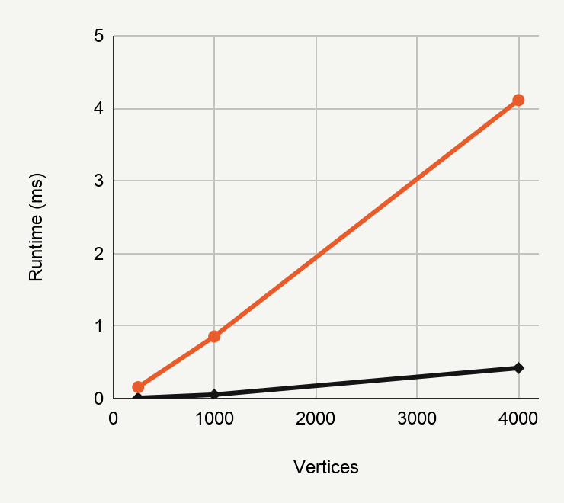
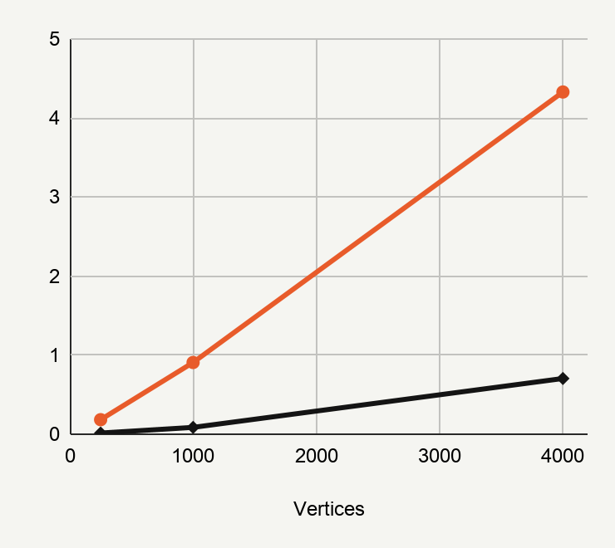
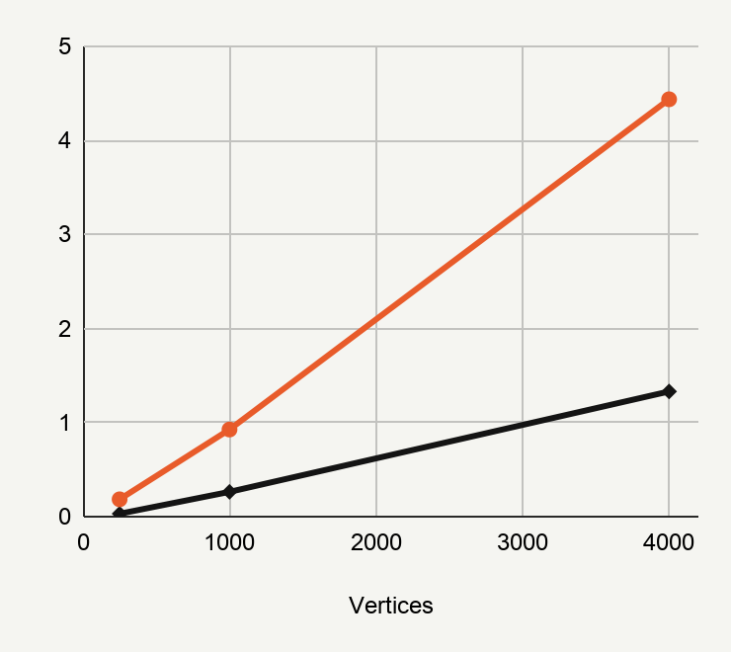
Matched runtime comparison
James’s binary implementation has lower medians in all nine configurations.
James’s binary heap
Ben’s Fibonacci heap
Values below: runtime at V = 4,000
E/V = 4
E/V = 16
E/V = 64
0.422 ms
4.114 ms
0.705 ms
4.330 ms
1.331 ms
4.438 ms
Figure 9. Each point is the median of three seed-specific medians. Every panel uses a 0–5 ms scale.
11
Notes:
SLIDE 11 | BEN | VIDEO 7:40–8:45
YOUR RECORDING: 2:20–3:25
READ ALOUD
Black shows the binary implementation, and orange shows Fibonacci. The panels use the same vertical scale, so their gaps are directly comparable.
Each point is the median across three graph seeds. Each seed’s result is itself the median of eight batch means.
Binary had the lower median in all nine configurations, and in all twenty-seven individual graphs.
At four thousand vertices and sixty-four edges per vertex, the medians were about one point three three milliseconds for binary and four point four four for Fibonacci.
There is still an interesting relative trend. At four thousand vertices, the Fibonacci-to-binary ratio falls from about nine point seven five to six point one four, then three point three three as the edge ratio rises.
Fibonacci becomes relatively more competitive, but we did not observe a crossover.
DO NOT READ ALOUD — SLIDE CUE
BEN: NEXT SLIDE → 12 — The heap is only part of the difference.
EVIDENCE AND RECORDING CHECKS — NOT SPOKEN
Evidence: results/aggregate.csv. Values in microseconds divided by1000 in linked charts. At V4000, E/V64: binary1.33115ms, Fib4.4382ms; ratio3.334109604. Ratios at V4000 across E/V4,16,64:9.753660,6.137789,3.334110. Both actual implementations, not the assistant reference.
Matched-run record: C:/Users/Admin/Life/output/dijkstra-matched-2026-11-04-actual/ .
Brief: https://edstem.org/au/courses/37005/lessons/115272/slides/792285 .

Slide 12
The heap is only part of the difference
Both examine the same edges, but their queue operations and outputs differ.
James / binary heap
Ben / Fibonacci heap
Insert vertices when discovered.
Return shortest-path distances.
Insert all vertices at initialisation.
Return distances and predecessors.
One graph: 10,820 binary decrease-keys vs 14,814 Fibonacci decrease-keys.
All tested families have E = cV. They remain asymptotically sparse; no dense-graph crossover was established.
Example: V = 4,000, E/V = 64, seed 11. Both implementations examine 256,000 edges.
12
Notes:
SLIDE 12 | BEN | VIDEO 8:45–9:35
YOUR RECORDING: 3:25–4:15
READ ALOUD
We need to qualify what that result means.
James’s version inserts vertices when they are discovered. My Fibonacci version inserts every vertex initially, then decreases its key on discovery. It also returns predecessor information alongside distances.
Those choices change the work being timed. On the example shown, both implementations examine the same two hundred and fifty-six thousand edges, but record different numbers of decrease-key operations.
So we can say which complete implementation was faster on these inputs. We cannot attribute the entire difference to heap structure alone. The individual effects of allocation, initialization, outputs and other implementation choices were not isolated.
The size of the runtime gap was the result that surprised me most.
DO NOT READ ALOUD — SLIDE CUE
BEN: NEXT SLIDE → 13 — The size of the performance gap.
EVIDENCE AND RECORDING CHECKS — NOT SPOKEN
Evidence: results/operation-counts.csv, V4000 E/V64 seed11: binary10820 decrease-keys, Fib14814, edges256000 each. Initialization, output contracts, integer types and tie-breaking differ. Counts identify workload differences, not measured causal shares.
Matched-run record: C:/Users/Admin/Life/output/dijkstra-matched-2026-11-04-actual/ .
Brief: https://edstem.org/au/courses/37005/lessons/115272/slides/792285 .

Slide 13
Ben’s surprise: the size of the performance gap
3.33×
A better decrease-key bound
did not translate into a faster
complete implementation.
Fibonacci runtime ÷
binary runtime
Binary: 1.331 ms
Fibonacci: 4.438 ms
4,000 vertices
E/V = 64
The ratio uses medians across three seeds. A matched implementation comparison, not a heap-only experiment.
13
Notes:
SLIDE 13 | BEN | VIDEO 9:35–10:45
YOUR RECORDING: 4:15–5:25
READ ALOUD
What surprised me was the size of the performance gap between our two implementations.
Even at our largest graph size and highest tested edge ratio, Fibonacci took about three point three three times the binary runtime. Across the full set of configurations, that ratio ranged from roughly three to seventeen.
The better decrease-key bound had not translated into a faster complete program in this workload.
Our best explanation is that the asymptotic bound leaves out costs that matter at these sizes, alongside the differences in initialisation and returned results on the previous slide.
We have evidence that the implementations perform different work, but we have not measured how much each difference contributes.
That makes a more controlled comparison the next useful experiment, rather than claiming Fibonacci heaps are always slower.
DO NOT READ ALOUD — SLIDE CUE
BEN: NEXT SLIDE → 14 — Theory and measurement.
EVIDENCE AND RECORDING CHECKS — NOT SPOKEN
Ben explicitly confirmed the size of the performance gap as his surprise. Do not attribute a separate surprise to James or invent a dated personal prior expectation. Ratio range across 9 aggregate configurations3.3341–17.3164.
Matched-run record: C:/Users/Admin/Life/output/dijkstra-matched-2026-11-04-actual/ .
Brief: https://edstem.org/au/courses/37005/lessons/115272/slides/792285 .

Slide 14
THEORY × MEASUREMENT
9/9
James’s binary
implementation
was faster.
tested configurations
No crossover in this workload.
Next: use one Dijkstra implementation with interchangeable heaps, then test larger and more update-heavy graphs.
This result applies to these implementations within the tested input range.
14
Notes:
SLIDE 14 | BEN | VIDEO 10:45–11:15
YOUR RECORDING: 5:25–5:55
READ ALOUD
Our binary implementation was faster in all nine tested configurations, and we found no crossover within this workload.
Next, we would use one Dijkstra implementation with interchangeable heaps, matching initialization and outputs, then test larger and more update-heavy graphs.
That would help separate the effect of heap choice from the other implementation differences. Thank you.
DO NOT READ ALOUD — SLIDE CUE
BEN: STOP RECORDING. End of presentation.
EVIDENCE AND RECORDING CHECKS — NOT SPOKEN
The shared-Dijkstra follow-up is proposed, not run. Assignment video hard cap12minutes for2members. Rehearse actual duration; script timing is an estimate. AI-use material remains in report scope, not an unfinished video appendix.
Matched-run record: C:/Users/Admin/Life/output/dijkstra-matched-2026-11-04-actual/ .
Brief: https://edstem.org/au/courses/37005/lessons/115272/slides/792285 .

