Slide 1
Session 11: Wrap-up & Exam Exercise Information
GSERM - Deep Learning: Fundamentals and Applications
Damian Borth, Korbinian Riedhammer, Marco Schreyer

Slide 2
Lecture Team
Damian Borth
Korbinian Riedhammer
Marco
Schreyer

Slide 3
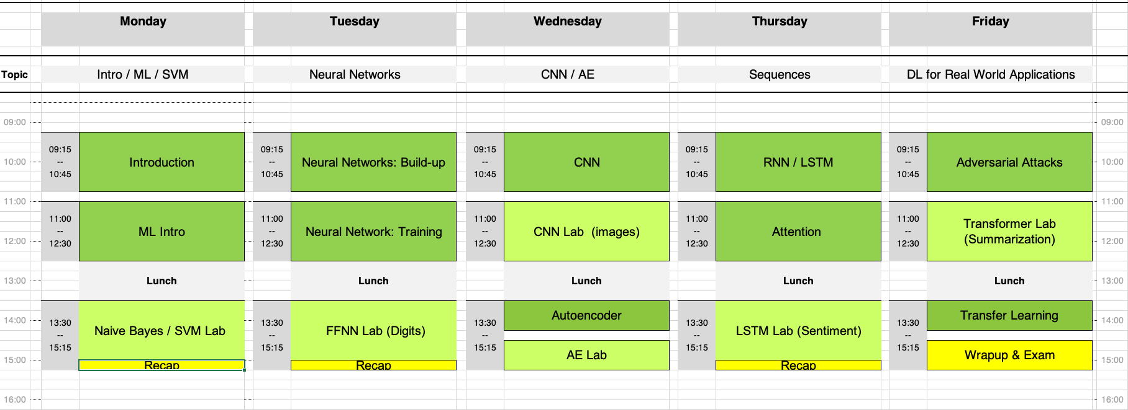
Course Plan

Slide 4
Exam Exercise

Slide 5
Exam Exercise - Setup
You will get:
all the Jupyter notebook from the course
PowerPoint template
You have you accomplish:
four inter-connected tasks
We need to receive:
Jupyter notebook (working code)
PowerPoint presentation as pdf or pptx (your documentation)
Deadline: Sunday - July 17th - end of day - St.Gallen time zone

Slide 6
Exam Exercise - Tasks
First Task
Work with the Fashion-MNIST dataset
Implement a CNN architecture to process the Fashion-MNIST dataset
Second Task
Train your network
Evaluate your CNN performance (at least accuracy and confusion matrix)
Third Task
try to improve your initial performance (e.g., architecture (layers, filters), learning rate, epochs, …)
Fourth Task
document your work in the PowerPoint presentation

Slide 7
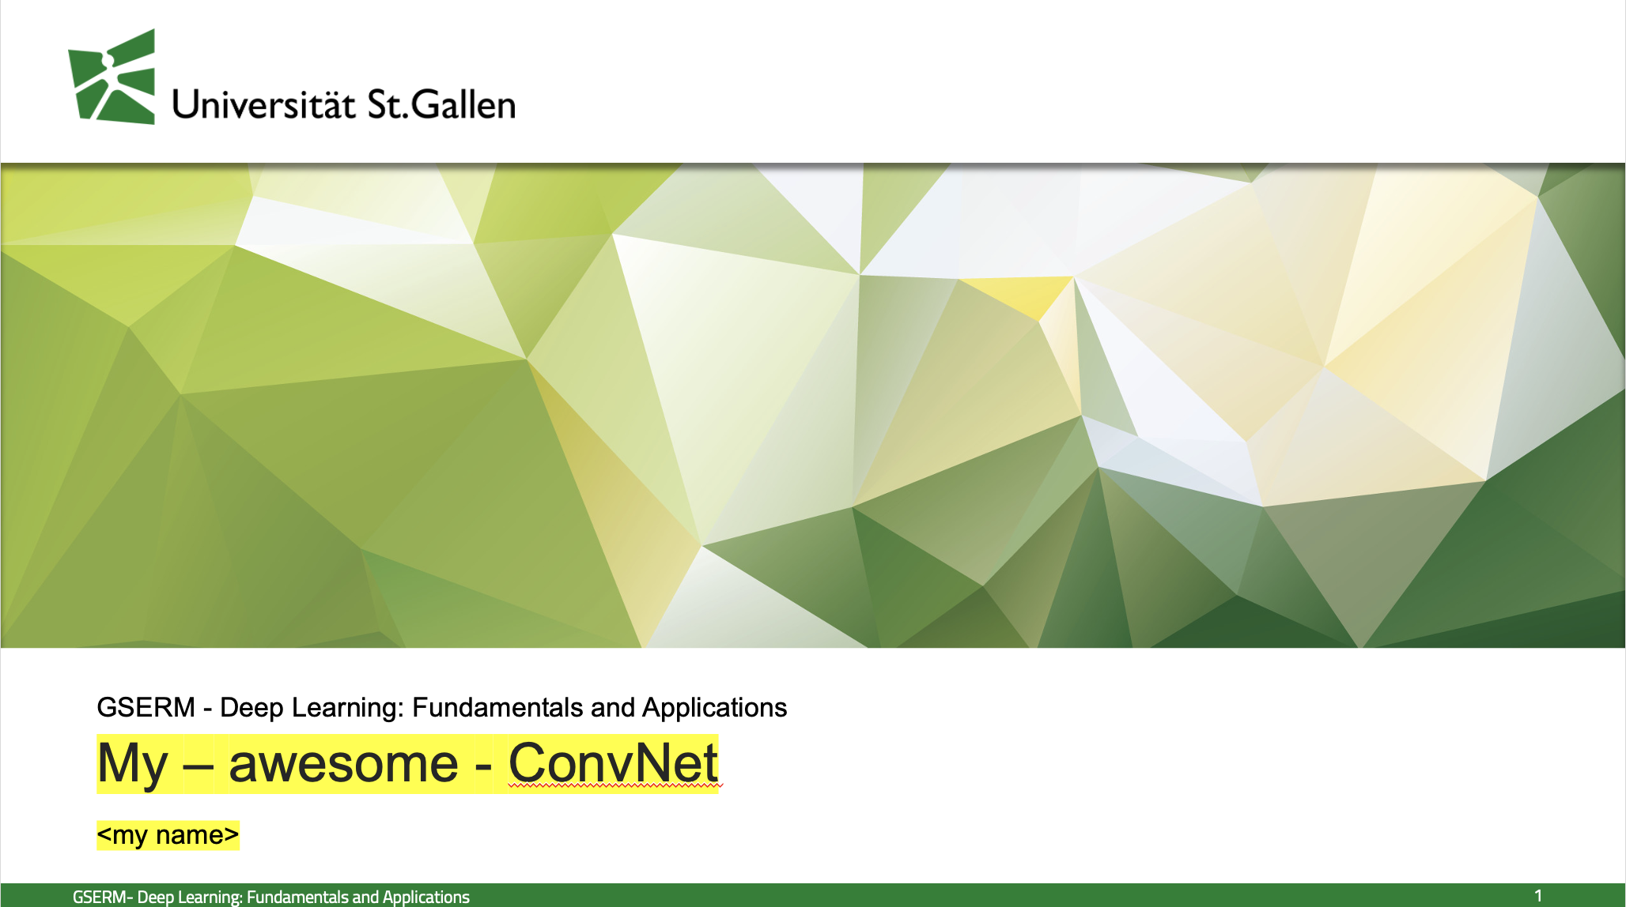
Exam Exercise – Suggest Slides Structure
Cover Sheet
your name
First part
illustrate your CNN architecture
baseline CNN, improved CNN
Second part
show your CNN evaluation (plots & numbers)
baseline CNN, improved CNN
Third part
your interpretation why your improved CNN is able / or not able to outperform the baseline CNN
use what you have learned during the lectures
Additional ideas / illustrations / results are welcome

Slide 8
Rules
Everybody has to send us her/his material individually
You can discuss the task and exchange ideas
You should not copy / paste code from your peers
this is plagiarism and a no-go in academia
however, as mentioned you can use the code from the Coding Labs !
Notes:
Everybody

Slide 9
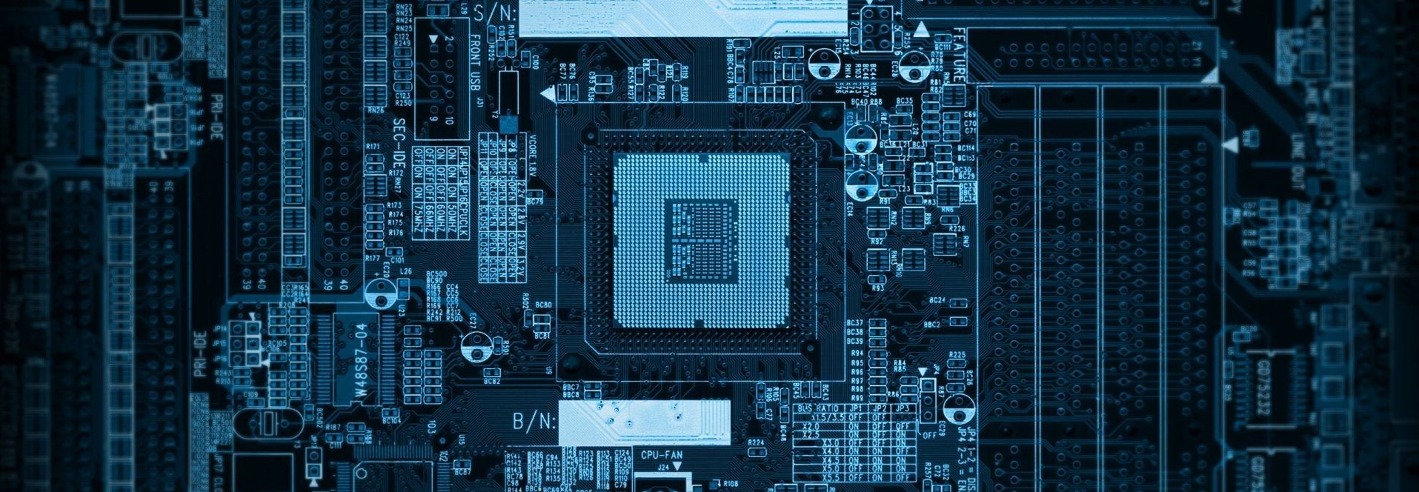
Questions?

