Slide 1

TRACK DOWN
PREPARED BY
18DCS003 | JIMMY AGHERA
18DCS007 | RUDRA BARAD
18DCS013 | HARDIK CHAVDA
6CSE1 - GroupId_03
SUPERVISOR
Ms. Krishna Patel
CS349 | Software Group Project - IV
Notes:
R

Slide 2
01
TABLE OF CONTENTS
02
03
04
05
06
07
INTRODUCTION AND
MOTIVATION
CURRENT
SYSTEMS
HARDWARE AND SOFTWARE ENVIRONMENTS
GANTT CHART AND
FLOW CHART
IMPLEMENTATION SNAPSHOTS
OR DEMONSTRATION
LIMITATIONS AND
FUTURE SCOPE
CONCLUSION
Notes:
R

Slide 3
INTRODUCTION
Track down is a web application which helps us to track people by finding and registering lost people.
Notes:
R

Slide 4
MOTIVATION
On estimation 8 million people are said to go missing each year, worldwide out of which only 1.3 were reported
According to the surveys conducted by multiple organizations in India approximately 60,000 children are going missing every year.
Notes:
R

Slide 5
DOMAINS USED
MACHINE
LEARNING
COMPUTER
VISION
Machine Learning is science of getting computers to learn and act like humans do, and improve their over time in autonomous machines.
Computer Vision enables computers to understand the content of images and videos.
WEB
APPLICATION
Web Application development is the creation of application programs that reside on remote servers
Notes:
H

Slide 6
CURRENT SYSTEMS
Peoplefinders.com
peoplefinder.ai
It is a public records business located in California. The company offers a variety of public records including address histories, phone numbers & background
It is chrome extension to find people from a huge database of millions of business professionals. It can help find customers contact information and profile based on search keywords
Notes:
H

Slide 7
HARDWARE AND SOFTWARE ENVIRONMENTS
HARDWARE
Laptop / Computer with Core i5 8th gen
2GB Hard Disk Storage
SOFTWARE
Google Collab
Visual Studio Code
MongoDB
Browser
Notes:
H

Slide 8
GANTT CHART
25%
50%
75%
90%
Face Recognition and Comparison
Web Application UI and Development
Database and backend.
Integrating Backend and Frontend.
Notes:
H

Slide 9
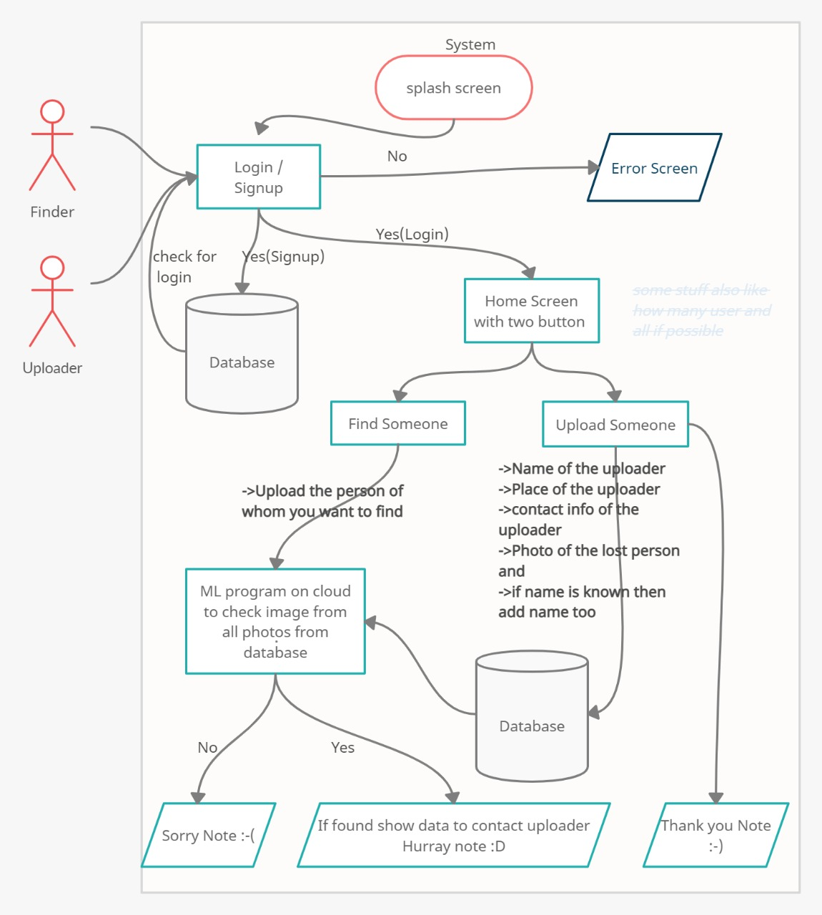
Flow chart
Notes:
J

Slide 10
LIMITATIONS
LIMITED FILTERS
More Filters Could be added to get accurate results
Advance security
To prevent heap of false information, authentication of uploader can be asked
QUALITY
Model will not be able to compare inappropriate photos.
Notes:
J

Slide 11
FUTURE SCOPE
01
nOTIFICATION
02
INSTANT SEARCH
When a person is found then the uploader gets notified automatically
Connecting it with CCTV Cameras in order to find anyone at any instant
03
EXPANDING
04
TIme complexity
Time complexity of searching can be reduced by using clustering.
Expanding the database and reachability of people around the world
Notes:
J

Slide 12
RESOURCES
IDEAS AND ABSTRACTS
face_recognition/examples at master · ageitgey/face_recognition (github.com)
https://creately.com/
https://material-ui.com/getting-started/templates/
FACTS
https://trackimo.com/facts-statistics-on-missing-persons/
https://www.hindustantimes.com/india-news/with-60-000-children-going-missing-in-india-every-year-social-media-has-propelled-child-lifting-fear/story-AvL4yvASeN4fgXQPoAkBKP.htm

Slide 13
THANKYOU !

Slide 15
CONCLUSION

