Slide 1
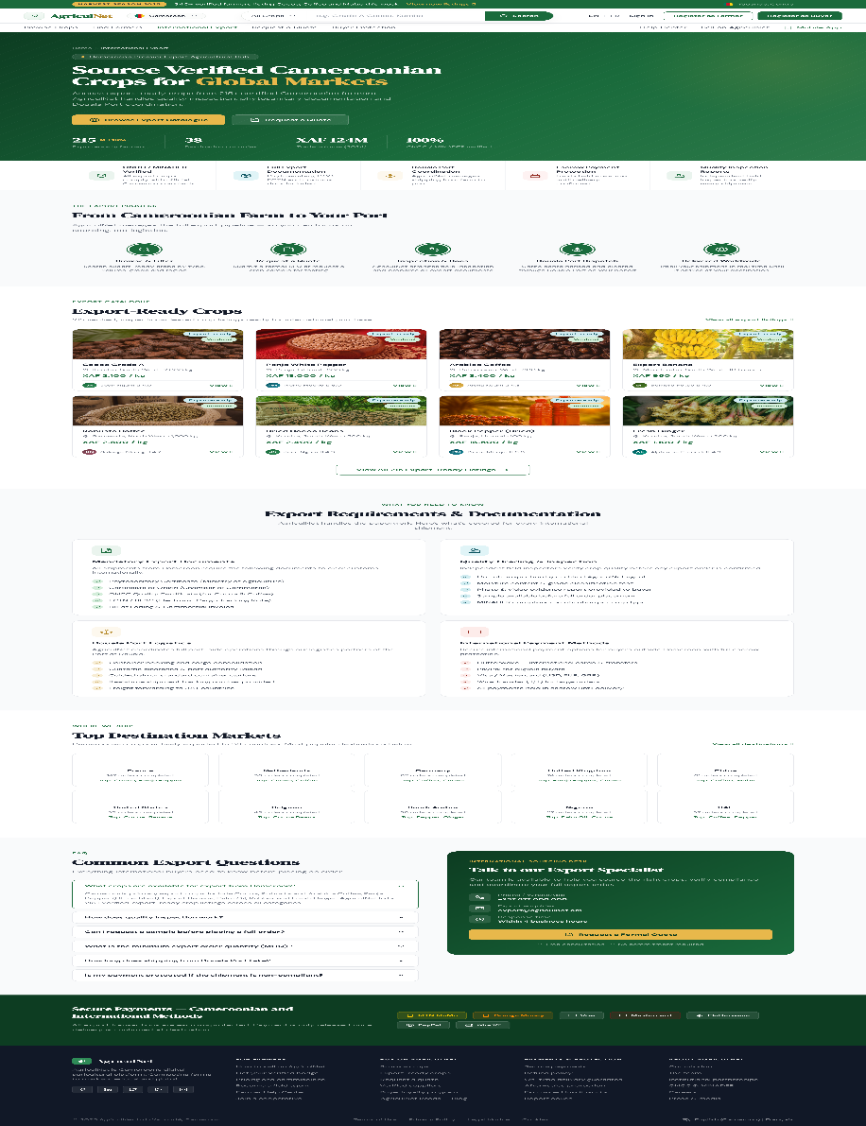
FINAL YEAR PROJECT PRESENTATION
AgriculNet
A digital platform connecting Cameroonian farmers, resellers, buyers, and administrators through verified sourcing, protected trade workflows, and export support.
Prepared for academic panel review | Cameroon-focused agricultural trade system
Stack: Next.js, Express, Supabase, Railway, Vercel

Slide 2
PROBLEM STATEMENT
Why AgriculNet matters
Current trade pain points
â€¢ No reliable digital marketplace tied to real farmer verification
â€¢ Limited coordination for documentation, inspection, and export readiness
â€¢ Payment uncertainty between buyer and seller
â€¢ Weak visibility for verified farmers and cooperatives
â€¢ Few digital tools adapted to local agricultural trade realities
Many Cameroonian farmers still depend on fragmented buyer networks, weak price visibility, informal payment practices, and poor access to export-ready workflows. These issues reduce trust, margin, and delivery confidence.
Academic framing
The project addresses a real business and logistics problem with a software system that combines marketplace access, verification, communication, and protected trade operations.
AgriculNet | Academic Presentation | 2026
2

Slide 3
OBJECTIVES
What the system was designed to achieve
â€¢ Digitize crop sourcing between farmers, resellers, and buyers
â€¢ Provide verified farmer and listing visibility
â€¢ Support buyer protection and controlled payment release
â€¢ Create a structured communication path for quotes, orders, and support
â€¢ Enable international export workflows and compliance-aware sourcing
â€¢ Give administrators operational oversight over users, listings, orders, disputes, and payments
Primary users
Farmers, resellers, buyers, and admins all operate on the same platform with role-specific dashboards and permissions.
Expected outcomes
Higher trade trust, better sourcing visibility, clearer operational workflows, and a platform that reflects Cameroonian agricultural realities rather than generic marketplace assumptions.
AgriculNet | Academic Presentation | 2026
3

Slide 4
USERS AND SCOPE
Who uses AgriculNet and what each role does
Farmers
Resellers
Buyers
Admins
Create and manage listings, complete identity verification, respond to inquiries, track orders, and receive controlled payout visibility.
Source and resell crop supply, publish trade-ready inventory, coordinate with buyers, and operate like sellers within marketplace controls.
Browse crops, find farmers, save listings, place orders, communicate with sellers, manage support issues, and initiate payment.
Review users and verification submissions, oversee listings and operations, monitor payments, and resolve disputes or inspections.
Scope boundary
AgriculNet is not just a public catalogue. It combines public discovery pages with authenticated operational dashboards, internal order/payment records, and verification governance.
AgriculNet | Academic Presentation | 2026
4

Slide 5
SYSTEM OVERVIEW
Core platform features
Marketplace discovery
Role-based dashboards
Protected operations
Browse crops, find verified farmers, inspect listing detail, and search international export-ready supply.
Buyer, farmer, reseller, and admin workspaces present different controls, metrics, and operational flows.
Orders, payments, support requests, verification review, and admin oversight are all tracked through backend workflows.
Communication layer
Export readiness
Deployment
Inquiries, messages, support tickets, and order-related conversation flows reduce transaction friction.
Public pages explain international sourcing, documentation, and ONCC / MINADER-aligned compliance expectations.
Frontend is deployed on Vercel, backend on Railway, with Supabase for database and storage services.
AgriculNet | Academic Presentation | 2026
5

Slide 6
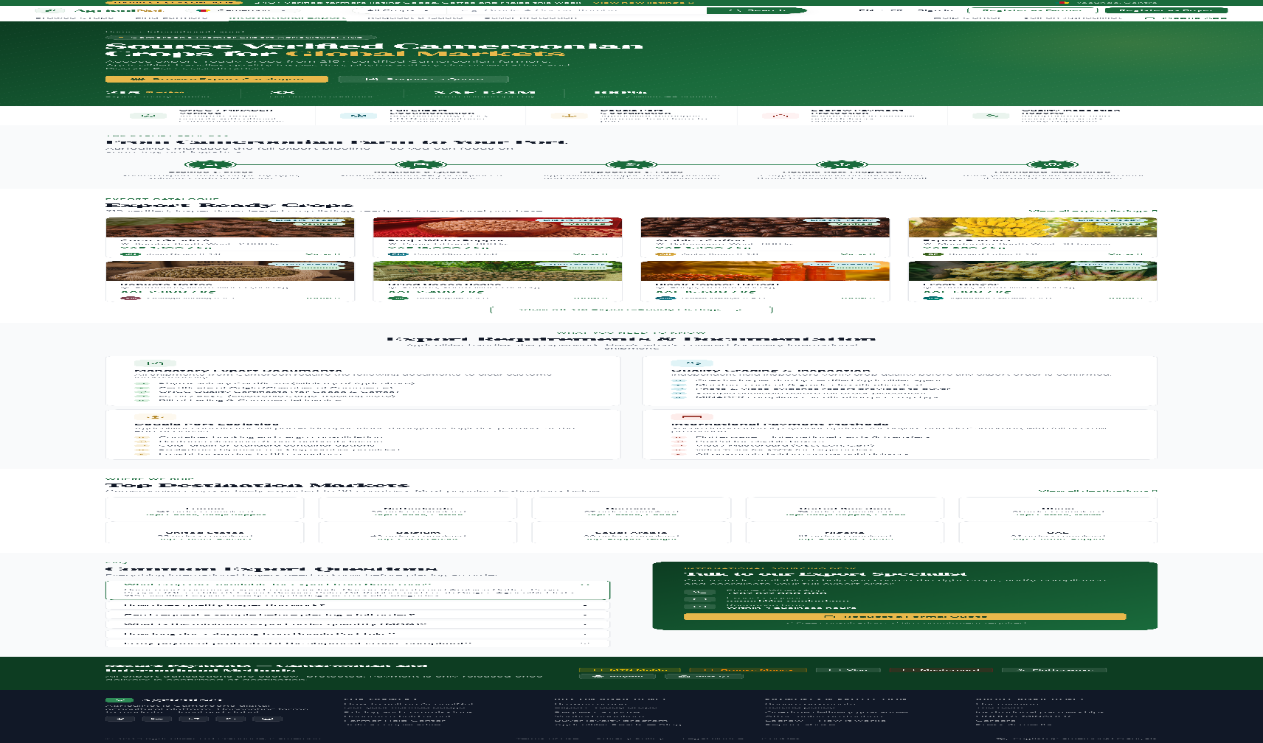
PUBLIC EXPERIENCE
Public marketplace and export-facing presentation
â€¢ Export-focused public page for international buyers
â€¢ Showcases export-ready listings and sourcing process
â€¢ Explains logistics, documentation, and payment protection
â€¢ Uses branded green and gold visual identity
Presenter cue
Use this slide to explain how AgriculNet attracts and informs buyers before they enter authenticated workflows.
AgriculNet | Academic Presentation | 2026
6

Slide 7
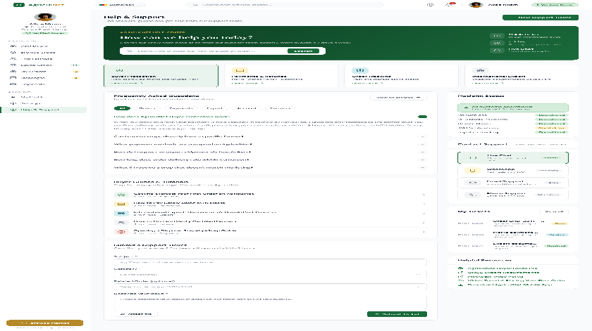
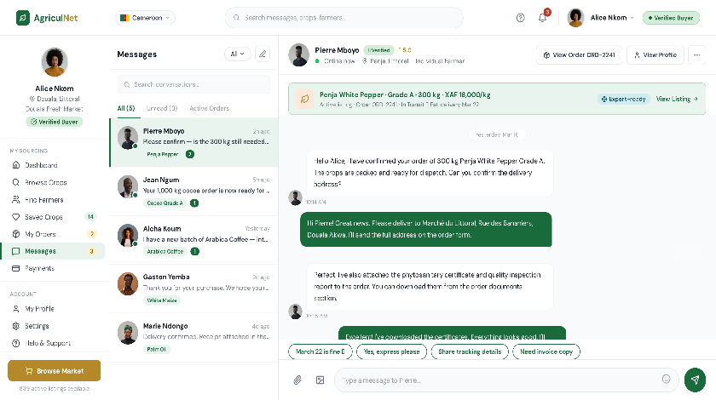
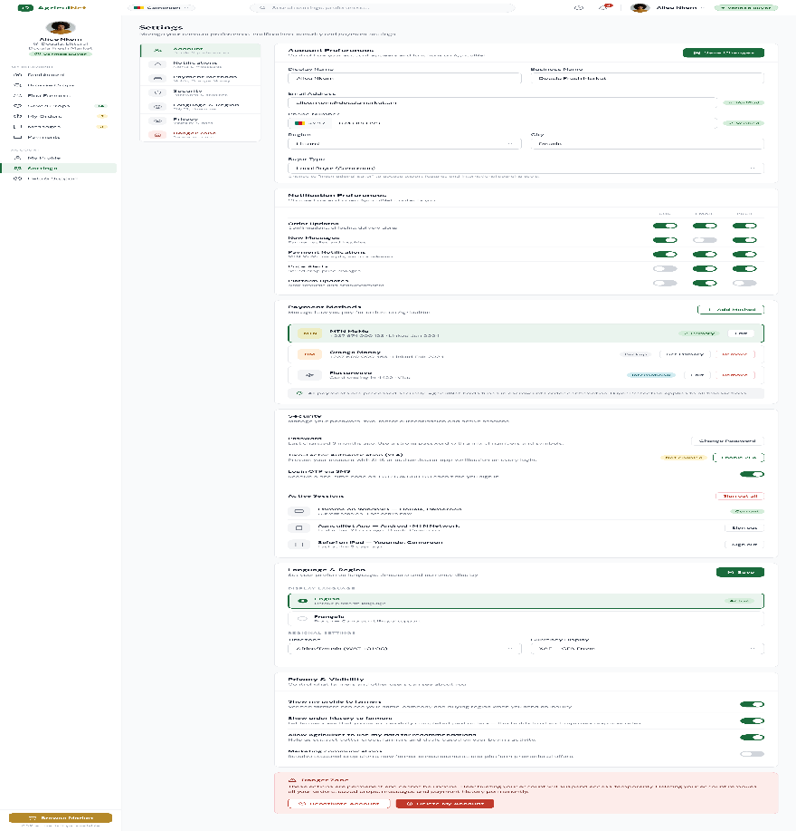
BUYER DASHBOARD
Buyer workflows: support, communication, and preferences
â€¢ Help & Support page combines FAQ, guides, live support categories, and ticket submission
â€¢ Messages page keeps conversation context tied to order and listing activity
â€¢ Settings page centralizes account preferences, payment-method preference, language, privacy, and security surfaces
AgriculNet | Academic Presentation | 2026
7

Slide 8
SELLER OPERATIONS
Farmer and reseller workflows
Listing management
Order visibility
Verification controls
Sellers create listings, upload media, manage crop details, track availability, and present inventory to buyers.
Farmer and reseller dashboards track active orders, communication with buyers, and payout-related operational state.
Seller trust is tied to account state, identity verification, and listing-readiness review rather than open anonymous selling.
1
Register
2
Verify
3
List
4
Fulfill
Seller account created and role assigned.
Identity and profile workflow completed.
Crop inventory becomes visible to buyers.
Seller responds, confirms, and delivers against the order.
AgriculNet | Academic Presentation | 2026
8

Slide 9
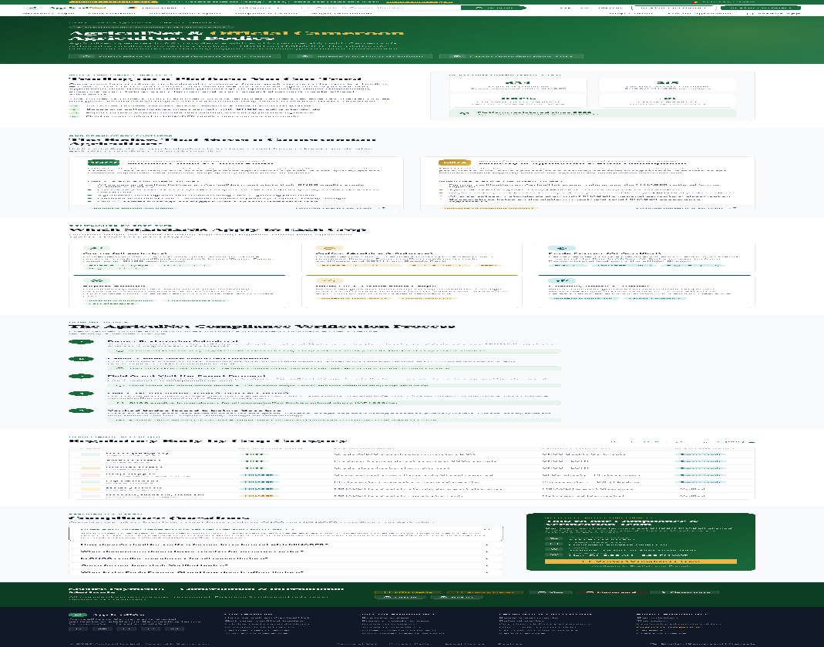
ADMINISTRATION
Admin and verification workflows
â€¢ Admins review operational data across users, listings, payments, disputes, and inspections
â€¢ Verification evidence and account states are controlled from the backend
â€¢ Admin role maintains platform trust by deciding review, approval, rejection, and operational escalation paths
Verification flow
Registration -> email and phone verification -> identity review where required -> active dashboard access -> ongoing operational oversight.
AgriculNet | Academic Presentation | 2026
9

Slide 10
ARCHITECTURE
System architecture and technology stack
Frontend
Backend API
Supabase
Fapshi
Next.js 14 app router, Tailwind CSS, Zustand, React Query
Express.js services, auth, orders, payments, messaging
Database, storage, and supporting backend data services
Hosted mobile-money checkout for MTN MoMo and Orange Money
Frontend hosting
Backend hosting
Integration model
Vercel serves the public site and authenticated dashboards.
Railway runs the production API with environment-based configuration.
Role-based dashboards talk to the API, which persists orders, payments, preferences, and messages.
AgriculNet | Academic Presentation | 2026
10

Slide 11
PAYMENT FLOW
From checkout to payment confirmation
1
Browse
2
Checkout
3
Create Order
4
Hosted Pay
5
Webhook
Buyer reviews listing detail and selects crop to source.
Quantity, address, notes, and channel preference are entered.
Backend creates order and payment intent.
Buyer is redirected to Fapshi for MoMo or Orange Money payment.
Fapshi confirms payment status back to AgriculNet.
Business meaning
Near-term direction
Payment is initiated by buyers only. Farmers and resellers remain sellers and do not use buyer checkout surfaces. Admin controls later payout/release oversight.
The current integration direction uses hosted checkout, transaction tracking, and webhook confirmation rather than direct card-wallet capture inside the frontend.
AgriculNet | Academic Presentation | 2026
11

Slide 12
DEPLOYMENT
How the system is hosted and delivered
Frontend
Backend
Data Layer
Hosted on Vercel under the AgriculNet web domain, serving public pages and dashboard routes.
Hosted on Railway with environment-based configuration for API routing, auth, email, SMS, and payment services.
Supabase provides database persistence and storage for platform records and assets.
â€¢ Vercel frontend calls the Railway API through configured environment variables
â€¢ Railway handles protected backend routes and webhook endpoints
â€¢ Supabase stores marketplace data, profiles, listings, orders, and asset references
â€¢ This split improves delivery speed while keeping database and file workflows centralized
AgriculNet | Academic Presentation | 2026
12

Slide 13
CHALLENGES AND LIMITATIONS
What was solved and what still needs refinement
Challenges solved
â€¢ Authentication and dashboard routing alignment
â€¢ Hosted frontend/backend deployment path
â€¢ Role-aware marketplace and admin separation
â€¢ Preparation for real mobile-money integration
Frontend-to-backend integration is now live, domain routing is configured, buyer/public experiences are much stronger, and the platform reflects real roles and workflows rather than static demo-only pages.
Current limitations
Some provider credentials and live payment-account details still need to be finalized. Some operational areas remain iterative, including deeper analytics, broader CMS-driven content, and production-hardening around provider integrations.
AgriculNet | Academic Presentation | 2026
13

Slide 14
Conclusion and Demo Cue
AgriculNet shows how software can structure agricultural trade around trust, visibility, and operational control.
â€¢ The platform is designed around real user roles and real trade workflows
â€¢ It combines marketplace access, verification, communication, and protected operations
â€¢ It is relevant to Cameroonâ€™s current agricultural and export context
Live demo cue
Recommended walkthrough: home page -> browse -> crop detail -> buyer dashboard -> support/messages/settings -> admin overview.
Thank you
Questions and discussion

