Slide 1
ADMIN VIEW
ADMIN
FINANCIALS
STATUS
NOTIFICATION
INVENTORY
REGISTER
BILLS

Slide 2
STAFF VIEW
REQUESTS
TRACKING
DONOR’S VIEW

Slide 3
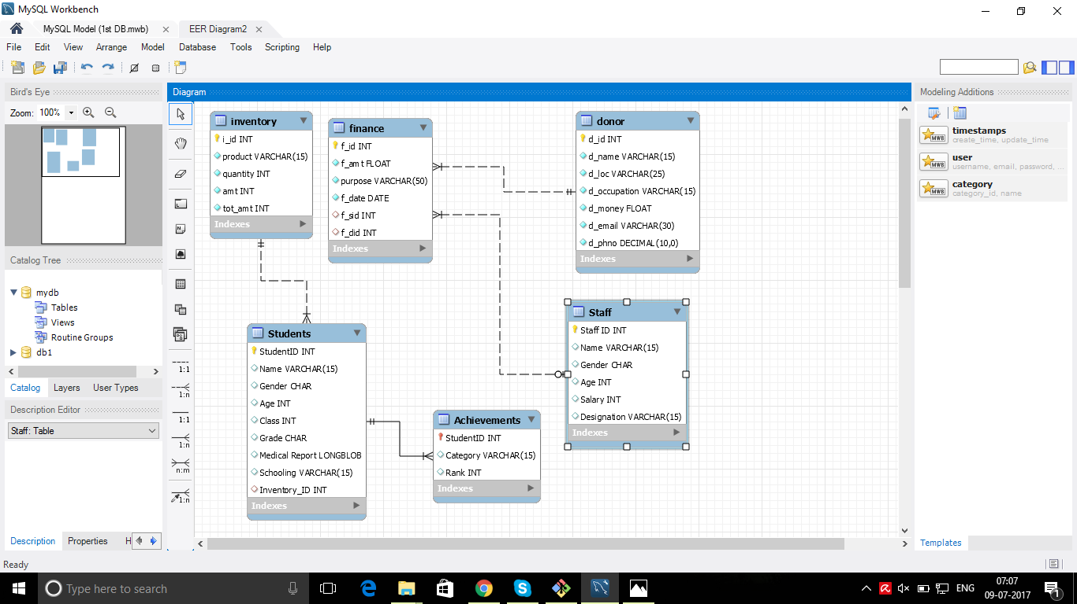
SCHEMA REPRESENTATION

