Slide 1



Deeksha for
Good
Team Number: 20

Slide 2

Problem Statement
To create a training platform for differently abled users with the goal of helping them fulfill their aspirations.

Slide 3
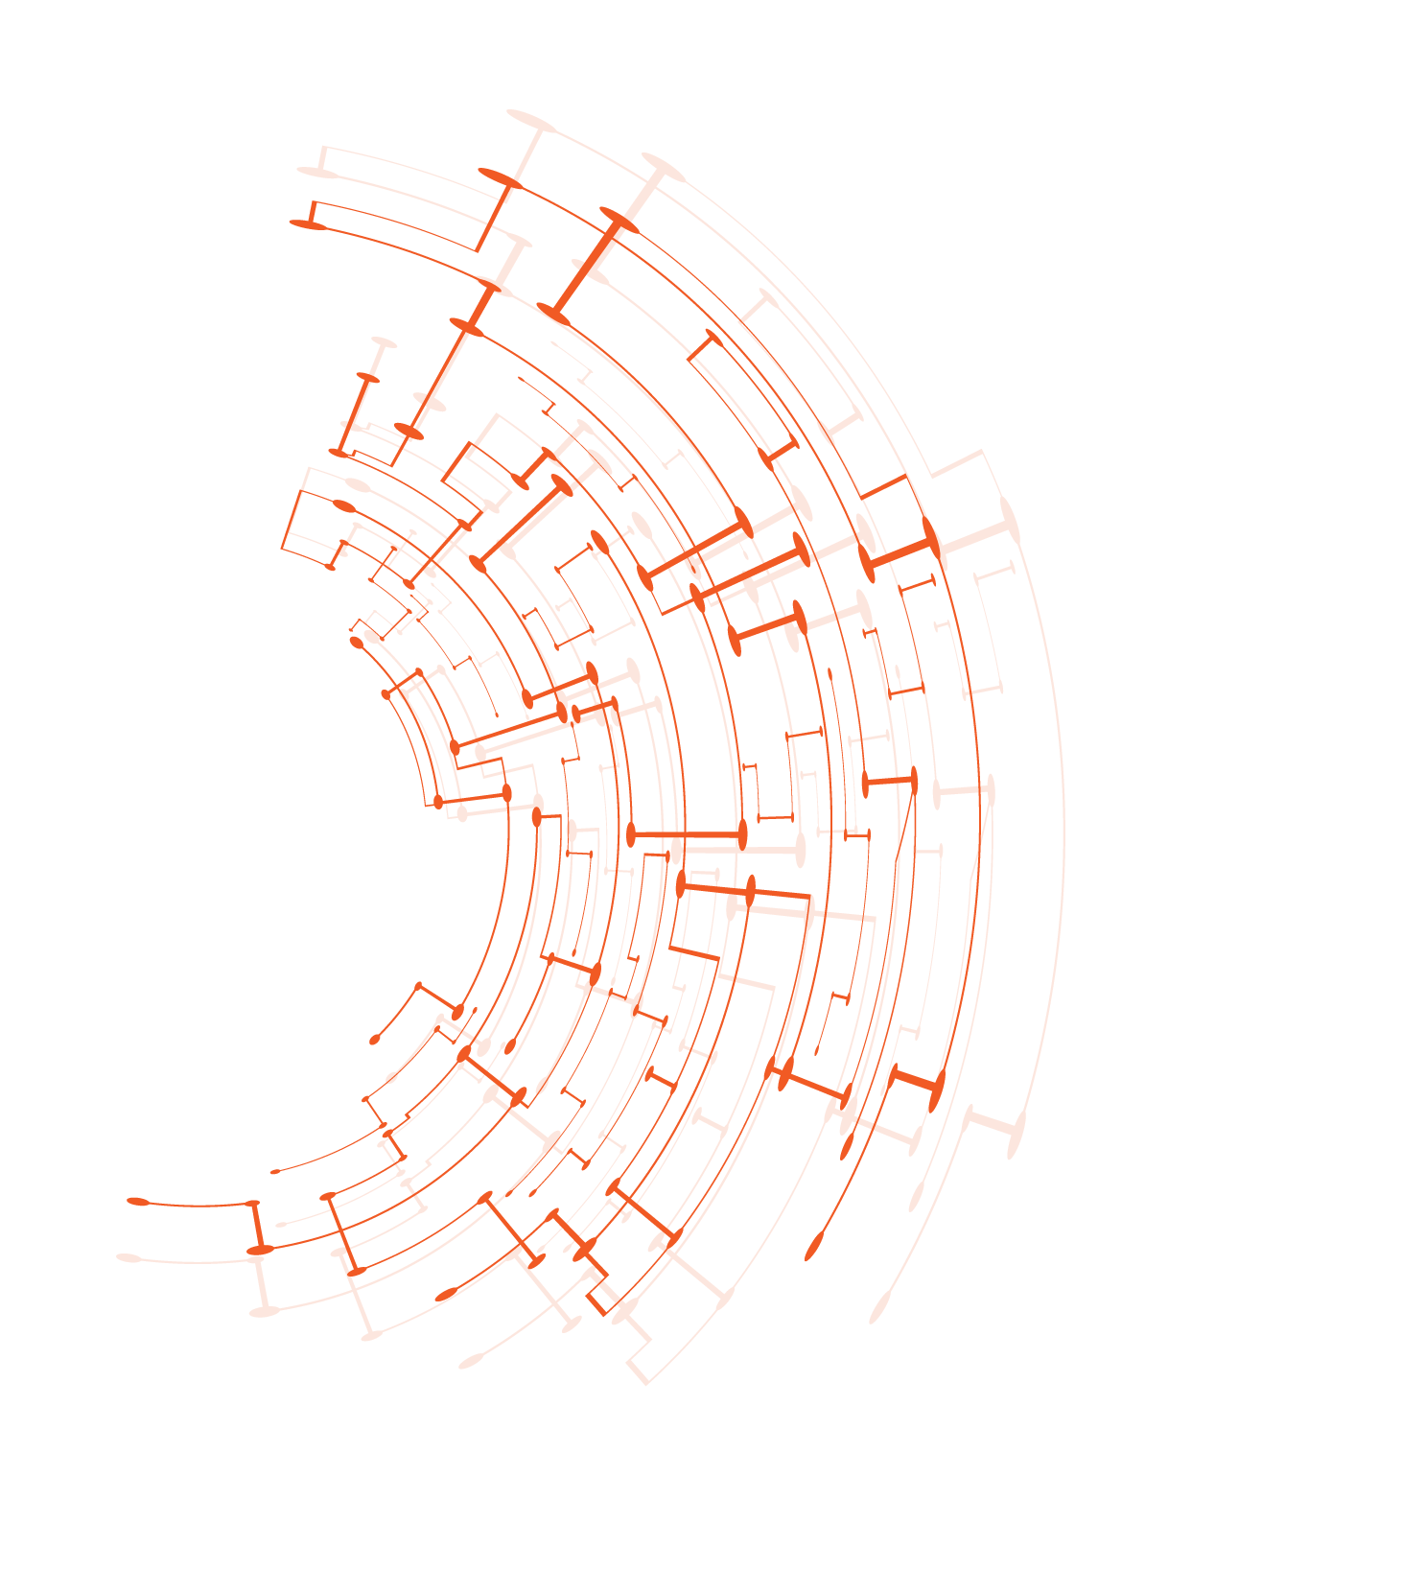
Technology Stack
CSS HTML BootStrap XML
PHP Mysql
Adobe Illustrator Android Studio Adobe Premiere pro Handbrake
Front End
Back End
Tools

Slide 4

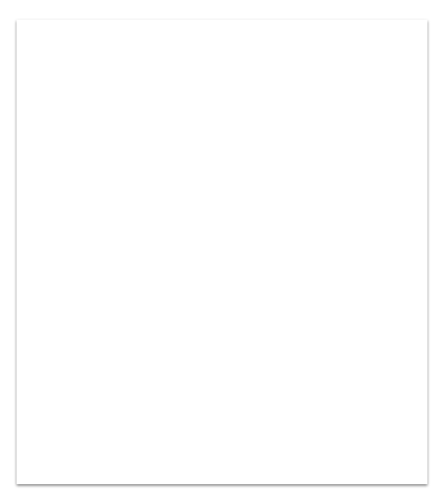

USP
Simple As simple as possible
Statistics & Analytics So that we are aware...
Tutorials Every assignment come with a video tutorial.
Real life forms We have used the forms users will actually work on in real life.

Slide 5
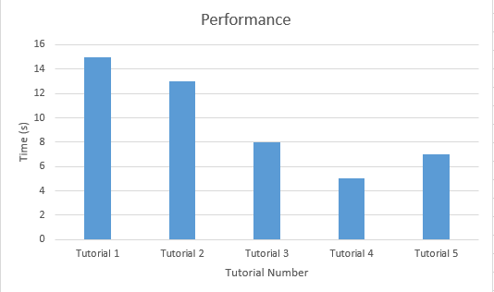
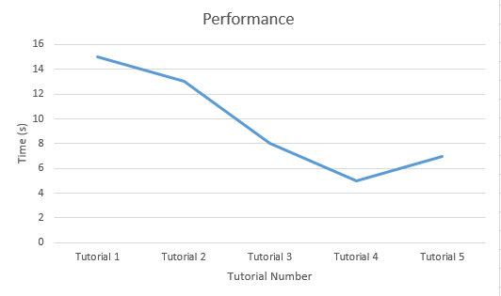
Analytics

Slide 6
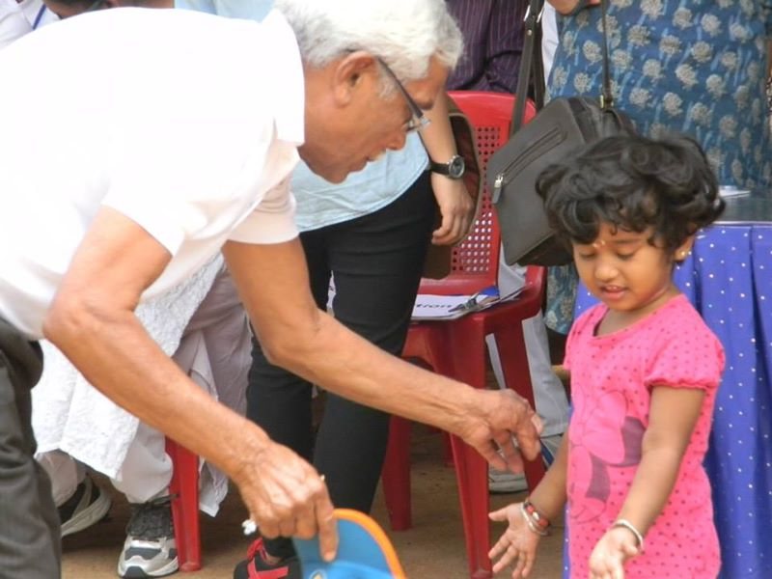
Other Benefits…….
Scalable
Color Coding
Easy to add new type of forms

Slide 7
DEMO

