Slide 1
Kshamata
Touching Lives. Supporting Liberation
Team 4

Slide 2
The Problem
Manual Entry of Tracking Data Leading to Inefficiency

Slide 3

The Solution
Digitization of Women Tracking with Progressive Web App

Slide 4
Administrator
Volunteer
Add Users and Members
Schedule Visit
Activity Tracking
Generate Reports
View Assigned Women
Generate Track Records
Update Information

Slide 5
The Tech Stack & The Demo
HTML5, CSS3 & JS
Bootstrap 4
jQuery & AngularJS
Firebase
AWS EC2
LIVE DEMO

Slide 6
What Makes Us Unique?
USP 1
Connect Without Connectivity
USP 2
One Language. Many Platforms.
USP 3
Complete Open Source Development
USP 4
Extremely Lightweight App

Slide 7
The Road Ahead
Profile Matching
Voice Recording
- | - | - | - | - | - | - | - | - | - | - | -
Red-Yellow-Green Categorization
Volunteer Trainings

Slide 8
Three Fold Benefit
THE NGO
THE VOLUNTEER
WOMAN MEMBER
- Paperless - Easy Management - Faster Updates
- More Effective - Reduced Travel
- More Expressive - Wider Opportunities

Slide 9
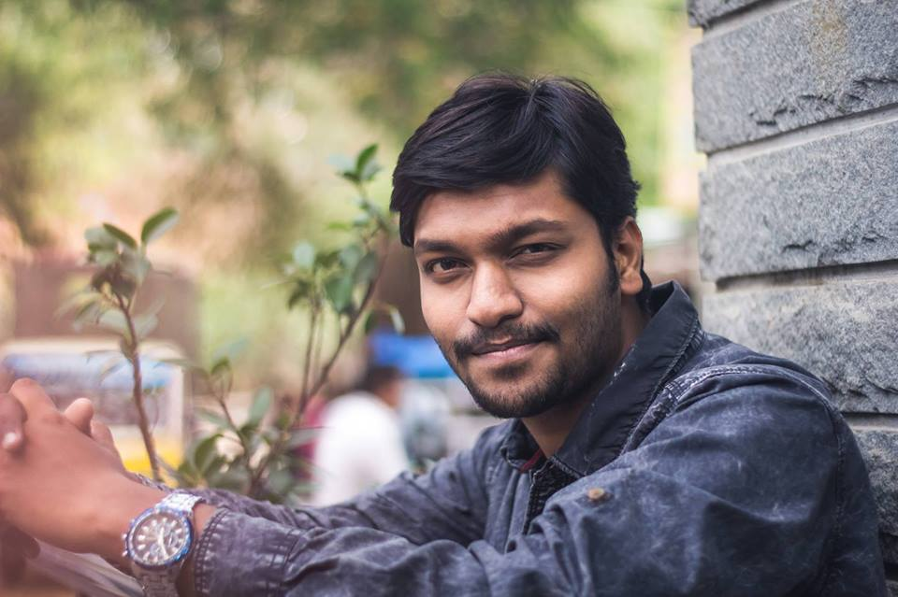
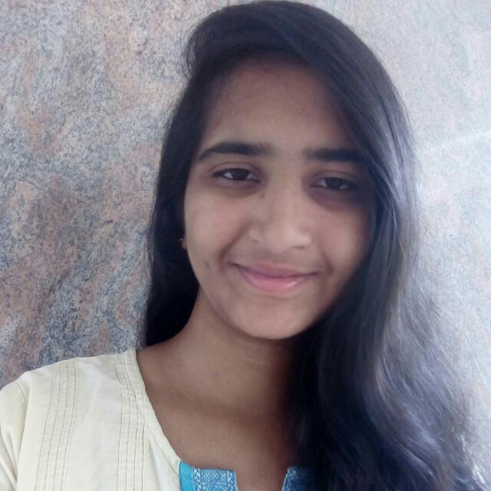

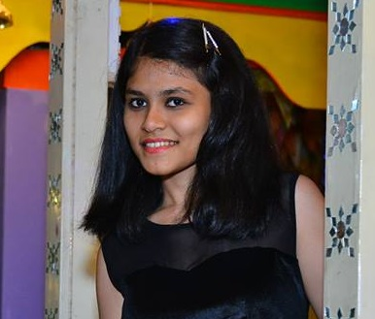
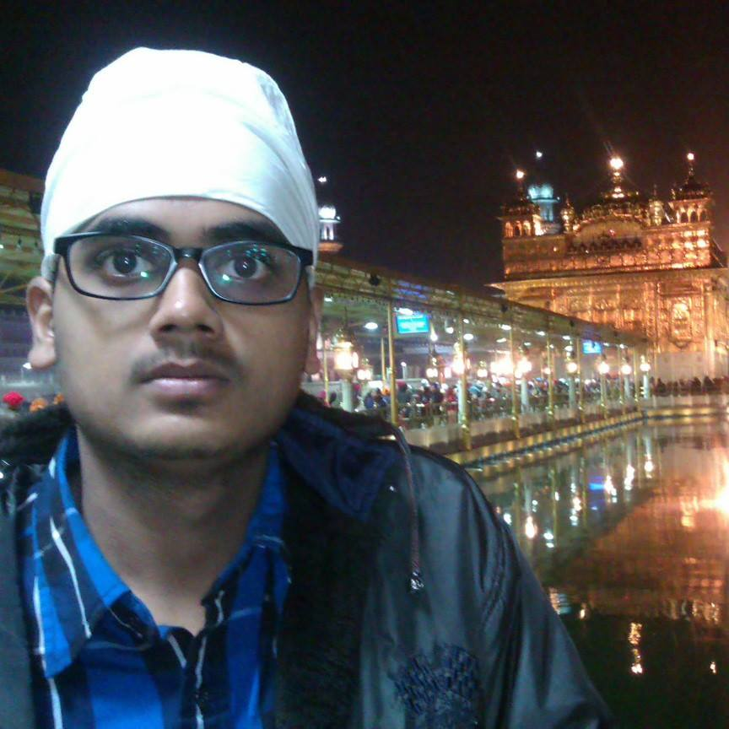
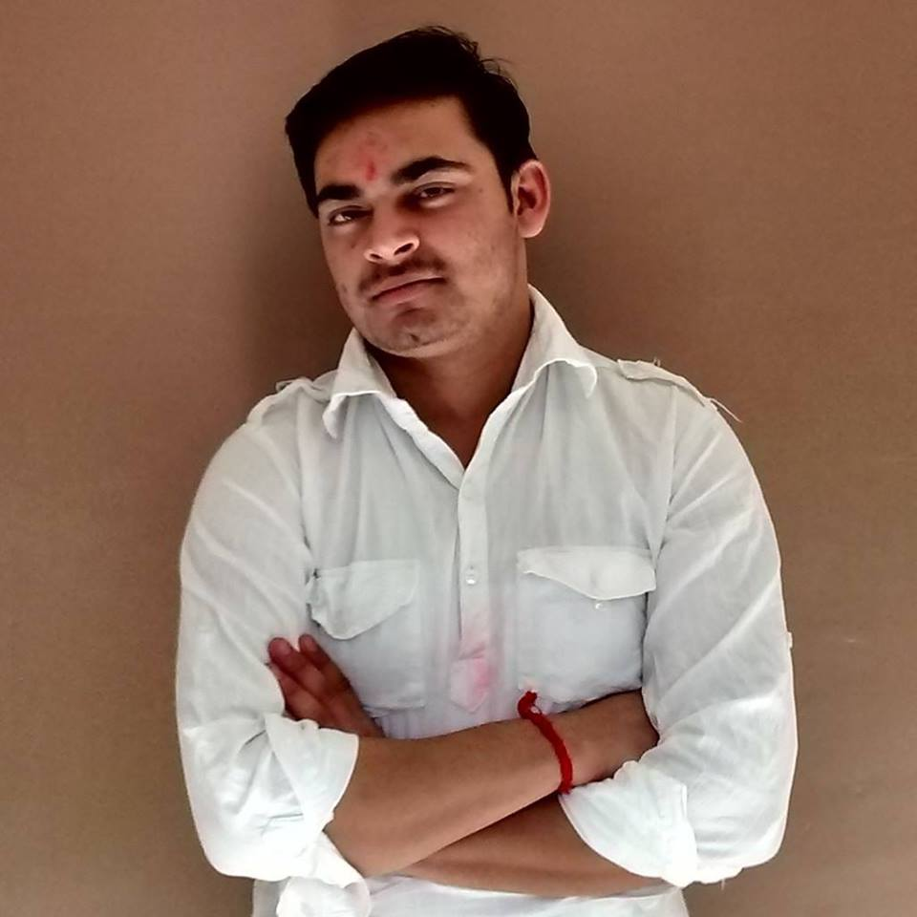
Thank You
Raja Rajan
Veena M
Samrudh J
Dimple Doshi
Milind B
Sharadindu

