Slide 1

AMOGH
We know you can.

Slide 2
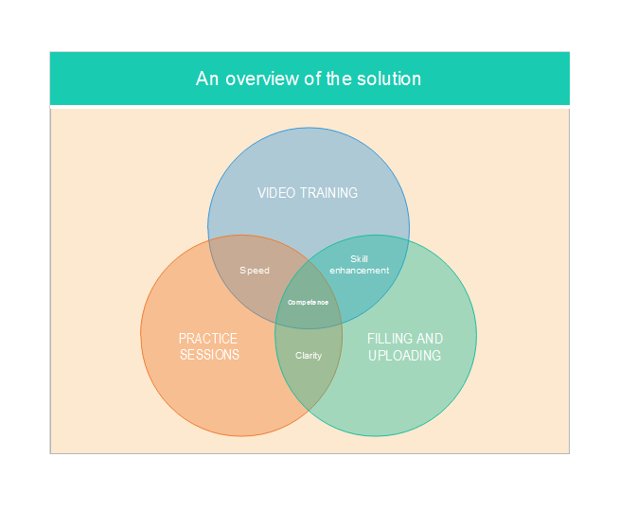

Slide 3
TECHNOLOGIES USED
PHP, JavaScript
HTML,CSS
BOOTSTRAP

Slide 4
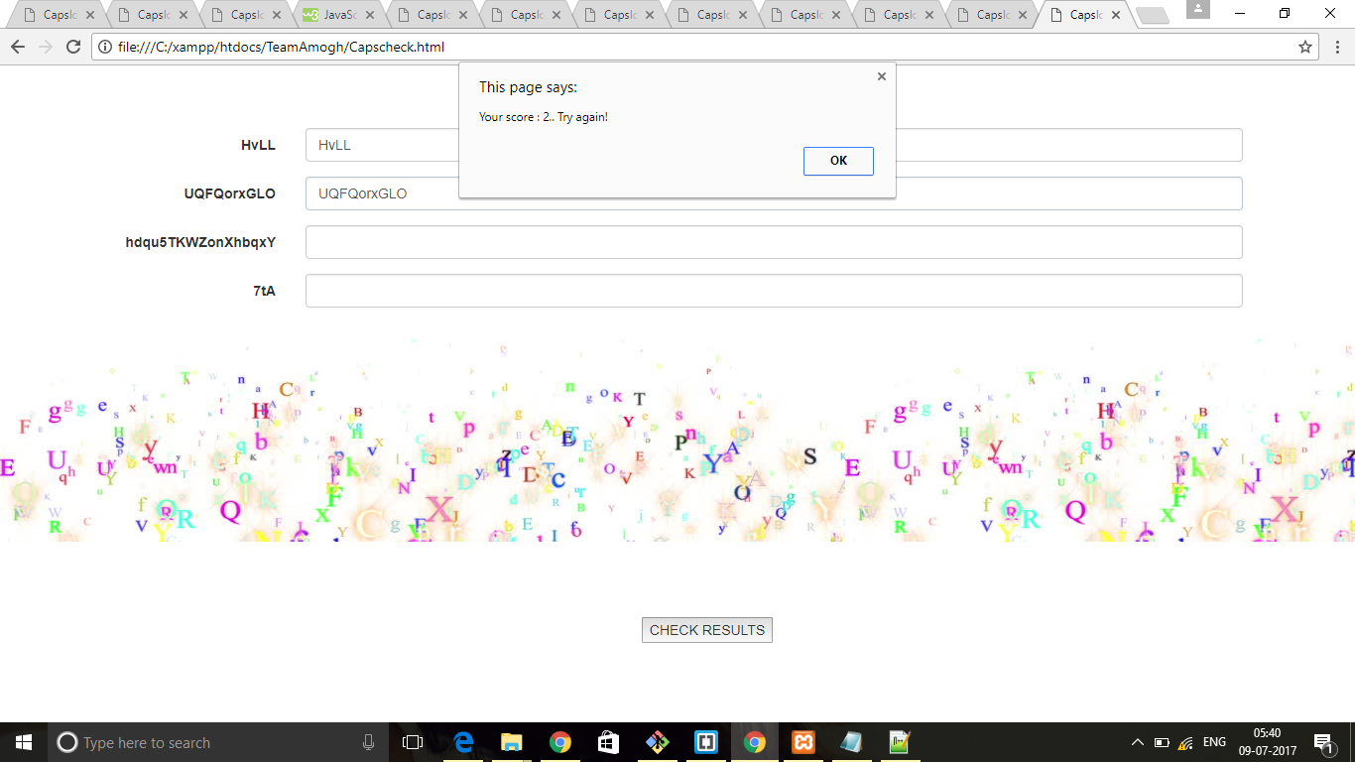
SCREEN SHOTS

Slide 5
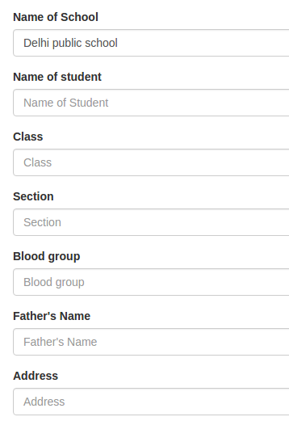


Slide 6
