Slide 1

TEAM UNOS
CARE WORKS FOUNDATION
Archana
Aditya
Abijith
Arundhati
Ashish
Rishabh

Slide 2

PROBLEM STATEMENT
An application to facilitate the collection of the data required to conduct a ‘Need Assessment’ on the government schools they visit
RECOMMONDATION
Web application
Mobile application

Slide 3
Login Page
Web
Web/Mobile
Admin logins in
Field worker
Logins in
Views list of recent pending surveys, accepted and rejected surveys
Views new survey or monitorial survey
Particular survey
is selected
If rejected
Select the one school from new survey or monitorial survey
Accepts or rejects
Give the survey
If accepted
Summarize plan of action

Slide 4

Technologies Used
Firebase
HTML
CSS
JavaScript
Android
Google charts API

Slide 5
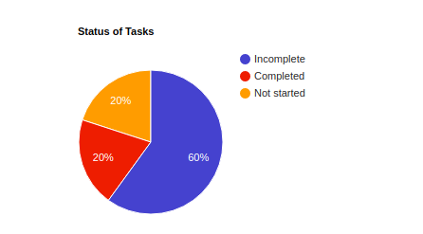
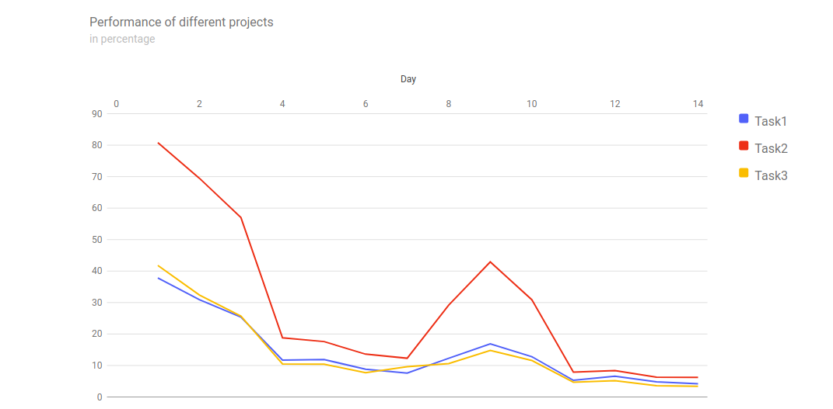
Why are we cool?
Flexible
Easy to track
Easy to maintain
Graphical representations

Slide 6
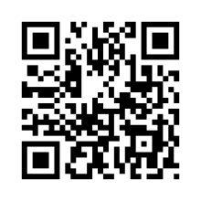

FURTHER IMPLEMENTATION
QR code
Machine learning
Automated Import of CSV file.
Location Based Service.
Photo Upload Facility.

Slide 7
“You never change things by fighting the existing reality. To change something, build a new model that makes the existing model obsolete.”
― R. Buckminster Fuller

Slide 8
THANK YOU

