Slide 1
CODE FOR GOOD
Workflow Solution for Careworks
Presented by : Carefree Community
(Team 19)
Abhishek Krishna
Bhargavi B
Geeta A K
Nithin
Sagarika Ramesh

Slide 2
INTRODUCTION
CareWorks Foundation:
A Non Profit organization that is dedicated towards the overall development of the government schools throughout India.
Providing an automated solution to the existing problem is our motto.

Slide 3
Challenges
Duplication of effort
Central accessibility problem
Report generation is a time consuming process
Dividing the project into activities and capturing each activity with its related parameters is a highly cumbersome and error prone endeavor

Slide 4
Solution
To mitigate the challenges we came up with a digital application that eliminates the duplication of effort .
we have also developed a Chat-Bot using Artificial Intelligence

Slide 5
Methodology
Frontend
HTML,CSS and JavaScript
Backend
Python flask
MySQL
Python Bot

Slide 6
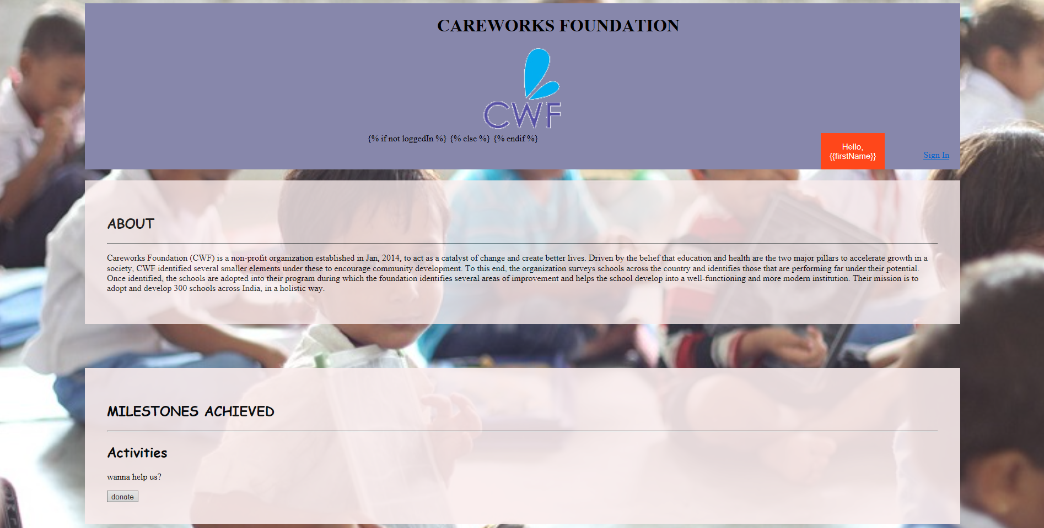

Slide 7
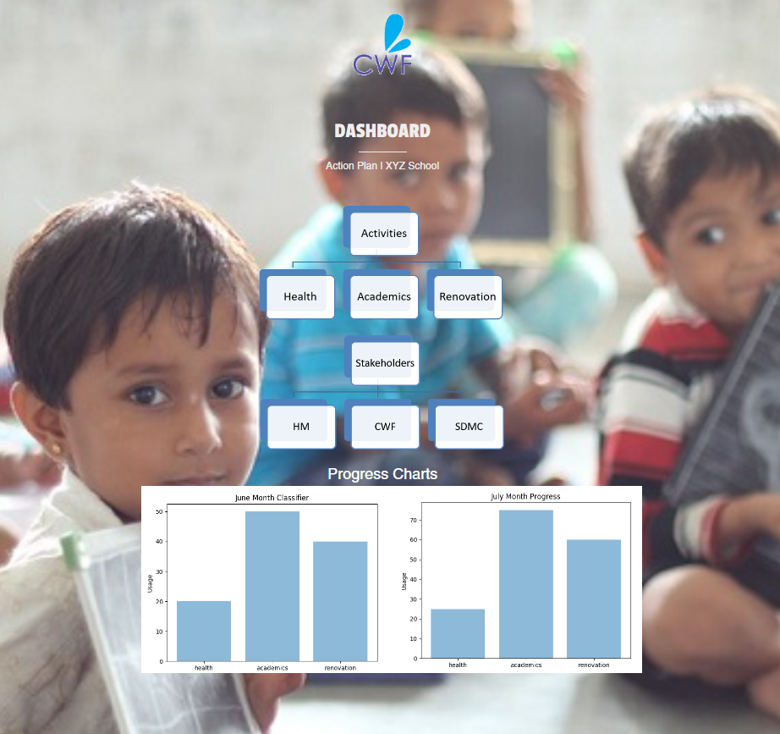
Examples

Slide 8
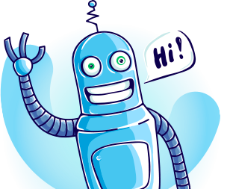
What is AI Chat Bot?
In short, AI Chat Bot is a computer program that simulates human conversation or chat, through artificial intelligence.

Slide 9
Logic Adapters
Logic adapters determine the logic for how Chat Bot selects a response to a given input statement.
The Adapters that are used in this chat bot are:
Best Match Adapter
Mathematical Evaluation Adapter
Low Confidence Response Adapter
Specific Response Adapter
Multi logic Adapter

Slide 10
Concepts Used
Artificial Intelligence: Intelligence exhibited by machines for "learning" and "problem solving“.
Machine Learning : Computers the ability to learn without being explicitly programmed.
Natural Language Toolkit (NLTK): Leading open source platform for building Python programs to work with human language data.
Telebot : A Telegram bot library, with simple route decorators.

Slide 11
Algorithms Used
Jaccard Similarity
Levenshtein distance
Sentiment Comparison
Synset Distance

Slide 12
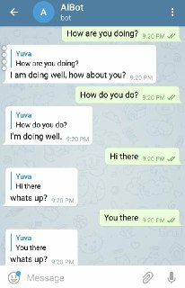
Examples
In the adjacent figure, we can see how the chat bot responds to different inputs with same answer and also its intelligence to respond differently to the inputs that are same in meaning.

Slide 13
Future work
AI-BOT: we can have the dashboard of the project by just a click of the button.
Web App:
Offline availability option to be integrated.
We can take our solution a step ahead by incoperating the ‘text-to-speech’ facility.

Slide 14


